Slide 1
React

Slide 2
What is React?
React is a JavaScript library for building user interfaces.
React is developed by Facebook.
React is used to build single-page applications.
React allows us to create reusable UI components.
React creates a VIRTUAL DOM in memory.
React only changes what needs to be changed!
When it comes to React, Babel is used to transpile modern JavaScript syntax into code that can run in all environments when writing React components.

Slide 3
Real DOM & Virtual DOM
Instead of manipulating the browser's real DOM directly, React creates a virtual DOM in memory.
React finds out what changes are made and only manipulates the virtual DOM before changing anything in the real/browser's DOM.
The Virtual DOM is nothing but the virtual representation of the DOM.
But the key difference is, every time with every change , the virtual DOM gets updated instead of the real DOM.

Slide 4
Real DOM & Virtual DOM
In React, each UI is an individual component and each component has it's own state.
🔸 React follows the observable pattern and observes the changes of the states.
🔸 Whenever a change is made in the state of any component, React updates the virtual DOM tree but does not change the real DOM tree
🔸 After updating, React then compares the current version of the virtual DOM with the previous version.
🔸 React knows which objects are changed in the virtual DOM, based on that it only changes those objects in the Real DOM, making minimum manipulating operations.

Slide 5
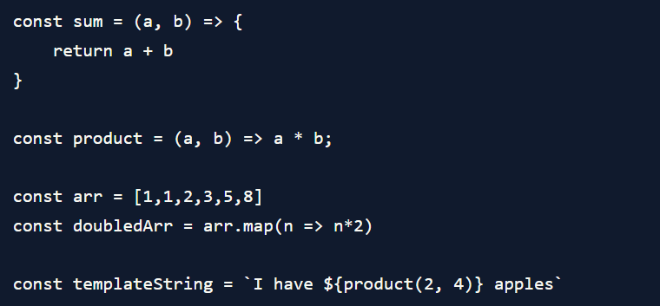
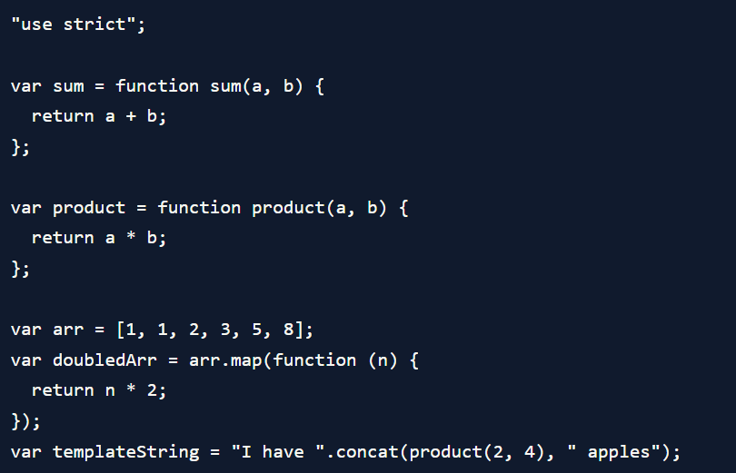
Babel
Babel is a JS compiler that is used to compile code between different versions of JavaScript. It’s mainly used with the ES6/ES2015 features.

Slide 6
React Render HTML
React's goal is in many ways to render HTML in a web page.
React renders HTML to the web page by using a function called createRoot() and its method render().

Slide 7
Difference between State and Props
SN | Props | State
1. | Props are read-only. | State changes can be asynchronous.
2. | Props are immutable. | State is mutable.
3. | Props allow you to pass data from one component to other components as an argument. | State holds information about the components.
4. | Props can be accessed by the child component. | State cannot be accessed by child components.
5. | Props are used to communicate between components. | States can be used for rendering dynamic changes with the component.
6. | Stateless component can have Props. | Stateless components cannot have State.

