Slide 1
Web Analytics

Slide 2
What is web analytics?
Web analytics is the process of analyzing the behavior of visitors to a website.
This involves tracking, reviewing and reporting data to measure web activity, including the use of a website and its components, such as webpages, images and videos.
Data collected through web analytics may include traffic sources, referring sites, page views, paths taken and conversion rates.
The results of web analytics are provided in the form of tables, charts and graphs.

Slide 3
What does it do?
Determine the likelihood that a given customer will repurchase a product after purchasing it in the past.
Personalize the site to customers who visit it repeatedly.
Monitor the amount of money individual customers or specific groups of customers spend.
Observe the geographic regions from which the most and the least customers visit the site and purchase specific products.
Predict which products customers are most and least likely to buy in the future.

Slide 4
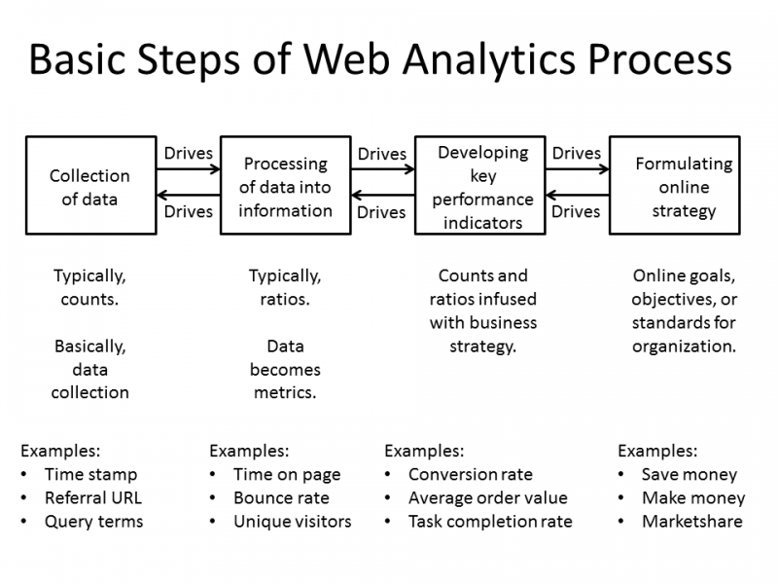
How does it work ?

Slide 5
Collection of data
Businesses can collect data directly from a website or web analytics tool, such as Google Analytics.
The data mainly comes from Hypertext Transfer Protocol requests -- including data at the network and application levels -- and can be combined with external data to interpret web usage.
For example, a user's Internet Protocol address is typically associated with many factors, including geographic location and clickthrough rates.

Slide 6
Processing data
The next stage of the web analytics funnel involves businesses processing the collected data into actionable information.

Slide 7
Identifying key performance indicators(KPIs)
In web analytics, a KPI is a quantifiable measure to monitor and analyze user behavior on a website.
Examples include bounce rates, unique users, user sessions and on-site search queries.

Slide 8
Developing a strategy
This stage involves implementing insights to formulate strategies that align with an organization's goals.
For example, search queries conducted on-site can help an organization develop a content strategy based on what users are searching for on its website.

Slide 9
Main categories of web analytics?
Off-site web analytics
The term off-site web analytics refers to the practice of monitoring visitor activity outside of an organization's website to measure potential audience.
It refers to the type of analytics that focuses on data collected from across the web, such as social media, search engines and forums.
On-site web analytics
On-site web analytics refers to a narrower focus that uses analytics to track the activity of visitors to a specific site to see how the site is performing. The data gathered is usually more relevant to a site's owner and can include details on site engagement, such as what content is most popular.

Slide 10
Web analytics tools
Google Analytics. Google Analytics is a web analytics platform that monitors website traffic, behaviors and conversions. The platform tracks page views, unique visitors, bounce rates, referral Uniform Resource Locators, average time on-site
Optimizely. Optimizely is a customer experience and A/B testing platform that helps businesses test and optimize their online experiences and marketing efforts, including conversion rate optimization
Kissmetrics. Kissmetrics is a customer analytics platform that gathers website data and presents it in an easy-to-read format.
Crazy Egg. Crazy Egg is a tool that tracks where customers click on a page.

Slide 11
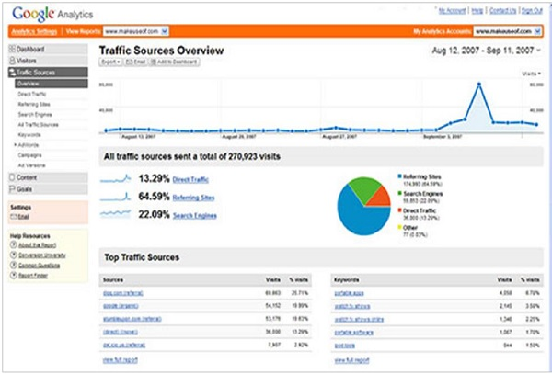
Google Analytics

Slide 12
Google analytics helps you to track and measure visitors, traffic sources, goals, conversion, and other metrics (as shown in the above image). It basically generates reports on −
Audience Analysis
Acquisition Analysis
Behavior Analysis
Conversion Analysis

Slide 13
Optimizely
Optimizely is an optimization platform to test and validate changes and the present look of your webpage. It also determines which layout to finally go with. It uses A/B Testing, Multipage, and Multivariate Testing to improve and analyze your website.
A wonderful feature of Optimizely is that you do not need to be a technical expert. You just need to insert a deployed code provided by Optimizely in your HTML. After putting it, you can trace anything, take any action, and make any changes in your website.

Slide 14
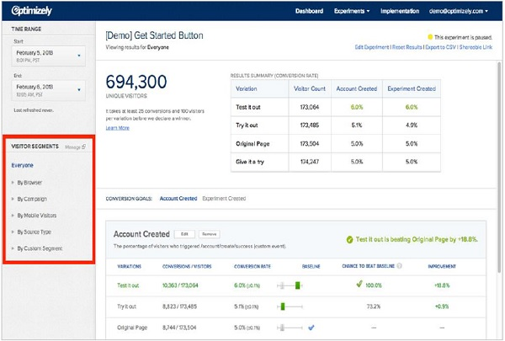

Slide 15
KISSmetrics
KISSmetrics helps you identify the following −
Cart size
Landing page conversion rate
Customer activity on your portal
Customer bounce points
Cart abandoned products
Customer occurrence before making a purchase
Customer lifetime value, etc.

Slide 16
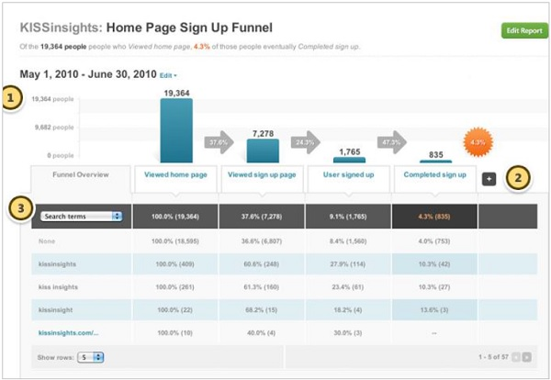

Slide 17
Crazy Egg
Crazy Egg is an online analytics application that provides you eye-tracking tools. It generates heatmaps based on where people clicked on your website. Thus, it gives you an idea on where to focus. It lets you filter data on top 15 referrers, search terms, operating systems, etc.
To use Crazy Egg, a small piece of JavaScript code needs to be placed on your site pages.
Once the code is on your site, Crazy Egg will track user behavior. Your servers will create a report that shows you the clicks on the pages you are tracking. You can review the reports in the dashboard within the member’s area of the Crazy Egg site. Setting up Crazy Egg is a quick and easy task.

