Slide 1
Flexbox Layout (Flexible Box)

Slide 2
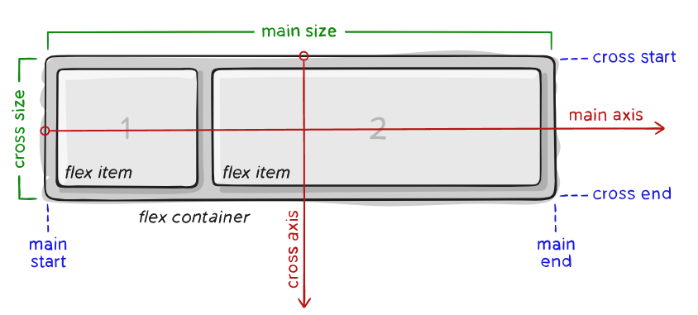
Items will be laid out following either the main axis (from main-start to main-end) or the cross axis (from cross-start to cross-end).
Main axis – The main axis of a flex container is the primary axis along which flex items are laid out. Beware, it is not necessarily horizontal; it depends on the flex-direction property Main-start | main-end – The flex items are placed within the container starting from main-start and going to main-end.
Main size – A flex item’s width or height, whichever is in the main dimension, is the item’s main size. The flex item’s main size property is either the ‘width’ or ‘height’ property, whichever is in the main dimension.
Cross axis – The axis perpendicular to the main axis is called the cross axis. Its direction depends on the main axis direction.
Cross-start | cross-end – Flex lines are filled with items and placed into the container starting on the cross-start side of the flex container and going toward the cross-end side.
Cross size – The width or height of a flex item, whichever is in the cross dimension, is the item’s cross size. The cross size property is whichever of ‘width’ or ‘height’ that is in the cross dimension.

Slide 3
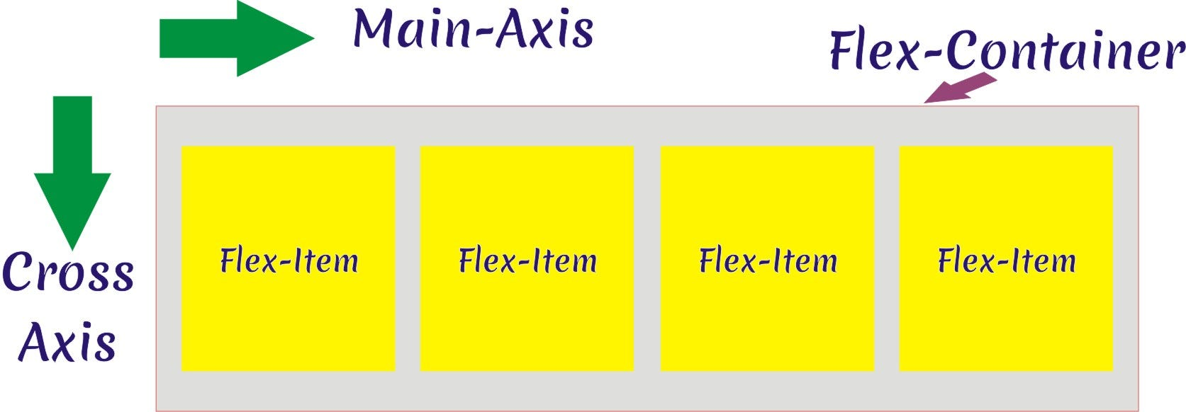

Slide 4
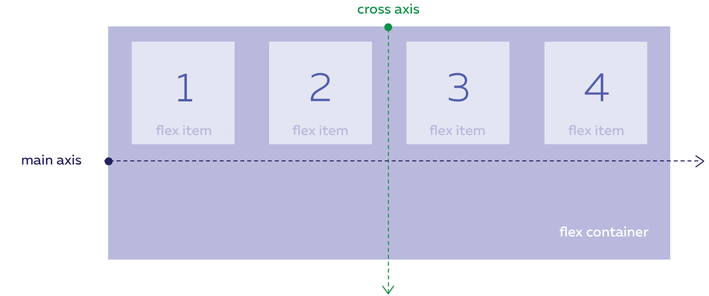

Slide 5
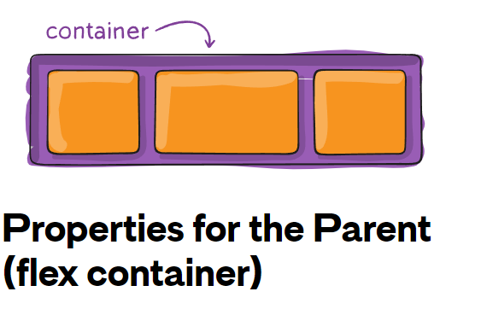
Flexbox properties

Slide 6
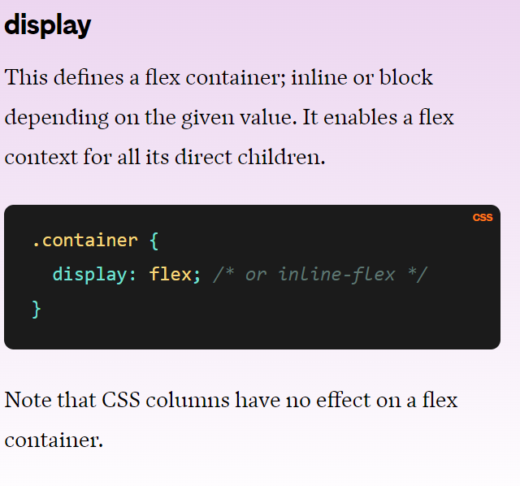

Slide 7
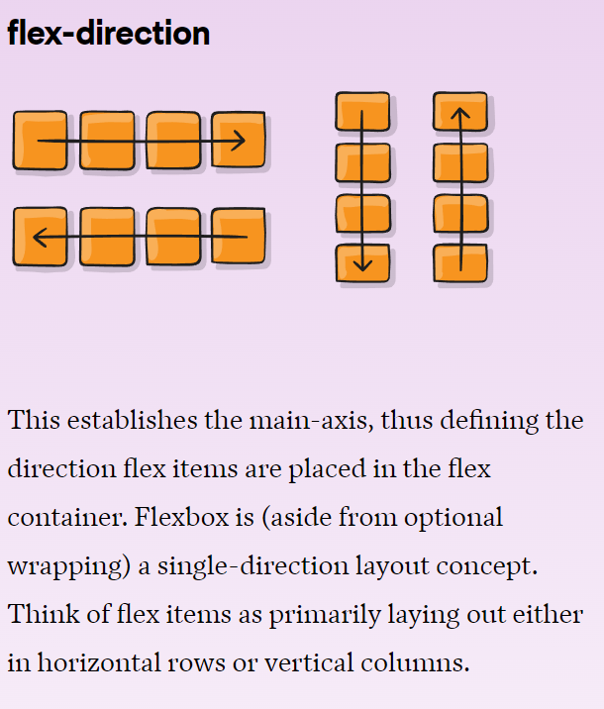

Slide 8
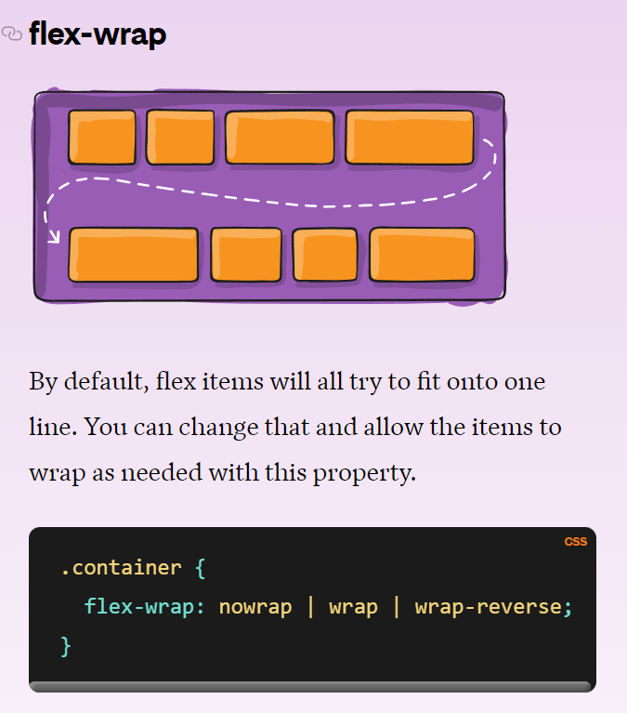

Slide 9
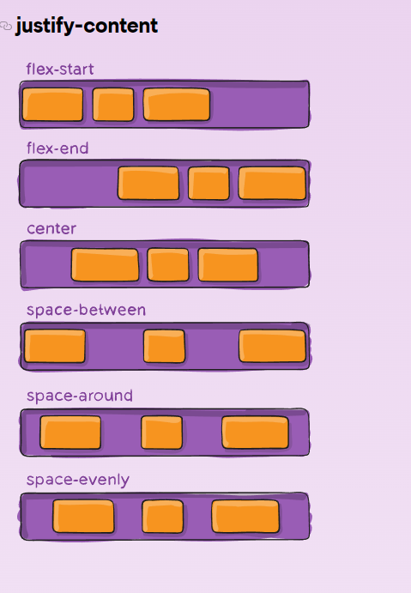
This defines the alignment along the main axis.

Slide 10
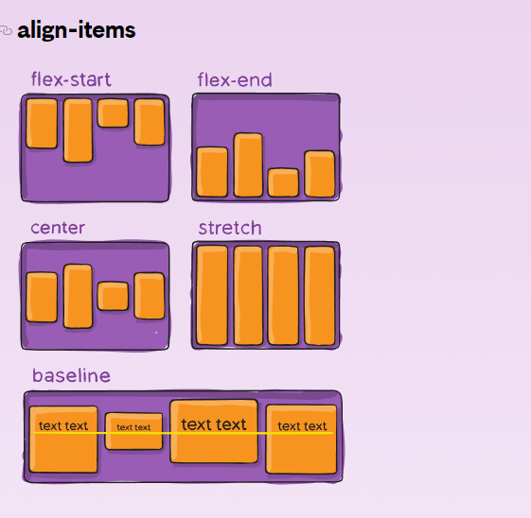
This defines the default behavior for how flex items are laid out along the cross axis on the current line.
.container { align-items: stretch | flex-start | flex-end | center | baseline | first baseline | last baseline | start | end | self-start | self-end + ... safe | unsafe; }

Slide 11
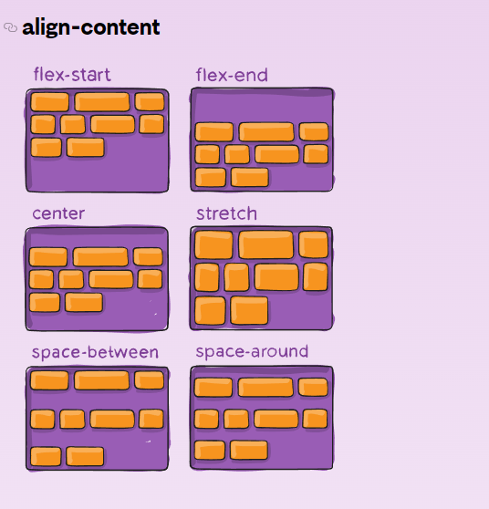
This property only takes effect on multi-line flexible containers, where flex-wrap is set to either wrap or wrap-reverse). A single-line flexible container (i.e. where flex-wrap is set to its default value, no-wrap) will not reflect align-content.

Slide 12
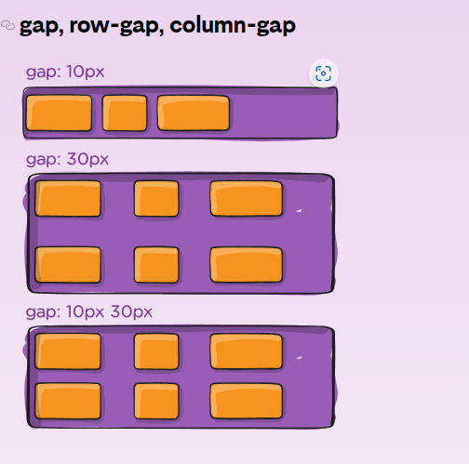
The gap property explicitly controls the space between flex items. It applies that spacing only between items not on the outer edges.

Slide 13
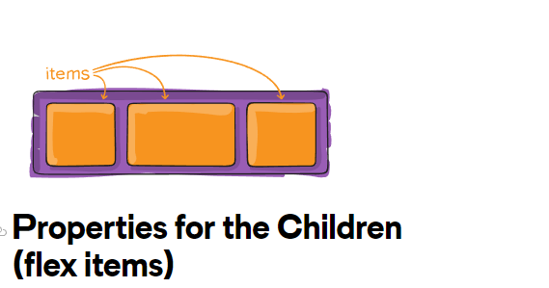
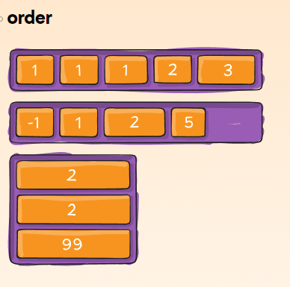
By default, flex items are laid out in the source order. However, the order property controls the order in which they appear in the flex container.

Slide 14
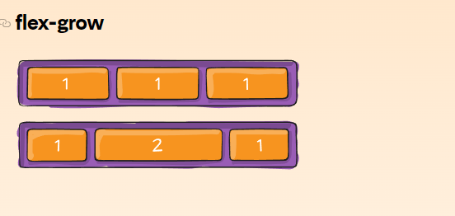
This defines the ability for a flex item to grow if necessary. It accepts a unitless value that serves as a proportion. It dictates what amount of the available space inside the flex container the item should take up.

Slide 15
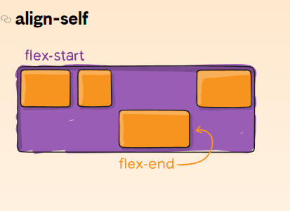
This allows the default alignment (or the one specified by align-items) to be overridden for individual flex items.

