Slide 1
SEO

Slide 2
What are Meta Tags?
Meta tags provide information about the webpage in the HTML of the document.
This information is called "metadata" and while it is not displayed on the page itself, it can be read by search engines and web crawlers.
Search engines such as Google use metadata from meta tags to understand additional information about the webpage.
They can use this information for ranking purposes, to display snippets in search results, and sometimes they can ignore meta tags.
Example of meta tags include the <title> and <description> elements.

Slide 3
What are Meta Tags?
Simply put, meta tags are tags within the HTML code of your website that describe the different components of your site to search engines.
These tags allow Bing or Google search algorithms to read descriptions of the makeup of your site.
They can use this information for ranking purposes, to display snippets in search results, and sometimes they can ignore meta tags.
Example of meta tags include the <title> and <description> elements.

Slide 4
Types of metatags
Meta Title Tag: An HTML element that communicates the title of a web page to search engines
Meta Description Tag: An HTML element that summarizes the content of a web page for search engines
Meta Keyword Tag: An HTML element that communicates target keywords related to the content of a web page to search engines
Meta Robots Tag: An HTML element that instructs search engine bots on how to read the content of a web page

Slide 5
Why Are Meta Tags Important?
High-quality meta tags are essential to effective digital marketing and technical SEO.
Using the right meta tags, the right way is all about communicating to the search engines:
What your page is about.
How to read it.
Who should see it.

Slide 6

The Most Important Meta Tags for SEO
Title Tag
Meta Description
Canonical Tag
Alternative Text Tag
Robots Meta Tag
Open Graph Meta Tags and Twitter Cards
Header Tags
Responsive Design Meta Tags

Slide 7
1. Title Tags
The title tag is your main and most important anchor.
The page’s title still is the first thing for a searcher to see in SERPs and decide if the page is likely to answer the search intent.
A well-written one may increase the number of clicks and traffic, which have at least some impact on rankings.

Slide 8
Best Practices
Keep
Keep your title tag under 60 characters if possible
Add
Add words that indicate what your content is about, such as “How to,” “Review,” “Best,” “Tips,” “Top,” “Find,” or “Buy”
Add
Add numbers to your title, such as “9 HTML Tags That Will Improve SEO”
Start
Start your title tag with your main targeted keyword
Include
Include a unique title tag on every page

Slide 9

2. Meta Description Tags
Meta description also resides in the <head> of a webpage .
A meta description is an HTML element that sums up the content on your web page. Search engines typically show the meta description in search results below your title tag.
Here’s an example of the meta description appearing on a search results page:

Slide 10
Best Practices
Give each page a unique meta description that clearly reflects what value the page carries.
1
Do not add duplicate meta descriptions.
2
Add a clear call to action (CTA) in your descriptions like “apply today,” “check out ____,”.
3
Add your targeted keywords in descriptions.
4
Add any discounts or offers you have.
5

Slide 11
3. Canonical Tag
A canonical tag is an HTML link tag with the attribute “rel=canonical."
It’s used to indicate that there are other versions of this webpage. By implementing the canonical tag in the code, your website tells search engines that this URL is the main page and that the engines shouldn’t index other pages.
Use the following syntax to add a canonical tag:
<link rel="canonical" href="http://example.com/" />

Slide 12
Alternative Text Tag
Search engines can’t read images, which are a crucial part of many websites. Alternative text (alt text) is a way around that issue.
You should add proper alt text to images, such as the one below, so that search engines know how to interpret them.
<img src=” image1.jpg” alt=”image1” />

Slide 13
Best Practices
Always use a proper description, and never stuff your keyword in this tag
Use informative filenames
Be clear and to the point
Create an image sitemap
Use 50-55 characters (up to 16 words) in the alt text

Slide 14
5. Robots Meta Tag
The robots meta tag tells search engines to either index or non-index your web page.
<meta name=”robots” content=”noindex, nofollow”> Means not to index or not to follow this webpage.
<meta name=”robots” content=”index, follow”> Means index and follow this webpage.
Place the robots meta tag in the <head> section of your webpage.

Slide 15
The tag has four main values for the search engine crawlers:
FOLLOW –The search engine crawler will follow all the links in that webpage
INDEX –The search engine crawler will index the whole webpage
NOFOLLOW – The search engine crawler will NOT follow the page and any links in that webpage
NOINDEX – The search engine crawler will NOT index that webpage

Slide 16
Open Graph Meta Tags and Twitter Cards
These tags make social media syncing easier.
Open graph meta tags promote integration between Facebook, LinkedIn, Google, and your website.
<meta property="og:type" content="article" />
<meta property="og:title" content="TITLE OF YOUR POST OR PAGE" />
<meta name="twitter:title" content="TITLE OF POST OR PAGE">
<meta name="twitter:description" content="DESCRIPTION OF PAGE CONTENT">

Slide 17
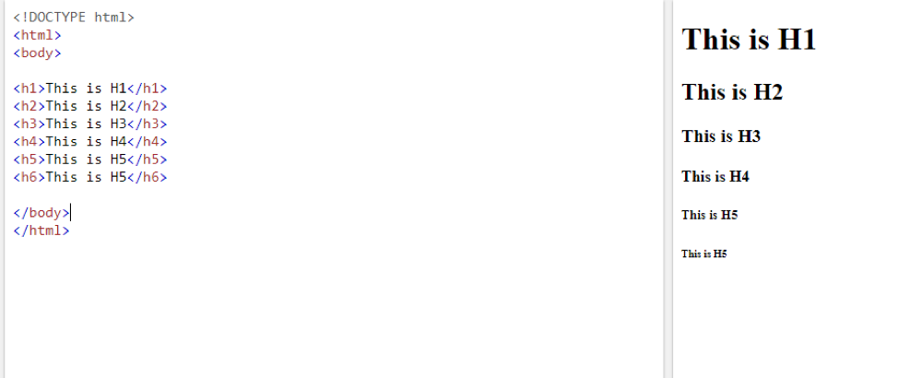
7. Header Tags
You can use header tags to change font sizes and signify information hierarchy on a page.
If you mark text with an H1 tag, you signify to search engines that it’s the most important text on that page.

Slide 18
Responsive Design Meta Tags for SEO
The final important meta tag is the responsive design meta tag, which is also called the viewport meta element.
Viewport meta tags allow web designers to configure how a page scales and displays on any device.
You can find the viewport element in the head section of your web page.
Use the following syntax to add a responsive design meta tag:
<meta name="viewport" content="width=device-width,initial-scale=1.0">

