Slide 1
MicroData

Slide 2
How does microdata improve my SEO?
Microdata is preferred by search engines because it makes their crawling easier for your website.
It tells them, "Here's what to highlight and what is important about my piece!" Think of it like organizing your cluttered store inventory into different labeled buckets.
Both metadata and microdata improve search — but there's evidence that microdata can actually improve your ranking, not just your click-through rates.

Slide 3
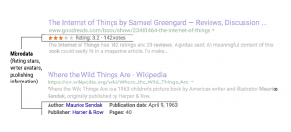
What is Microdata?
Microdata gives labels to individual content chunks. Then, a search engine will highlight these chunks in searches.
For example, we may use microdata to say, "Hey, Google, this following text is the author's name," or "This next chunk of information is a star rating."
This is like speaking directly to Google or Bing, but it benefits the searcher in the end.

Slide 4
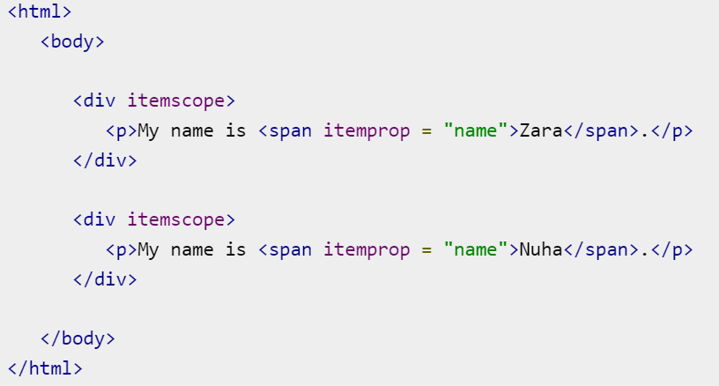
Microdata lets you define your own customized elements and start embedding custom properties in your web pages.
At a high level, microdata consists of a group of name-value pairs.
The groups are called items, and each name-value pair is a property.
Items and properties are represented by regular elements.
To create an item, the itemscope attribute is used.
To add a property to an item, the itemprop attribute is used on one of the item's descendants.

Slide 5
Sr.No. | Attribute & Description
1 | itemscope This is used to create an item. The itemscope attribute is a Boolean attribute that tells that there is Microdata on this page, and this is where it starts.
2 | itemtype This attribute is a valid URL which defines the item and provides the context for the properties.
3 | itemid This attribute is global identifier for the item.
4 | itemprop This attribute defines a property of the item.
5 | itemref This attribute gives a list of additional elements to crawl to find the name-value pairs of the item.
Microdata introduces five global attributes which would be available for any element to use and give context for machines about your data.

Slide 6
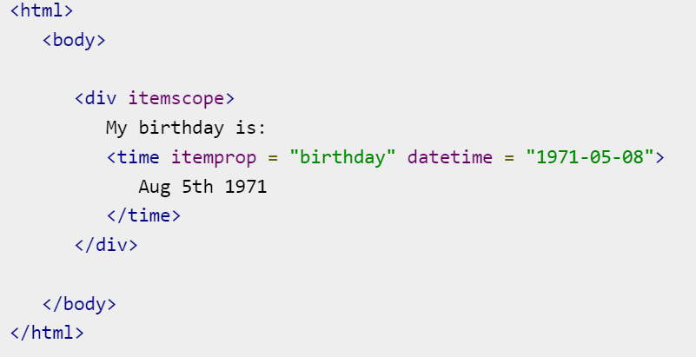
Properties can also have values that are dates, times, or dates and times. This is achieved using the time element and its datetime attribute.

Slide 7

Google supports microdata as part of their Rich Snippets program.
When Google's web crawler parses your page and finds microdata properties that conform to the http://datavocabulary.org/Person vocabulary, it parses out those properties and stores them alongside the rest of the page data.

