Slide 1
SOA

Slide 2
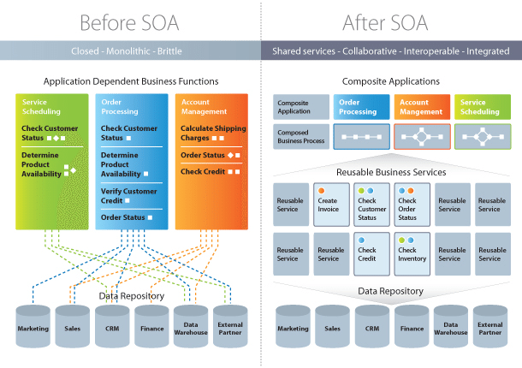

Slide 3
Implementing Service-Oriented Architecture
Service-Oriented Architecture is implemented with web services, which makes the “functional building blocks accessible over standard internet protocols.”
An example of a web service standard is SOAP, which stands for Simple Object Access Protocol.
SOAP “is a messaging protocol specification for exchanging structured information in the implementation of web services in computer networks.
Other options for implementing Service-Oriented Architecture include Jini, COBRA, or REST.

Slide 4
What is SOAP?
SOAP is a protocol which was designed before REST and came into the picture.
The main idea behind designing SOAP was to ensure that programs built on different platforms and programming languages could exchange data in an easy manner.
SOAP stands for Simple Object Access Protocol.
What is REST?
REST was designed specifically for working with components such as media components, files, or even objects on a particular hardware device.
Any web service that is defined on the principles of REST can be called a RestFul web service.
A Restful service would use the normal HTTP verbs of GET, POST, PUT and DELETE for working with the required components.
REST stands for Representational State Transfer.

Slide 5
What Is a Web Service?
Web services have two primary categories based on how they communicate –
RESTful web services
RESTful web services use a simpler architecture and rely on HTTP verbs to perform actions.
SOAP-based web services
SOAP-based web services use a more complex protocol for exchanging messages between systems.

Slide 6
What is a REST API?
Rest stands for Representational State Transfer. It is an architectural style and an approach for communication used in the development of Web Services.
REST has become a logical choice for building APIs. It enables users to connect and interact with cloud services efficiently.
For example, a Google website can have API for various functions like search, translations, calendars, etc.
In general API's are like below, they have server name, paths.., etc
http://<server name>/v1/export/Publisher/Standard_Publisher_Report?format=csv

Slide 7
COMMUNICATION BETWEEN CLIENT AND SERVER
In the REST architecture, clients send requests to retrieve or modify resources, and servers send responses to these requests.
MAKING REQUESTS
REST requires that a client make a request to the server in order to retrieve or modify data on the server.
A request generally consists of:
HTTP verb, which defines what kind of operation to perform
Header, which allows the client to pass along information about the request
A path to a resource
An optional message body containing data

Slide 8
What Is SOAP?
SOAP is a protocol for exchanging structured data between connected applications over the internet.
With SOAP, developers can enable applications to invoke events on different operating systems.
The SOAP uses Extensible Markup Language or XML to communicate, authenticate and authorize.
The HTTP protocols are enabled on all operating systems. Therefore, SOAP is able to communicate with web services and receive responses independent of language and platforms.
SOAP establishes a standard format for messaging. For example, it has a header part for message identification and a body part for the content of the message. It can transfer data over HTTP or HTTPS.

Slide 9
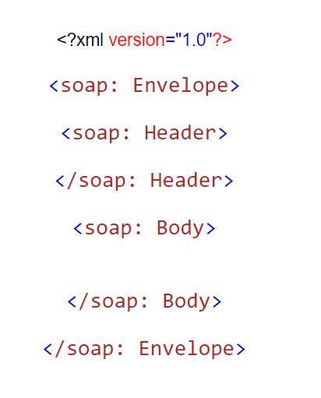
sample skeleton of the SOAP XML file:

Slide 10
No. | SOAP | REST
1) | SOAP is a protocol. | REST is an architectural style.
2) | SOAP stands for Simple Object Access Protocol. | REST stands for REpresentational State Transfer.
3) | SOAP can't use REST because it is a protocol. | REST can use SOAP web services because it is a concept and can use any protocol like HTTP, SOAP.
4) | SOAP uses services interfaces to expose the business logic. | REST uses URI to expose business logic.
6) | SOAP defines standards to be strictly followed. | REST does not define too much standards like SOAP.
7) | SOAP requires more bandwidth and resource than REST. | REST requires less bandwidth and resource than SOAP.
8) | SOAP defines its own security. | RESTful web services inherits security measures from the underlying transport.
9) | SOAP permits XML data format only. | REST permits different data format such as Plain text, HTML, XML, JSON etc.
9) | SOAP permits XML data format only. | REST permits different data format such as Plain text, HTML, XML, JSON etc.

