Slide 1
ARIA
Accessible Rich Internet Applications

Slide 2
HTML and ARIA play important roles in making digital products accessible, especially when it comes to assistive technology (AT) such as screen readers.
Both are used to convert content into an alternate format, such as Braille or Text-to-Speech (TTS).
ARIA is not a true programming language but a set of attributes you can add to HTML elements to increase their accessibility. These attributes communicate role, state, and property to assistive technologies via accessibility APIs found in modern browsers.
This communication happens through the accessibility tree.

Slide 3
Where does ARIA come from?
ARIA is a set of attributes you can add to HTML elements that define ways to make web content and applications accessible to users with disabilities who use assistive technologies (AT).
When accessibility issues cannot be managed with native HTML, ARIA can help bridge those gaps.
The formal name for ARIA is “Web Accessibility Initiative - Accessible Rich Internet Applications (WAI-ARIA).”
WAI-ARIA is a technical specification published by the World Wide Web Consortium (W3C), who are an international community that develops web standards.

Slide 4
Who is ARIA for?
ARIA is not supported by all technologies.
However, support for ARIA is most definitely growing. Those who do support ARIA include browsers, AT (i.e. screen readers, magnifiers, text-to-speech, etc.), applications, and JavaScript toolkits.
It’s a very complex set of standards, so complete support is difficult to achieve.
Even so, almost all current versions of the technologies mentioned do support at least some of ARIA.

Slide 5

What can ARIA do?
It supplements HTML so that interactions and widgets commonly used in applications can be passed to assistive technologies when there is not otherwise a mechanism.
For example, ARIA enables accessible JavaScript widgets, form hints and error messages, live content updates, and more.
There are three main components used in ARIA:
Roles
States
Properties

Slide 6

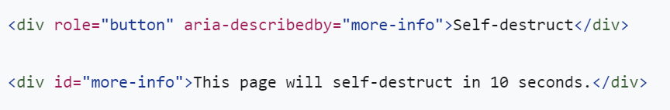
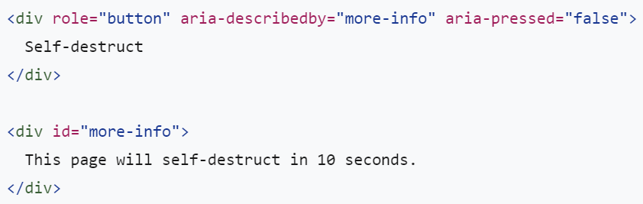
The three main features of ARIA are roles, properties, and states/values
Roles define what an element is or does on the page or app.
Properties express characteristics or relationships to an object.
States/values define the current conditions or data values associated with the element.

Slide 7

categories of states and properties:
Drag-and-Drop Attributes
Examples: aria-dropeffect and aria-grabbed (i.e. aria-grabbed=“true”)
Live Region Attributes
Examples: aria-atomic, aria-busy, and aria-live (i.e. aria-live=“polite”)
Relationship Attributes
Examples include aria-describedby and aria-labelledby (i.e. aria-labelledby=“uid-123”).
Widget Attributes
Examples include aria-autocomplete, aria-checked, aria-disabled, aria-label, and aria-required (i.e. aria-required=“true”)

Slide 8
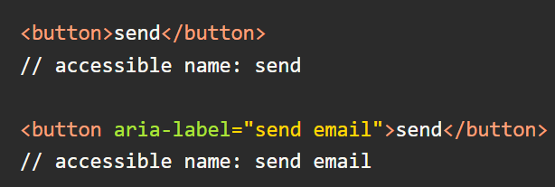
aria-label
The aria-label should be used to provide a text alternative to an element that has no visible text on the screen.
By default, an HTML element will use its text content as the accessibility label. If an element has aria-label, the accessible name becomes the string that it's passed in the attribute.

Slide 9
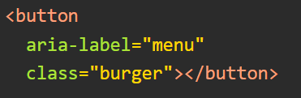

How to use
You can make use of aria-label by adding it to certain Footnote1) HTML elements.
VoiceOver on OSX will read this button as "menu, button", as shown in the image below.

Slide 10
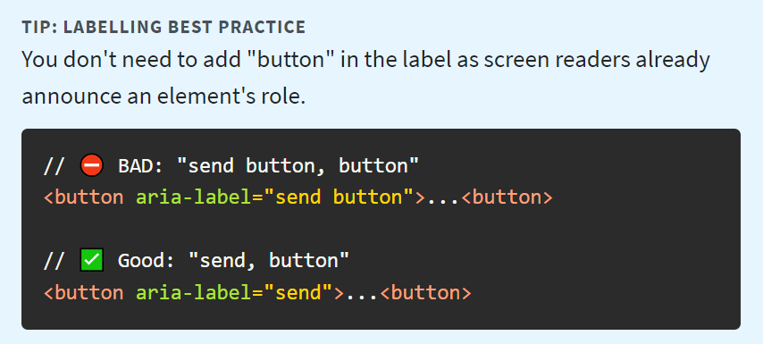
When to use
You should use it when you have non-textual indication of an element's purpose, but still need to provide text alternates for users who use assistive technology, such as screen readers.

Slide 11
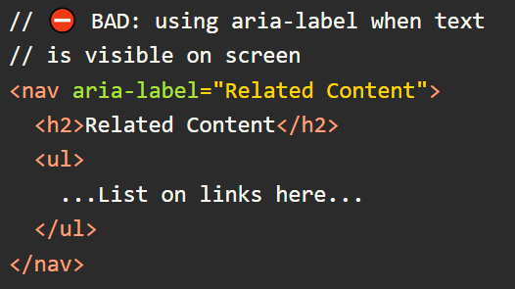
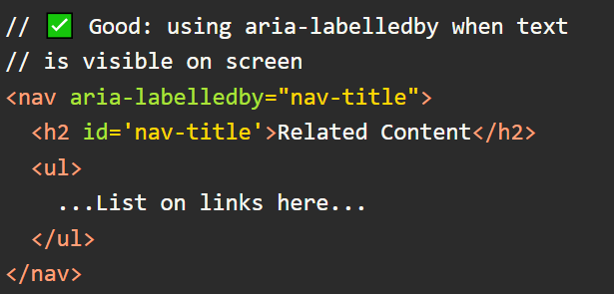
aria-label vs. aria-labelledby
When label text is visible on screen, you should use aria-labelledby instead of aria-label.

Slide 12
Rules of ARIA
Use Semantic HTML Elements Where Possible
Elements such as nav, article and button have default implicit ARIA statements of role="navigation", role="article" and role="button" respectively.
Before semantic HTML elements existed, it was common to have elements such as <div class="main-navigation" role="navigation">.
Now we are able to use nav in place of div, but we no longer need to add role="navigation“
2. Your Element Can Only Have One Role.

Slide 13

Do Not Change Native Semantics
You should not apply a contrasting role to an element that is already semantic, as adding a role overrides the native semantics of an element. For example:
Use as Many Semantic Elements as Possible
Use alt Attribute for images.

