Slide 1
Architecture and Design Pattern

Slide 2
We can design our applications using different design architectures like the Model-View- ViewModel (MVVM), Model-View-Presenter (MVP), and Model-View-Controller (MVC).
We use these architectures widely as they provide modularity to the code and ensure that it gets covered in the unit testing.
The goal of these architectures is to separate responsibility for visualization, processing, and data management of UI applications.

Slide 3
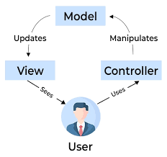
Model-View-Controller
Model — is responsible for the business logic of the application. It manages the state of the application. This also includes reading and writing data, persisting application state, and it may even include tasks related to data management such as networking and data validation.
View — this component has two important tasks: presenting data to the user and handling user interaction.
Controller — the view layer and the model layer are glued together by one or more controllers.

Slide 4
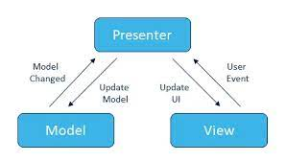
Model View Presenter
Model — The Model represents a set of classes that describes the business logic and data. It also defines business rules for data means how the data can be changed and manipulated.
View — The View is used for making interactions with users like XML, Activity, fragments. It has got nothing to do with the logic that is to be implemented in the process.
Presenter — The presenter gets the input from the View, processes the data with the help of the Model, and passes the results back to the View after the processing is done.

Slide 5
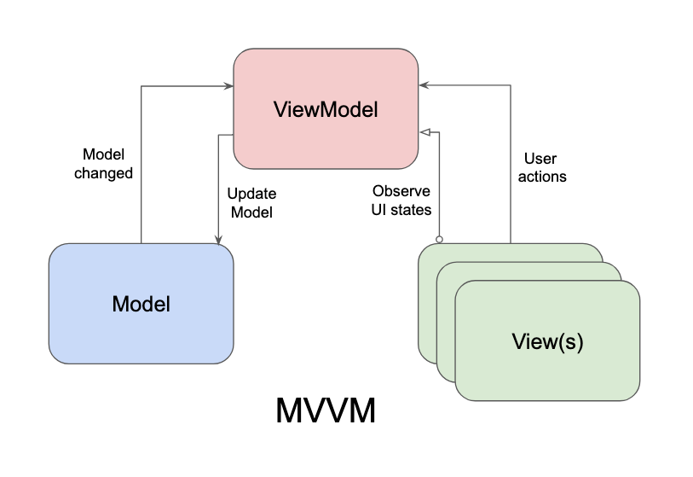
Model-View-ViewModel
Model: This layer is mainly responsible for the abstraction of the data source. Model and ViewModel work together to get and save the data.
View: This layer aims to inform the view model of the user's actions. This layer monitors the ViewModel and does not contain any application logic.
ViewModel: Exposes the data stream associated with the view. It also acts as a link between the model and the view.

Slide 6
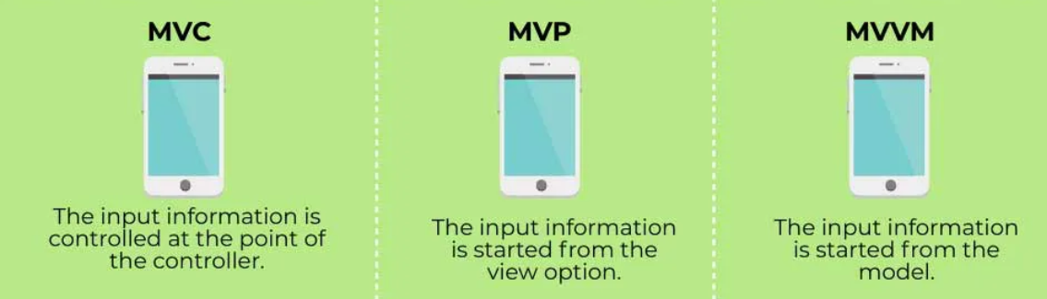

Slide 7
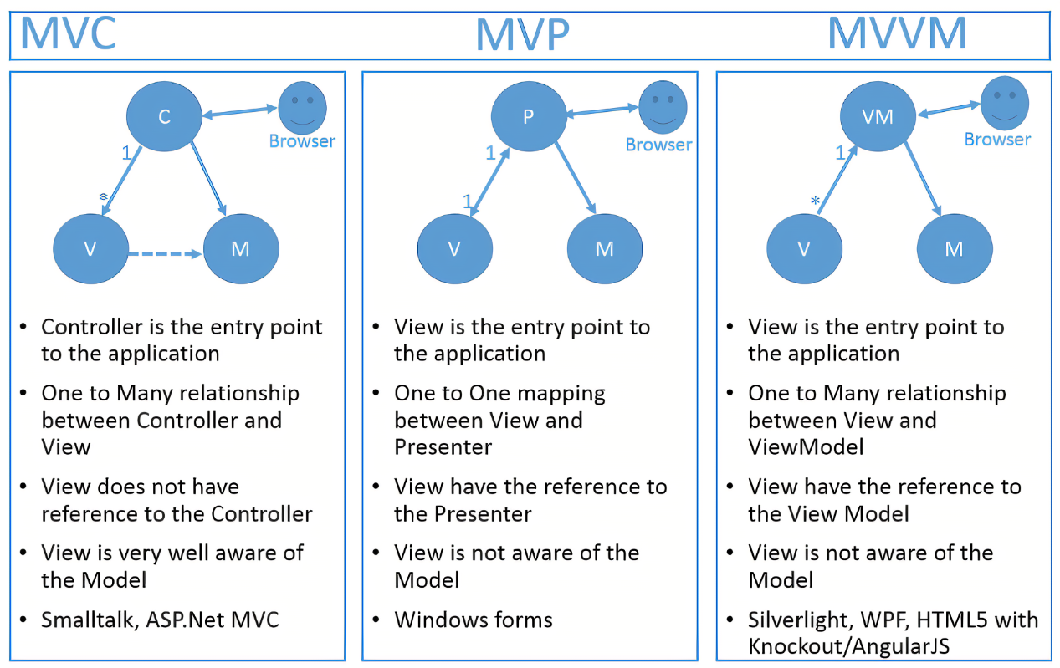
Difference Between MVC, MVP, and MVVM

Slide 8
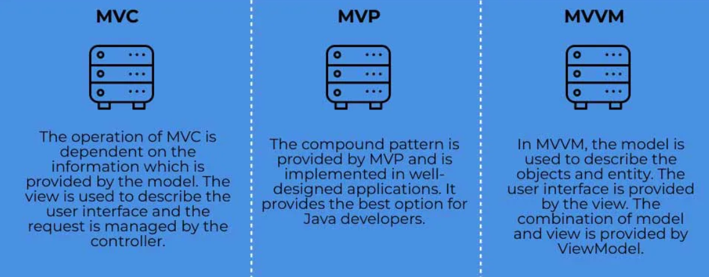

Slide 9
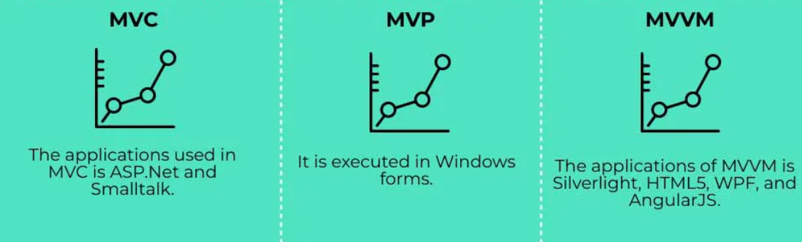

Slide 10
Development of the model
MVC: This model was developed before the other two models and is one of the oldest developed models.
MVP: This software architecture was developed as an advanced version of the model view controller architecture and helped address numerous drawbacks of the previous model.
MVVM is a software architecture that is highly recommended for industry use. We developed it to simplify event programming.

Slide 11
Coupling of the Components
MVC: The Model View Controller architecture tightly couples the view and the model components of the architecture.
MVP: This software architecture has a dependent user interface as it uses the presenter to act as a link between the view and the model.
MVVM: MVVM implements data binding and allows easy separation of the model and the view.

Slide 12
Relationship between Components
MVC: The controller and the view component exhibit a one-to-many relationship.
MVP: There is a one-to-one relationship between the presenter and the view in this architecture.
MVVM allows mapping multiple views with the single view mode, allowing one too many relationships.

Slide 13
In classical MVC (and also in Model2 MVC) view is active structure. It requests information from model layer. Controller only changes the state of model layer and view.
In MVP the view is passive. Instead presenter request information from model layer and passes it the view. You can read more extensively on about MVP pattern here.
In MVVM is similar to MVP, but the viewmodel has to manipulate the information before passing it to view.

Slide 14
Applicability
MVC: We can use it suitably for small-scale projects only.
MVP: We can use it for simple as well as complex projects.
MVVM: This architecture model must only be used for complex projects.

Slide 15
Testing Support
MVC: Unit Testability is the lowest in this architecture.
MVP: It allows appreciable unit testability.
MVVM: It allows maximum unity testability.

