Slide 1
Bootstrap

Slide 2
What is Bootstrap?
Bootstrap, originally named Twitter Blueprint, was developed by Mark Otto and Jacob Thornton as a framework to encourage consistency across internal tools.
Bootstrap is the most popular HTML, CSS, and JavaScript framework for developing responsive, mobile-first websites.
Bootstrap provides basic style definitions for all HTML elements. The result is a uniform appearance for prose, tables and form elements across web browsers.
In addition, developers can take advantage of CSS classes defined in Bootstrap to further customize the appearance of their contents.

Slide 3
How to add Bootstrap to HTML
1: Using the Bootstrap Content Delivery Network (CDN)
<link rel="stylesheet" href="https://cdn.jsdelivr.net/npm/bootstrap@4.0.0/dist/css/bootstrap.min.css" integrity="sha384-Gn5384xqQ1aoWXA+058RXPxPg6fy4IWvTNh0E263XmFcJlSAwiGgFAW/dAiS6JXm" crossorigin="anonymous">
2: Downloading files locally
Another way of importing Bootstrap to HTML is to directly download the files locally to your HTML project folder.
3: Using package managers to import Bootstrap to HTML
Package managers like npm and yarn can prove to be yet another efficient way of adding Bootstrap to HTML effortlessly.
Bootstrap 4: npm install bootstrap
Bootstrap 5: npm install bootstrap@next

Slide 4
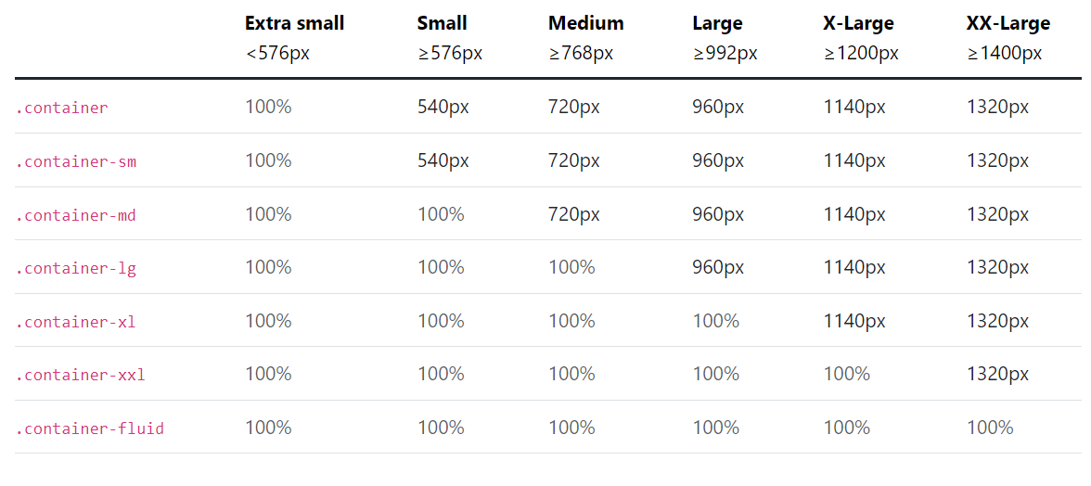

Slide 5
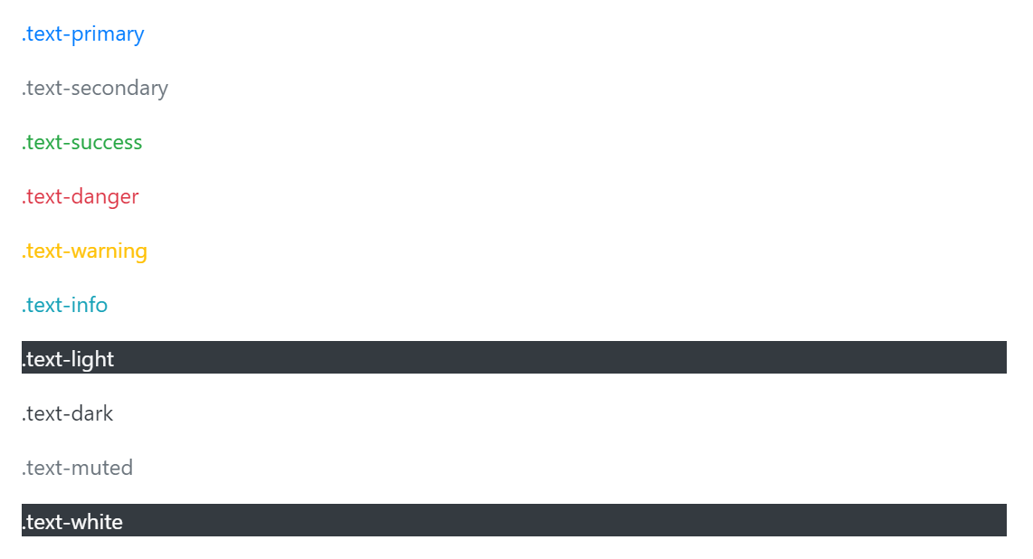

Slide 6
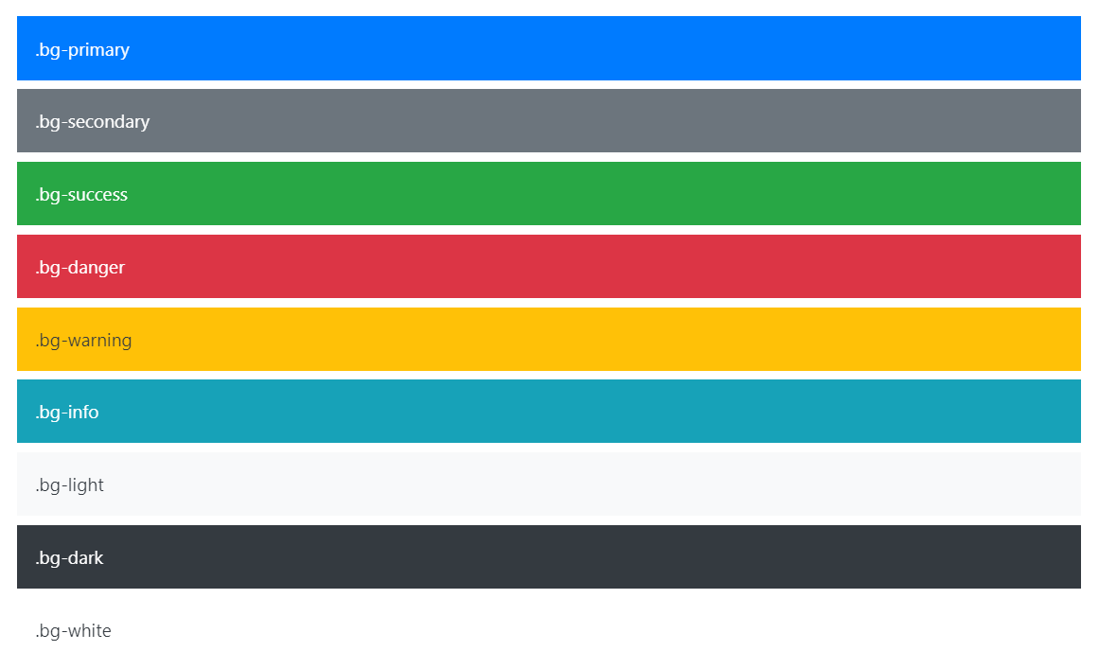

Slide 7
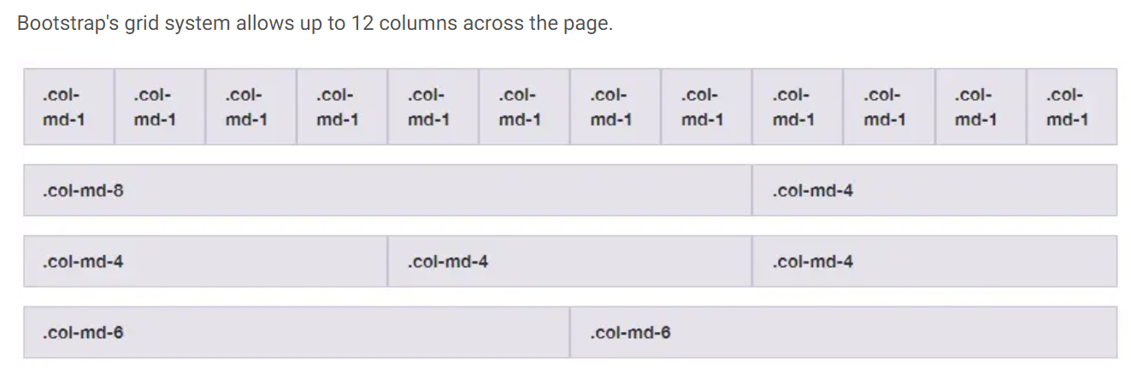
Grid system

Slide 8
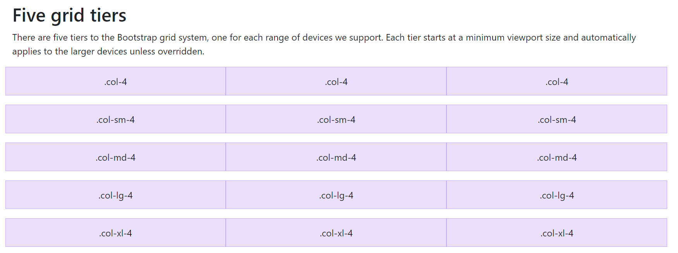
Five grid tiers

Slide 9
