Slide 1
How Browser Renders HTML

Slide 2
Start
Start to parse the HTML
Fetch
Fetch external resources
Parse
Parse the CSS and build the CSSOM
Execute
Execute the JavaScript
Merge
Merge DOM and CSSOM to construct the render tree
Calculate
Calculate layout and paint

Slide 3
Start to parse the HTML
When the browser begins to receive the HTML data of a page over the network, it immediately sets its parser to work to convert the HTML into a Document Object Model (DOM).
The first step of this parsing process is to break down the HTML into tokens that represent start tags, end tags, and their contents.
From that it can construct the DOM.

Slide 4
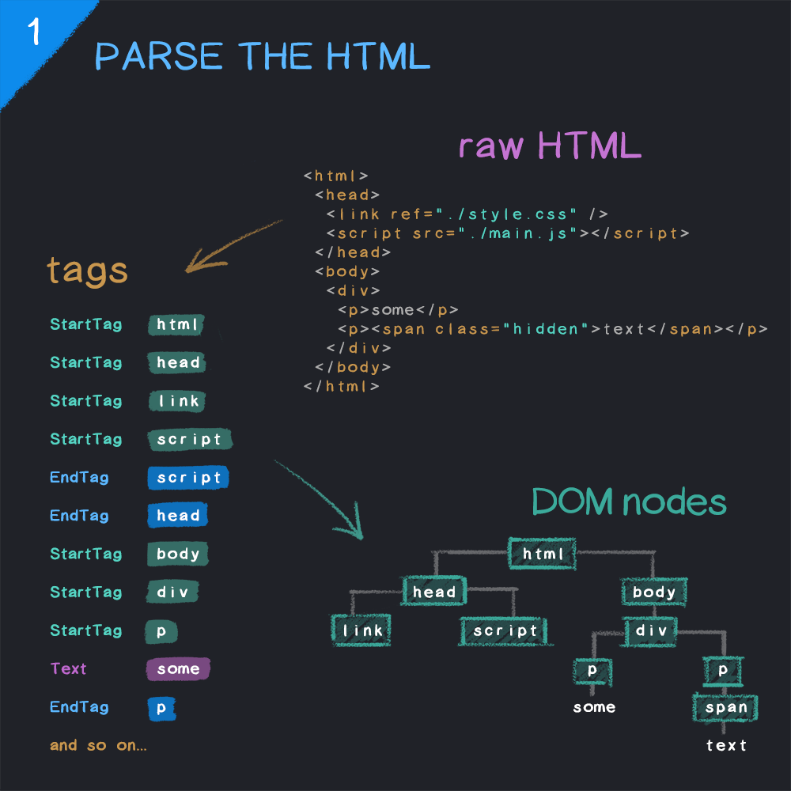

Slide 5
2. Fetch external resources
When the parser comes across an external resource like a CSS or JavaScript file, it goes off to fetch those files.
The parser will continue as a CSS file is being loaded, although it will block rendering until it has been loaded and parsed.

Slide 6
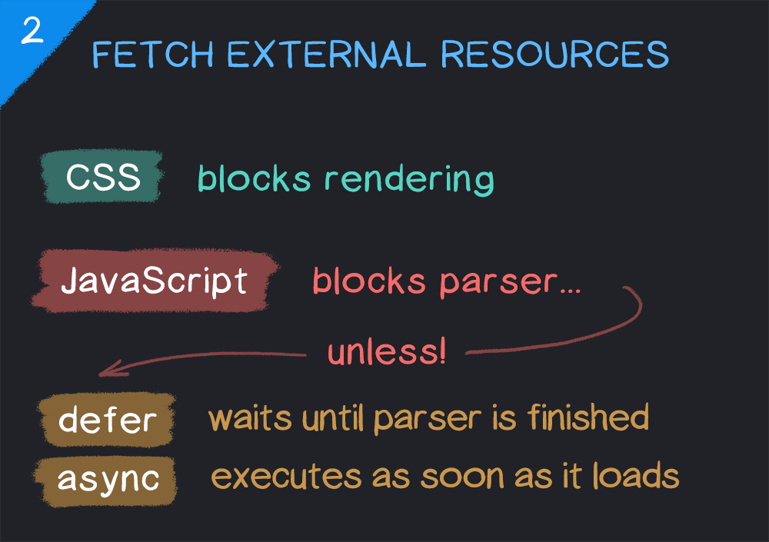

Slide 7

Parse the CSS and build the CSSOM
Similar to HTML files and the DOM, when CSS files are loaded they must be parsed and converted to a tree - this time the CSSOM.
It describes all of the CSS selectors on the page, their hierarchy and their properties.

Slide 8
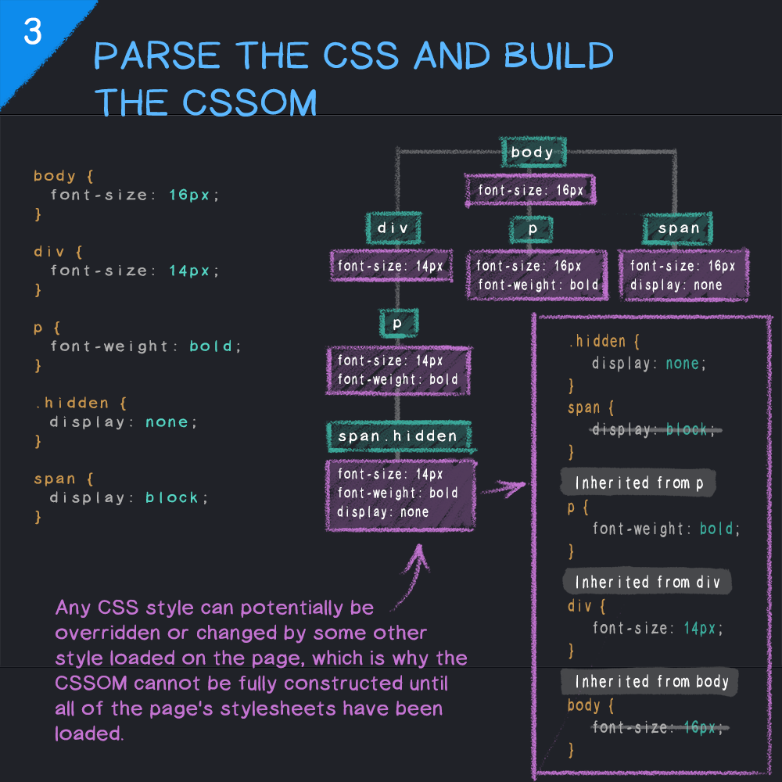

Slide 9
Execute the JavaScript
How and when the JavaScript resources are loaded will determine exactly when this happens, but at some point, they will be parsed, compiled and executed.
Different browsers have different JavaScript engines to perform this task

Slide 10
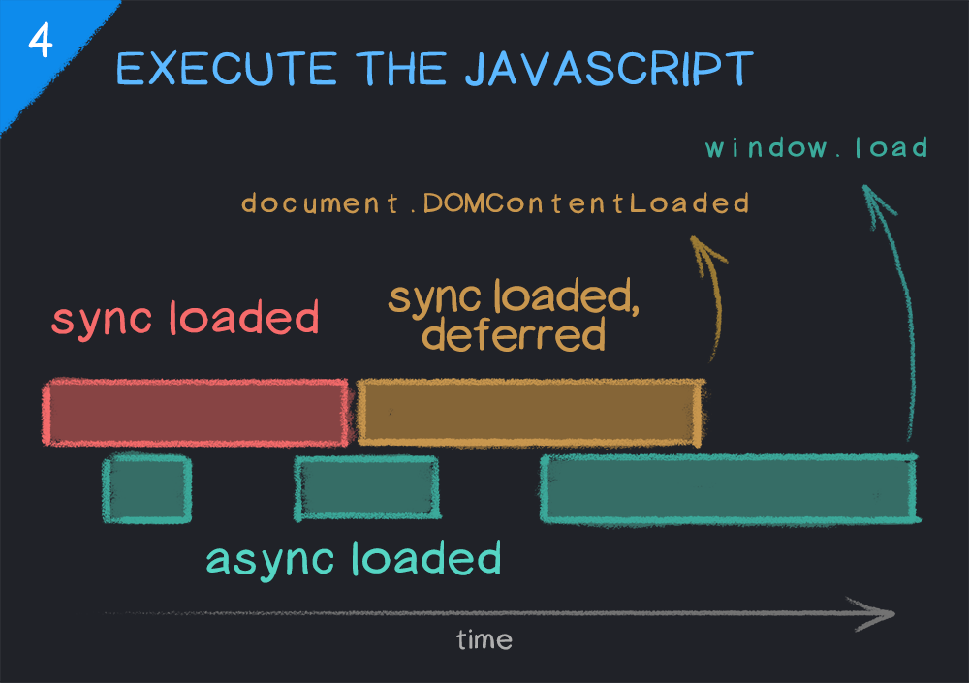

Slide 11
Merge DOM and CSSOM to construct the render tree
The render tree is a combination of the DOM and CSSOM and represents everything that will be rendered onto the page.
That does not necessarily mean all nodes in the render tree will be visually present.
For example, nodes with styles of opacity: 0 or visibility: hidden will be included and may still be read by a screen reader etc., whereas those set to display: none will not be included.

Slide 12
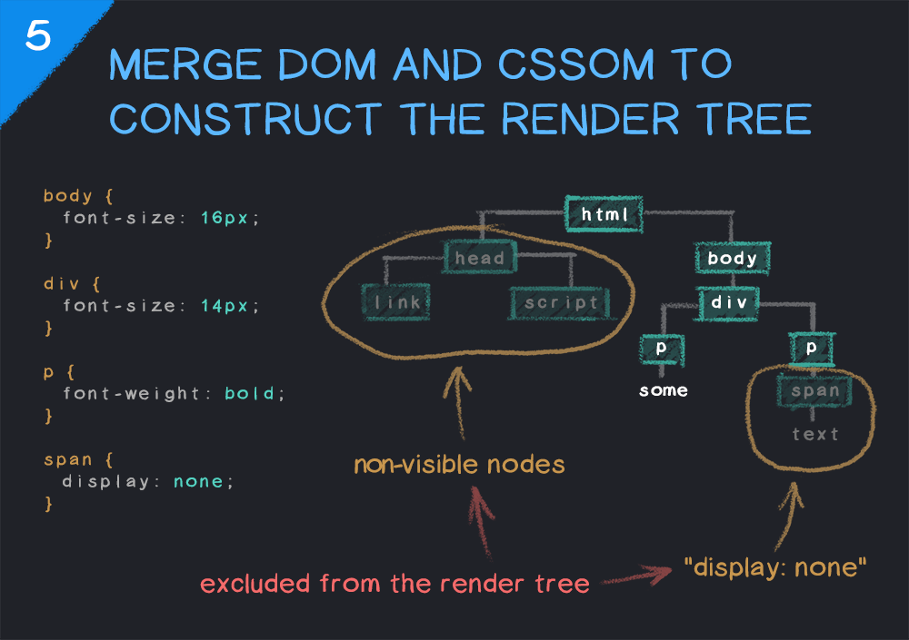

Slide 13

Calculate layout and paint
Now that we have a complete render tree the browser knows what to render, but not where to render it.
Therefore, the layout of the page (i.e., every node's position and size) must be calculated.
The rendering engine traverses the render tree, starting at the top and working down, calculating the coordinates at which each node should be displayed.
Once that is complete, the final step is to take that layout information and paint the pixels to the screen.

Slide 14
