Slide 1
LESS

Slide 2
What IS LESS
LESS stands for Leaner Style Sheets. It is a backward-compatible language extension for CSS.
LESS was designed by Alexis Sellier in 2009. LESS is an open-source. The first version of LESS was written in Ruby; in the later versions, the use of Ruby was replaced by JavaScript.
LESS is designed in JavaScript and also created to be used in live, which compiles faster than other CSS pre-processors.
LESS keeps your code in modular way which is really important by making it readable and easily changeable.
Faster maintenance can be achieved by the use of LESS variables.

Slide 3


Installation of LESS
Step 1 − We need NodeJs to run LESS examples. To download NodeJs, open the link https://nodejs.org/en/
Step 2 − Run the setup to install the Node.js on your system.
Step 3 − Next, Install LESS on the server via NPM (Node Package Manager). Run the following command in the command prompt.
To compile Less file into css run the following.

Slide 4
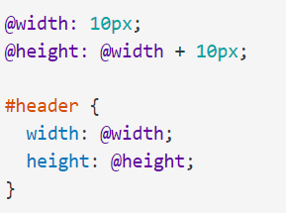
Variables
Less variables are defined with a symbol @ and the values are assigned in the variable with a colon ( : ). Variables are actually "constants" in that they can only be defined once.

Slide 5
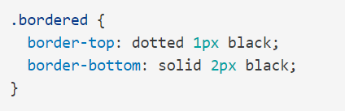
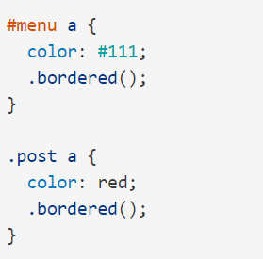
Mixins
Mixins are a way of including ("mixing in") a bunch of properties from one rule-set into another rule-set.
So say we have the following class:
And we want to use these properties inside other rule-sets. Well, we just have to drop in the name of the class where we want the properties, like so:

Slide 6
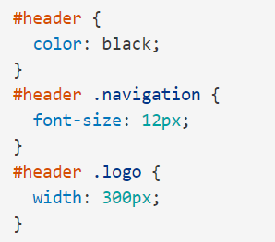
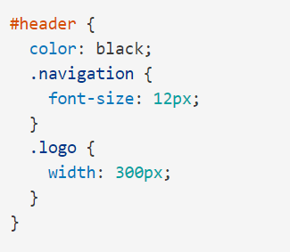
Nesting
Let's say we have the
following CSS:
In Less, we can also
write it this way:

Slide 7
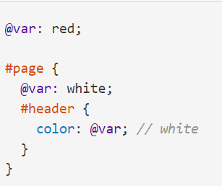
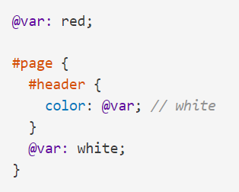
Scope
Scope in Less is very similar to that of CSS.
Variables and mixins are first looked for locally, and if they aren't found, it's inherited from the "parent" scope.
Mixin and variable definitions do not have to be placed before a line where they are referenced.
So the following Less code is identical to the previous example:

Slide 8
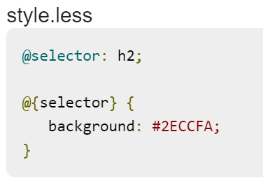
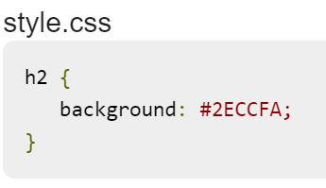
LESS - Selectors
The selector can reference any variable and it is built during the compile time. The variable name must be placed inside the curly braces( { } ) prefixed with the @ symbol.

Slide 9

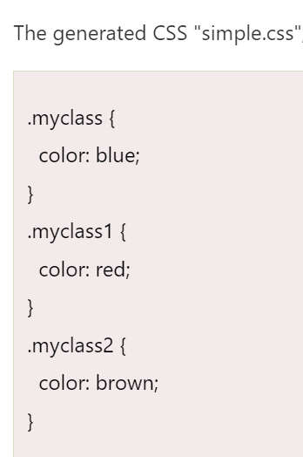
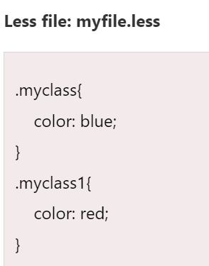
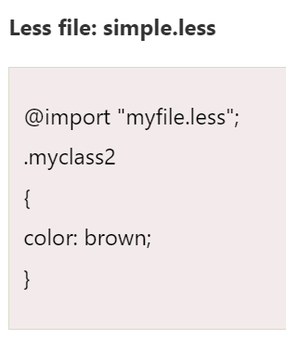
Less - Importing
You can import a .less file, and all the variables in it will be available. The extension is optionally specified for .less files.

Slide 10
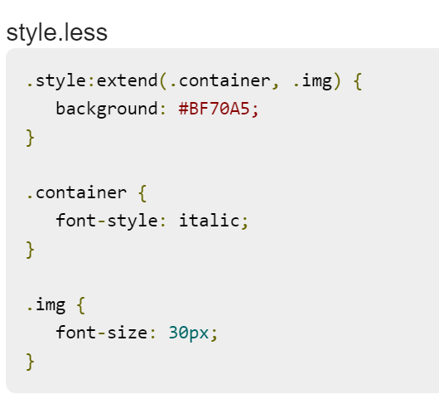
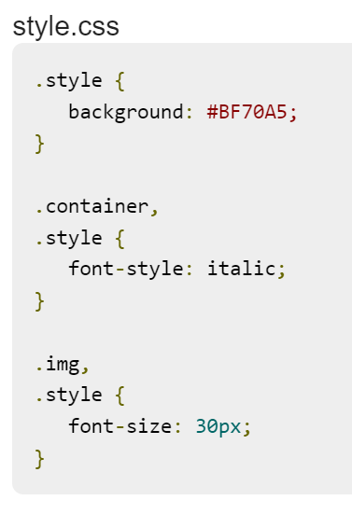
LESS - Extend
The extend feature acts as a pseudo class which extends other selector's styles in one selector by using: extend selector.

Slide 11
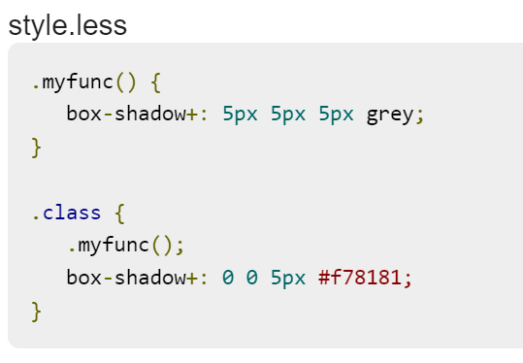
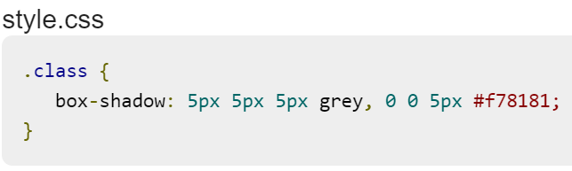
LESS – Merge Comma
This feature in LESS allows the addition of values to comma or space separated list from multiple properties using a single property. It can be used for background and transform properties.

Slide 12
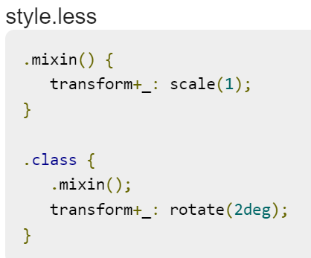
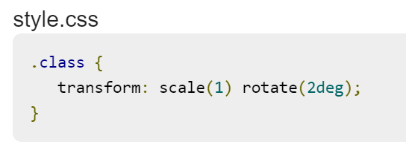
LESS - Merge Space
The Merge Space feature adds property value with space.

