Slide 1
SASS
(Syntactically Awesome Style Sheets)

Slide 2
Node commands
To install SASS using node run the following command in cmd.
npm install -g node-sass
Open the vscode terminal from the SASS project and run the following command to transpile SASS into CSS.
npx node-sass style.scss style.css

Slide 3
Sass
Sass is a CSS pre-processor.
Sass reduces repetition of CSS and therefore saves time.
Saas includes various features such as variables, nested rules, mixins, inline imports, built-in functions to manipulate color and other values, all with a fully CSS-compatible syntax.

Slide 4
Key Features of SASS
Compatibility with CSS: One of the major features of SASS is its high compatibility with cascading style sheets
Multi-featured: SASS brings a plethora of features to the table, including interpolation, partials and importing, control directives, nesting, etc.
Mature and Backed by a Huge Community: Sass was first released in 2006 and since then it has been actively developed by its core team that includes many big tech organizations and independent developers.
Tools and Frameworks: There are several CSS frameworks that are developed using SASS. Bourbon and Compass are examples of such frameworks.

Slide 5


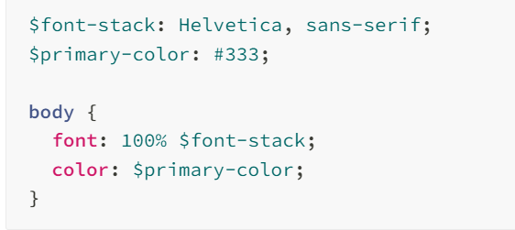
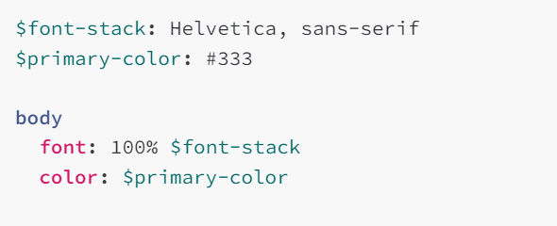
Sass has two syntaxes!
The SCSS syntax (.scss) is used most commonly.
It’s a superset of CSS, which means all valid CSS is also valid SCSS.
The indented syntax (.sass) is more unusual: it uses indentation rather than curly braces to nest statements, and newlines instead of semicolons to separate them

Slide 6
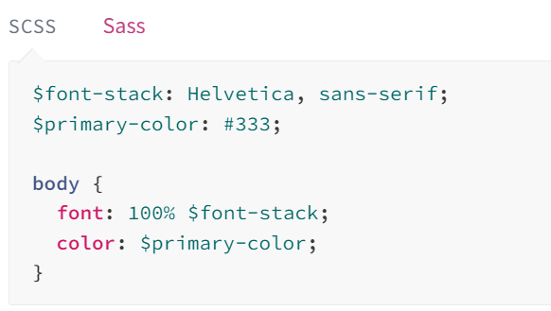
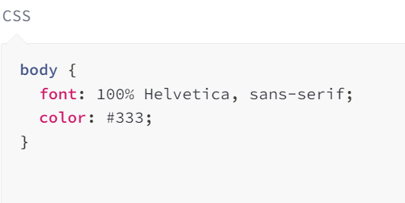
Sass Variables
Sass uses the $ symbol, followed by a name, to declare variables:

Slide 7
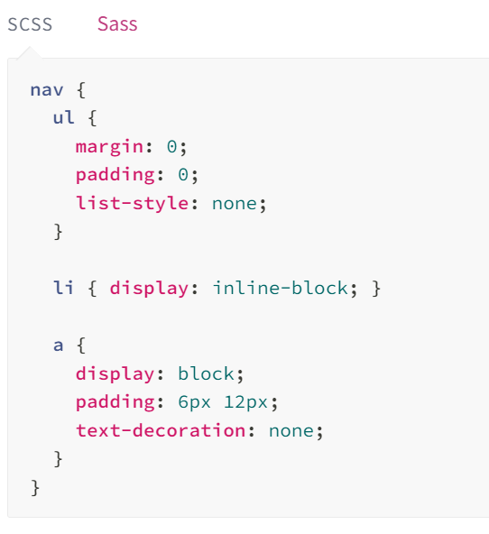
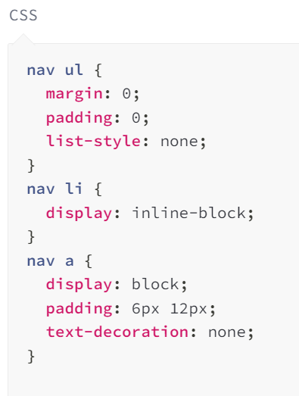
Nesting
Sass will let you nest your CSS selectors in a way that follows the same visual hierarchy of your HTML. Be aware that overly nested rules will result in over-qualified CSS that could prove hard to maintain and is generally considered bad practice.

Slide 8
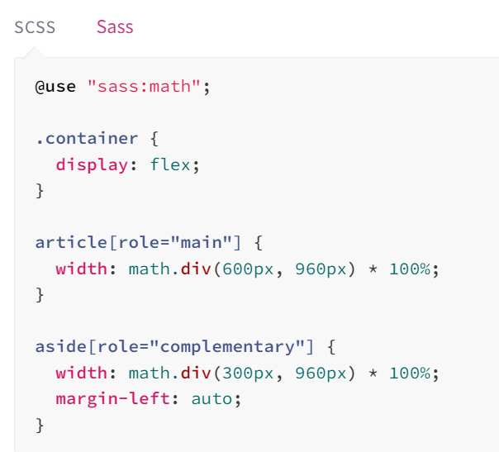
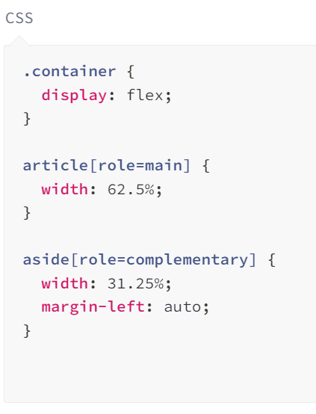
Sass Operators
Doing math in your CSS is very helpful. Sass has a handful of standard math operators like +, -, *, math.div(), and %

Slide 9
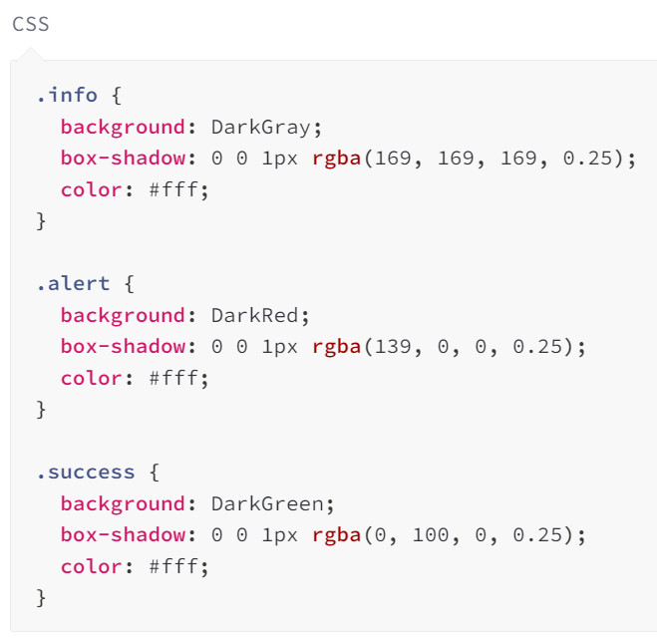
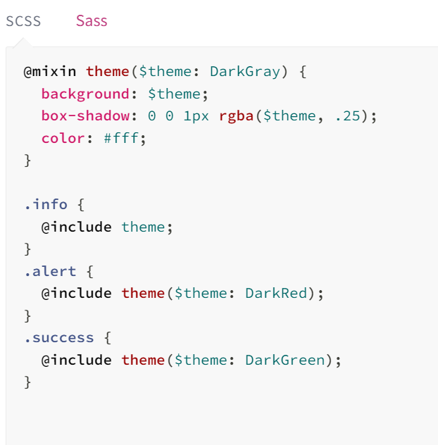
Sass - Mixins
Sass provides another way, via the @mixin directive. Mixins are primarily used to provide non-semantic styling, but they can contain any valid CSS or Sass.
The syntax is straight-forward:

Slide 10
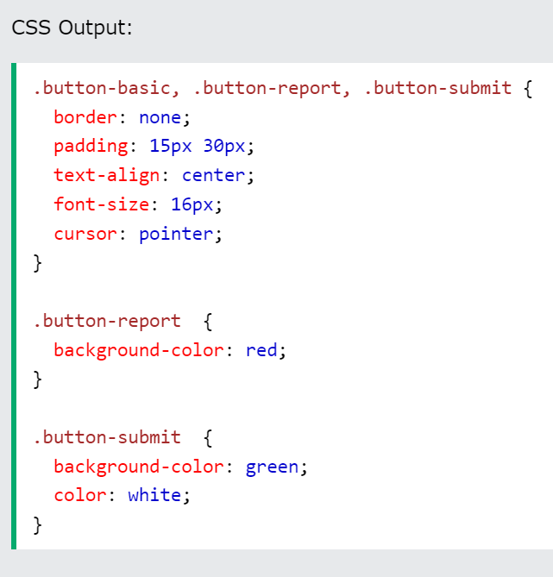
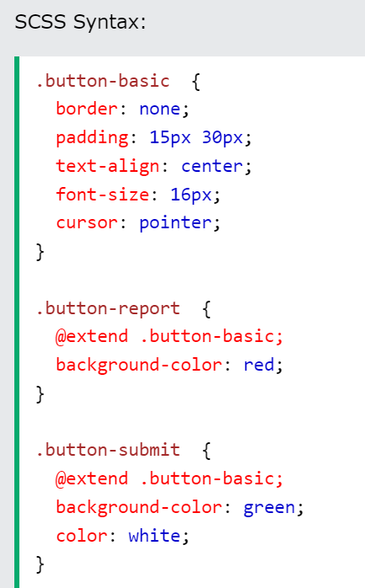
Sass @extend and Inheritance
Using @extend lets you share a set of CSS properties from one selector to another.

Slide 11
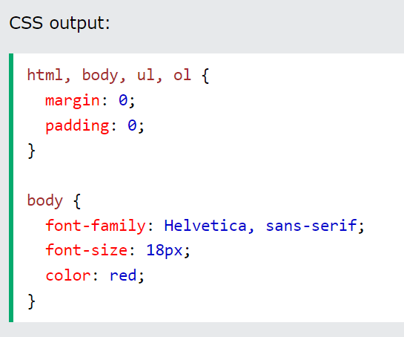
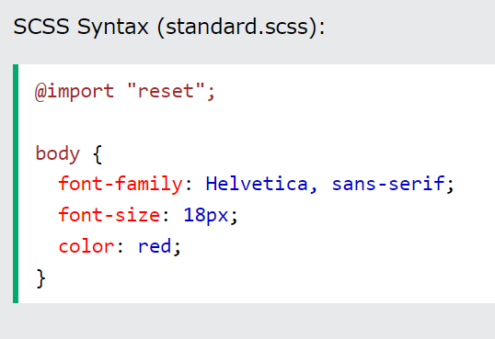
Sass @import
Just like CSS, Sass also supports the @import directive.
The @import directive allows you to include the content of one file in another.

Slide 12
Sass Partials
Sass transpiles all the .scss files directly. However, when you want to import a file, you do not need the file to be transpiled directly.
Sass has a mechanism for this: If you start the filename with an underscore, Sass will not transpile it. Files named this way are called partials in Sass.
So, a partial Sass file is named with a leading underscore

Slide 13
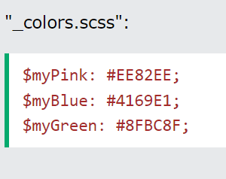
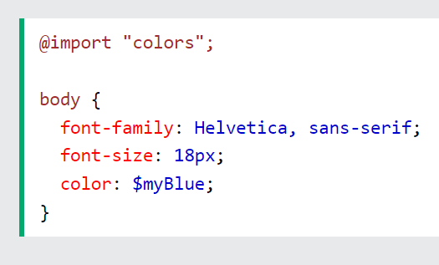
Sass Partials
Now, if you import the partial file, omit the underscore. Sass understands that it should import the file "_colors.scss":

Slide 14
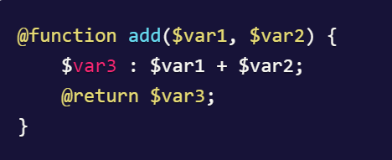
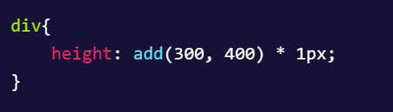
Sass Function
SASS @function at-rule is used to define functions with complex operations, taking in arguments and returning a result. SASS functions are used to declare complex formulas and behaviors which can then be used throughout the stylesheet.

Slide 15
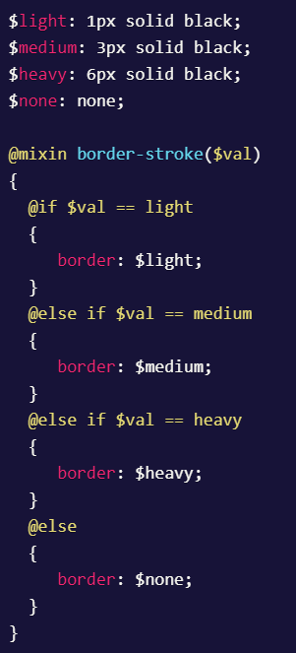
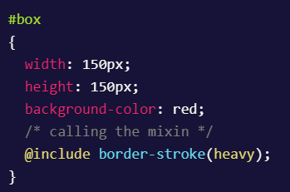
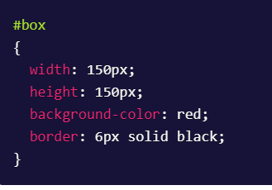
Sass Conditional statements
SASS also provides support for flow control by providing @if, @else and @else if at-rules which can be used in SASS to write complex code by implementing conditions in your stylesheets.

Slide 16
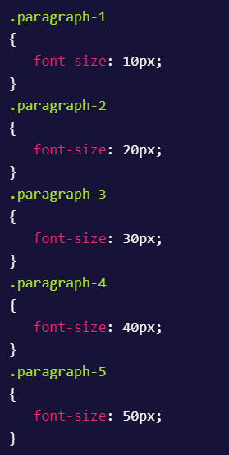
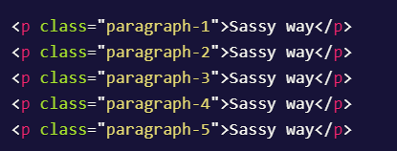
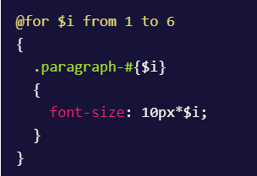
SASS @for At-rule:
SASS @for at-rule works the same way like a for loop in any programming/scripting language. It is used to iterate and compile a style block with a different value each time.

Slide 17

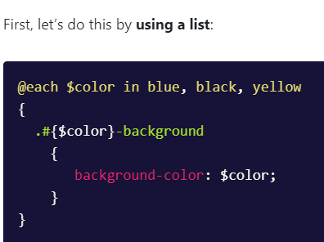
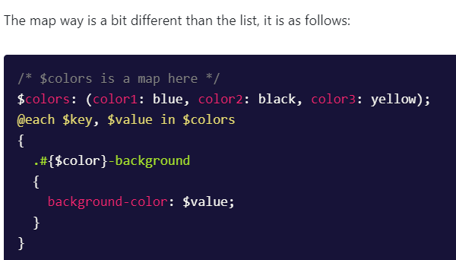
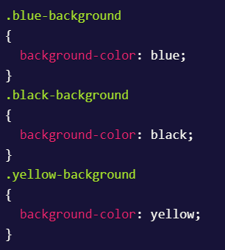
SASS @each At-rule:
SCSS/SASS @each at-rule is also similar to the @for at-rule with the only difference being that it is used to iterate over the values of a list and map.

Slide 18
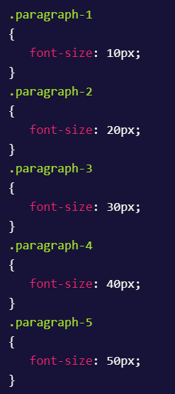
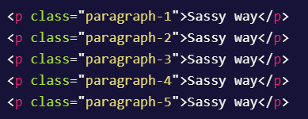
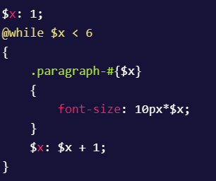
SASS @while At-rule:
SASS @while is similar to the while loop in any other programming/scripting language. It executes until the specified expression evaluates to true.

Slide 19
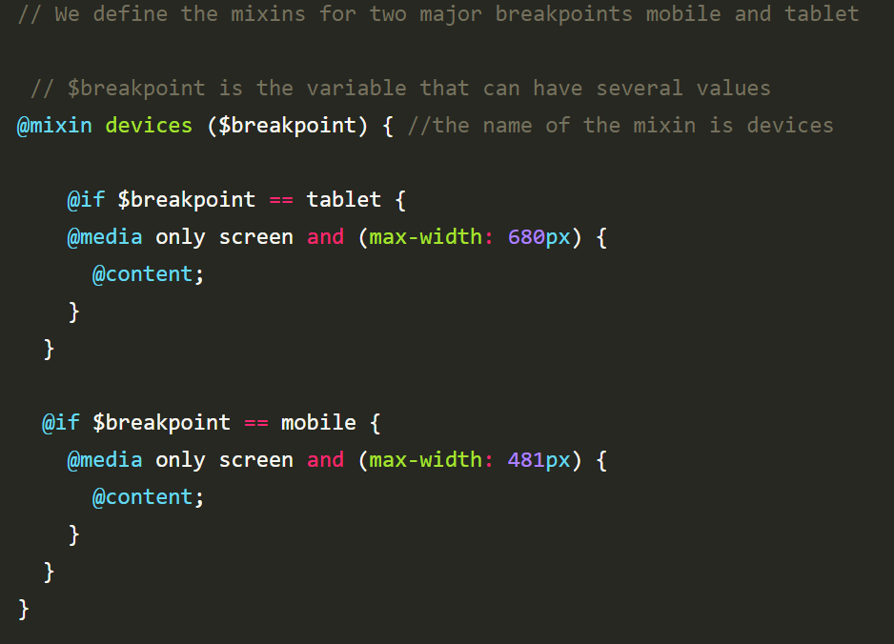
SASS Media
Mixins will help you manage your media query by defining it in one location. So you can apply it as needed, and then Sass enables you to compile it to the corresponding CSS code.

Slide 20
SASS Media
Mixins will help you manage your media query by defining it in one location. So you can apply it as needed, and then Sass enables you to compile it to the corresponding CSS code.

Slide 21
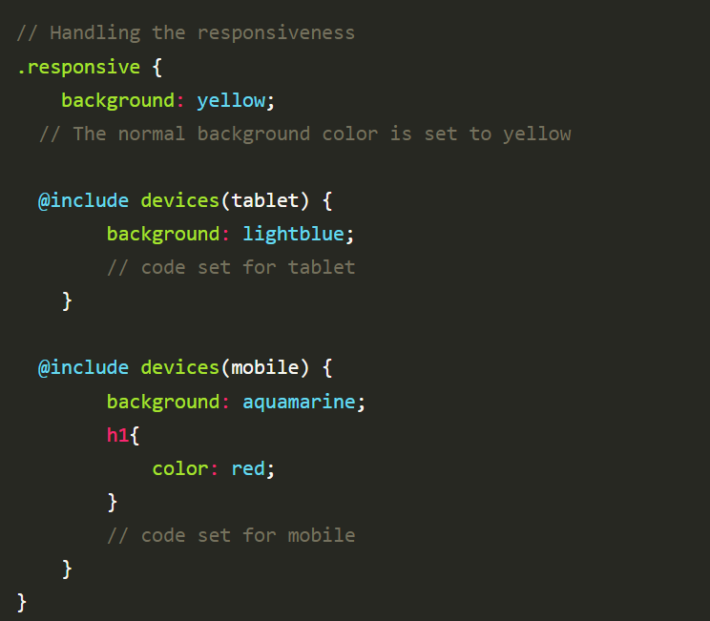

Slide 22
