Slide 1
Stips
Additional Documents requirement from Lenders

Slide 2





Lenders

Slide 3
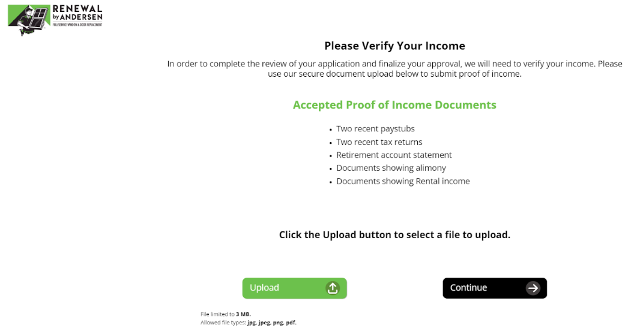
Types
Income Stips
Residence Stips

Slide 4
Know more about Stips..
Stips are checked before TILA
We call Stips API to check whether there are any Stips for the loan.
Stips API will provide response whether a loan application has Stips or not.
Non RBA
We pend the loan application before TILA Consumer must upload the Stips documents Application will move forward only after the internal team’s clearance.
RBA
RBA Stips are checked before TILA After Consumer uploads the documents, we send TILA automatically without waiting for the clearance from the lenders.
Note: ‘Upgrade’ sends the TILA of the loan without waiting for the clearance even in Non RbA

Slide 5
RbA
RbA DC Flow
Stips before TILA
Offer Pends
Manual Review
Consumer Uploads documents
TILA sent to the Consumer
RbA Send App Flow
Stips before TILA
Offer Releases
Consumer Uploads documents
TILA sent to the Consumer

Slide 6
Thank You !

