Slide 1
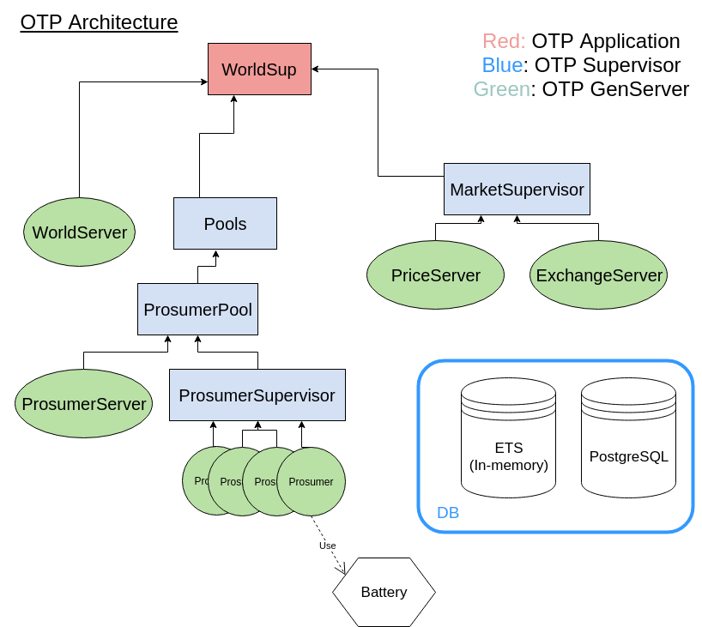
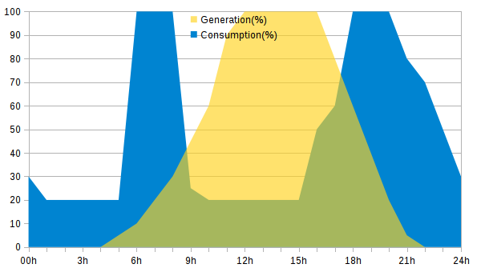
MVP status____________
Prosumer features
- No real sensor/HW reading
- Simulation of (charging, consumig e-, purchasing kwh from market...)
- Has cache to keep balance of purchased electricity from the market
- If current_storage < 30% & cache < current_storage ---→ Purchase more power from the exchange.
- If cache > 0 --→ consume from cache
- Simulated Hour-to-%PV(W) power curve:
Features
- New Transaction (TR)
1. Find Prosumers with > 30% storage
2. Check price from PriceServer
3. Let ExchangeServer create the new transation ( later at blockchain level)
4. Save new TR to DB
5. Increment buyer's cache. Decrement seller's storage.
- PriceServer: determine €/kwh based on global supply, demand, and external grid.
- DB. Save Transactions, price evolution, generation history, etc

