Slide 1
Quota Retirement Amount (QRA) Automation
Van Truong
truongvh@uci.edu
https://www.linkedin.com/in/van-truong-88041319a/
For demonstration purposes only.
No confidential information is included in this document.

Slide 2
High Level Overview
Date
Calculate product category QRA
Opp goes CW
Prep for QRA calc
Subscriptions generate
Aggregate QRA
Done
Deal is booked and won
Rep marks Opp as Closed Won and books products on a contract. Sales Analytics team wants to know how much quota was retired by this deal.
Ready to calculated Quota Retirement Amount
QRA records are created and then awaits subscription data to finalize.
Subscription data settles
Subscription house final billing information and are the source of truth for how much revenue was won on a deal. Upon subscription generation, QRA calc is queued.
The Hard Part
Each product category has it own formula and logic. For each product category, qualified subscriptions are inputted into formula calculations to determine the Quota Retirement Amount for said product category.
Begin populating Opportunity
As each QRA finishes calculating, the corresponding Opportunity field for each product category will update and be aggregated in a total QRA field.
Data is ready for analysis
QRA info is now available on the Opportunity for Opp level reporting by users or integrations unable to look at custom objects.

Slide 3
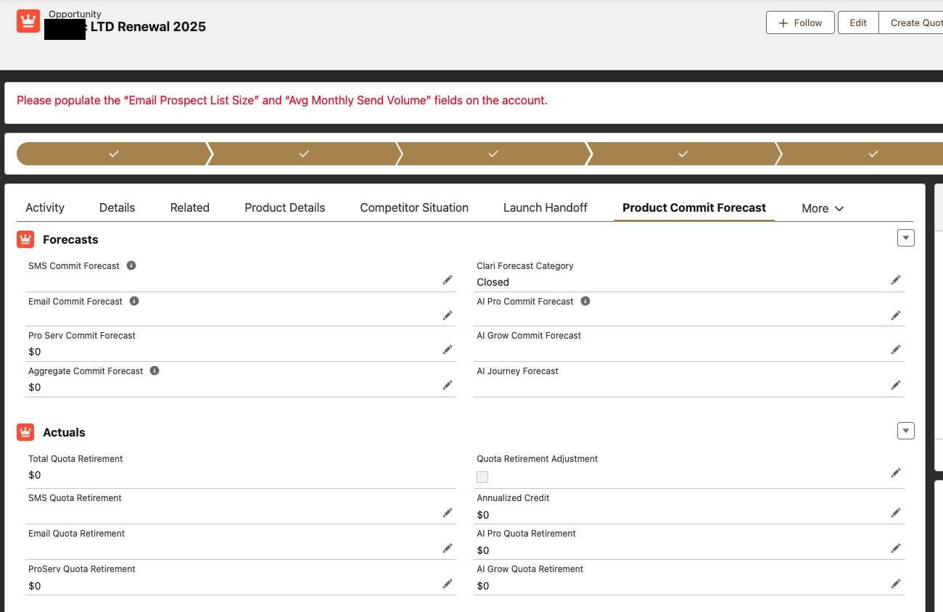
Sales Analytics team wants to synced subscription data over to Clari, which could only source data from Opportunity
Each product category had their own formula for calculating quota retirement amount
Opportunity could sell multiple subscriptions of the same product category

Slide 4
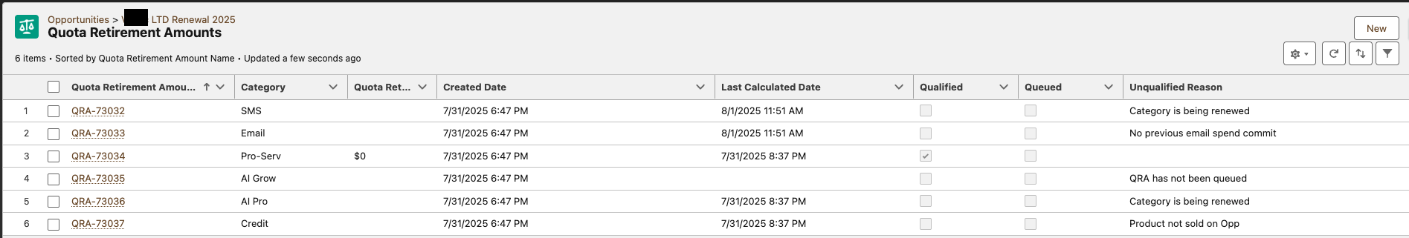
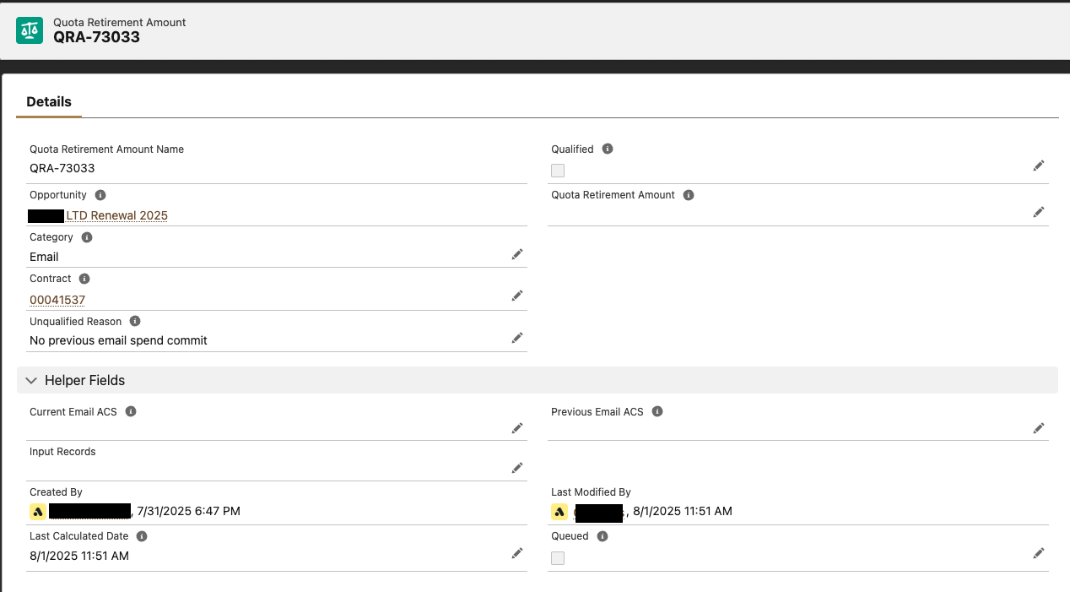
Child Object
To keep complex and resource intensive automation off of closed won Opportunity, a related object was leveraged to house triggers and automation logic

Slide 5
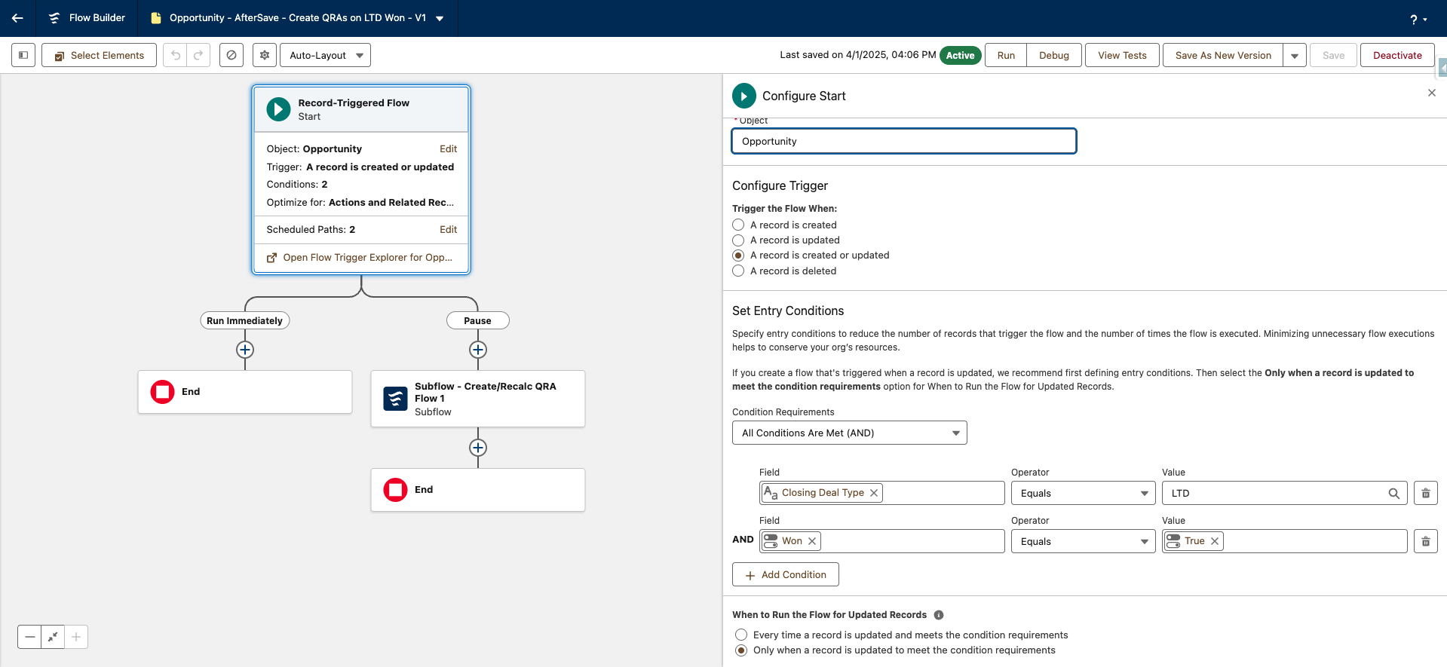
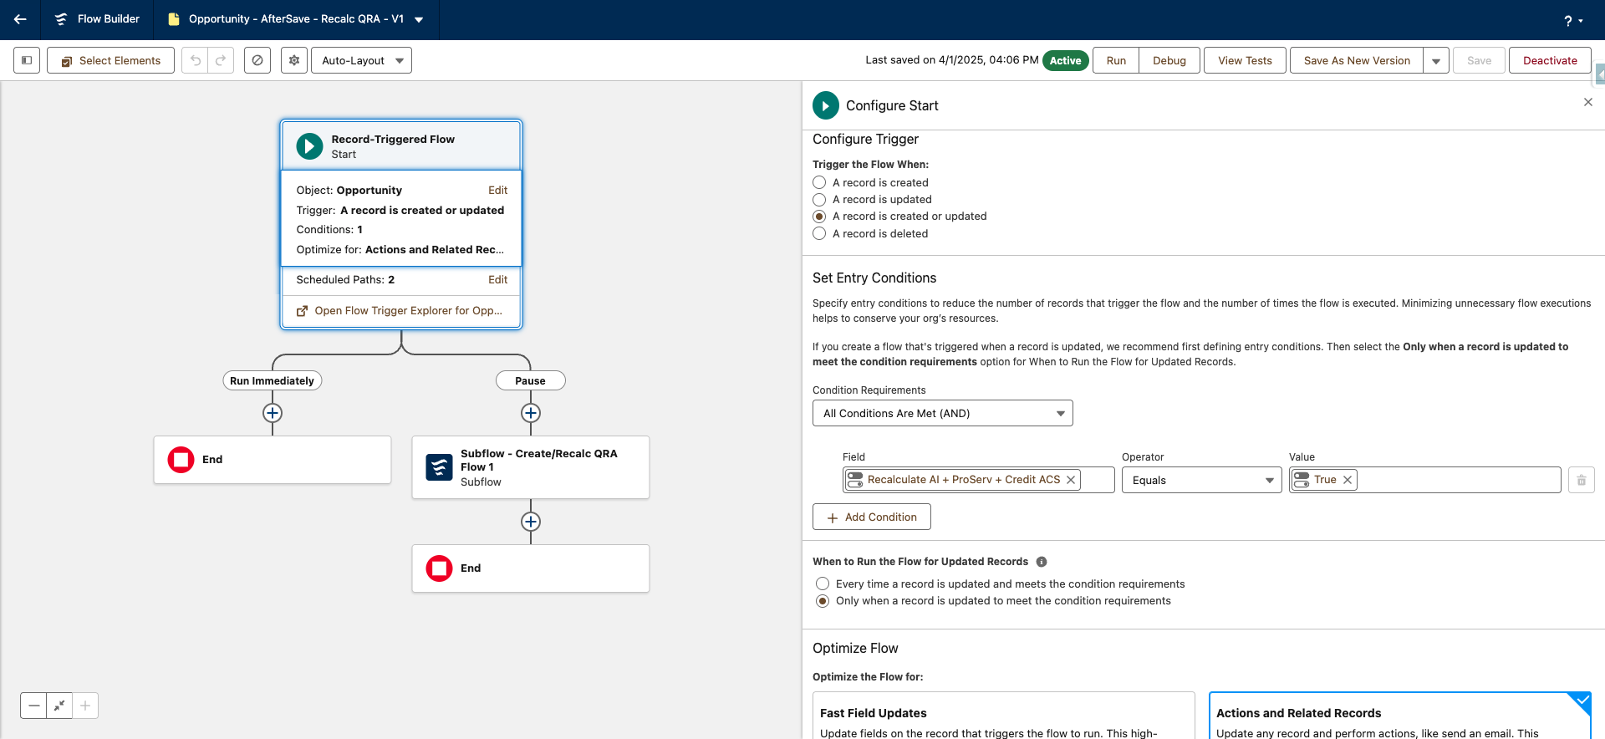
2 Triggers - 1 Subflow
QRA calculation could be triggered either by Opp going CW or on demand by for a recalculaton. 95% of the logic was the same with both trigger so creating a subflow with different triggers was utilized to reduce flow management.

Slide 6
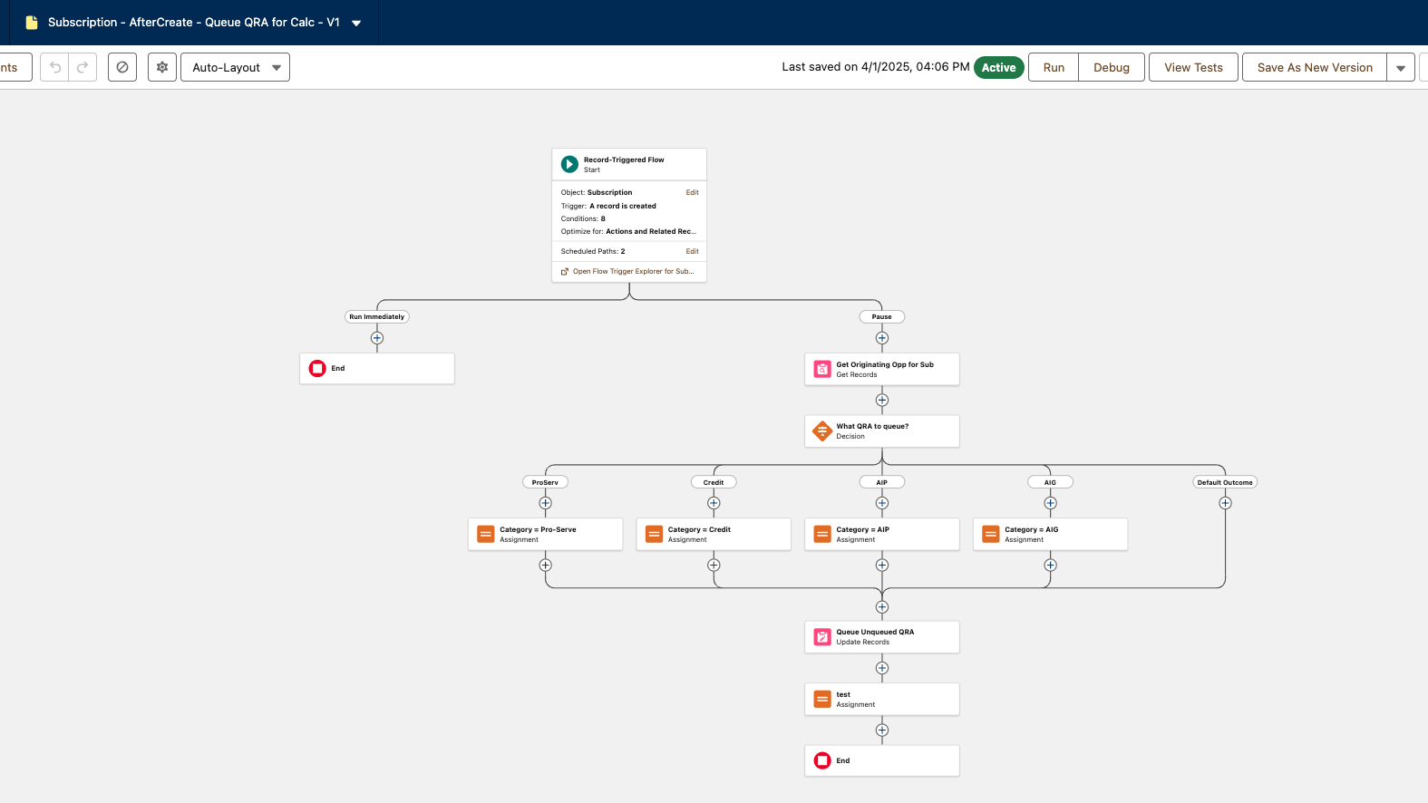
A schedule path was utilized upon subscription creation to avoid any row lock or automation error rolling back subscription creation.
Trigger Conditions ensured only subscriptions for qualifying product category entered the flow and Update Record filter criteria prevents incorrect QRA from being queued.

Slide 7
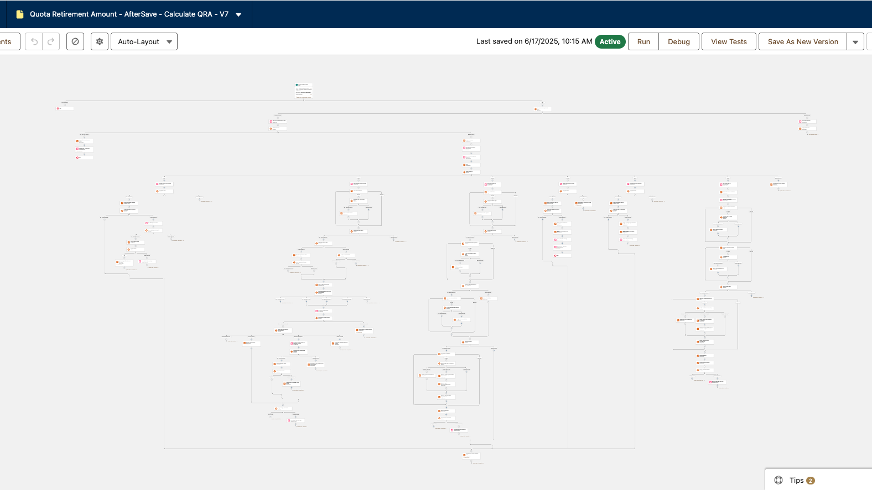
Date
Each product category has it own formula and logic.
For each product category, qualified subscriptions are inputted into formula calculations to determine the Quota Retirement Amount for said product category.

Slide 8
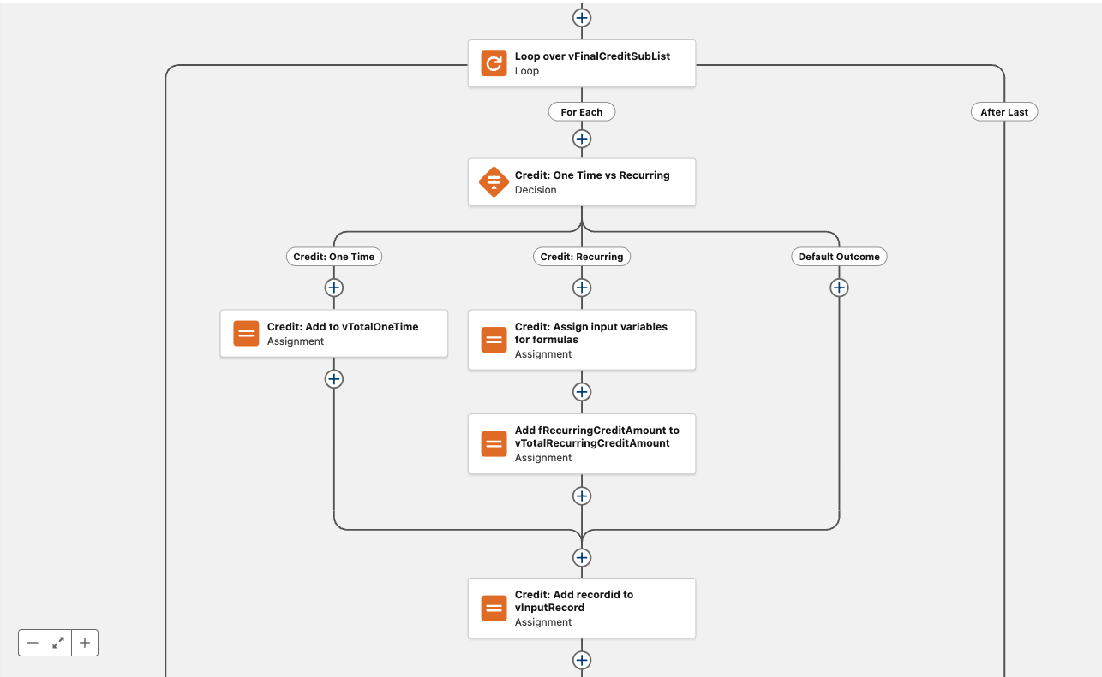
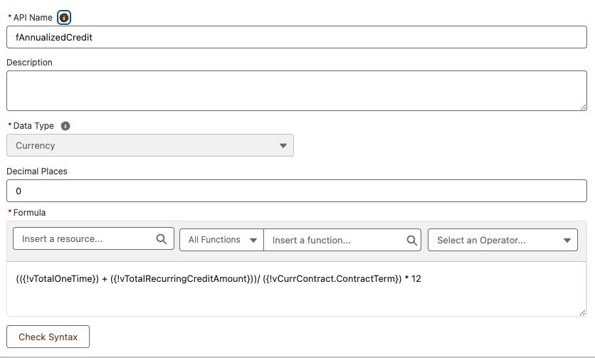
QRA Calculation Example
Credit subscriptions can be either one time or recurring. Depending on their type, we would calculate their annualized values differently.
Each credit subscription needs to be evaluated individually and then passed through the corresponding formula, then aggregated to list a single total Quota Retirement Amount for Credit subscriptions.

Slide 9
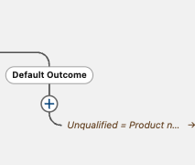
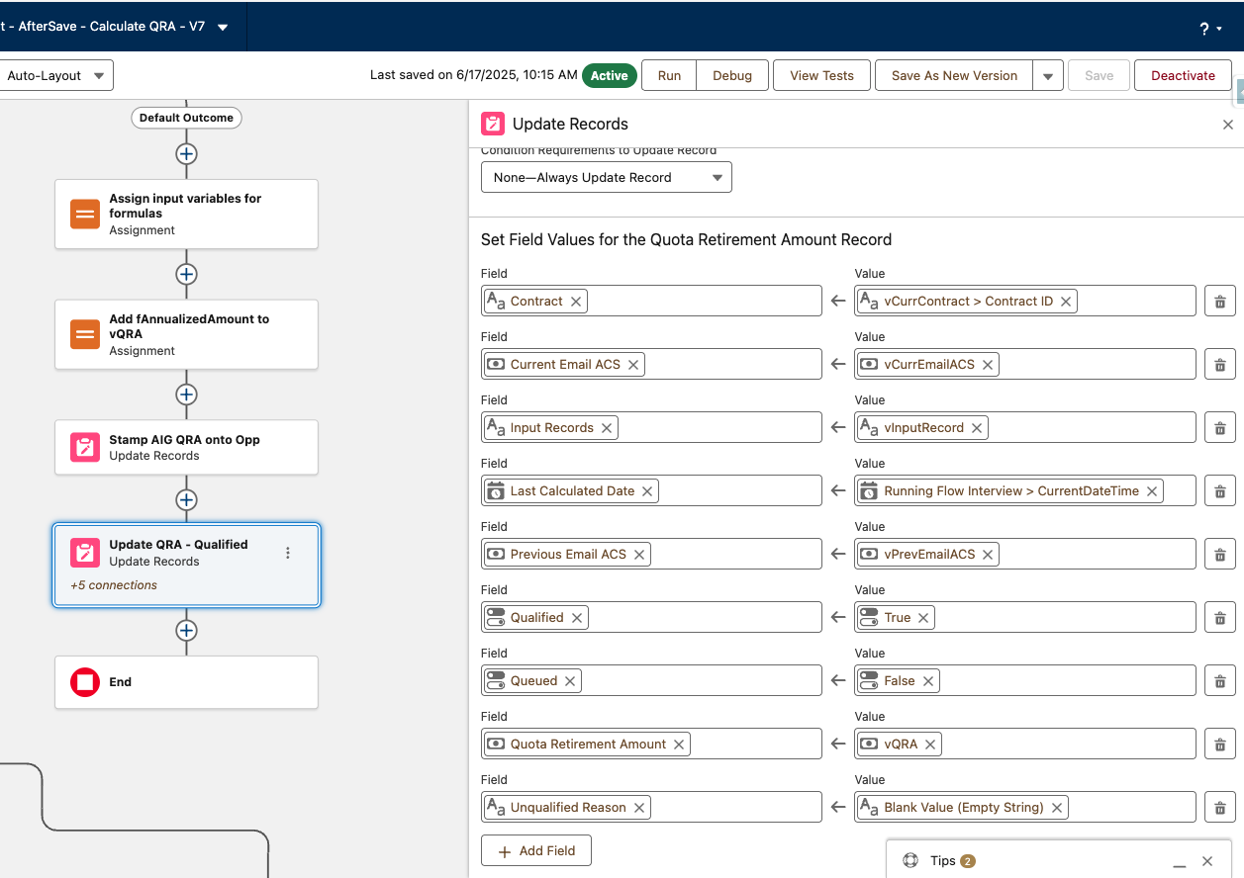
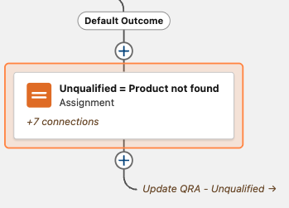
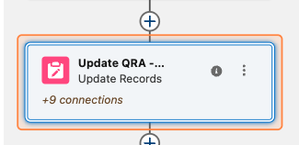
Consolidating Elements
Common outcomes
While each product category has it own formula, they still shared common outcomes such as unqualified
Common variables
Some outcomes have common variables that could be shared between each product category
Common Action
Instead of duplicating and configuring an Update Record element for each product category, routing a connection to a common Update Record avoids additional overhead.
1
2
3

Slide 10

Key concepts demonstrated
Date
1
2
3
4
Automation Trigger control
Optimizing for maintainability
Minimizing and localizing errors
Executing complexity
Localized data and logic on a custom related object to avoid automation traffic on Opportunity.
Subflows and node connections allows the reuse of common actions and reduces maintenances on duplicative elements on a complex piece of automation.
Avoid rollbacks on subscription creation, preventing QRA errors from affecting subscription billing.
Get Record filter criteria, Collection filtering, and Looping over Collections enabled complex product rules and calculations to be performed.

