Slide 1
Introduction
1
Analiza Algoritmilor

Slide 2
Contents
Syllabus
What is an algorithm?
Grade calculation
  Assignments
  Midterm exam
  Lab Attendance
  Final exam

Slide 3
Syllabus
Computability Theory
Complexity Theory
Correctness

Slide 4
Computability Theory
What are algorithms and what can they do?

Slide 5
Euclid’s algorithm
Euclid_GCD(a, b):
while (a ≠ b)
if (a > b)
a := a - b
else
b := b - a
return a
a = 49, b = 84
a = 49, b = 35
a = 14, b = 35
a = 14, b = 21
a = 14, b = 7
a = 7, b = 7

Slide 6
An algorithm is
a finite sequence of precise steps
that can be used
to solve a problem
in a finite amount of time

Slide 7


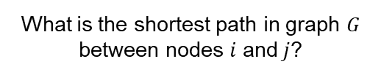

What is the GCD of $x$ and $y$?
What is the shortest path in graph $G$ between nodes $i$ and$j$?
What is the sorted order of list $l$?
A problem is a function from a set of inputs to a set of outputs
$$f:I→O$$

Slide 8

A problem is a function from a set of inputs to a set of outputs
$$f:I→O$$

Slide 9




Is number $n$ prime?
Is graph $G$ fully connected?
Can program $p$ ever trigger a SEGFAULT?
A decision problem is a problem with a boolean output
$$f:I→\{FALSE, TRUE\}$$

Slide 10

A decision problem is a problem with a boolean output
$$f:I→\{FALSE, TRUE\}$$

Slide 11
Inputs (outputs) as strings
3
2
1
4
6
5
“(1>2);(1>3);(1>6);(2>3);(3>1);(3>4);(3>5);(4>5);(5>4)”

Slide 12


A problem is a function from a set of inputs to a set of outputs
strings
strings
$$f:Σ^{∗}→Σ^{∗}$$
A decision problem is a problem with a boolean output
$$f:Σ^{∗}→\{FALSE, TRUE\}$$

Slide 13
Administrative stuff

Slide 14
Grade calculation
Semester activities: 60 points
Assignments: 20 points
Partial exam: 30 points
Lab attendance: 10 points
Exam: 40 points
Minimum 30 points required.
Minimum 20 points required.

Slide 15
Assignments (20p)
Two assignments, 10 points each
First assignment:
Turing Machines
1.NOV.2022 – 14.NOV.2022
Second assignment:
P and NP
19.DEC.2022 – 15.JAN.2023

Slide 16
Midterm exam (30p)
15 multiple-choice questions
2 points per questions
60 minutes
On December 21st, 18:00 (at the lecture)

Slide 17
Lab attendance (10p)
12 labs
1 point per lab
Physical presence + active engagement

Slide 18
Lecture (0p)
Slides and lecture notes available on moodle

Slide 19
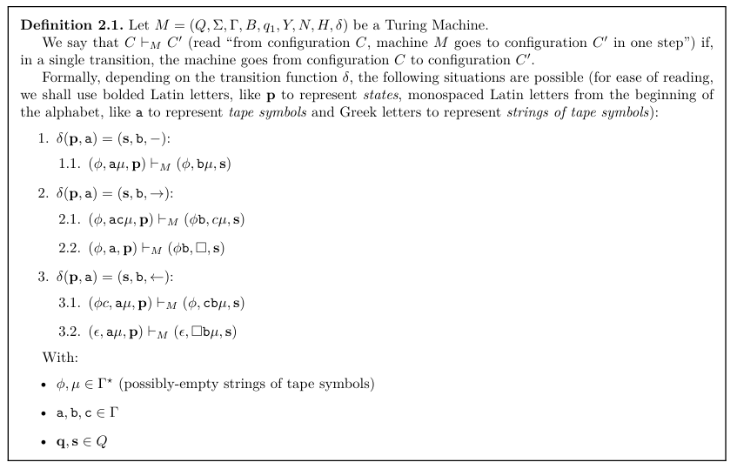

Slide 20
Exam (40p)
You need a minimum of 30 points in semester activities to take the exam
You need a minimum of 20 points on the exam in order to pass

