Slide 1

Recap
A problem is a function from strings to strings:
  $$f:Σ^{∗}→Σ^{∗}$$
A decision problem is a problem with a Boolean answer:
  $$f:Σ^{∗}→\{FALSE, TRUE\}$$
What is an algorithm?

Slide 2
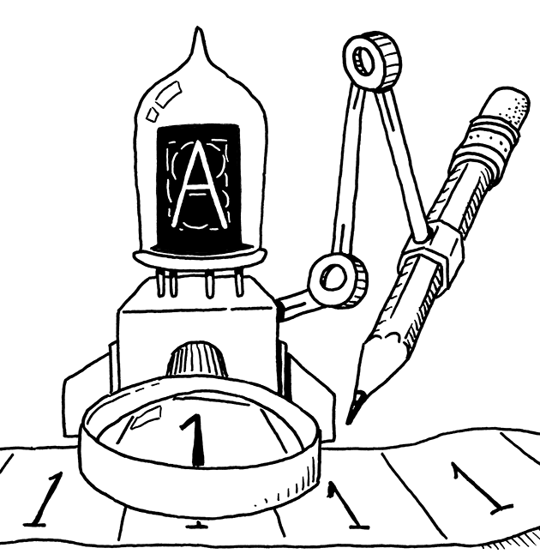
The Turing Machine
2
Analiza Algoritmilor

Slide 3
q

Slide 4
q
 |  |  |  |  |  |  |  | 1 | 0 | 0 | 1 | 1 | 1

Slide 5
H
r
 |  |  |  |  |  |  |  | 1 | 0 | 0 | 1 | 1 | 1
1
0
0
0

Slide 6

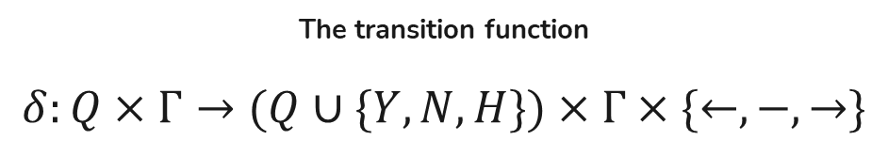
Formal definition
$$M=(Q, Σ,Γ,B,q_{1}, Y,N,H,δ)$$
The transition function
$$δ:Q×Γ→(Q∪\{Y, N, H\})×Γ×\{←, −, →\}$$
Finite set of states the machine “can be in”
The accepting state
The halting state
The rejecting state
The “blank” symbol
Finite set of symbols – the “tape alphabet”
Initial state
Finite set of symbols – the “input alphabet”

Slide 7
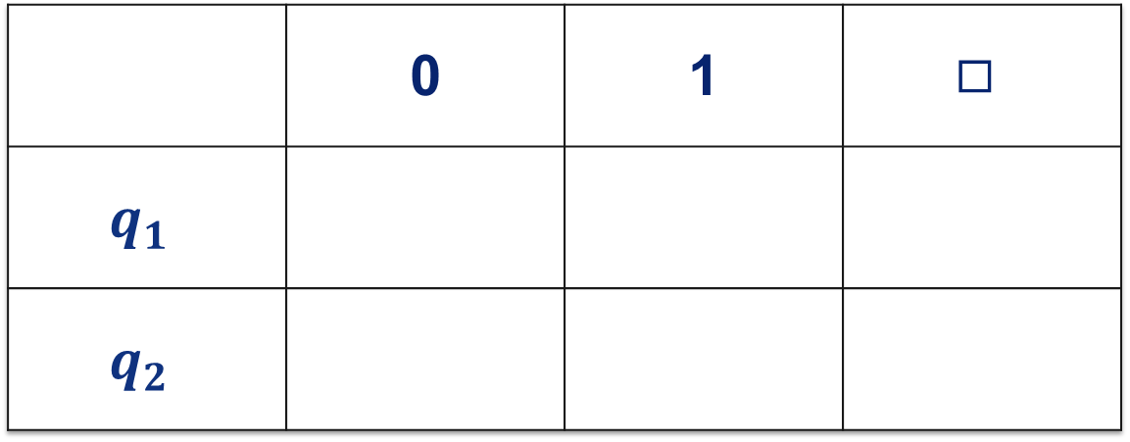
Checking if a number is even
 | 0 | 1 | $$◻$$
$$q_{1}$$
$$q_{2}$$

Slide 8
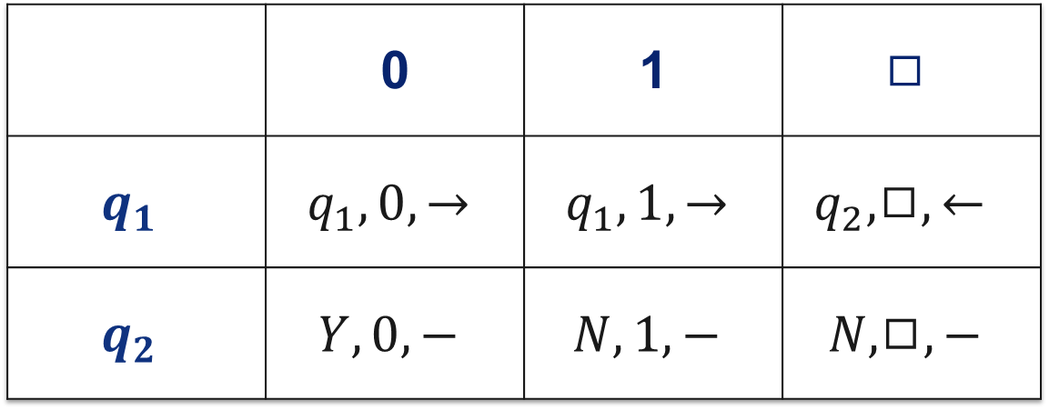
Checking if a number is even
 | 0 | 1 | $$◻$$
$$q_{1}$$ | $$q_{1}, 0, →$$ | $$q_{1}, 1, →$$ | $$q_{2},◻,←$$
$$q_{2}$$ | $$Y, 0, −$$ | $$N, 1, −$$ | $$N, ◻,−$$

Slide 9
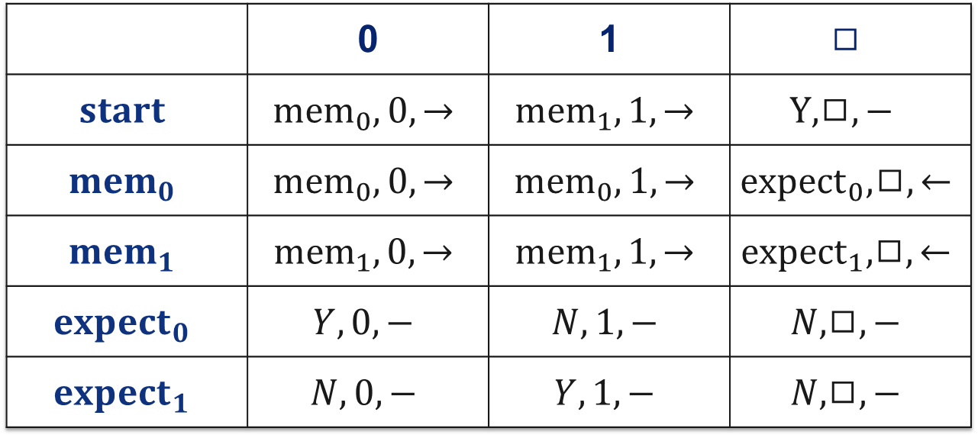
Using states as memory
 | 0 | 1 | $$◻$$
$$start$$ | $${mem}_{0}, 0, →$$ | $${mem}_{1}, 1, →$$ | $$Y,◻,−$$
$${mem}_{0}$$ | $${mem}_{0}, 0, →$$ | $${mem}_{0}, 1, →$$ | $${expect}_{0}, ◻,←$$
$${mem}_{1}$$ | $${mem}_{1}, 0, →$$ | $${mem}_{1}, 1, →$$ | $${expect}_{1}, ◻,←$$
$${expect}_{0}$$ | $$Y, 0, −$$ | $$N, 1, −$$ | $$N, ◻,−$$
$${expect}_{1}$$ | $$N, 0, −$$ | $$Y, 1, −$$ | $$N, ◻,−$$

Slide 10
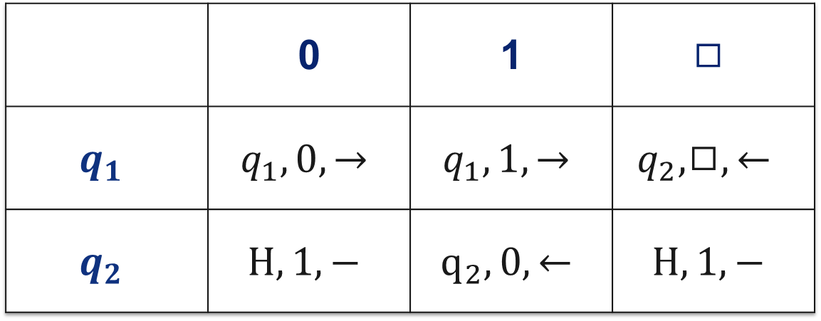
Incrementing a number
 | 0 | 1 | $$◻$$
$$q_{1}$$ | $$q_{1}, 0, →$$ | $$q_{1}, 1, →$$ | $$q_{2},◻,←$$
$$q_{2}$$ | $$H, 1, −$$ | $$q_{2}, 0, ←$$ | $$H, 1,−$$

Slide 11
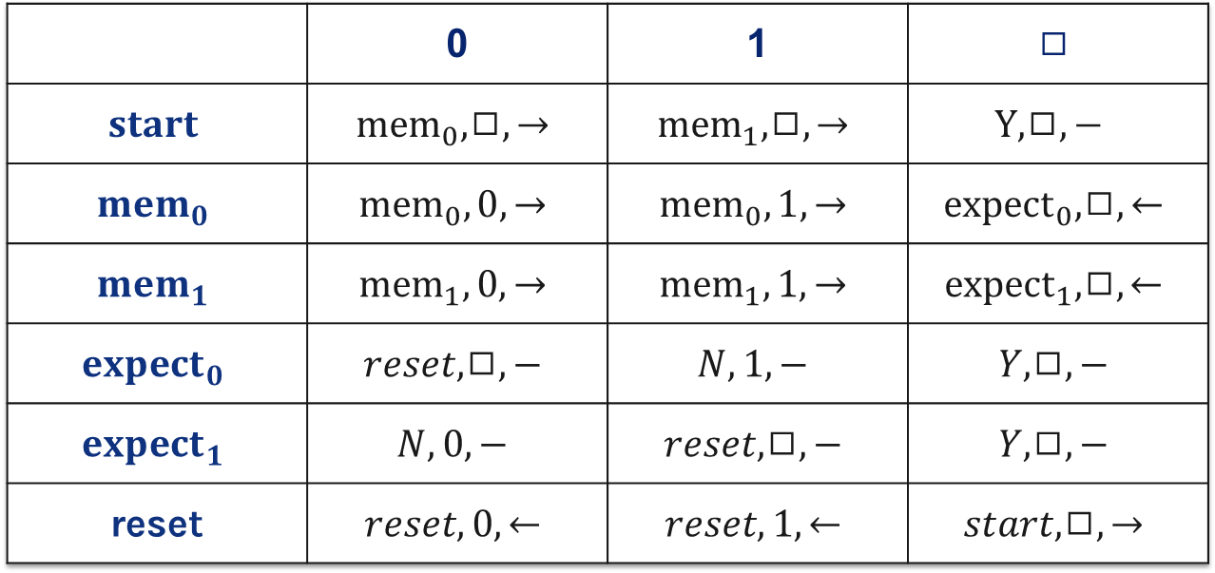
Checking for palindromes
 | 0 | 1 | $$◻$$
$$start$$ | $${mem}_{0},◻, →$$ | $${mem}_{1},◻, →$$ | $$Y,◻,−$$
$${mem}_{0}$$ | $${mem}_{0}, 0, →$$ | $${mem}_{0}, 1, →$$ | $${expect}_{0}, ◻,←$$
$${mem}_{1}$$ | $${mem}_{1}, 0, →$$ | $${mem}_{1}, 1, →$$ | $${expect}_{1}, ◻,←$$
$${expect}_{0}$$ | $$reset,◻, −$$ | $$N, 1, −$$ | $$Y, ◻,−$$
$${expect}_{1}$$ | $$N, 0, −$$ | $$reset,◻, −$$ | $$Y, ◻,−$$
reset | $$reset,0,←$$ | $$reset,1,←$$ | $$start,◻,→$$

Slide 12
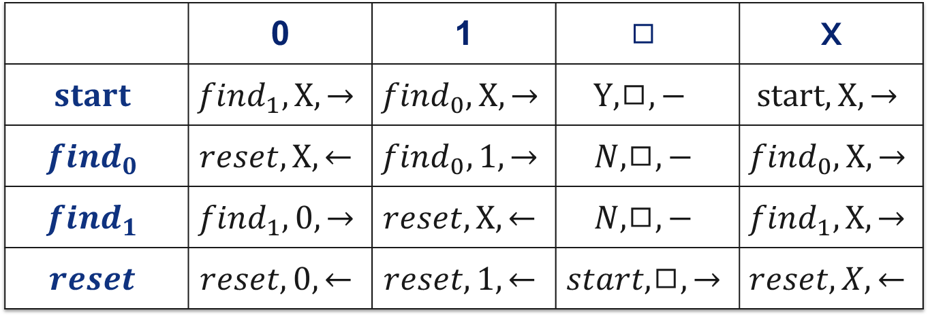
Same number of 0s and 1s
 | 0 | 1 | $$◻$$ | X
$$start$$ | $${find}_{1}, X, →$$ | $${find}_{0}, X, →$$ | $$Y,◻,−$$ | $$start,X,→$$
$${find}_{0}$$ | $$reset, X, ←$$ | $${find}_{0}, 1, →$$ | $$N, ◻,−$$ | $${find}_{0}, X, →$$
$${find}_{1}$$ | $${find}_{1}, 0, →$$ | $$reset, X, ←$$ | $$N, ◻,−$$ | $${find}_{1}, X, →$$
$$reset$$ | $$reset,0,←$$ | $$reset,1,←$$ | $$start,◻,→$$ | $$reset,X,←$$

