Slide 1
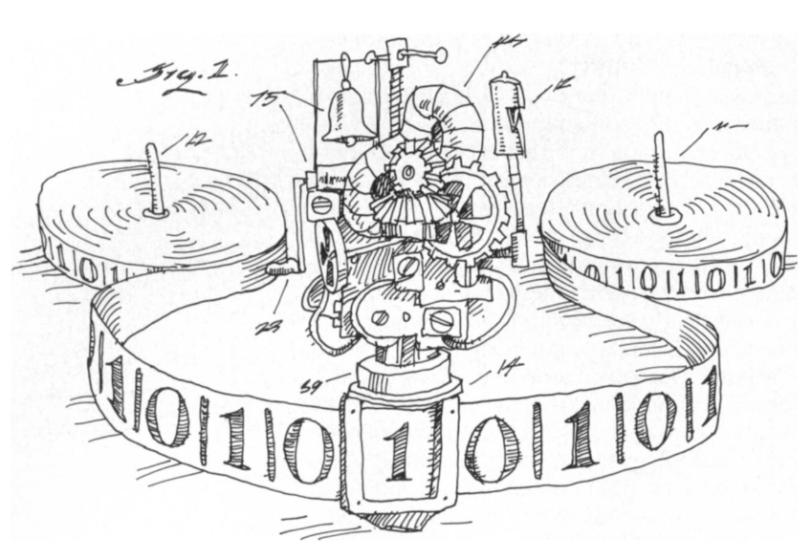
Computing
3
Analiza Algoritmilor

Slide 2
Contents
Possible results of running a Turing Machine
Configurations
Solving a problem:
  Computing
  Deciding
  Accepting
The Church-Turing thesis

Slide 3
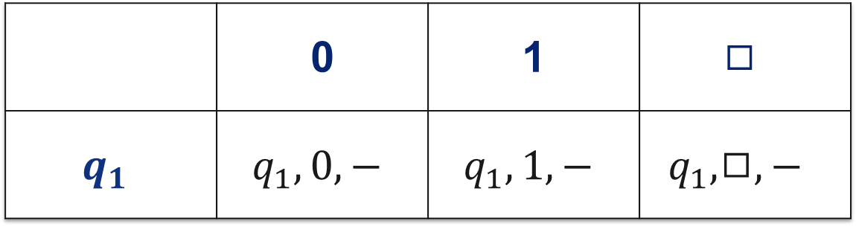
Doing nothing
 | 0 | 1 | $$◻$$
$$q_{1}$$ | $$q_{1}, 0, −$$ | $$q_{1}, 1, −$$ | $$q_{1},◻,−$$

Slide 4
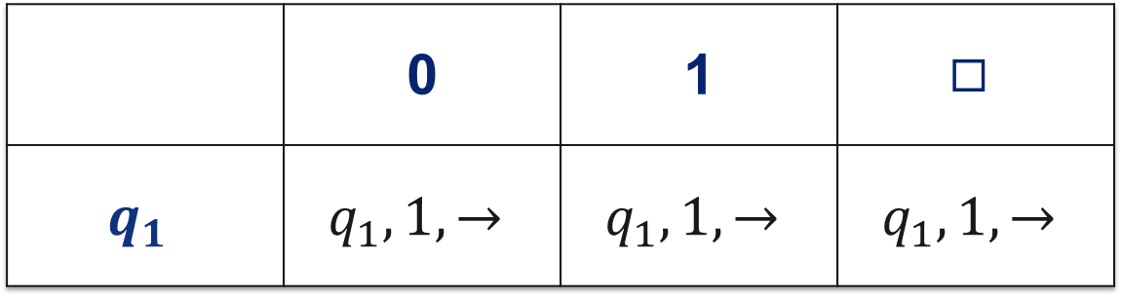
Writing 1 forever
 | 0 | 1 | $$◻$$
$$q_{1}$$ | $$q_{1}, 1, →$$ | $$q_{1}, 1, →$$ | $$q_{1},1,→$$

Slide 5
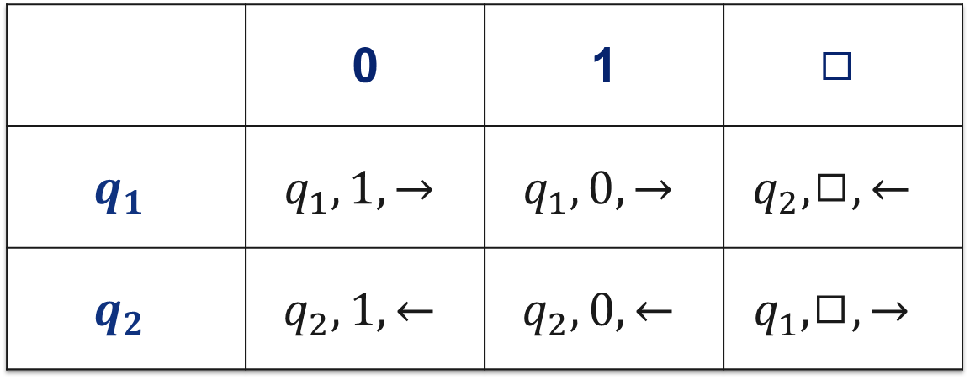
Flipping forever
 | 0 | 1 | $$◻$$
$$q_{1}$$ | $$q_{1}, 1, →$$ | $$q_{1}, 0, →$$ | $$q_{2},◻,←$$
$$q_{2}$$ | $$q_{2}, 1, ←$$ | $$q_{2}, 0, ←$$ | $$q_{1},◻,→$$

Slide 6
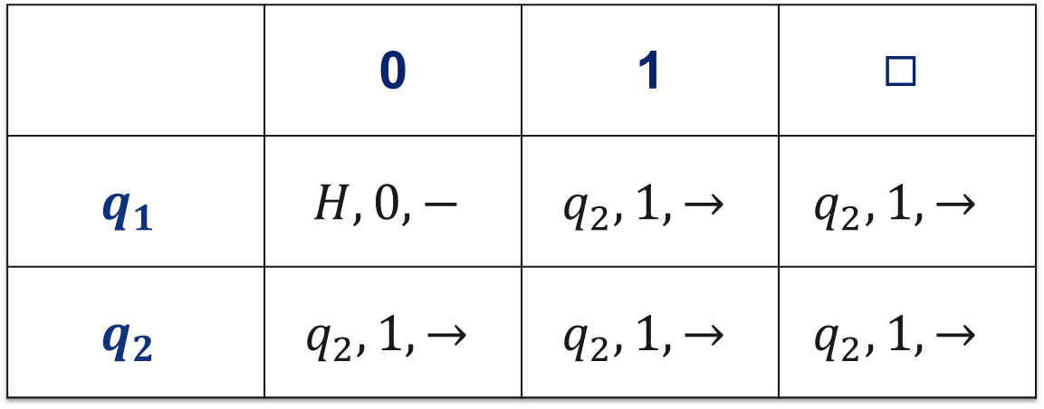
Halting on some inputs
 | 0 | 1 | $$◻$$
$$q_{1}$$ | $$H, 0, −$$ | $$q_{2}, 1, →$$ | $$q_{2},1,→$$
$$q_{2}$$ | $$q_{2}, 1, →$$ | $$q_{2}, 1, →$$ | $$q_{2},1,→$$

Slide 7

When a machine runs…
…it can eventually halt in one of the final states: $Y, N, H$
…it can go on forever, without halting
$$M\left[1001\right]→⊥$$

Slide 8
Configurations
q
q
 |  |  |  |  |  |  |  | 1 | 0 | 0 | 1 | 1 | 0 | 1
1
0
0
1
1
0
1
(100, 1101, q)

Slide 9
From one configuration to another
q
 |  |  |  |  |  |  |  | 1 | 0 | 0 | 1
(100, 1, q)
($ε$, 1001, q)
(1, 001, q)
(10, 01, q)
(1001,$◻$, q)
Notes:
Write configurations live on the blackboard for input 110

Slide 10
From one configuration to another
r
 |  |  |  |  |  |  |  | 1 | 0 | 0 | 1
0
(1001,$◻$, q)
(100, 1, r)
(10, 00, r)
Notes:
Write configurations live on the blackboard for input 110

Slide 11
From one configuration to another
s
 |  |  |  |  |  |  |  | 1 | 0 | 0 | 1
1
0
($ε$, 1010, r)
(1, 010, s)
($ε$, $◻$1010, s)
Notes:
Write configurations live on the blackboard for input 110

Slide 12
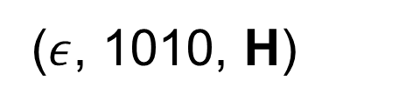
From one configuration to another
H
 |  |  |  |  |  |  |  | 1 | 0 | 0 | 1
1
0
($ε$, $◻$1010, s)
($ε$, 1010, H)
Notes:
Write configurations live on the blackboard for input 110

Slide 13
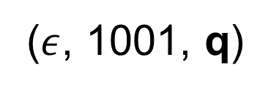
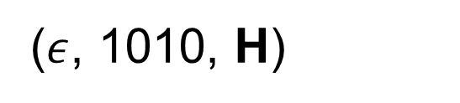
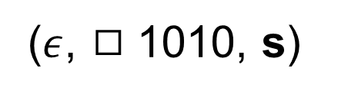
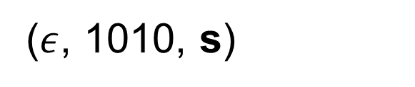

($ε$, 1001, q)
(10, 00, r)
(1, 001, q)
(1, 010, s)
(10, 01, q)
($ε$, 1010, s)
(100, 1, q)
($ε$, $◻$1010, s)
(1001,$◻$, q)
($ε$, 1010, H)
(100, 1, r)
Notes:
Formal information about the triplet members written on the blackboard live

Slide 14


One step
$$C⊢_{M}C′$$
“From configuration $C$, machine $M$ goes to configuration $C′$ in one step.”

Slide 15

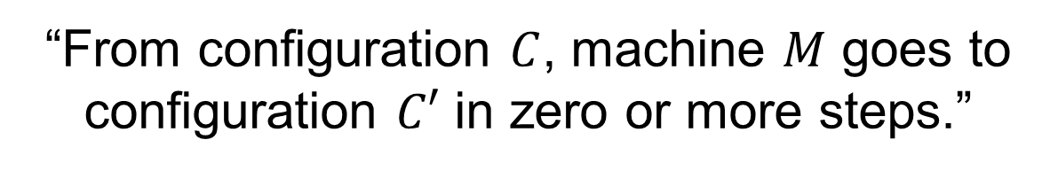
Zero or more steps
$$C⊢_{M}^{∗}C′$$
“From configuration $C$, machine $M$ goes to configuration $C′$ in zero or more steps.”

Slide 16
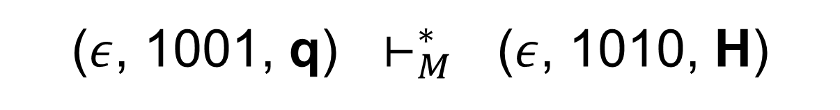

Computing an output
($ε$, 1001, q) $⊢_{M}^{∗}$ ($ε$, 1010, H)
$$M\left[1001\right]→1010$$
“On input 1001, $M$ computes output 1010”
Notes:
Formal information about the triplet members written on the blackboard live

Slide 17
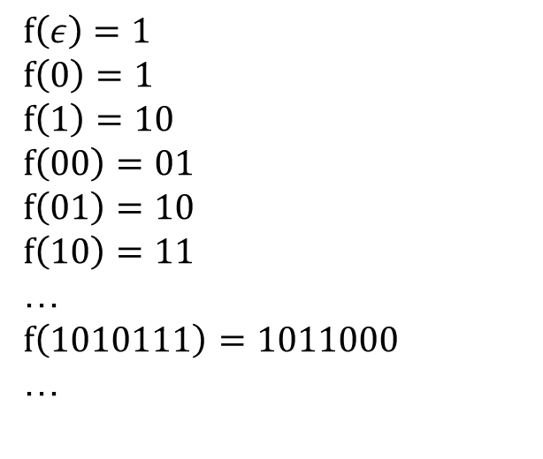
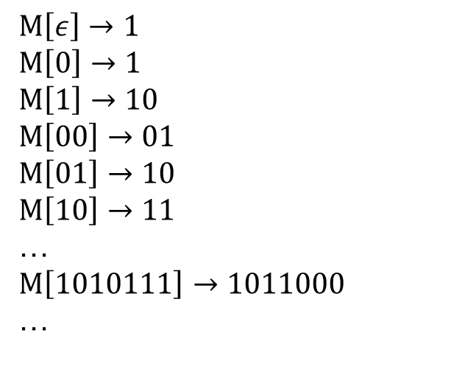
Computing a function
$$f\left(ε\right)=1$$
$$f\left(0\right)=1$$
$$f\left(1\right)=10$$
$$f\left(00\right)=01$$
$$f\left(01\right)=10$$
$$f\left(10\right)=11$$
…
$$f\left(1010111\right)=1011000$$
…
$$M\left[ε\right]→1$$
$$M\left[0\right]→1$$
$$M\left[1\right]→10$$
$$M\left[00\right]→01$$
$$M\left[01\right]→10$$
$$M\left[10\right]→11$$
…
$$M\left[1010111\right]→1011000$$
…
$$M computes f$$
Notes:
Formal information about the triplet members written on the blackboard live

Slide 18
Computable functions
$$f is computable ≝∃M, s.t. M computes f$$
Notes:
Formal information about the triplet members written on the blackboard live

Slide 19
Accepting an input
q
 |  |  |  |  |  |  |  | 1 | 0 | 0 | 0 | 1 | 0

Slide 20

Accepting an input
Y
e0
 |  |  |  |  |  |  |  | 1 | 0 | 0 | 0 | 1 | 0
$$M\left[100010\right]→TRUE$$
“$M$ accepts input 100010”

Slide 21
Rejecting an input
q
 |  |  |  |  |  |  |  | 1 | 1 | 1 | 0 | 0 | 1

Slide 22

Rejecting an input
N
e0
 |  |  |  |  |  |  |  | 1 | 1 | 1 | 0 | 0 | 1
$$M[111001]→FALSE$$
“$M$ rejects input 111001”

Slide 23
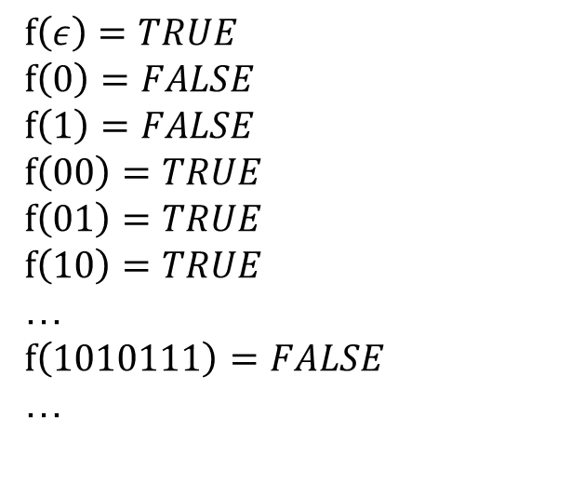
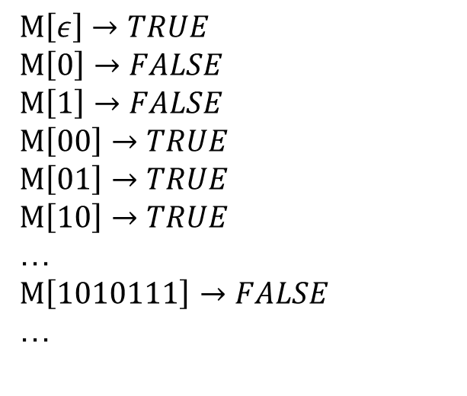
Deciding a function
$$f\left(ε\right)=TRUE$$
$$f\left(0\right)=FALSE$$
$$f\left(1\right)=FALSE$$
$$f\left(00\right)=TRUE$$
$$f\left(01\right)=TRUE$$
$$f\left(10\right)=TRUE$$
…
$$f\left(1010111\right)=FALSE$$
…
$$M\left[ε\right]→TRUE$$
$$M\left[0\right]→FALSE$$
$$M\left[1\right]→FALSE$$
$$M\left[00\right]→TRUE$$
$$M\left[01\right]→TRUE$$
$$M\left[10\right]→TRUE$$
…
$$M\left[1010111\right]→FALSE$$
…
$$M decides f$$
Notes:
Formal information about the triplet members written on the blackboard live

Slide 24
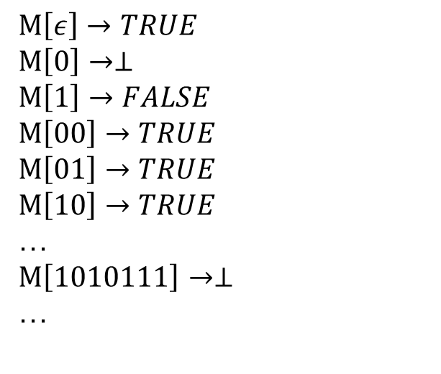
Accepting a function
$$f\left(ε\right)=TRUE$$
$$f\left(0\right)=FALSE$$
$$f\left(1\right)=FALSE$$
$$f\left(00\right)=TRUE$$
$$f\left(01\right)=TRUE$$
$$f\left(10\right)=TRUE$$
…
$$f\left(1010111\right)=FALSE$$
…
$$M\left[ε\right]→TRUE$$
$$M\left[0\right]→⊥$$
$$M\left[1\right]→FALSE$$
$$M\left[00\right]→TRUE$$
$$M\left[01\right]→TRUE$$
$$M\left[10\right]→TRUE$$
…
$$M\left[1010111\right]→⊥$$
…
$$M accepts f$$
Notes:
Formal information about the triplet members written on the blackboard live

Slide 25
Types of decision problems
$$f is acceptable≝∃M, s.t. M accepts f$$
$$f is decidable≝∃M, s.t. M decides f$$
Notes:
Formal information about the triplet members written on the blackboard live

Slide 26



The sets $RE, R$
$$RE= \{f∣f is acceptable\}$$
$$R= \{f∣f is decidable\}$$
RE
Pairs
Decoding
R
Notes:
Formal information about the triplet members written on the blackboard live

Slide 27
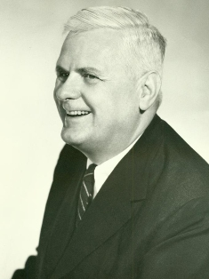
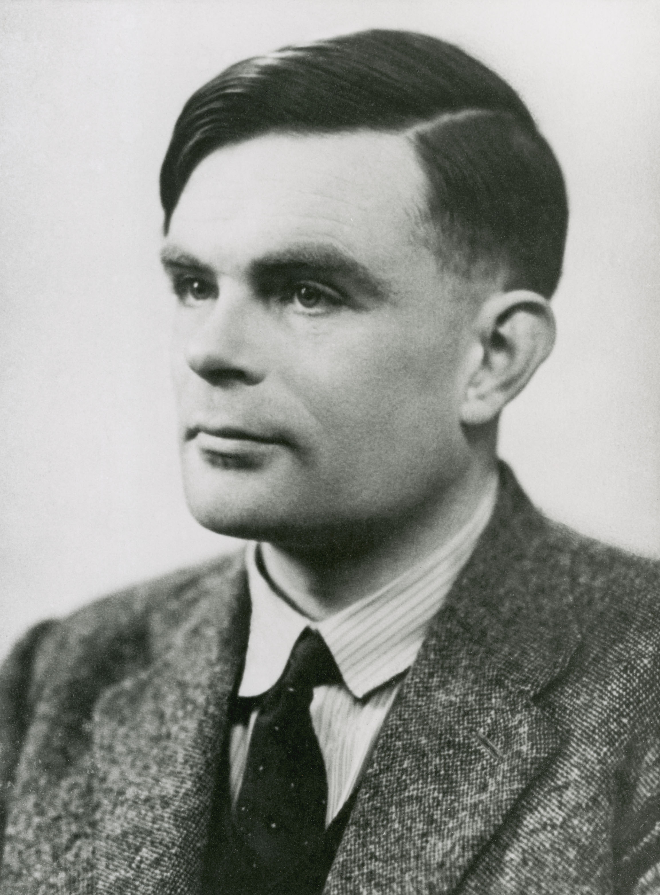
The Church-Turing thesis
“The problems solvable by algorithms
are those
computable by Turing machines.”
Alonzo Church
(1903 – 1995)
Alan Turing
(1912 – 1954)

Slide 28

All roads lead to $R$
Recursive functions
λ-calculus
Turing machines
Markov algorithms
RAM machines
Queue automata
Counter machines
Post canonical system
Wang B-machine
Uniform Boolean circuits

