Slide 1









Recap
$$(ε, 101, q_{1})$$
$$⊢_{M}(1, 01,r)$$
$$⊢_{M}(ε, 101,Y)$$
Configurations
Computing an output
Accepting/Rejecting an input
Computing a problem
Deciding a problem
Accepting a problem
R and RE
CTT: “Algorithmically solvable = Turing computable/decidable”
$$M\left[w\right]→v$$
$$M\left[w\right]→TRUE$$
$$M\left[w\right]→FALSE$$
$$∀w,M\left[w\right]→f(w)$$
$$∀w,\left(M\left[w\right]→TRUE⇔f\left(w\right)=TRUE\right)∧ \left(M\left[w\right]→FALSE⇔f\left(w\right)=FALSE\right)$$
$$∀w,M\left[w\right]→TRUE⇔f\left(w\right)=TRUE$$

Slide 2
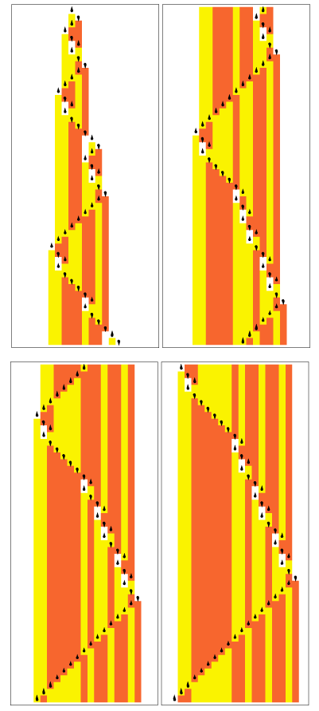
The Universal Turing Machine
4
Analiza Algoritmilor

Slide 3
Contents
Multitape Turing Machines
  Vizualization
  Definition
  Examples
  Equivalence with single-tape Turing Machines
Encoding Turing Machines
  The binary alphabet is enough
The Universal Turing Machine

Slide 4
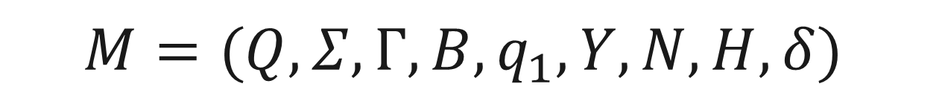
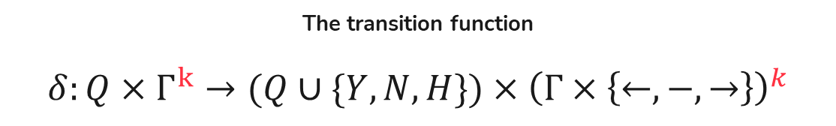
Formal definition
$$M=(Q, Σ,Γ,B,q_{1}, Y,N,H,δ)$$
The transition function
$$δ:Q×Γ^{k}→(Q∪\{Y, N, H\})×{\left(Γ×\left\{←, −, →\right\}\right)}^{k}$$
Same as for a single-tape Turing machine

Slide 5
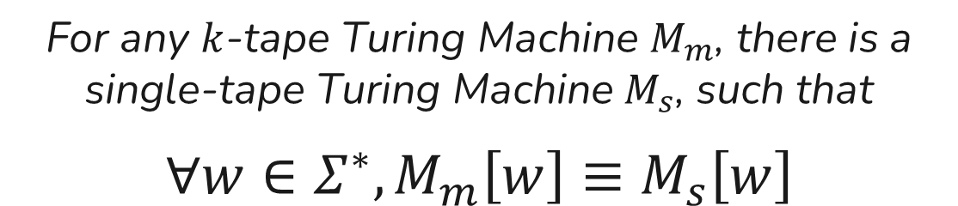
Equivalence with single-tape TMs
For any $k$-tape Turing Machine $M_{m}$, there is a single-tape Turing Machine$M_{s}$, such that
$∀w∈Σ^{∗}, M_{m}\left[w\right]≡M_{s}\left[w\right]$

Slide 6




q
 |  |  |  |  |  |  |  |  |  |  |  |  |  | 1 | 2 | e | r
1
2
e
r
 |  |  |  |  |  |  |  |  |  |  |  |  |  | 4 | U | u
4
U
u
 |  |  |  |  |  |  |  |  |  |  |  |  |  | 7 | 7 | 6
7
7
6
$$⋄$$
$$⋄$$
$$⋄$$
$$⋄$$
□
□
U
7

Slide 7








q
s
 |  |  |  |  |  |  |  |  |  |  |  |  |  | 1 | 2 | e | r
1
2
e
r
 |  |  |  |  |  |  |  |  |  |  |  |  |  | 4 | U | u
4
t
u
 |  |  |  |  |  |  |  |  |  |  |  |  |  | 7 | 7 | 6
8
7
6
$$δ(q, \left(\text{□}\text{, }\text{U}\text{, }\text{7}\text{)) = (}\text{s}\text{, ((□, }←\right), \left(t, −\right),\left(8, →\right))$$
$$⋄$$
$$⋄$$
$$⋄$$
$$⋄$$
 |  |  |  |  |  |  |  |  |  |  |  |  | 1 | 2 | e | r |  |  | 4 |  | u |  |  | 7 | 6
□
□
U
7
r
□
t
8
7
s
s¹_$\text{□}\text{_}\text{U}\text{_}\text{7}$
s²_$\text{□}\text{_}\text{U}\text{_}\text{7}$
auxL_s¹_$\text{□}\text{_}\text{U}\text{_}\text{7}$
q_$\text{□}\text{_}\text{U}$
s³_$\text{□}\text{_}\text{U}\text{_}\text{7}$
q_$\text{□}\text{_}\text{U}\text{_}\text{7}$
q
q_$\text{□}$
auxR_s³_$\text{□}\text{_}\text{U}\text{_}\text{7}$

Slide 8





q
s
 |  |  |  |  |  |  |  |  |  |  |  |  |  | 1 | 2 | e | r
1
2
e
r
 |  |  |  |  |  |  |  |  |  |  |  |  |  | 4 | U | u
4
t
u
 |  |  |  |  |  |  |  |  |  |  |  |  |  | 7 | 7 | 6
8
7
6
$$δ(q, \left(\text{□}\text{, }\text{U}\text{, }\text{7}\text{)) =(}\text{s}\text{, ((□, }→\right), \left(t, −\right),\left(8, ←\right))$$
$$⋄$$
$$⋄$$
$$⋄$$
$$⋄$$
 |  |  |  |  |  |  |  |  |  |  |  |  | 1 | 2 | e | r |  |  | 4 |  | u
□
□
U
□
□
7
6
7
8
s³_$\text{□}\text{_}\text{U}\text{_}\text{7}$_shift
s²_$\text{□}\text{_}\text{U}\text{_}\text{7}$
s³_$\text{□}\text{_}\text{U}\text{_}\text{7}$
auxL_s³_$\text{□}\text{_}\text{U}\text{_}\text{7}$

Slide 9

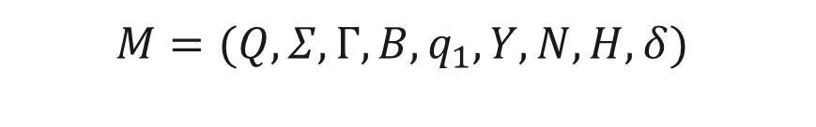
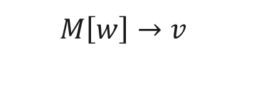

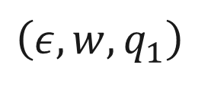



UTM - definition
$$w∈Σ^{∗}$$
$$M=(Q, Σ,Γ,B,q_{1}, Y,N,H,δ)$$
$$w∈Σ^{∗}$$
$$\left(ε, w, q_{1}\right)⊢_{M}^{∗} (ε, v, H)$$
$$M\left[w\right]→v$$
$$M\left[w\right]→FALSE$$
$$M\left[w\right]→TRUE$$
$$\left(ε, w, q_{1}\right)$$
$$M\left[w\right]→⊥$$
w
q₁
Notes:
Formal information about the triplet members written on the blackboard live

Slide 10






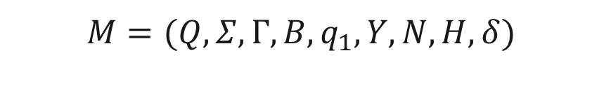

UTM - definition
$$w∈Σ^{∗}$$
$$M=(Q, Σ,Γ,B,q_{1}, Y,N,H,δ)$$
$$w∈Σ^{∗}$$
$$M=(Q, Σ,Γ,B,q_{1}, Y,N,H,δ)$$
$$M\left[w\right]→v$$
$$U[\left(M, w\right)]→v$$
$$M\left[w\right]→FALSE$$
$$U\left[\left(M, w\right)\right]≡M[w]$$
$$U[\left(M,w\right)] →FALSE$$
$$M\left[w\right]→TRUE$$
$$U[\left(M,w\right)]→TRUE$$
$$M\left[w\right]→⊥$$
$$U[\left(M,w\right)]→⊥$$
M
w
q
Notes:
Formal information about the triplet members written on the blackboard live

Slide 11

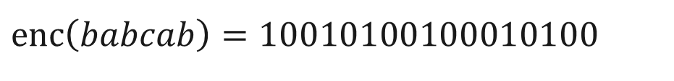
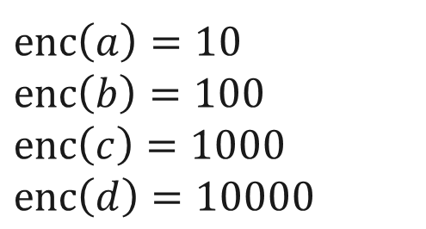

Dealing with different alphabets
$$Σ=\{a, b, c, d\}$$
$$Σ_{b}=\{0,1\}$$
$$enc\left(a\right)=10$$
$$enc\left(b\right)=100$$
$$enc\left(c\right)=1000$$
$$enc\left(d\right)=10000$$
$$enc\left(babcab\right)=10010100100010100$$
Notes:
Formal information about the triplet members written on the blackboard live

Slide 12

q
r
 |  |  |  |  |  |  |  |  |  |  |  |  |  | a | a | b | d
a
$$δ\left(q, b\right)=(r,a,→)$$
 |  |  |  |  |  |  |  |  |  |  |  |  | 1 | 0 | 1 | 0 | 1 | 0 | 0 | 1 | 0 | 0 | 0 | 0
q
q_a
q_b
r_a_ $→$_delete

Slide 13




r
 |  |  |  |  |  |  |  |  |  |  |  |  |  | a | a | a | d
$$δ\left(q, b\right)=(r,a,→)$$
 |  |  |  |  |  |  |  |  |  |  |  |  | 1 | 0 | 1 | 0 | 1 | 0 | 0
0
1
0
0
0
0
q
q_a
q_b
r_a_ $→$
r_a_ $→$_delete
r_a_ $→$_insert
r_$→$
r

Slide 14


Encoding machines for the
Universal Turing Machine
$$1010010110101101000101010100101001$$
$$1110110001010010010010001001000001$$
$$M=(Q, Σ,Γ,B,q_{1}, Y,N,H,δ)$$

Slide 15
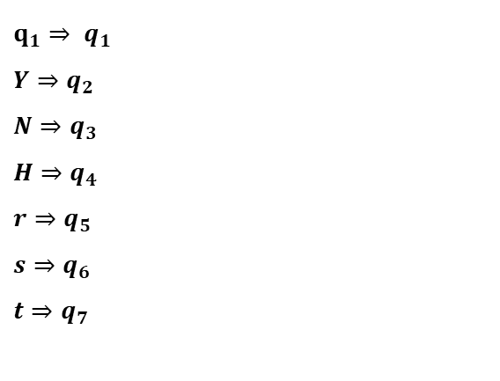
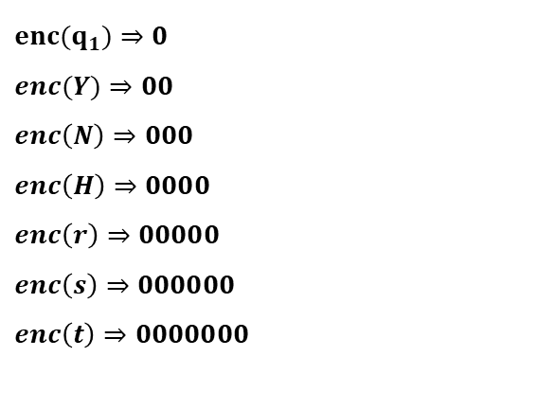
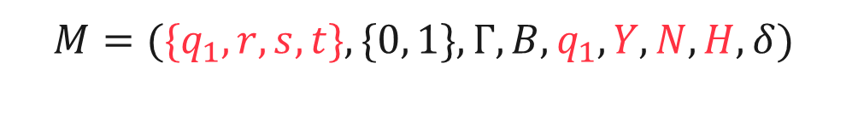
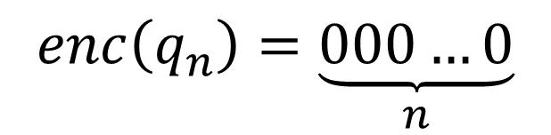
Encoding states
$$M=(\{q_{1}, r, s, t\}, \{0, 1\},Γ,B,q_{1}, Y,N,H,δ)$$
$$q_{1}⇒ q_{1}$$
$$Y⇒q_{2}$$
$$N⇒q_{3}$$
$$H⇒q_{4}$$
$${r⇒q}_{5}$$
$${s⇒q}_{6}$$
$$t{⇒q}_{7}$$
$${enc(q}_{1})⇒0$$
$$enc(Y)⇒00$$
$$enc\left(N\right)⇒000$$
$$enc\left(H\right)⇒0000$$
$$enc\left(r\right)⇒00000$$
$$enc\left(s\right)⇒000000$$
$$enc\left(t\right)⇒0000000$$
$$enc\left(q_{n}\right)=\underset{n}{\underbrace{000…0}}$$
Notes:
Formal information about the triplet members written on the blackboard live

Slide 16
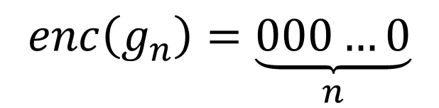
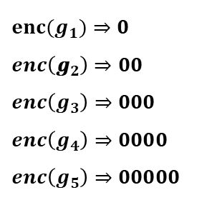
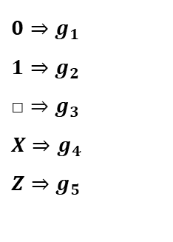
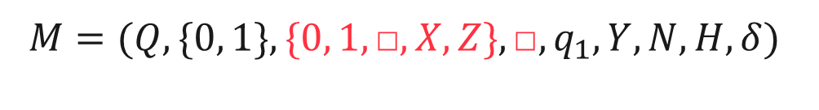
Encoding tape symbols
$$M=(Q, \{0, 1\},\{0, 1,\text{□}, X, Z\},\text{□},q_{1}, Y,N,H,δ)$$
$$0⇒g_{1}$$
$$1⇒g_{2}$$
$$\text{□}⇒g_{3}$$
$$X⇒g_{4}$$
$${Z⇒g}_{5}$$
$${enc(g}_{1})⇒0$$
$$enc\left({\text{g}}_{2}\right)⇒00$$
$$enc\left(g_{3}\right)⇒000$$
$$enc\left(g_{4}\right)⇒0000$$
$$enc\left(g_{5}\right)⇒00000$$
$$enc\left(g_{n}\right)=\underset{n}{\underbrace{000…0}}$$
Notes:
Formal information about the triplet members written on the blackboard live

Slide 17
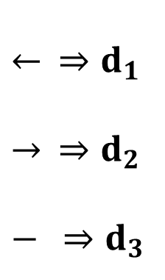
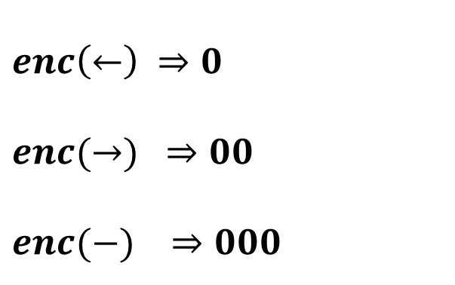
Encoding head movement directions
$← ⇒d_{1}$
$$→ ⇒d_{2}$$
$$− ⇒d_{3}$$
$$enc\left(←\right) ⇒0$$
$$enc(→) ⇒00$$
$$enc(−) ⇒000$$
Notes:
Formal information about the triplet members written on the blackboard live

Slide 18


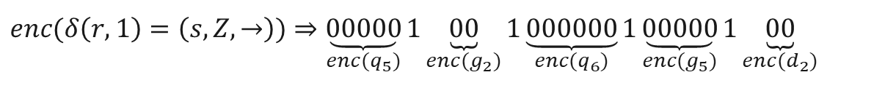
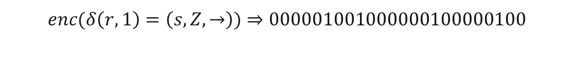

Encoding transitions
$$M=(Q, \{0, 1\},Γ,B,q_{1}, Y,N,H,δ)$$
$$δ\left(r, 1\right)=\left(s, Z,→\right)$$
$$⇒ δ\left(q_{5},g_{2}\right)=(q_{6}, g_{5},d_{2})$$
$$enc(δ\left(r, 1\right)=\left(s, Z,→\right))⇒\underset{enc(q_{5})}{\underbrace{00000}}1\underset{enc(g_{2})}{\underbrace{00}}1\underset{enc(q_{6})}{\underbrace{000000}}1\underset{enc(g_{5})}{\underbrace{00000}}1\underset{enc(d_{2})}{\underbrace{00}}$$
$$enc(δ\left(r, 1\right)=\left(s, Z,→\right))⇒000001001000000100000100$$
Notes:
Formal information about the triplet members written on the blackboard live

Slide 19
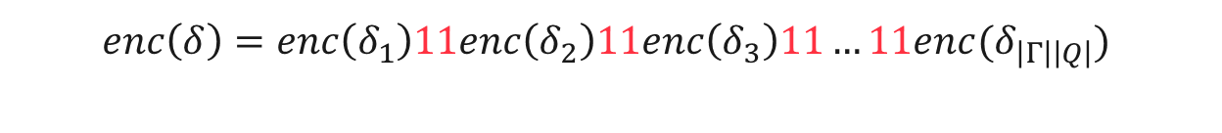
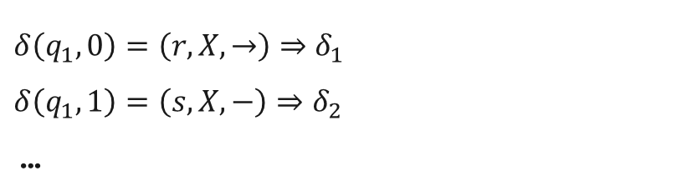
Encoding a transition function
$$M=(Q, \{0, 1\},Γ,B,q_{1}, Y,N,H,δ)$$
$$δ\left(q_{1}, 0\right)=\left(r, X,→\right)⇒δ_{1}$$
$$δ\left(q_{1}, 1\right)=\left(s, X,−\right)⇒δ_{2}$$
…
$$enc\left(δ\right)=enc\left(δ_{1}\right)11enc\left(δ_{2}\right)11enc\left(δ_{3}\right)11…11enc(δ_{\left|Γ\right|\left|Q\right|})$$
Notes:
Formal information about the triplet members written on the blackboard live

Slide 20



Input of a UTM
$$M=(Q, \{0, 1\},Γ,B,q_{1}, Y,N,H,δ)$$
$$enc\left(M\right)=enc\left(δ\right)$$
$$enc\left((M, w)\right)=enc\left(M\right)111w$$
Notes:
Formal information about the triplet members written on the blackboard live

Slide 21
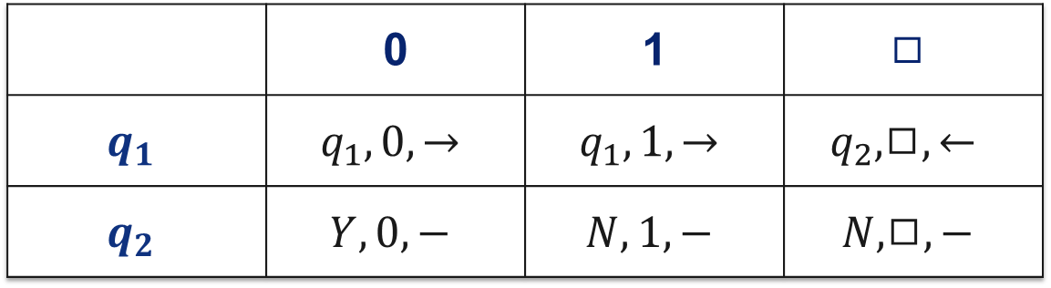
Example encoding - isEven
 | 0 | 1 | $$◻$$
$$q_{1}$$ | $$q_{1}, 0, →$$ | $$q_{1}, 1, →$$ | $$q_{2},◻,←$$
$$q_{2}$$ | $$Y, 0, −$$ | $$N, 1, −$$ | $$N, ◻,−$$

Slide 22


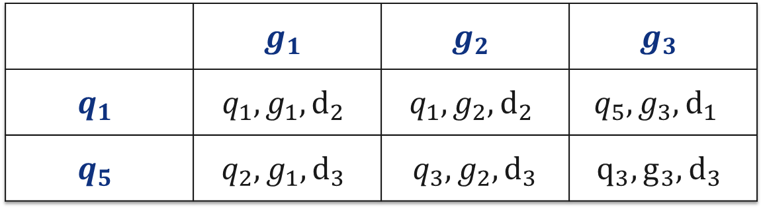








Example encoding - isEven
 | $$g_{1}$$ | $$g_{2}$$ | $$g_{3}$$
$$q_{1}$$ | $$q_{1},g_{1}, d_{2}$$ | $$q_{1},g_{2}, d_{2}$$ | $$q_{5},g_{3},d_{1}$$
$$q_{5}$$ | $$q_{2},g_{1}, d_{3}$$ | $q_{3},g_{2}, d_{3}$ | $$q_{3}, g_{3},d_{3}$$
$$enc\left(isEven\right)=$$
$$0101010100$$
$$11$$
$$010010100100$$
$$11$$
$$01000100000100010$$
$$11$$
$$11$$
$$000001000100010001000$$
$$11$$
$$0000010010001001000$$
$$0000010100101000$$
Notes:
Write configurations live on the blackboard for input 110

Slide 23
q₁
w
 |  |  |  |  |  |  |  |  |  |  |  |  |  |  |  |  |  |  | 1 | 1 | 1
enc(M)
enc(w)
enc(w)
enc(q₁)
find_transition
copy_input
init
reset

Slide 24
q_{j}
tape contents
 |  |  |  |  |  |  |  |  |  |  |  |  |  |  |  |  |  |  | 1 | 1 | 1
enc(M)
enc(w)
enc(tape contents)
enc(q_{j})
find_transition
copy_input
init
reset

Slide 25


r
 |  |  |  |  |  |  |  |  |  |  |  |  |  |  |  |  | Z | 0 | 1 | X | 1
$$δ\left(r,X\right)=( Y, 0,−)$$
$$δ\left(q_{5},g_{4}\right)=(q_{2}, g_{1},d_{3})$$
 |  |  |  |  |  |  |  | 0 | 1 | 1 | 0 | 0 | 0 | 0 | 0 | 1 | 0 | 0 | 0 | 0 | 1 | 0 | 0 | 1 | 0 | 1 | 0 | 0 | 0
 |  |  |  |  |  |  |  |  |  |  | 0 | 0 | 0 | 1 | 0 | 1 | 0 | 0 | 1 | 0 | 0 | 0 | 0 | 1 | 0 | 0 | 1
 |  |  |  |  |  |  |  |  |  |  |  | 0 | 0 | 0 | 0 | 0
delete_state
check_state
check_symbol
find_transition
go_to_symbol
copy_input
init
reset

Slide 26
r
 |  |  |  |  |  |  |  |  |  |  |  |  |  |  |  |  | Z | 0 | 1 | X | 1
$$δ\left(r,X\right)=( Y, 0,−)$$
$$δ\left(q_{5},g_{4}\right)=(q_{2}, g_{1},d_{3})$$
 |  |  |  |  |  |  |  | 0 | 1 | 1 | 0 | 0 | 0 | 0 | 0 | 1 | 0 | 0 | 0 | 0 | 1 | 0 | 0 | 1 | 0 | 1 | 0 | 0 | 0 | 1
 |  |  |  |  |  |  |  |  |  |  | 0 | 0 | 0 | 1 | 0 | 1 | 0 | 0 | 1 | 0 | 0 | 0 | 0
0
1
0
0
1
 |  |  |  |  |  |  |  |  |  |  |  | 0 | 0 | 0 | 0 | 0
0
0
move_head_00
delete_state
restart
copy_state
insert_symbol
check_state
move_head_0
check_symbol
move_head_000
delete_symbol
find_transition
go_to_symbol
copy_input
init
reset
move_head

