Slide 1

Recap
Multitape Turing Machines
  Can be simulated by a single-tape machine
Turing Machines with $Σ={\left\{0, 1\right\}}^{∗}$ can simulate other machines
Encoding Turing Machines as binary strings; $enc\left(M\right)=01010100100110…$
The Universal Turing Machine
  $U\left[enc\left(\left(M, w\right)\right)\right]≡M\left[w\right]$

Slide 2
Undecidable Problems
5
RE
R
Analiza Algoritmilor

Slide 3
Contents
Cardinality
  Even numbers
  Integers
  Binary strings
  Reals in [0, 1)
  Turing Machines
  Decision problems
There exist undecidable problems
The Halting Problem
  The Halting problem is undecidable
  The Halting problem is acceptable

Slide 4


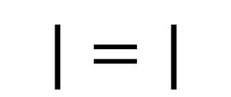
Cardinality
34
62
118
$$|$$
$$|=|$$
$$|$$
34
62
118

Slide 5


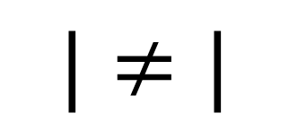
Cardinality (2)
a
b
c
d
$$|<|$$
$$|$$
$$|≤|$$
$$|$$
$$|≠|$$
a
b
c
d

Slide 6



Cardinality of infinite sets
$$ℕ$$
$$𝔼$$
0
1
2
3
4
5
6
7
8
9
…
0
2
4
6
8
10
12
14
16
18
…
$$\left|ℕ\right|=|𝔼|$$

Slide 7


Cardinality of the integers
$$ℕ$$
$ℤ$
0
1
2
3
4
5
6
7
8
9
…
…
-4
-3
-2
-1
0
1
2
3
4
-5
$$\left|ℕ\right|=|ℤ|$$
…

Slide 8



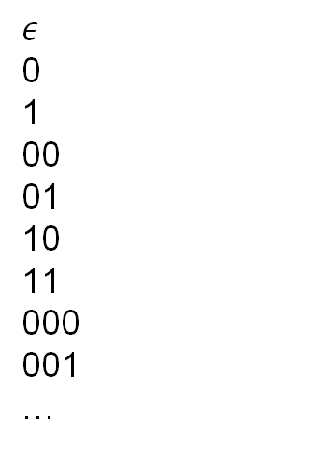
Cardinality of binary strings
$${\left\{0, 1\right\}}^{∗}$$
$$ℕ$$
$$ε$$
0
1
00
01
10
11
000
001
…
0
1
2
3
4
5
6
7
8
…
$${\left|\{0, 1\right\}}^{∗}|=\left|ℕ\right|$$

Slide 9


Cardinality of $[0, 1)$
0.2169460714693289171222729971066…
0.7631763176317631763176317631763…
0.6895404337592950674809357136346…
0.6895404337592950600000000000000…
0.3805454783500225038873577418048…
0.9200778257579442881690521804839…
0.3137692127249575025762653280831…
0.3700368070995432261445179661871…
0.2410751557594412258050924569386…
0
1
2
3
4
5
6
7
8
…
2
6
9
5
4
7
2
0
5
0.370658316…
0.269547205…
$$\left|ℕ\right|≠|[0, 1)|$$

Slide 10


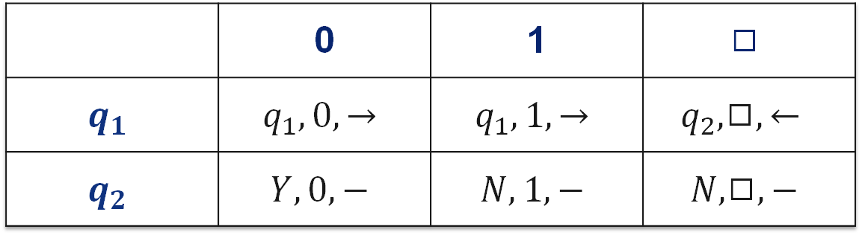








Cardinality of Turing Machines $𝕄$
 | 0 | 1 | $$◻$$
$$q_{1}$$ | $$q_{1}, 0, →$$ | $$q_{1}, 1, →$$ | $$q_{2},◻,←$$
$$q_{2}$$ | $$Y, 0, −$$ | $$N, 1, −$$ | $$N, ◻,−$$
$$enc\left(isEven\right)=$$
$$0101010100$$
$$11$$
$$010010100100$$
$$11$$
$$01000100000100010$$
$$11$$
$$11$$
$$000001000100010001000$$
$$11$$
$$0000010010001001000$$
$$0000010100101000$$
Notes:
Write configurations live on the blackboard for input 110

Slide 11
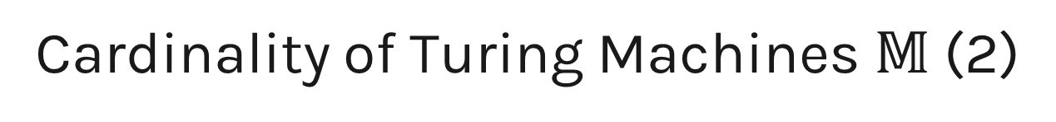

Cardinality of Turing Machines $𝕄$ (2)
$$M=(Q, Σ,Γ,B,q_{1}, Y,N,H,δ)$$
$$enc\left(M\right)∈{\{0, 1\}}^{∗}$$
$$\left|𝕄\right|≤|{\left\{0, 1\right\}}^{∗}|$$
Notes:
Write configurations live on the blackboard for input 110

Slide 12
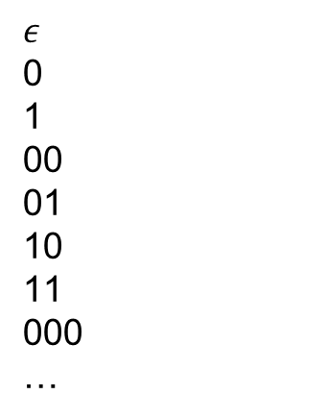
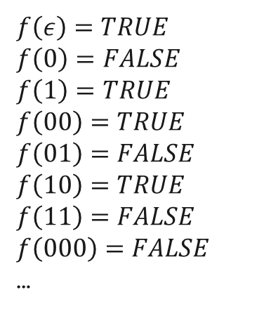
Representing a decision problem
$$f:{\{0, 1\}}^{∗}→\{FALSE, TRUE\}$$
$$ε$$
0
1
00
01
10
11
000
…
$$f\left(ε\right)=TRUE$$
$$f\left(0\right)=FALSE$$
$$f\left(1\right)=TRUE$$
$$f\left(00\right)=TRUE$$
$$f\left(01\right)=FALSE$$
$$f\left(10\right)=TRUE$$
$$f\left(11\right)=FALSE$$
$$f\left(000\right)=FALSE$$
…
1
0
1
1
0
1
0
0
…
10110100…

Slide 13


Cardinality of decision problems $𝔻$
0101010111011010101001001000100…
0110001001100110000100011100100…
0100101001000101111110100100010…
1111111011110111100001010001001…
1001100101011010110001000100001…
1001000111001000010010101101100…
0010100100100111000100001000101…
1100100010001000010001000100001…
1110110100010110001110001001000…
0
1
2
3
4
5
6
7
8
…
0
1
0
1
1
0
0
0
0
010110000…
101001111…
$$\left|ℕ\right|≠|𝔻|$$

Slide 14
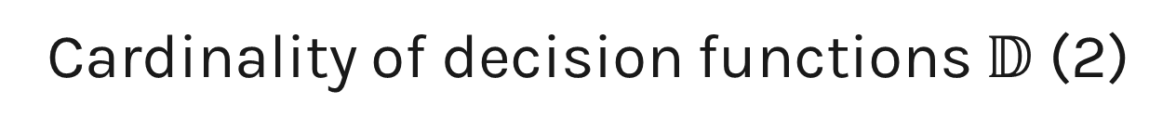

Cardinality of decision functions $𝔻$ (2)
0
1
2
3
4
5
6
7
8
…
0000000000000000000000000000000…
1000000000000000000000000000000…
1100000000000000000000000000000…
1110000000000000000000000000000…
1111000000000000000000000000000…
1111100000000000000000000000000…
1111110000000000000000000000000…
1111111000000000000000000000000…
1111111100000000000000000000000…
…
$$\left|ℕ\right|≤|𝔻|$$

Slide 15







Machines vs. decision problems
$$\left|𝕄\right|≤|{\left\{0, 1\right\}}^{∗}|$$
$$\left|𝕄\right|≤|ℕ|$$
$${\left|\{0, 1\right\}}^{∗}|=\left|ℕ\right|$$
$$\left|𝕄\right|<|𝔻|$$
$$\left|ℕ\right|≠|𝔻|$$
$$\left|ℕ\right|<|𝔻|$$
$$\left|ℕ\right|≤|𝔻|$$

Slide 16

There exist undecidable problems
(also unacceptable)
$$𝔻$$
RE
R

Slide 17
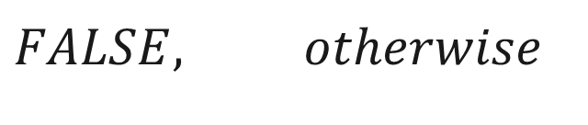
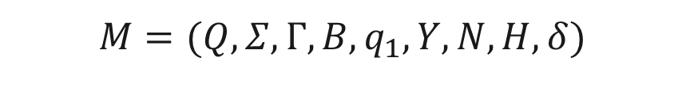
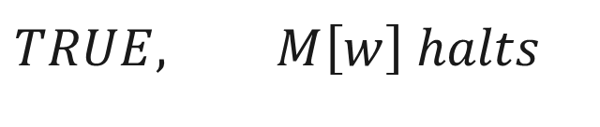
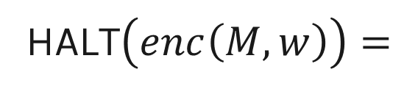


The Halting Problem
$$M=(Q, Σ,Γ,B,q_{1}, Y,N,H,δ)$$
$$w∈Σ^{∗}$$
$$M\left[w\right] halts?$$
$$TRUE, M\left[w\right] halts$$
HALT$\left(enc\left(M, w\right)\right)=$
$$FALSE, otherwise$$

Slide 18



HALT is undecidable
$$Assume HALT∈R$$
$$⇒∃M_{H}, M_{H} decides HALT$$
$$Construct machine D$$

Slide 19

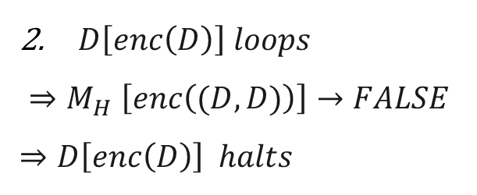
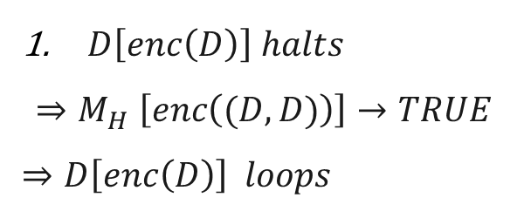
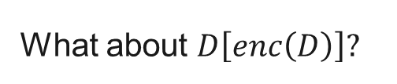
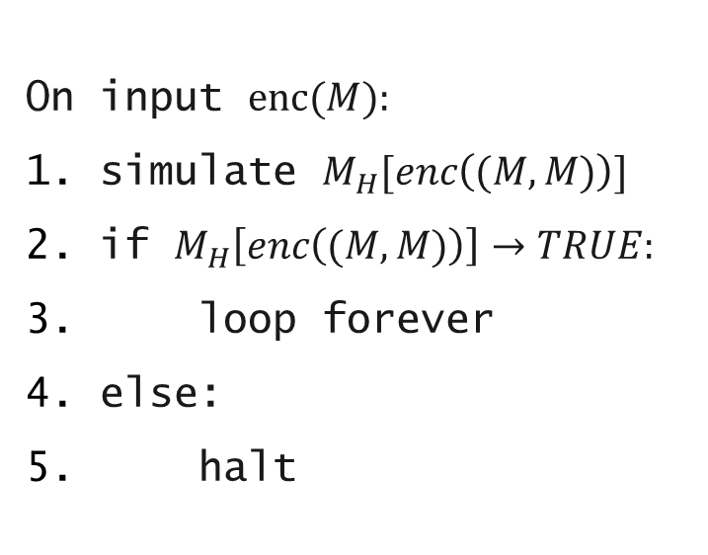
Behavior of $D$
On input $enc(M):$
simulate $M_{H}[enc\left((M, M)\right)]$
if $M_{H}\left[enc\left((M, M)\right)\right]→TRUE:$
loop forever
else:
halt
What about $D\left[enc\left(D\right)\right]?$
$D\left[enc\left(D\right)\right] loops$
  $${⇒M}_{H}\left[enc\left((D, D)\right)\right]→FALSE$$
  $⇒D\left[enc\left(D\right)\right] halts$
$D\left[enc\left(D\right)\right] halts$
  $${⇒M}_{H}\left[enc\left((D, D)\right)\right]→TRUE$$
  $⇒D\left[enc\left(D\right)\right] loops$

Slide 20


HALT is undecidable (2)
$$M_{H} cannot exist$$
$$HALT∉R$$

Slide 21
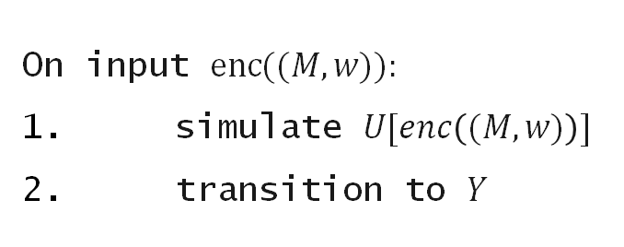

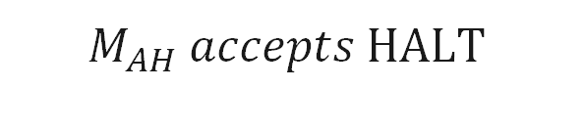

HALT is acceptable
$$Machine M_{AH}:$$
On input $enc((M, w)):$
simulate $U[enc\left((M, w)\right)]$
transition to $Y$
$$M_{AH} accepts HALT$$
$$HALT∈RE$$

Slide 22
$$HALT∈RE∖R$$
$$𝔻$$
HALT
RE
R

