Slide 1

Recap
Cardinality
$\left|𝕄\right|<\left|𝔻\right|$
There exist undecidable problems
The Halting Problem
  The Halting problem is undecidable
  The Halting problem is acceptable

Slide 2
Reductions
6
Analiza Algoritmilor

Slide 3

Contents
Reducing a problem to another
Mapping reducibility
Proving (un)decidability of new problems:
  ALL
  ANY
Complement of a problem
coRE
$ALL∉RE∪coRE$

Slide 4


String prefix
“Does string s begin with string p?”
s = 01011011
010
s = 1001101
p = 010
p = 0100
$$PREFIX∈R?$$

Slide 5
Substring
“Does string s contain string p?”
s = 010111011
110
s = 1110101
p = 110
p = 0110
$$SUBSTRING∈R?$$

Slide 6
Reducing SUBSTRING to PREFIX
010111011
10111011
0111011
s = 010111011
111011
11011
p = 110
“Does string 010111011 begin with string 110?”
“Does string 10111011 begin with string 110?”
“Does string 0111011 begin with string 110?”
“Does string 111011 begin with string 110?”
“Does string 11011 begin with string 110?”

Slide 7
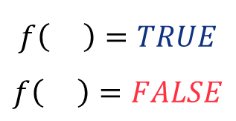



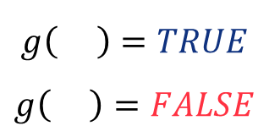
Mapping reductions
$$\{0, 1\}^{∗}$$
$$\{0, 1\}^{∗}$$
11100110
10110
10001
1
00
111
101
11
$$ε$$
0
010
1111
110
1110
110
0
$$f\left( \right)=TRUE$$
$$f\left( \right)=FALSE$$
$$g\left( \right)=TRUE$$
$$g\left( \right)=FALSE$$

Slide 8

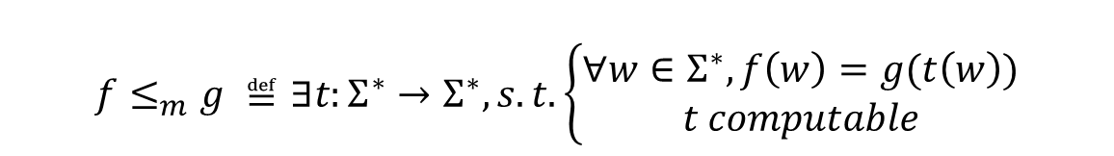




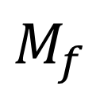
Mapping reductions (2)
$$f≤_{m}g ≝∃t:Σ^{∗}→Σ^{∗}, s.t. \left\{\begin{aligned}∀w∈Σ^{∗}, f\left(w\right)=g(t\left(w\right)) \\ t computable\end{aligned}\right.$$
$$M_{f}$$
$$M_{t}$$
$$M_{g}$$
$$w$$
$$t(w)$$
$$FALSE/TRUE$$

Slide 9







“Hardness”
$$f≤_{m}g$$
$f$is either “easier” or “as hard as”$g$
$$𝔻$$
R
$$f$$
RE
RE \ R
$$g$$
R
$$g$$
$𝔻∖$ RE
$$g$$

Slide 10




“Hardness”
$$f≤_{m}g$$
$f$is either “easier” or “as hard as”$g$
$$𝔻$$
R
$$f$$
$$g$$
RE
$$f$$
$$f$$
RE \ R
R
$𝔻∖$ RE

Slide 11
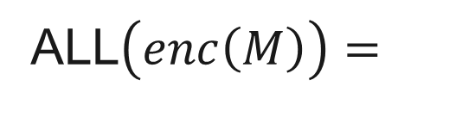
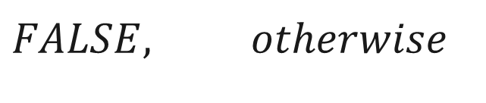

ALL
$$TRUE, ∀w, M\left[w\right] halts$$
ALL$\left(enc\left(M\right)\right)=$
$$FALSE, otherwise$$

Slide 12
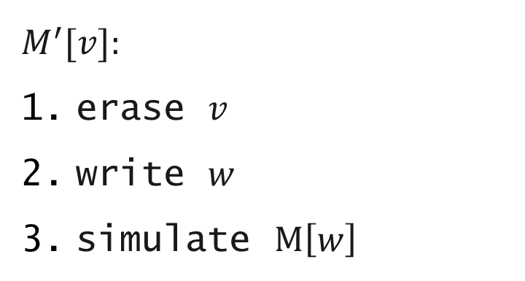



HALT${ ≤}_{m}$ ALL
$$M_{t}$$
$$enc((M, w))$$
$$enc(M′)$$
$$M^{′}[v]:$$
erase $v$
write $w$
simulate $M\left[w\right]$

Slide 13
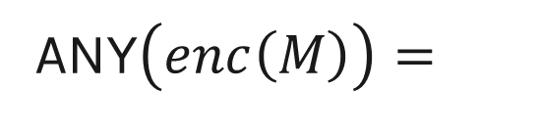

ANY
$$TRUE, ∃w, M\left[w\right] halts$$
ANY$\left(enc\left(M\right)\right)=$
$$FALSE, otherwise$$

Slide 14
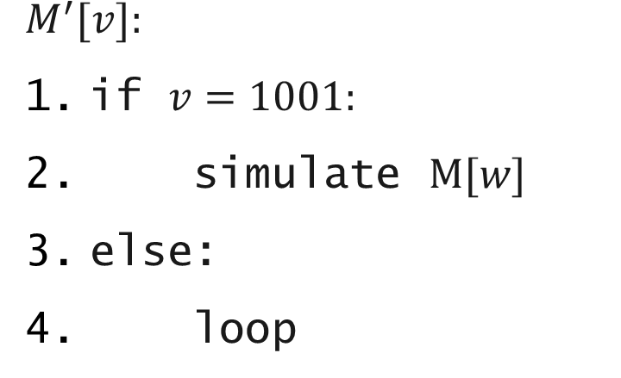
HALT${ ≤}_{m}$ ANY
$$M_{t}$$
$$enc((M, w))$$
$$enc(M′)$$
$$M^{′}[v]:$$
if $v=1001:$
simulate $M[w]$
else:
loop

Slide 15
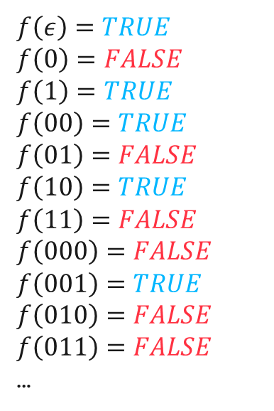
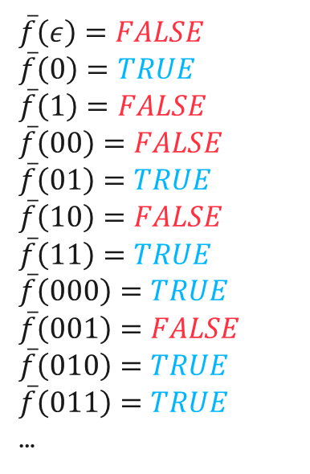
Complement of a problem
$$f\left(ε\right)=TRUE$$
$$f\left(0\right)=FALSE$$
$$f\left(1\right)=TRUE$$
$$f\left(00\right)=TRUE$$
$$f\left(01\right)=FALSE$$
$$f\left(10\right)=TRUE$$
$$f\left(11\right)=FALSE$$
$$f\left(000\right)=FALSE$$
$$f\left(001\right)=TRUE$$
$$f\left(010\right)=FALSE$$
$$f\left(011\right)=FALSE$$
…
$$\overline{f}\left(ε\right)=FALSE$$
$$\overline{f}\left(0\right)=TRUE$$
$$\overline{f}\left(1\right)=FALSE$$
$$\overline{f}\left(00\right)=FALSE$$
$$\overline{f}\left(01\right)=TRUE$$
$$\overline{f}\left(10\right)=FALSE$$
$$\overline{f}\left(11\right)=TRUE$$
$$\overline{f}\left(000\right)=TRUE$$
$$\overline{f}\left(001\right)=FALSE$$
$$\overline{f}\left(010\right)=TRUE$$
$$\overline{f}\left(011\right)=TRUE$$
…

Slide 16
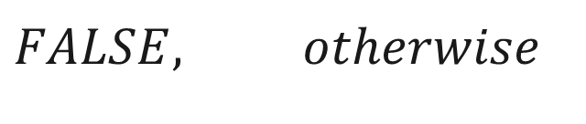
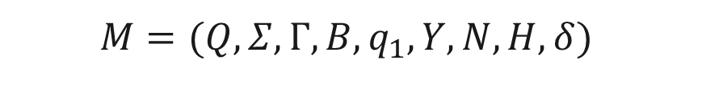
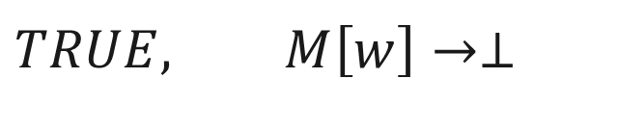
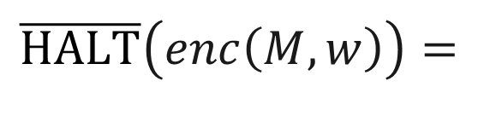


$$\overline{HALT}$$
$$M=(Q, Σ,Γ,B,q_{1}, Y,N,H,δ)$$
$$w∈Σ^{∗}$$
$$M\left[w\right]→⊥?$$
$$TRUE, M\left[w\right]→⊥$$
$$\overline{HALT}\left(enc\left(M, w\right)\right)=$$
$$FALSE, otherwise$$

Slide 17






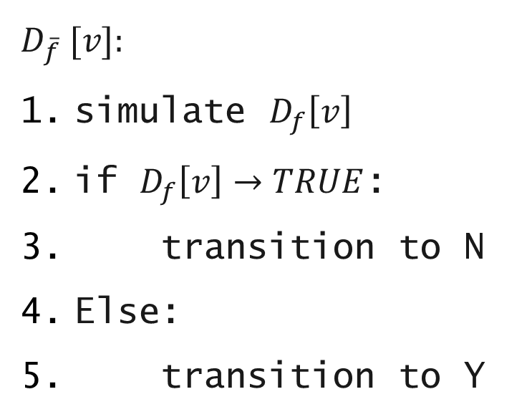
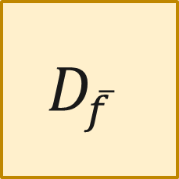
$$f∈R⇒\overline{f}∈R$$
$$D_{\overline{f}} [v]:$$
simulate $D_{f}\left[v\right]$
if $D_{f}\left[v\right]→TRUE$:
transition to N
Else:
transition to Y
$$w$$
$$D_{\overline{f}}$$
$$D_{f}$$
$$FALSE$$
$$TRUE$$
$$TRUE$$
$$FALSE$$

Slide 18
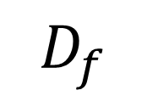
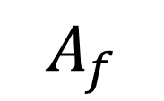
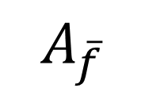
$\left(f∈RE\right)∧\left(\overline{f}∈RE\right)⇒f∈R$
$$D_{f}$$
$$A_{f}$$
N
r_s
r
 |  |  |  |  |  |  |  |  |  |  |  |  |  | 1 | 0 | 0 | 1 | 0 | 1 | 0 | 1 | 0 | 1
$$A_{\overline{f}}$$
s
Y
 |  |  |  |  |  |  |  |  |  |  |  |  |  | 1 | 0 | 0 | 1 | 0 | 1 | 0 | 1 | 0 | 1

Slide 19
RE
coRE
R

Slide 20
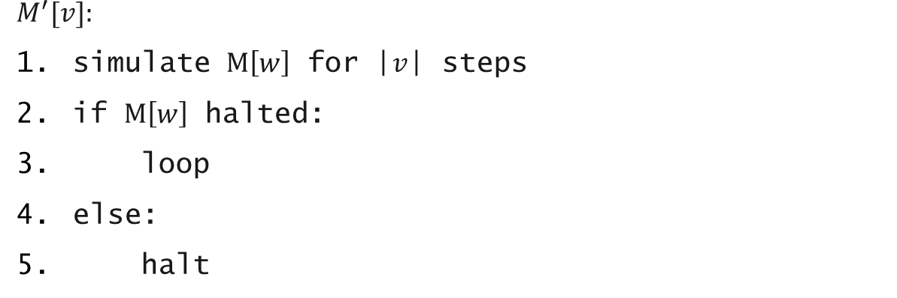
$$\overline{HALT}≤_{m}ALL$$
$$M_{t}$$
$$enc((M, w))$$
$$enc(M′)$$
$$M^{′}[v]:$$
simulate $M\left[w\right]$ for |$v$| steps
if $M\left[w\right]$ halted:
loop
else:
halt

Slide 21


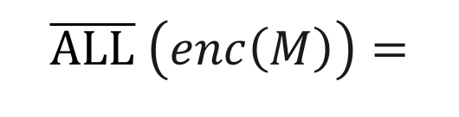
$$\overline{ALL}$$
$$TRUE, ∃w, M\left[w\right]→⊥$$
$$\overline{ALL} \left(enc\left(M\right)\right)=$$
$$FALSE, otherwise$$

Slide 22
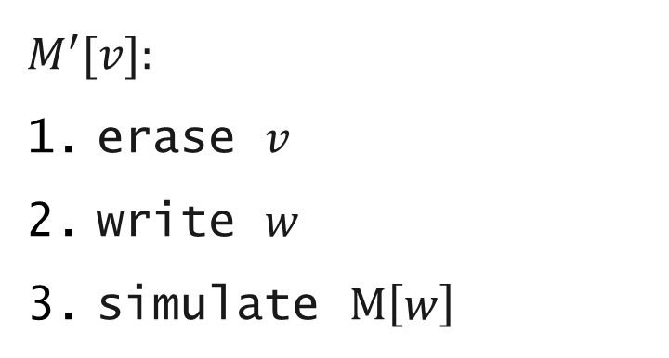
$$\overline{HALT}≤_{m}\overline{ALL}$$
$$M_{t}$$
$$enc((M, w))$$
$$enc(M′)$$
$$M^{′}[v]:$$
erase $v$
write $w$
simulate $M\left[w\right]$

Slide 23

ALL
RE
coRE
R
HALT
$$\overline{HALT}$$
PREFIX

