Slide 1

Recap
Reducing a problem to another
Mapping reducibility
Proving (un)decidability of new problems:
  ALL
  ANY
Complement of a problem
coRE
$ALL∉RE∪coRE$

Slide 2
Undecidability
Results
7
Analiza Algoritmilor

Slide 3

Contents
Rice’s theorem
  Statement
  Interpretation
  Proof
Post’s Correspondence Problem
  $HALT≤_{m} PCP$

Slide 4
Rice’s Theorem

Slide 5
“Any non-trivial property of acceptable problems is undecidable”

Slide 6
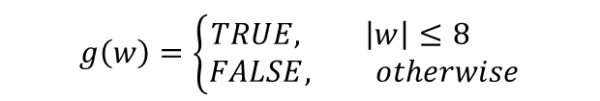
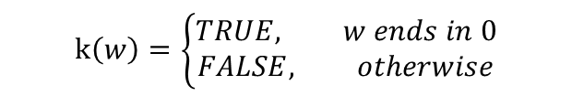
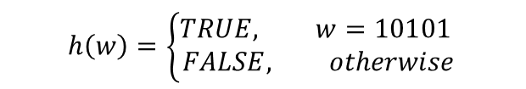
“… property of acceptable problems…”
k
Property P: having a finite number of TRUE inputs
$$g\left(w\right)=\left\{\begin{aligned}TRUE, \left|w\right|≤8 \\ FALSE, otherwise\end{aligned}\right.$$
RE
$$h\left(w\right)=\left\{\begin{aligned}TRUE, w=10101 \\ FALSE, otherwise\end{aligned}\right.$$
P
$$k\left(w\right)=\left\{\begin{aligned}TRUE, w ends in 0 \\ FALSE, otherwise\end{aligned}\right.$$
g
h

Slide 7


“… non-trivial property…”
RE
RE
$$∅$$
$$RE$$

Slide 8

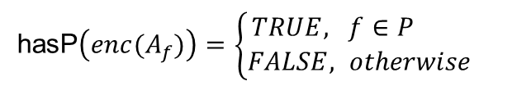
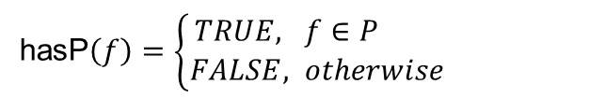


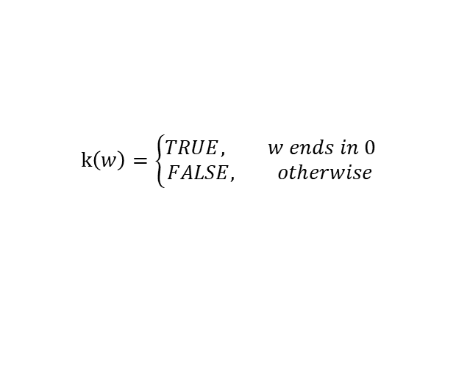

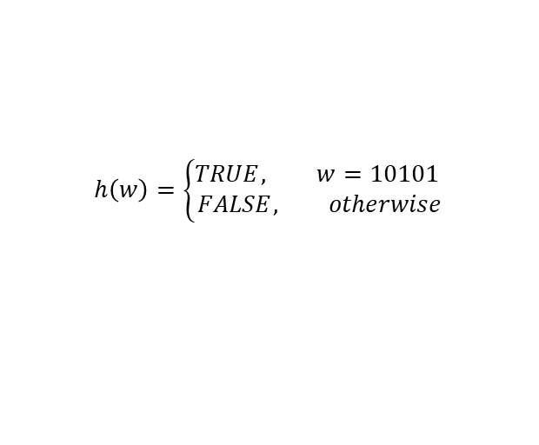

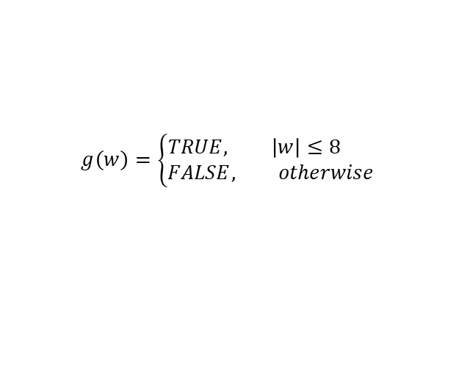

“… property […] is undecidable…”
hasP$\left(enc(A_{f})\right)=\left\{\begin{aligned}TRUE, f∈P \\ FALSE, otherwise\end{aligned}\right.$
hasP$\left(f\right)=\left\{\begin{aligned}TRUE, f∈P \\ FALSE, otherwise\end{aligned}\right.$
$$f$$
$$A_{f} is a Turing Machine that accepts f$$
RE
Property P: having a finite number of TRUE inputs
$$g\left(w\right)=\left\{\begin{aligned}TRUE, \left|w\right|≤8 \\ FALSE, otherwise\end{aligned}\right.$$
hasP$\left(g\right)=TRUE$
P
$$h\left(w\right)=\left\{\begin{aligned}TRUE, w=10101 \\ FALSE, otherwise\end{aligned}\right.$$
hasP$\left(h\right)=TRUE$
$$k\left(w\right)=\left\{\begin{aligned}TRUE, w ends in 0 \\ FALSE, otherwise\end{aligned}\right.$$
$$Σ^{∗}$$
hasP$\left(k\right)=FALSE$
hasP$:Σ^{∗}→\{FALSE, TRUE\}$

Slide 9
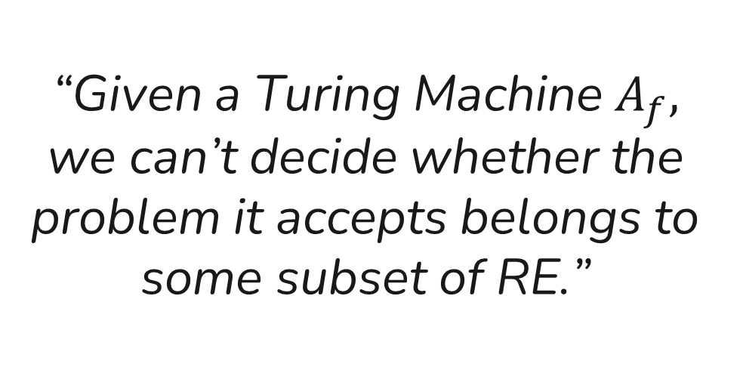
“Given a Turing Machine $A_{f},$ we can’t decide whether the problem it accepts belongs to some subset of RE.”

Slide 10
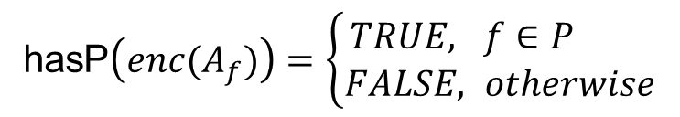

Formal statement
hasP$\left(enc(A_{f})\right)=\left\{\begin{aligned}TRUE, f∈P \\ FALSE, otherwise\end{aligned}\right.$
RE
P
$$(P≠∅ ∧P≠RE)⇔hasP∉R$$

Slide 11

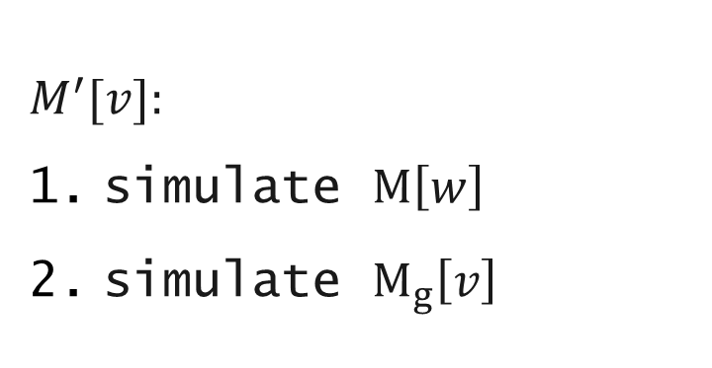



Proof $(HALT≤_{m}hasP)$
$$f_{FALSE}$$
$${(f}_{FALSE}\left(w\right)=FALSE, ∀w∈Σ^{∗})$$
$$M_{g} accepts g$$
RE
$$M^{′}[v]:$$
simulate $M\left[w\right]$
simulate $M_{g}\left[v\right]$
P
g

Slide 12



Proof $(HALT≤_{m}hasP)$
Proof $(HALT≤_{m}\overline{hasP})$
g
$${(f}_{FALSE}\left(w\right)=FALSE, ∀w∈Σ^{∗})$$
$$M_{g} accepts g$$
RE
$$M^{′}[v]:$$
simulate $M\left[w\right]$
simulate $M_{g}\left[v\right]$
P
P
$$f_{FALSE}$$
$$f_{FALSE}$$

Slide 13
Post’s Correspondence Problem

Slide 14
Refresher
0
001
1
One pair = one “blue” word,
and one “yellow” word
01
0
0011
pair 1
pair 2
pair 3
001
0
001
1
0
01
0
0011
pair 2
pair 1
pair 2
pair 3

Slide 15
Refresher
0
001
1
One pair = one “blue” word,
and one “yellow” word
01
0
0011
pair 1
pair 2
pair 3
001
0
001
1
0
01
0
0011
pair 2
pair 1
pair 2
pair 3

Slide 16
Refresher
0
001
1
One pair = one “blue” word,
and one “yellow” word
01
0
0011
pair 1
pair 2
pair 3
001
0
001
1
0
01
0
0011
pair 2
pair 1
pair 2
pair 3

Slide 17
Refresher
0
001
1
One pair = one “blue” word,
and one “yellow” word
01
0
0011
pair 1
pair 2
pair 3
The blue word concatenation matches the yellow concatenation
We can reuse pairs several times
1
001
0
001
01
0
0
0011
pair 2
pair 1
pair 2
pair 3

Slide 18
Modified Post’s Correspondence Problem
0
001
1
Solutions must start with “pair 1”
01
0
0011
pair 1
pair 2
pair 3
No solution that starts with pair 1

Slide 19
Modified Post’s Correspondence Problem (2)
110
0
01
Solutions must start with “pair 1”
11
100
00
pair 1
pair 2
pair 3
110
01
110
0
11
00
11
100
pair 1
pair 3
pair 1
pair 2

Slide 20



$$PCP∉R$$
$$HALT≤_{m}MPCP$$
$$HALT≤_{m}PCP$$
$$MPCP≤_{m}PCP$$

Slide 21
Configurations
q
q
 |  |  |  |  |  |  |  | 1 | 0 | 0 | 1 | 1 | 0 | 1
1
0
0
1
1
0
1
(100, 1101, q)
100q1101

Slide 22
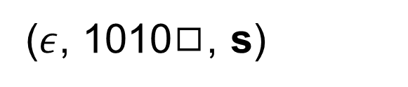
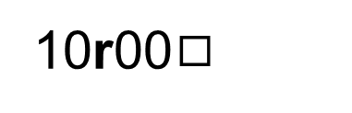
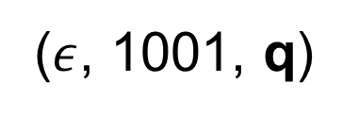
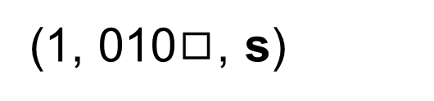
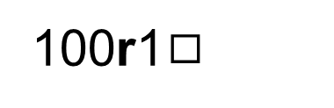
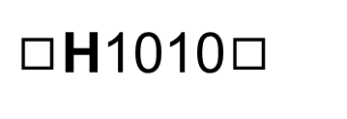

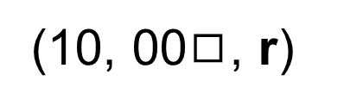
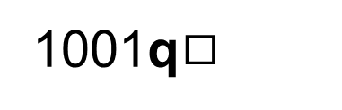
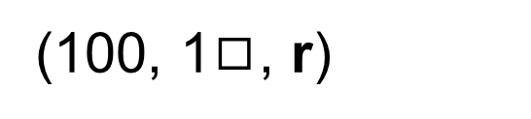
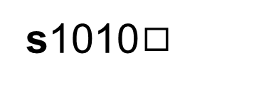
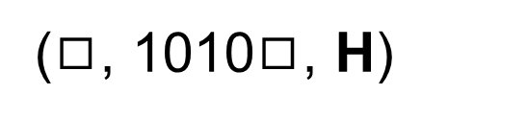
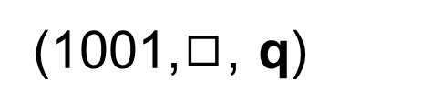
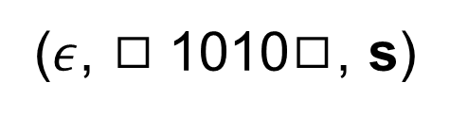
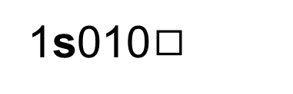
q1001
($ε$, 1001, q)
(10, 00$◻$, r)
10r00$◻$
(1, 001, q)
1q001
(1, 010$◻$, s)
1s010$◻$
(10, 01, q)
s1010$◻$
10q01
($ε$, 1010$◻$, s)
(100, 1, q)
100q1
s$◻$1010$◻$
($ε$, $◻$1010$◻$, s)
(1001,$◻$, q)
($◻$, 1010$◻$, H)
1001q$◻$
$◻$H1010$◻$
(100, 1$◻$, r)
100r1$◻$
Notes:
Formal information about the triplet members written on the blackboard live

Slide 23
Computational history
q
 |  |  |  |  |  |  |  | 1 | 0 | 1 | 0
q
 |  |  |  |  |  |  |  | 1 | 0 | 1 | 0
q
 |  |  |  |  |  |  |  | 1 | 0 | 1 | 0

Slide 24

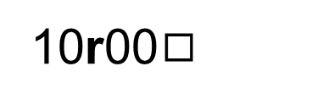
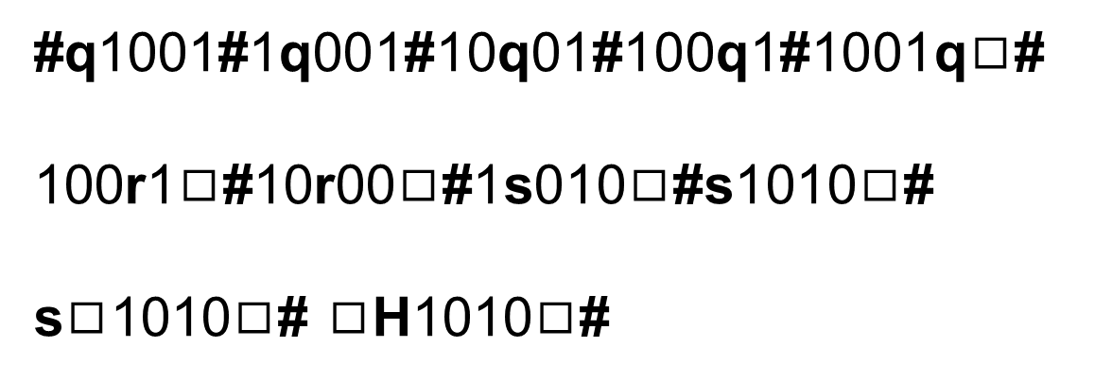

q1001
10r00$◻$
1q001
1s010$◻$
#q1001#1q001#10q01#100q1#1001q$◻$#
100r1$◻$#10r00$◻$#1s010$◻$#s1010$◻$#
s$◻$1010$◻$# $◻$H1010$◻$#
10q01
s1010$◻$
100q1
s$◻$101$0◻$
1001q$◻$
$◻$H101$0◻$
100r1$◻$
Notes:
Formal information about the triplet members written on the blackboard live

Slide 25


















$HALT≤_{m}MPCP$ idea
$$\#C_{1}\#C_{2}\#C_{3}\#…\#C_{n}\#C_{n+1}\#…\#C_{f}\#$$
$$\#C_{1}\#C_{2}\#C_{3}\#…\#C_{n}\#C_{n+1}\#…\#$$
$\#C_{1}\#C_{2}\#C_{3}\#…\#C_{n}$#
$$\#C_{1}\#C_{2}\#C_{3}\#$$
$$\#C_{1}\#C_{2}\#$$
$$\#C_{1}\#$$
$$\#$$
$$M\left[w\right] halts$$
$$\#C_{1}\#C_{2}\#C_{3}\#C_{4}\#…\#C_{n+1}\#…\#C_{f}\#$$
$$\#C_{1}\#C_{2}\#C_{3}\#C_{4}\#…\#C_{n+1}\#…\#C_{f}\#$$
$$\#C_{1}\#C_{2}\#C_{3}\#C_{4}\#…\#C_{n+1}\#$$
$$\#C_{1}\#C_{2}\#C_{3}\#C_{4}\#$$
$$\#C_{1}\#C_{2}\#C_{3}\#$$
$$\#C_{1}\#C_{2}\#$$
$$\#C_{1}\#$$
$$\#C_{1}\#C_{2}\#C_{3}\#…\#C_{n}\#C_{n+1}\#…\#C_{i}\#$$
$$M\left[w\right]→⊥$$
$$\#C_{1}\#C_{2}\#C_{3}\#C_{4}\#…\#C_{n+1}\#…\#C_{i}\#C_{i+1}\#$$

Slide 26
Restricted Turing Machines
q
1
 | 0 | 1 | 0
$$δ:Q×Γ→(Q∪\{Y, N, H\})×Γ×\{←, →\}$$

Slide 27
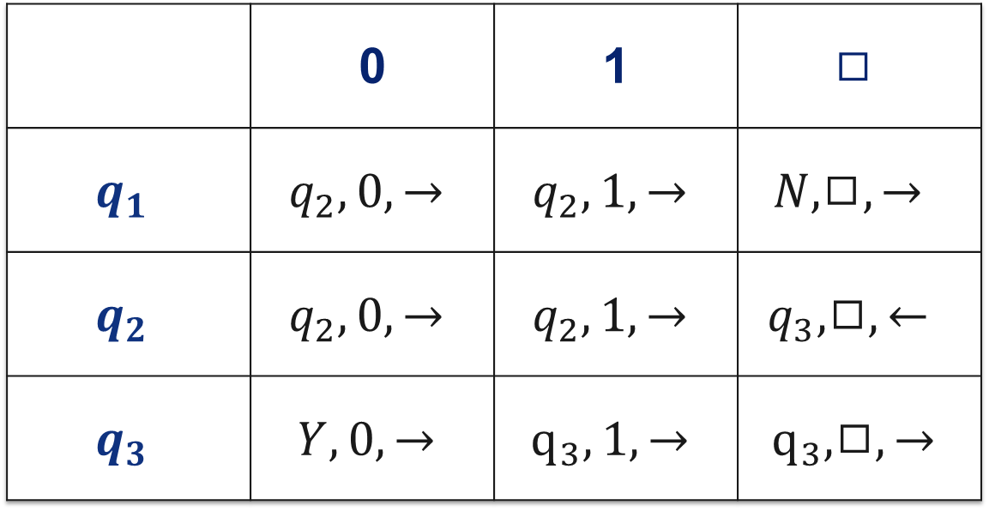
isEven’
 | 0 | 1 | $$◻$$
$$q_{1}$$ | $$q_{2}, 0, →$$ | $$q_{2}, 1, →$$ | $$N,◻,→$$
$$q_{2}$$ | $$q_{2}, 0, →$$ | $$q_{2}, 1, →$$ | $$q_{3},◻,←$$
$$q_{3}$$ | $$Y, 0, →$$ | $$q_{3}, 1, →$$ | $$q_{3}, ◻,→$$

Slide 28

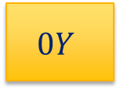


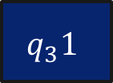




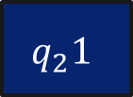
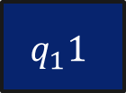








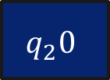
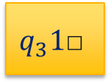


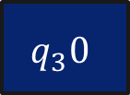

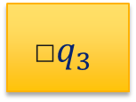





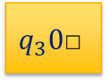


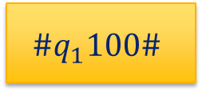






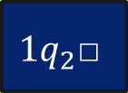
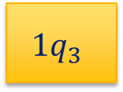


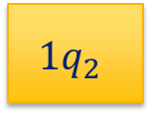

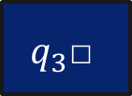







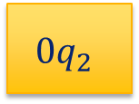
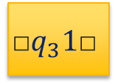
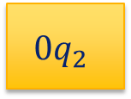

#
$$q_{1}0$$
$$q_{1}1$$
$$q_{1}\text{□}$$
$$0$$
$$1$$
$$\text{□}$$
$$\#$$
$$\#$$
$$\#q_{1}100\#$$
$${0q}_{2}$$
$${1q}_{2}$$
$$\text{□}N$$
$$0$$
$$1$$
$$\text{□}$$
$$\#$$
$$\text{□}\#$$
pair 1
$$q_{2}0$$
$$q_{2}1$$
$$0q_{2}\text{□}$$
$$1q_{2}\text{□}$$
$$\text{□}q_{2}\text{□}$$
$$Y\#\#$$
$${0q}_{2}$$
$${1q}_{2}$$
$$q_{3}0\text{□}$$
$$q_{3}1\text{□}$$
$${\text{□}q}_{3}1\text{□}$$
$$\#$$
$$q_{3}0$$
$$q_{3}1$$
$$q_{3}\text{□}$$
$$0Y$$
$$1Y$$
$$\text{□}Y$$
$$Y0$$
$$Y1$$
$$Y\text{□}$$
$$0N$$
$$1N$$
$$\text{□}N$$
$$N0$$
$$N1$$
$$N\text{□}$$
$$0Y$$
$$1q_{3}$$
$$\text{□}q_{3}$$
$$Y$$
$$Y$$
$$Y$$
$$Y$$
$$Y$$
$$Y$$
$$N$$
$$N$$
$$N$$
$$N$$
$$N$$
$$N$$

Slide 29
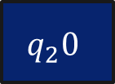

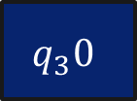















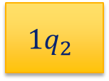


















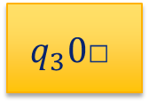





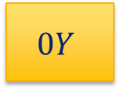





























$$\left(isEven′, 100\right) tileset solution$$
#
$$q_{1}1$$
$$0$$
$$0$$
$$\#$$
$$1$$
$$q_{2}0$$
$$0$$
$$\#$$
$$1$$
$$0$$
$$q_{2}0$$
$$\#$$
$$\#q_{1}100\#$$
$${1q}_{2}$$
$$0$$
$$0$$
$$\#$$
$$1$$
$${0q}_{2}$$
$$0$$
$$\#$$
$$1$$
$$0$$
$${0q}_{2}$$
$$\text{□}\#$$
$$1$$
$$0$$
$$0q_{2}\text{□}$$
$$\#$$
$$1$$
$$0$$
$$q_{3}0$$
$$\text{□}$$
$$\#$$
$$1$$
$$0$$
$$0$$
$$Y\text{□}$$
$$\#$$
$$1$$
$$0$$
$$1$$
$$0$$
$$q_{3}0\text{□}$$
$$\#$$
$$1$$
$$0$$
$$0Y$$
$$\text{□}$$
$$\#$$
$$1$$
$$0$$
$$0$$
$$Y$$
$$\#$$
$$1$$
$$0$$
$$0Y$$
$$\#$$
$$1$$
$$0Y$$
$$\#$$
$$1Y$$
$$\#$$
$$Y\#\#$$
$$Y$$
$$\#$$
$$1$$
$$Y$$
$$\#$$
$$Y$$
$$\#$$
$$\#$$

Slide 30

#
$$q_{1}0$$
$$q_{1}1$$
$$q_{1}\text{□}$$
$$0$$
$$1$$
$$\text{□}$$
$$\#$$
$$\#$$
$$\#q_{1}11\#$$
$${0q}_{2}$$
$${1q}_{2}$$
$$\text{□}N$$
$$0$$
$$1$$
$$\text{□}$$
$$\#$$
$$\text{□}\#$$
pair 1
$$q_{2}0$$
$$q_{2}1$$
$$0q_{2}\text{□}$$
$$1q_{2}\text{□}$$
$$\text{□}q_{2}\text{□}$$
$$Y\#\#$$
$${0q}_{2}$$
$${1q}_{2}$$
$$q_{3}0\text{□}$$
$$q_{3}1\text{□}$$
$${\text{□}q}_{3}1\text{□}$$
$$\#$$
$$q_{3}0$$
$$q_{3}1$$
$$q_{3}\text{□}$$
$$0Y$$
$$1Y$$
$$\text{□}Y$$
$$Y0$$
$$Y1$$
$$Y\text{□}$$
$$0N$$
$$1N$$
$$\text{□}N$$
$$N0$$
$$N1$$
$$N\text{□}$$
$$0Y$$
$$1q_{3}$$
$$\text{□}q_{3}$$
$$Y$$
$$Y$$
$$Y$$
$$Y$$
$$Y$$
$$Y$$
$$N$$
$$N$$
$$N$$
$$N$$
$$N$$
$$N$$

Slide 31













































$$\left(isEven′, 11\right) tileset −no solution$$
#
$$q_{1}1$$
$$1$$
$$\#$$
$$1$$
$$q_{2}1$$
$$\#$$
$$1$$
$$1q_{2}\text{□}$$
$$\#$$
$$1$$
$$\#q_{1}\text{11}\#$$
$${1q}_{2}$$
$$1$$
$$\#$$
$$1$$
$${1q}_{2}$$
$$\text{□}\#$$
$$1$$
$$q_{3}\text{1}\text{□}$$
$$\#$$
$$1$$
$$q_{3}1$$
$$\text{□}$$
$$\#$$
$$1$$
$$1$$
$$q_{3}\text{□}$$
$$\#$$
$$1$$
$$1$$
$$\text{□}$$
$$q_{3}\text{□}$$
$$\#$$
$$1q_{3}$$
$$\text{□}$$
$$\#$$
$$1$$
$$1$$
$$\text{□}q_{3}$$
$$\text{□}\#$$
$$1$$
$$1$$
$$\text{□}$$
$$\text{□}q_{3}$$
$$\text{□}\#$$

Slide 32
$$MPCP≤_{m}PCP$$
110
0
01
11
100
00
pair 1
pair 2
pair 3
110
01
110
0
11
00
11
100
pair 1
pair 3
pair 1
pair 2

Slide 33










$MPCP≤_{m}PCP$ (2)
0
001
1
$⋄$0
$⋄$0
$⋄$0$⋄$0$⋄$1
$⋄$1
$⋄$$
01
0
0011
$⋄$0$⋄$1$⋄$
0$⋄$1$⋄$
0$⋄$
0$⋄$0$⋄$1$⋄$1$⋄$
$$\$$$
pair 1
pair 2
pair 3
pair 1
pair 2
pair 3
pair 4
pair 5
001
0
001
1
0
01
0
0011
pair 2
pair 1
pair 2
pair 3

Slide 34




$MPCP≤_{m}PCP$ (2)
0
001
1
$⋄$0
$⋄$0
$⋄$0$⋄$0$⋄$1
$⋄$1
$⋄$$
01
0
0011
$⋄$0$⋄$1$⋄$
0$⋄$1$⋄$
0$⋄$
0$⋄$0$⋄$1$⋄$1$⋄$
$$\$$$
pair 1
pair 2
pair 3
pair 1
pair 2
pair 3
pair 4
pair 5
$⋄$0
$⋄$1
$⋄$0$⋄$1$⋄$
0$⋄$0$⋄$1$⋄$1$⋄$
pair 1
pair 4

Slide 35













$$MPCP≤_{m}PCP (3)$$
110
0
01
$⋄1$⋄1⋄0
$⋄1$⋄1⋄0
$⋄$0
$⋄0⋄$1
$⋄$$
11
100
00
$⋄1⋄$1$⋄$
$1⋄$1$⋄$
1$⋄$0$⋄$0$⋄$
0$⋄$0$⋄$
$$\$$$
pair 1
pair 2
pair 3
pair 1
pair 2
pair 3
pair 4
pair 5
$⋄1$⋄1⋄0
$⋄0⋄$1
$⋄1$⋄1⋄0
$⋄$0
$⋄$$
$⋄1⋄$1$⋄$
0$⋄$0$⋄$
$1⋄$1$⋄$
1$⋄$0$⋄$0$⋄$
$$\$$$
pair 1
pair 4
pair 2
pair 3
pair 5

