Slide 1
Communicating and Operationalizing an Analytics Project
Submitted by,
Yuvaraj .A
II - MCA

Slide 2
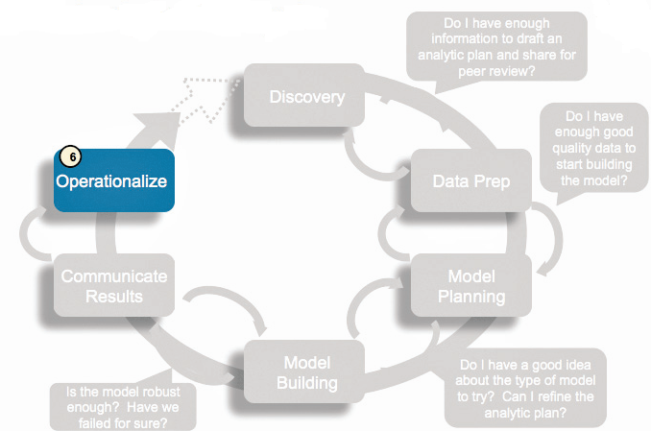
Data Analytics Lifecycle

Slide 3
Operationalize
This approach enables team to learn about performance and related constraints of the model in production environment on small scale , and make adjustments before full deployment.
The team delivers final reports, briefings, codes.

Slide 4
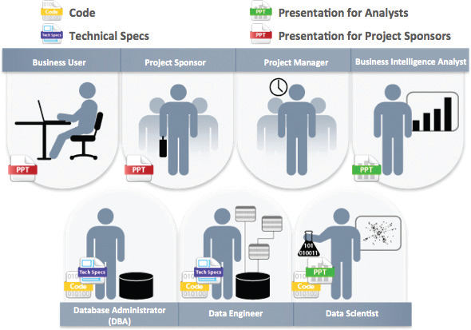
Key outputs from a successful analytic project
Business User
Project Sponsor
Project Manager
Business Intelligence Analyst
Database Administrator (DBA)
Data Engineer
Data Scientist

Slide 5

Business User
Business User typically tries to determine the benefits and implications of the findings to the business.

Slide 6

Project Sponsor
Project Sponsor typically asks questions related to the business impact of the project, the risks and return on investment (ROI), and how the project can be evangelized within the organization and beyond.

Slide 7

Project Manager
Project Manager needs to determine if the project was completed on time and within budget.

Slide 8

Business Intelligence Analyst
Business Intelligence Analyst needs to know if the reports and dashboards he manages will be impacted and need to change.

Slide 9
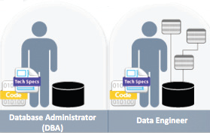
Data Engineer and Database Administrator (DBA)
Database Administrator (DBA) typically need to share the code from the analytical project and create technical documents that describe how to implement the code.

Slide 10
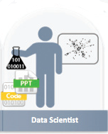
Data Scientist
Data Scientists need to share the code and explain the model to their peers, managers, and other stakeholders.
Although these seven roles represent many interests within a project, these interests usually overlap, and most of them can be met with four main deliverables

Slide 11
Four Main Deliverables
Presentation for Project Sponsors contains high-level takeaways for executive-level stakeholders, with a few key messages to aid their decision-making process. Focus on clean, easy visuals for the presenter to explain and for the viewer to grasp.
Presentation for Analysts, which describes changes to business processes and reports. Data scientists reading this presentation are comfortable with technical and will be interested in the details.
Code for technical people, such as engineers and others managing the production environment.
Technical specifications for implementing the code.

Slide 12

THANK YOU

