Slide 1

REGIONAL DESCRIPTORS
By
Yuvaraj A

Slide 2
REGION DESCRIPTORS
Boundary descriptors use external representations to model the shape characteristics of region
Regional descriptors use internal representations to model the internal contents of regions
Example: statistics and histogram

Slide 3
DESCRIPTORS
A descriptors describes characteristics about a particular image or sub-image
aims to compare and contrast the different principles involved in calculating histograms, spin images, filtering-based descriptors, and moment-based descriptors

Slide 4
DESCRIPTORS
Some simple descriptors
The area of a region: the number of pixels in the region
The perimeter of a region: length of its boundary
The compactness of the region: (perimeter)² /Area
The mean and median of the gray-levels
The minimum and maximum gray-level values

Slide 5
REGIONAL DESCRIPTORS
Various Regional descriptors are
Simple descriptors
Topological descriptors
texture

Slide 6
TOPOLOGICAL DESCRIPTORS
Used for global descriptions of regions in the image plane
topology - the study of properties of a figure that are unaffected by any deformation except tearing or folding

Slide 7
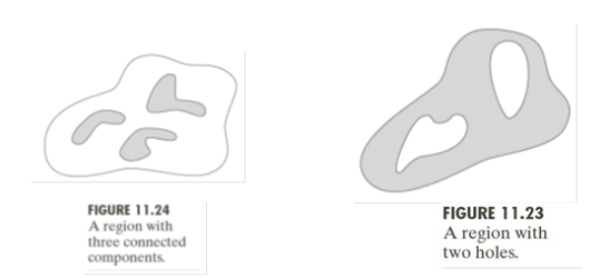
TOPOLOGICAL DESCRIPTORS
Features that not change deformation
E=C-H
E=eular number
C=number of connected region
H=number of holes

Slide 8
TOPOLOGICAL DESCRIPTORS
topological features give a global description of a region examples:
number of holes
number of connected components
number of object edges
number of faces number of vertices
Euler number (the difference between the number of connected components and number of holes)

Slide 9
TEXTURE
texture, as observed in wood grain, stone, cloth, grass, etc., is an important region description
no formal definition; intuitively this descriptor provides measures of properties, such as smoothness, coarseness, regularity, etc.

Slide 10
TEXTURE
three principal approaches used to describe the texture are:
statistical - smoothness, coarseness, graininess (using moments, entropy, etc.)
structural - arrangement of image primitives, such as regularity of parallel lines
spectral - based on properties of Fourier spectrum (periodic patterns in an image)

Slide 11
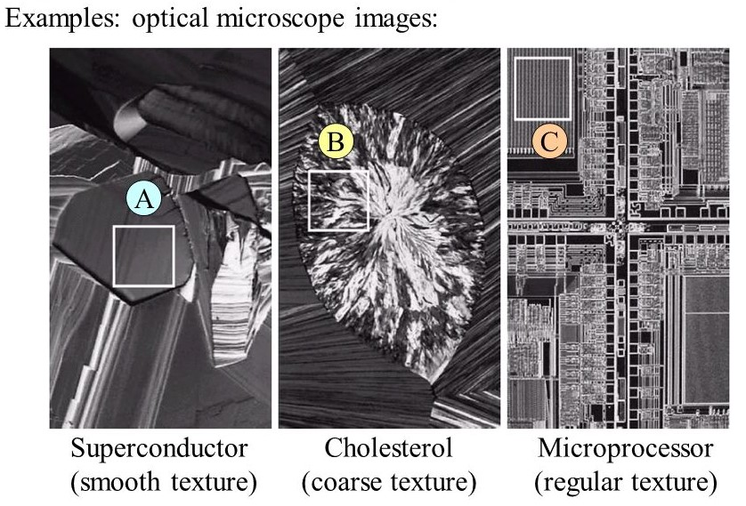
TEXTURE
Purpose: to describe the texture of the region

Slide 12
THANK YOU

