Slide 1
IBM University Engagement Project Submission
“Exploring the Power of Agentic AI with IBM Granite and IBM Bob”

Slide 2

Project Title : Interview Trainer Agent
Domain of Project – Education
Student Name | Recent Passport Photo | Email ID | Mobile number [WhatsApp]
Roshana B A |  | baroshana367@gmail.com | 9353179544

Slide 3
Problem Statement -
Problem Statement – Interview Trainer Agent
The Challenge
Preparing for job interviews is often difficult due to lack of personalized guidance, limited access to real interview questions, and absence of proper feedback. Information about interview patterns, technical questions, and HR expectations is scattered across unreliable sources. Without real-time, tailored preparation, candidates struggle to identify their weaknesses, improve communication skills, and build confidence for interviews.
The Objective
Build an AI-powered Interview Trainer Agent that delivers personalized interview preparation and evaluation. The solution should:
Personalized Question Generation – Generate role-based technical, behavioural, and HR questions.
RAG-based Retrieval – Fetch real interview questions and company expectations from reliable sources.
Answer Evaluation & Feedback – Provide scoring, feedback, and improvement suggestions.
Mock Interview Simulation – Conduct live interview sessions with performance tracking.
Preparation Strategy – Suggest study plans based on user performance.
Multi-Agent System – Question Generator, Evaluation Agent, and Strategy Planner.
Visualization Dashboard – Show progress, scores, and weak areas.

Slide 4
Proposed Solution -
Proposed Solution: AI-Powered Interview Trainer Agent
The proposed solution is a multi-agent AI-powered Interview Trainer Agent built using IBM watsonx.ai, IBM Granite Models, and IBM Cloud Lite services to provide personalized interview preparation and real-time feedback. The system addresses challenges in interview preparation by offering structured guidance, question generation, and performance evaluation.
At its core, the solution uses a Retrieval-Augmented Generation (RAG) pipeline to fetch relevant interview questions, company-specific patterns, and industry expectations from trusted sources. This data is embedded and stored in a vector database, enabling accurate retrieval and intelligent response generation.
The system consists of key agents:
Question Generator Agent retrieves and generates role-specific technical and HR questions using RAG.
Evaluation Agent analyzes user answers and provides scoring, feedback, and improvement suggestions.
Strategy Agent recommends personalized preparation plans based on performance.
Resume Analyzer Agent extracts skills and generates targeted interview questions.
The solution includes a user-friendly dashboard (built with Streamlit) that allows users to attempt mock interviews, track performance, and view progress over time.
IBM watsonx.ai manages model deployment and embeddings, while Granite models enable reasoning, summarization, and personalization.
Overall, this system delivers an end-to-end intelligent interview preparation assistant that improves user confidence, enhances performance, and increases success rates in job interviews.

Slide 5
Technology Used
IBM Bob platform – Multi-agent orchestration
IBM Granite Model – Question generation & evaluation
IBM watsonx.ai – Model deployment & AI services
RAG (Retrieval-Augmented Generation) – Fetch real interview data
Vector Database (Chroma) – Store & retrieve embeddings
Streamlit – User interface

Slide 6
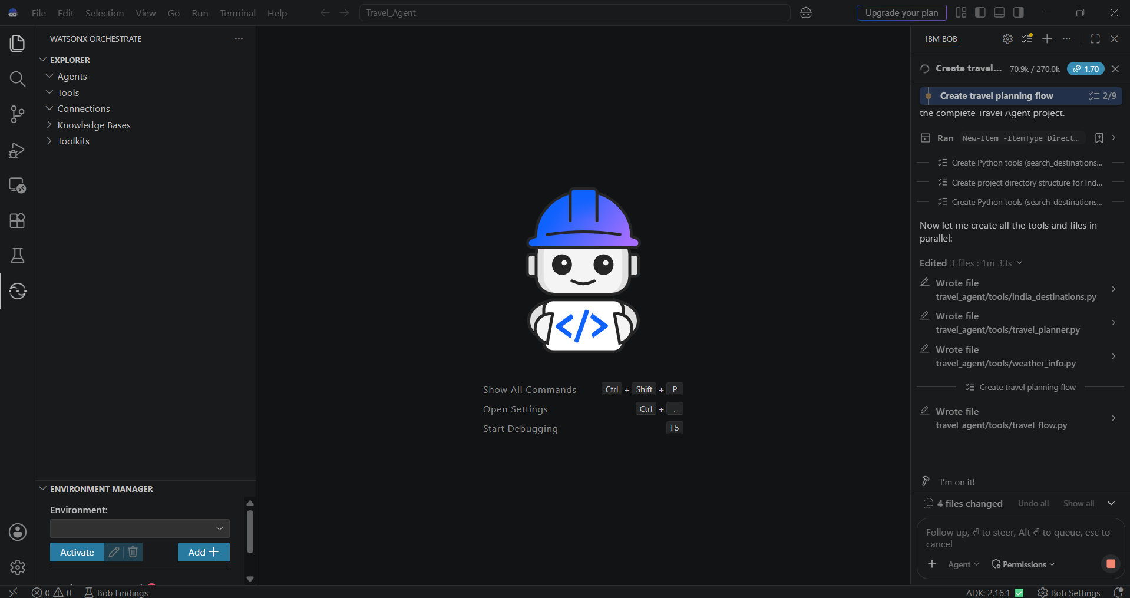
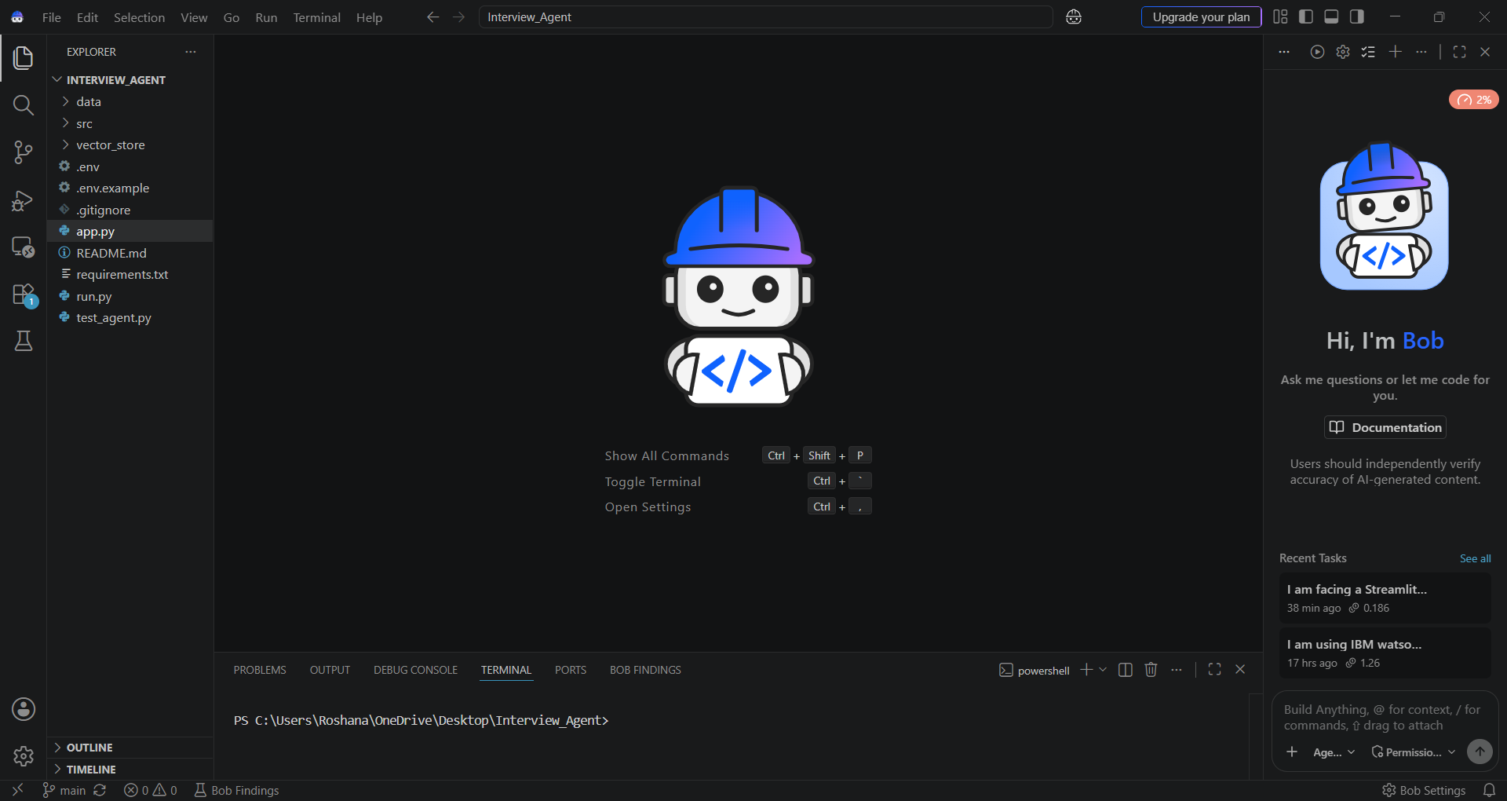
IBM Bob Screenshots:

Slide 7
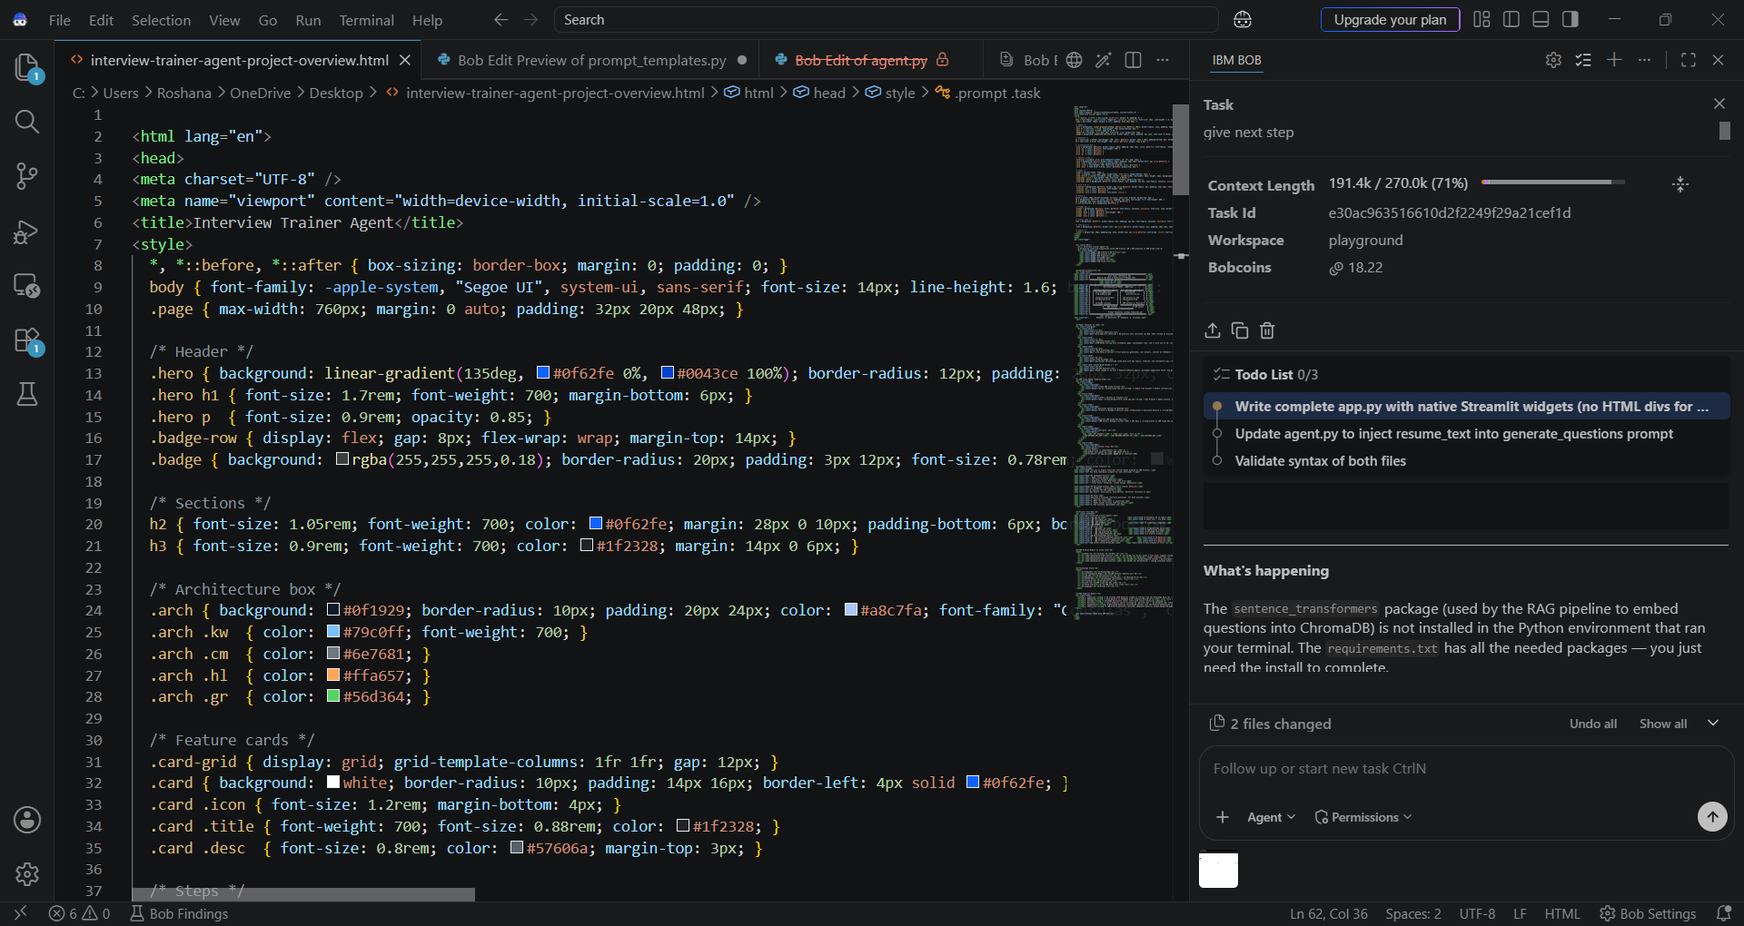
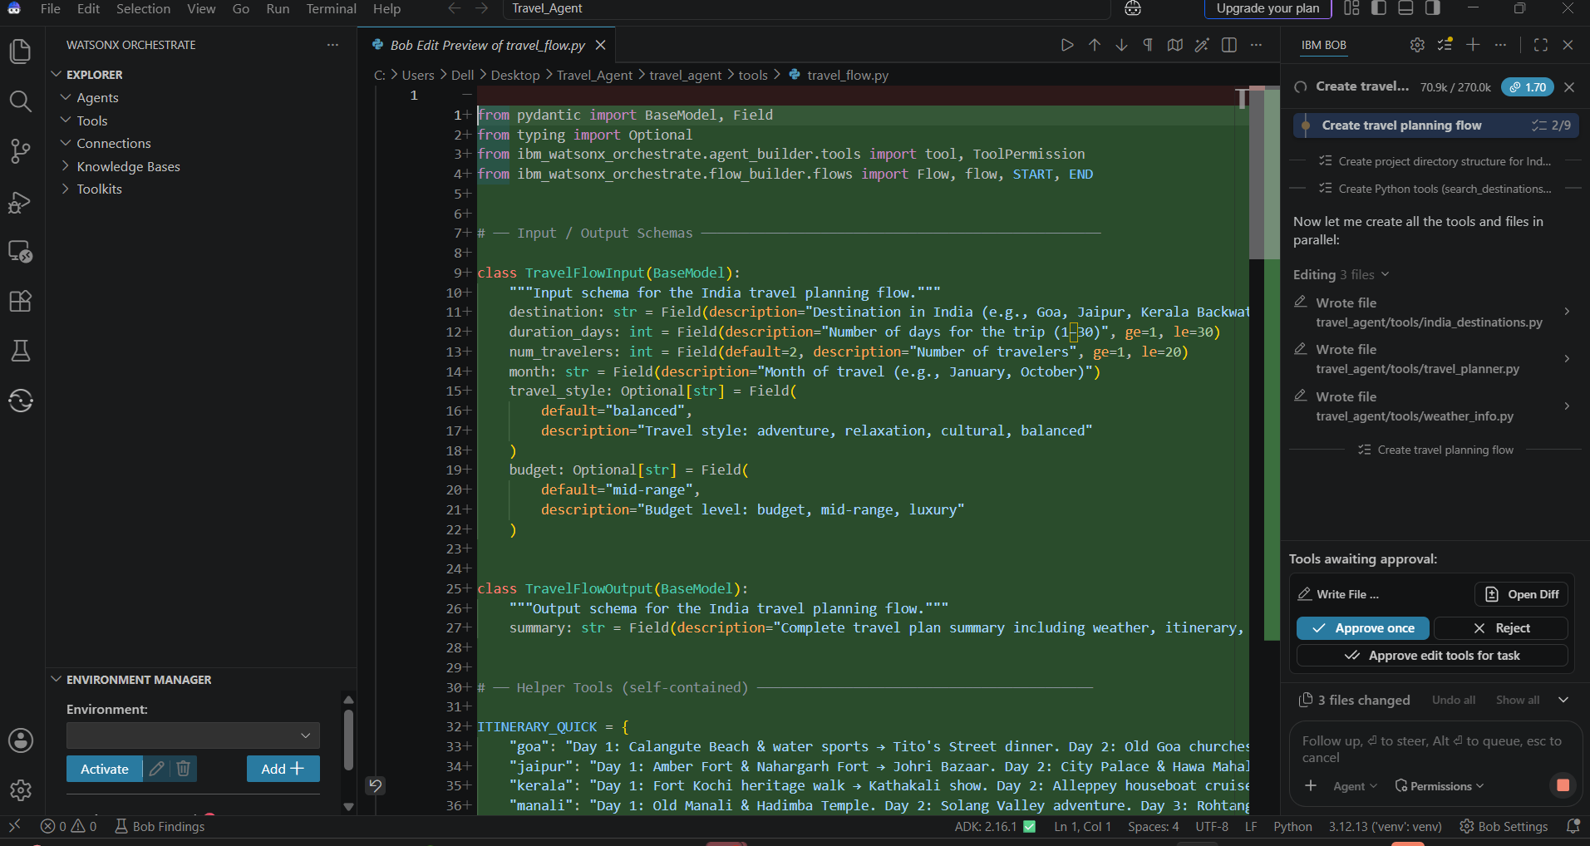
Required Files created using IBM bob -

Slide 8
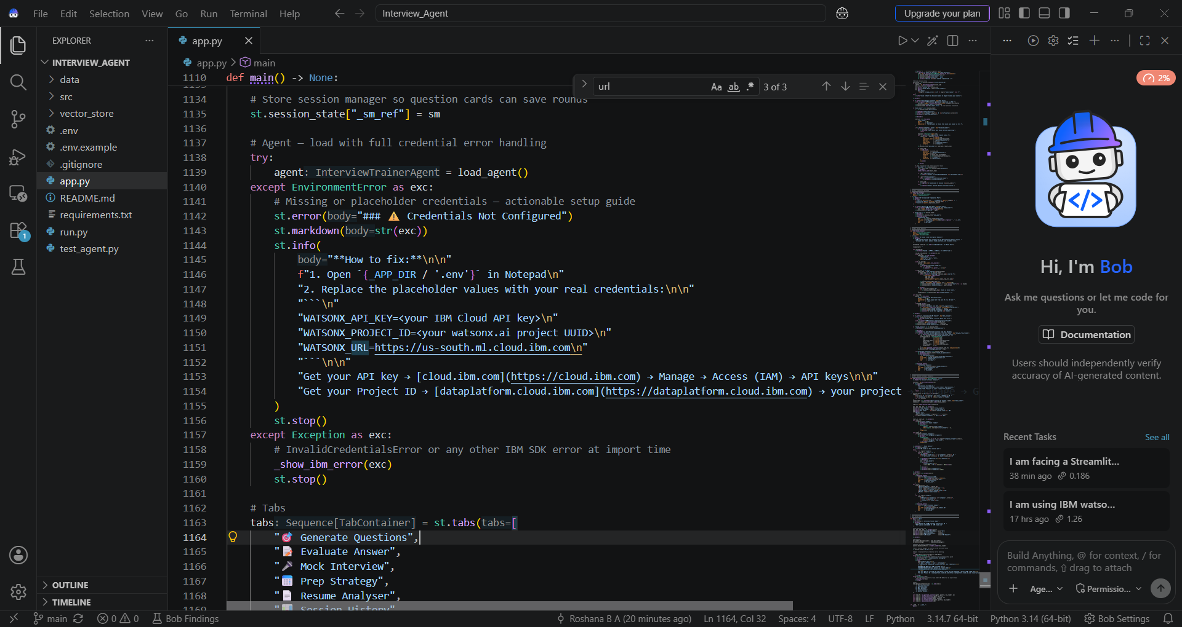
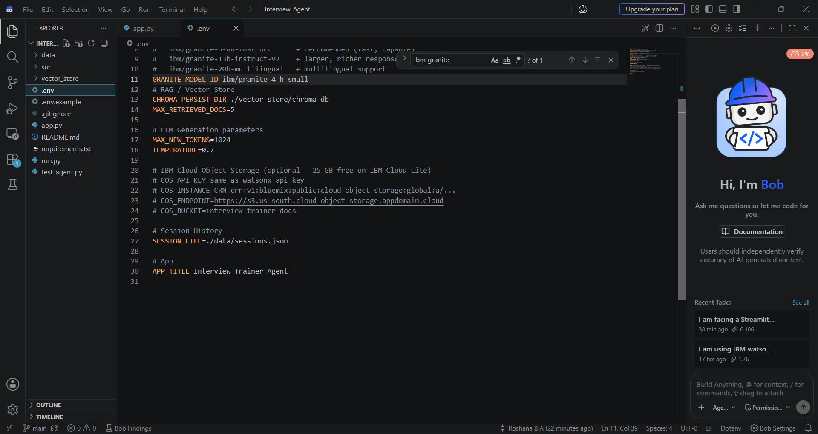

Slide 9
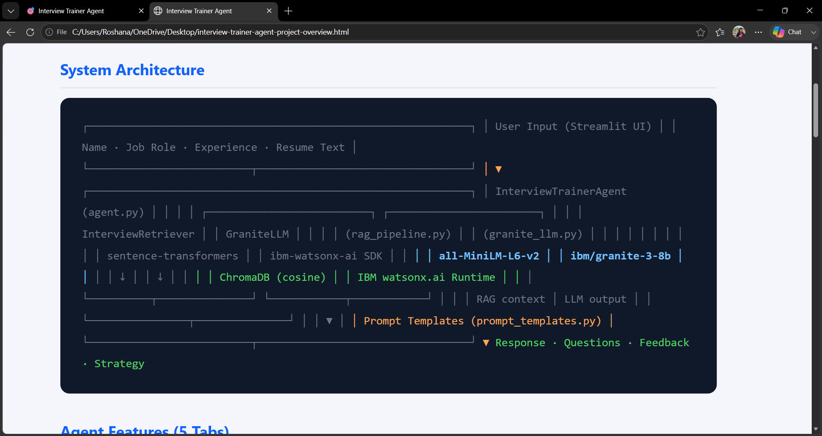
Architecture blueprint for IBM bob:

Slide 10

Role of Agentic AI in the solution
Role of Agentic AI in Interview Trainer Agent
Agentic AI enables the Interview Trainer Agent to function as an intelligent, autonomous system rather than a simple chatbot. Using IBM watsonx.ai and IBM Granite models, it coordinates multiple specialized agents to deliver personalized interview preparation.
Each agent performs a specific role—such as retrieving interview questions, generating model answers, evaluating user responses, and providing feedback—while working collaboratively. This multi-agent approach ensures accurate and structured interview guidance.
Agentic AI brings context awareness, understanding user inputs like job role, experience level, and resume details to generate relevant questions and strategies. It supports real-time adaptation, continuously improving suggestions based on user performance.
Additionally, agents communicate with each other to refine responses, provide scoring, and suggest improvements, enabling better learning outcomes.
Overall, Agentic AI makes the system proactive, personalized, and goal-driven, acting like a smart interview coach that boosts confidence, improves answers, and increases success in job interviews.

Slide 11
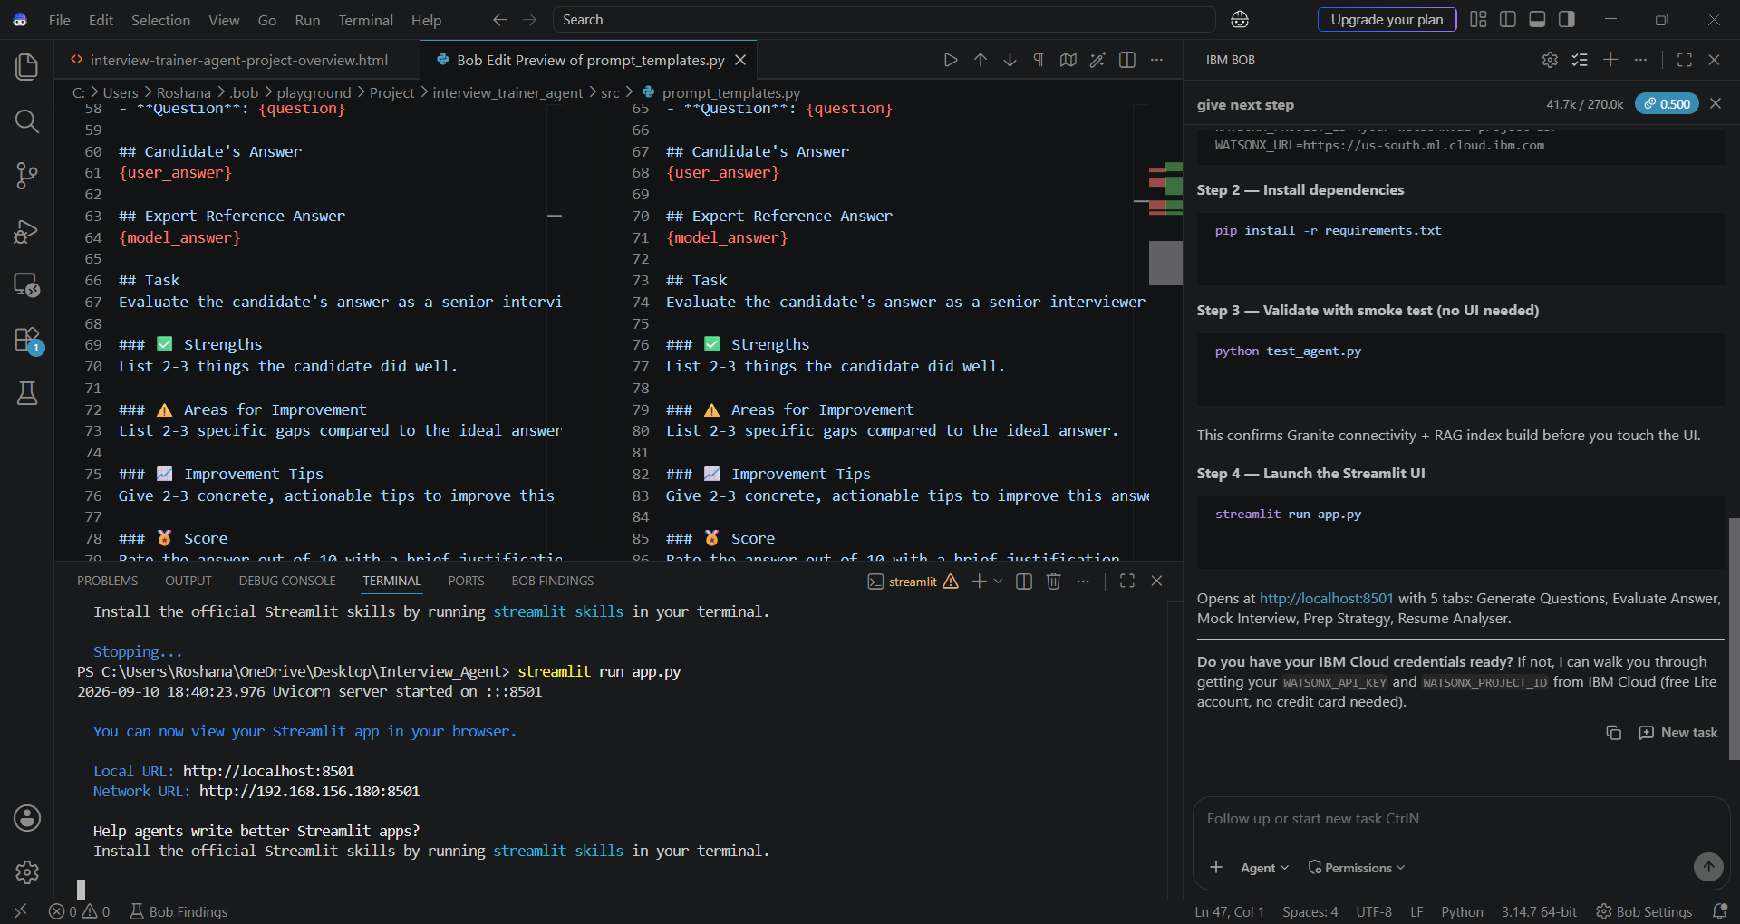
Project Output Screenshot
Please put IBM Bob output screenshots with 2-3 prompts.
You can take 2-3 more slides for each screenshot
·
·
·

Slide 12
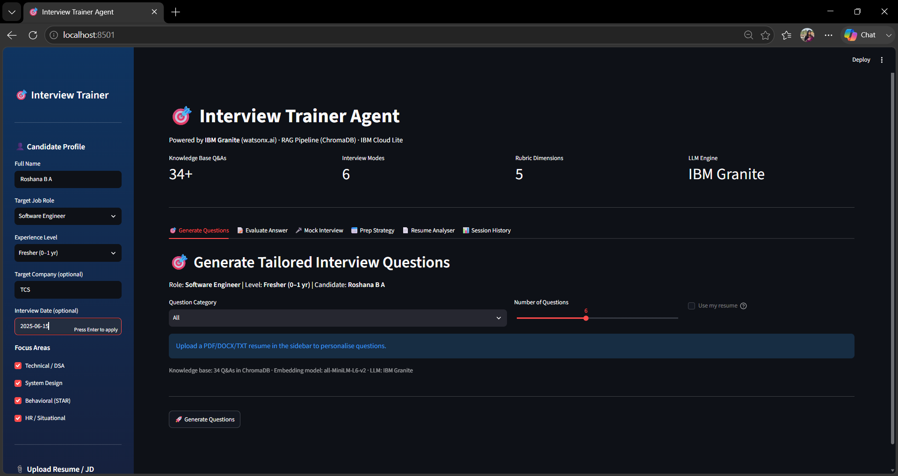
Project Output Screenshot
Please put IBM Bob output screenshots with 2-3 prompts.
You can take 2-3 more slides for each screenshot
·
·
·

Slide 13
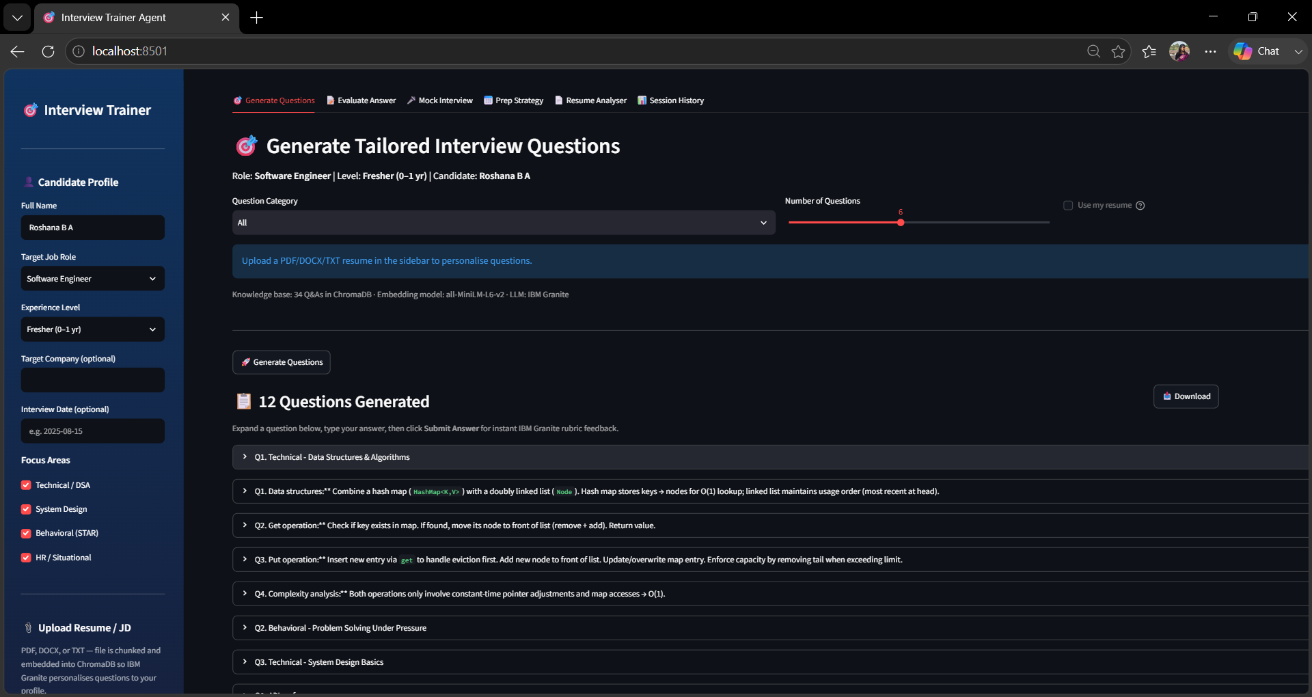
Project Output Screenshot
Please put IBM Bob output screenshots with 2-3 prompts.
You can take 2-3 more slides for each screenshot
·
·
·

Slide 14
Novelty and Uniqueness
Novelty and Uniqueness
The proposed Interview Trainer Agent stands out by combining Agentic AI, RAG, and personalization into a single intelligent system.
Multi-Agent Intelligence – Multiple specialized agents collaborate to generate technical, HR, and behavioral interview preparation.
RAG-Based Accuracy – Retrieves real-time interview questions, company patterns, and industry expectations from trusted sources.
Hyper-Personalization – Tailors questions and answers based on user profile, resume, role, and experience level.
Real-Time Feedback Loop – Provides instant evaluation, improvement tips, and answer refinement.
Multi-Modal Input – Supports resume upload, text input, and future voice-based interview practice.
End-to-End Interview Preparation – Covers aptitude, technical, and HR rounds in one platform.
Scalable & Industry-Ready – Built using IBM watsonx.ai and IBM Granite models for reliable and scalable deployment.

Slide 15
Git Hub Link
·
GitHub Link : https://github.com/git1ttt/Interview_Agent.git
·
·
·

Slide 16
Future Scope
1. Integration with Resume & Job Platforms
The system can be integrated with platforms like LinkedIn, Naukri, or resume databases to automatically extract user profiles, job roles, and experience. This will enable the Interview Trainer Agent to generate highly personalized interview questions and preparation strategies based on real-world job requirements.
2. AI-Powered Voice Interview Simulation & Multilingual Support
The solution can be enhanced with a voice-based mock interview system where users can practice real-time interviews. Adding multilingual support will allow users to practice interviews in different languages, improving accessibility and helping candidates prepare for global job opportunities.
·
·
·

Slide 17
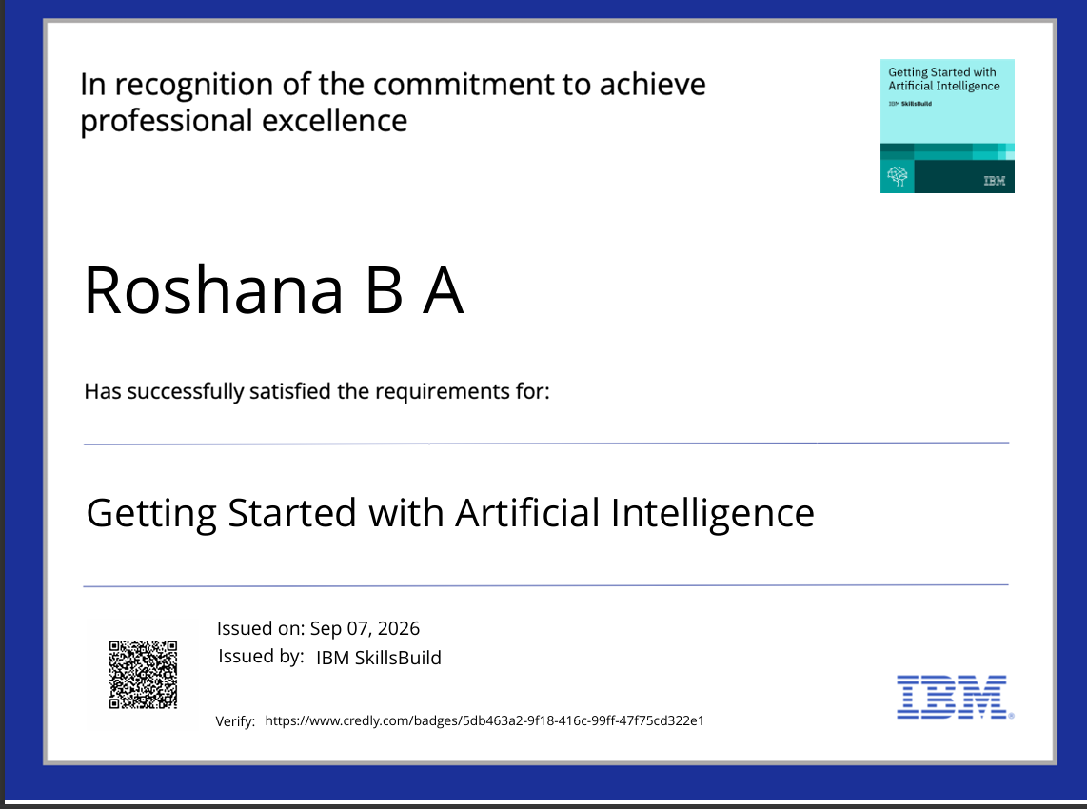
Certificates Earned:

Slide 18
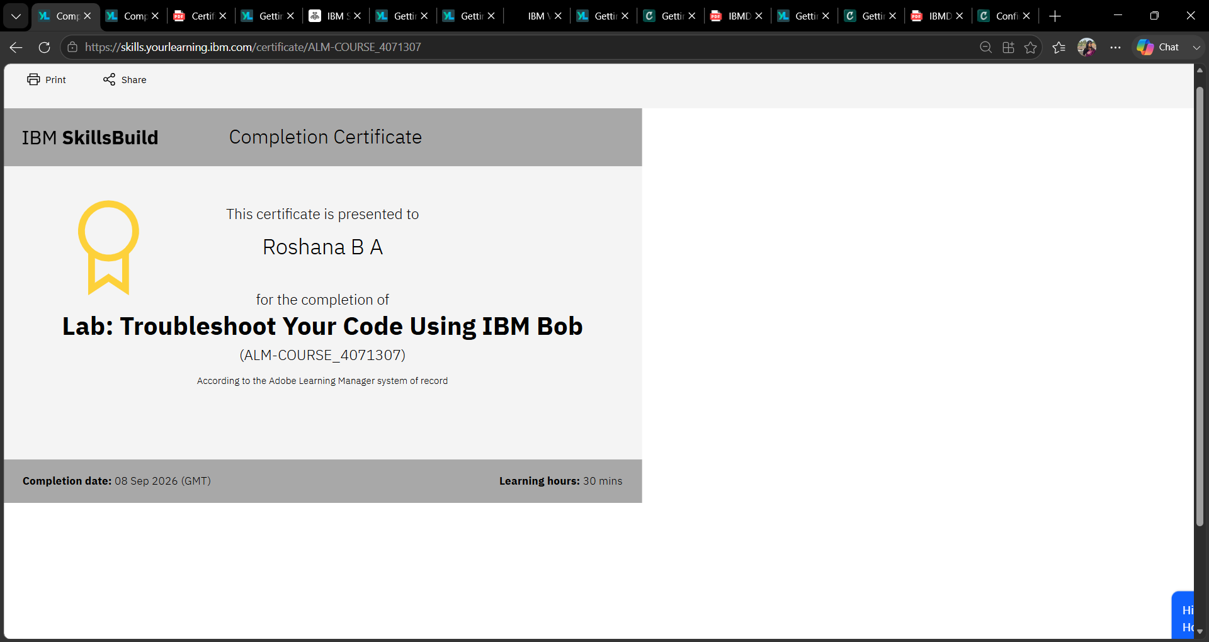
Certificates Earned:​

Slide 19


