Slide 1



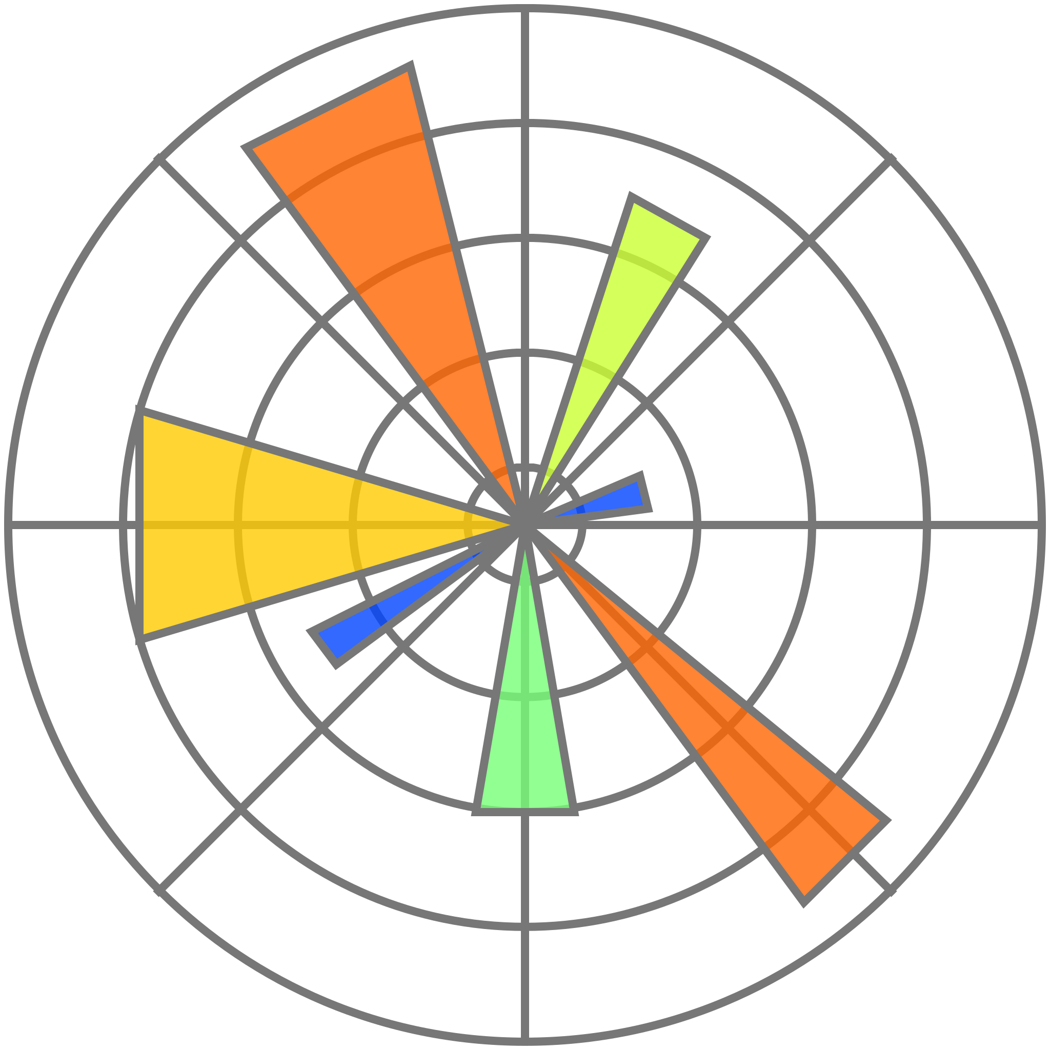


Overview
Problem
Dataset
Model
Result
Insight
Workflow
Conclusion
BANK MARKETING RESPONSE PREDICTION
Goal: Predict if a client subscribes to a term deposit
Stack: Python | Scikit-learn | Matplotlib
MD ALAUDDIN ANSARI | 22F1001182 | MACHINE LEARNING PROJECT | IIT MADRAS

Slide 2
Overview
Problem
Dataset
Model
Result
Insight
Workflow
Conclusion
PROBLEM AND MOTIVATION
Banks run costly marketing calls; need smarter targeting.
Task: Binary classification (yes/no).
Challenge: Imbalanced data & correlated predictors.
Impact: Reduce campaign cost + increase conversion efficiency.

Slide 3
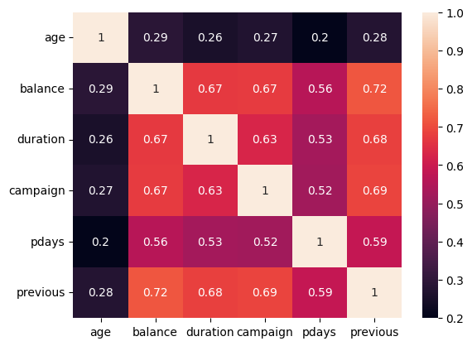
Overview
Problem
Dataset
Model
Result
Insight
Workflow
Conclusion
DATA EXPLORATION AND PREPROCESSING
Data: 39 K records | 17 features
Missing → mode / “unknown” imputation
Engineered: days_since_contact, age_group, balance_category, financial_risk
Encoding: Ordinal + One-Hot
Scaling: StandardScaler
Outliers handled: skewed features normalized
Correlation heatmap

Slide 4
Overview
Problem
Dataset
Models
Result
Insight
Workflow
Conclusion
MODELS AND PIPELINE
All models wrapped in unified Pipeline FeatureEng → Preprocess → Classifier
Baseline: Logistic Regression
Advanced: Random Forest & XGBoost
Tuning: RandomizedSearchCV (50–100 trials)

Slide 5
Overview
Problem
Dataset
Model
Result
Insight
Workflow
Conclusion
RESULTS AND EVALUATION
ROC & PR curves → XGB slightly ahead
Balanced recall and precision on validation set
Model | F1 | Accuracy | AUC | Remarks
Logistic Regression | 0.71 | 0.81 | 0.80 | Underfit
Random Forest | 0.77 | 0.85 | 0.91 | Stable
XGBoost | 0.77 | 0.86 | 0.91 | Best overall

Slide 6
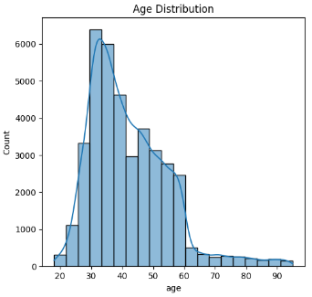
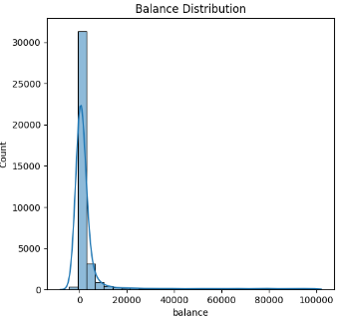
Overview
Problem
Dataset
Model
Result
Insight
Workflow
Conclusion
INSIGHTS AND EXPLAINABILITY
EDA: strong correlations (between balance, duration, previous)
Outliers: balance, duration → may impact model performance
Age → minor impact
Feature distribution

Slide 7
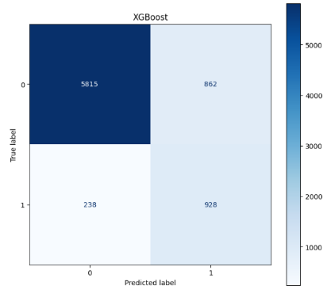
Overview
Problem
Dataset
Model
Result
Insight
Workflow
Conclusion
SYSTEM WORKFLOW
Flow: Input → Feature Engineering → Preprocessor → Model → Output
Automated with sklearn.pipeline.Pipeline()
RandomizedSearchCV for efficient tuning
Output metrics + visual diagnostics (ROC, PR, CM)
Confusion matrix

Slide 8
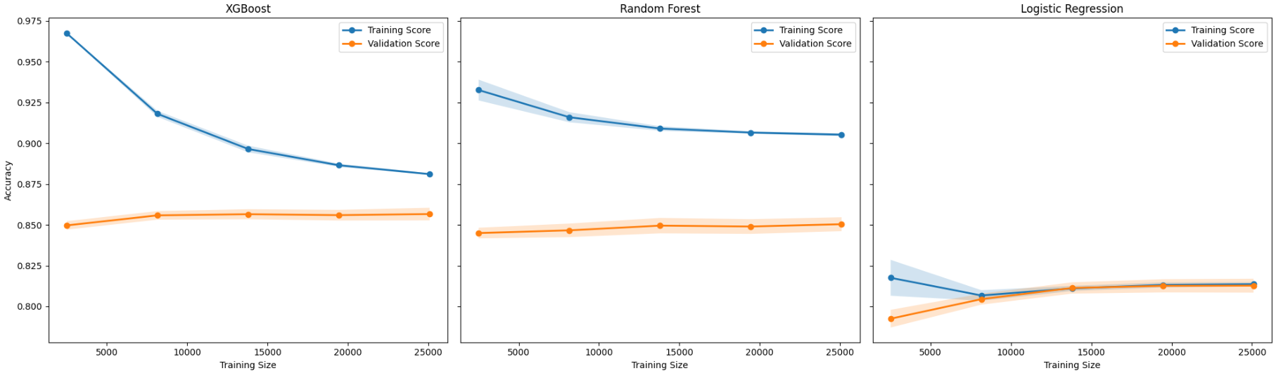
Overview
Problem
Dataset
Model
Result
Insight
Workflow
Conclusion
CONCLUSION
XGBoost achieved best balance (F1 = 0.77, AUC = 0.91)
Robust feature engineering improved generalization
Learning curve

Slide 9
THANK YOU
MD ALAUDDIN ANSARI | 22F1001182 | MACHINE LEARNING PROJECT | IIT MADRAS

