Slide 1

JpA gotchas
Lessons and Best Practices from

Slide 2
Who Am I?
Neil Hartner
Lead Software Architect at Overstock.com
8 years experience using Hibernate

Slide 3
$1.3 billion in online sales in 2013
One of the fastest performing retail sites on the internet according to Gomez
Headquarters in Salt Lake City, UT
300 Developers and Testers
We use Hibernate heavily

Slide 4
OBLIGATORY HIRING SLIDE
Overstock is hiring
Looking for good Java developers
Visit overstock.com/careers for more info
Contact me: nhartner@overstock.com

Slide 5
Agenda
Discuss Entity Management
Entity Manager
Transactions
Flushing
Dirty checking
Lazy loading
Real-world examples where JPA/Hibernate has surprised us
Tips on how to tame your JPA

Slide 6
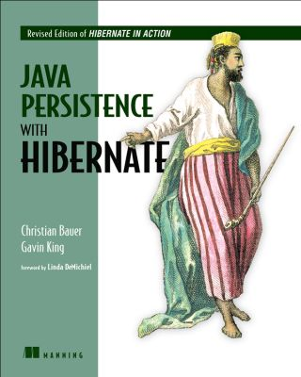

Slide 7

Two Faces of JPA
Object Relational Mapper
Entity Manager

Slide 8
Two Faces of JPA
Object Relational Mapper
Entity Manager

Slide 9
JPA Entity Manager / Hibernate Session
Unit of work
Single-threaded
A queue of SQL statements that need to be synchronized with the database at some point
Map of managed persistent entities

Slide 10
Let’s look at some code

Slide 11
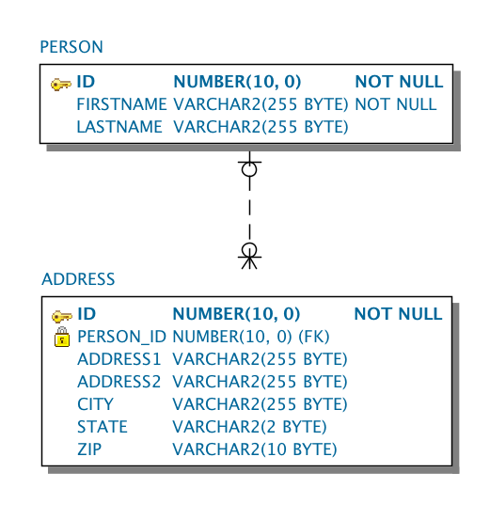
My database schema

Slide 12
My Person entity
@Entity
public class Person {
@Id private int id;
@Column private String firstName;
@Column private String lastName;
@OneToMany(
mappedBy="person",
cascade={ CascadeType.ALL })
private Set<Address> addresses = new HashSet<>();

Slide 13
My Address entity
@Entity
public class Address {
@Id private int id;
@Column private String address1;
@Column private String city;
@Column private String state;
@Column private String zip;
@ManyToOne
@JoinColumn(name="person_id")
private Person person;

Slide 14
Q: In the following code, when am I saved to the database
EntityManager manager= factory.createEntityManager();
Person person = new Person("Neil", "Hartner");
manager.persist(person);
println("Hallelujah!\n" + person + " is saved!");
manager.close();l

Slide 15
A: Never!
EntityManager manager= factory.createEntityManager();
Person person = new Person("Neil", "Hartner");
manager.persist(person);
println("Hallelujah!\n" + person + " is saved!");
manager.close();

Slide 16
No changes were persisted because I never triggered an event that would force Hibernate to flush. Note: persist() may not force flush!

Slide 17

Flushing

Slide 18

Flushing
All modifications made to persistent entity instances are synchronized with the database at some point, a process called flushing.
Hibernate uses a write-behind strategy which flushes as late as possible.

Slide 19
Flushing
Hibernate synchronizes to the database:
when commit() is called on a transaction
before a query is executed that may be affected by flushing
when flush() is called explicitly

Slide 20
Just because you called persist(), doesn’t mean it’s in the database
Lesson:

Slide 21
JPA Transactions
Atomic unit of work in the database
All SQL statements execute in a transaction
Must be either committed or rolled back.

Slide 22
Let’s try using a transaction

Slide 23
Q: In the following code, when will Hibernate save me to the database
EntityManager manager = factory.createEntityManager();
manager.getTransaction().begin();
Person person = new Person("Neil", "Hartner");
manager.persist(person);
println("Hallelujah!\n" + person + " is saved!");
manager.getTransaction().commit();
manager.close();

Slide 24
A: As expected, on commit
EntityManager manager = factory.createEntityManager();
manager.getTransaction().begin();
Person person = new Person("Neil", "Hartner");
manager.persist(person);
println("Hallelujah!\n" + person + " is saved!");
manager.getTransaction().commit();
manager.close();

Slide 25
What if the person table is queried during the transaction?

Slide 26
Q: In the following code, when will Hibernate save me to the database
EntityManager manager = factory.createEntityManager();
manager.getTransaction().begin();
Person me = new Person("Neil", "Hartner");
manager.persist(person);
println("Hallelujah!\n" + me + " is saved!");
manager.createQuery(
“from Person where firstName=:firstName”, Person.class)
.setParameter("firstName", "Neil")
.getResultList();
manager.getTransaction().commit();
manager.close();

Slide 27
A: On query of Person because Hibernate must ensure query consistency within a transaction
EntityManager manager = factory.createEntityManager();
manager.getTransaction().begin();
Person me = new Person("Neil", "Hartner");
manager.persist(person);
println("Hallelujah!\n" + me + " is saved!");
manager.createQuery(
“from Person where firstName=:firstName”, Person.class)
.setParameter("firstName", "Neil")
.getResultList();
manager.getTransaction().commit();
manager.close();

Slide 28
This can create some unexpected exceptions when querying via JPA

Slide 29
Q: Assume there is a non-null database constraint on firstname. Where will exception be thrown?
EntityManager manager= factory.createEntityManager();
manager.getTransaction().begin();
Person person = new Person(null, "Hartner");
manager.persist(person);
manager.createQuery(“from Person”, Person.class)
.getResultList();
manager.getTransaction.commit();
manager.close();

Slide 30
A: createQuery will throw a ConstraintViolationException

Slide 31
What if the Person class is modified to use sequence-identity strategy ids?
public class Person {
@GenericGenerator
(name = ”person_id_gen",
strategy = "sequence-identity",
parameters = @Parameter(name = "sequence",
value = "person_id_seq"))
@GeneratedValue(generator = “person_id_gen")
@Id private int id;

Slide 32
Q: If sequence-identity strategy is used, when will me be saved to the database.
EntityManager manager = factory.createEntityManager();
manager.getTransaction().begin();
Person me = new Person("Neil", "Hartner");
manager.persist(person);
println("Hallelujah!\n" + me + " is saved!");
manager.createQuery(”from Person”, Person.class)
.getResultList();
manager.getTransaction().commit();
manager.close();

Slide 33
A: On persist() due to IDENTITY generator forcing insert
EntityManager manager = factory.createEntityManager();
manager.getTransaction().begin();
Person me = new Person("Neil", "Hartner");
manager.persist(person);
println("Hallelujah!\n" + me + " is saved!");
manager.createQuery(”from Person”, Person.class)
.getResultList();
manager.getTransaction().commit();
manager.close();

Slide 34
Hibernate may persist changes to the database at any time Hibernate may throw exceptions where you least expect it
Lesson:

Slide 35
WARNING: Do not treat exceptions as recoverable
From JBoss website:
Do not treat exceptions as recoverable
This is more of a necessary practice than a "best" practice. When an exception occurs, roll back the Transaction and close the Session. If you do not do this, Hibernate cannot guarantee that in-memory state accurately represents the persistent state.

Slide 36
EntityManager and Transaction boundaries in a web app

Slide 37
JPA Open Entity Manager In View
Single EntityManager is used for a HTTP request
Create a new transaction at the beginning of each request
Commit or rollback transaction at the end of each request
Source: https://developer.jboss.org/wiki/OpenSessionInView

Slide 38
public void doFilter(ServletRequest request, ServletResponse response, FilterChain chain) throws IOException,ServletException {
EntityManager manager;
try {
// Starting a database transaction
manager = entityManagerFactory.createEntityManager();
manager.getTransaction.begin();
// Call the next filter (continue request processing)
chain.doFilter(request, response);
// Commit the database transaction
manager.getTransaction().commit();
}
catch (Throwable ex) {
// Rollback only
try {
if (manager.getTransaction().isActive())
manager.getTransaction().rollback();
}
catch (Throwable rbEx) {
log.error("Could not rollback after exception!", rbEx);
rbEx.printStackTrace();
}
// Let others handle it...
throw new ServletException(ex);
}
finally {
manager.close();
}
}

Slide 39
A single transaction per web request has some potential issues.

Slide 40
Open Entity Manager in View – Single Transaction issues
Transaction locks a database connection
Possibly delays database updates until after view is rendered
Overstock does not use this strategy.

Slide 41
Overstock Open Entity Manager In View
Differences:
Do NOT run the entire request in a single transaction.
Instead explicitly wrap multiple database operations in a single transaction
Note: Spring’s OpenEntityManagerInViewFilter also does this

Slide 42
Overstock Open Entity Manager In View
public void doFilter(ServletRequest request, ServletResponse response, FilterChain chain) throws IOException,ServletException {
EntityManager manager;
try {
// Starting a database transaction
manager = entityManagerFactory.createEntityManager();
// Call the next filter (continue request processing)
chain.doFilter(request, response);
// Create/commit transaction to flush
manager.getTransaction().begin().commit();
}
finally {
manager.close();
}
}

Slide 43
Get in and out of transactions as quickly as possible
Pro tip:

Slide 44
Next Gotcha

Slide 45
Q: What would happen if you implemented a price discount by modifying the getter result. For example:
@Entity public class Product {
private int id;
private BigDecimal price;
@Column
public BigDecimal getPrice() {
return price.subtract(getDiscount());
}
public void setPrice(BigDecimal price) { this. price = price; }

Slide 46
Here’s what happened to our site…

Slide 47
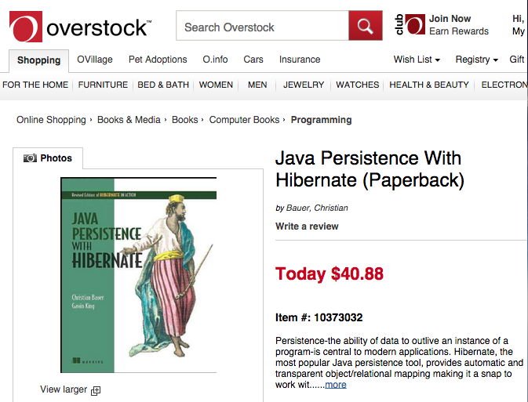
$40.00

Slide 48
And each time you refreshed the page…

Slide 49
$38.00

Slide 50
$36.10

Slide 51
$33.21

Slide 52
The price would keep decreasing until…

Slide 53
$0.00

Slide 54
Why did this happen?

Slide 55
A: Because property access (instead of field) is being used, Hibernate will dirty check using the getter
@Entity public class Product {
private int id;
private BigDecimal price;
@Column
public BigDecimal getPrice() {
return price.subtract(getDiscount());
}
public void setPrice(BigDecimal price) { this. price = price; }
}

Slide 56

Dirty Checking

Slide 57
Dirty Checking
Hibernate will synchronize changes to a persistent entity to the database – even if you don’t explicitly call persist
Use @Immutable when possible
Use field-level access when possible
Consider using @DynamicUpdate to update only columns that have changed

Slide 58
Dirty Checking Pro Tips:
Use @Immutable when possible
Use field-level access when possible
Consider using @DynamicUpdate to update only columns that are dirty

Slide 59
Next Gotcha: Dirty Checking Performance

Slide 60
Q: How many times will a Person instance be dirty checked in the following code?
EntityManager manager = factory.createEntityManager();
manager.getTransaction().begin();
for (int i = 1; i <= 100; i++) {
manager.persist(new Person("person" + i, "Name")); manager.flush();
}
manager.getTransaction().commit();
manager.close();

Slide 61
A: Potentially 5050 times!
EntityManager manager = factory.createEntityManager();
manager.getTransaction().begin();
for (int i = 1; i <= 100; i++) {
manager.persist(new Person("person" + i, "Name"));
manager.flush();
}
manager.getTransaction().commit();
manager.close();
Each time Hibernate needs to flush, it will dirty check every entity associated with the session

Slide 62
Each time Hibernate needs to flush, it will dirty check every entity associated with the session

Slide 63
1st iteration, Hibernate dirty checks 1 entity. 2nd iteration, dirty checks 2 entities. … Nth iteration dirty checks n entities.
EntityManager manager = factory.createEntityManager();
manager.getTransaction().begin();
for (int i = 1; i <= 100; i++) {
manager.persist(new Person("person" + i, "Name"));
manager.flush();
}
manager.getTransaction().commit();
manager.close();

Slide 64
Hibernate has turned this code into O(n²) performance.
EntityManager manager = factory.createEntityManager();
manager.getTransaction().begin();
for (int i = 1; i <= 100; i++) {
manager.persist(new Person("person" + i, "Name"));
manager.flush();
}
manager.getTransaction().commit();
manager.close();

Slide 65
For performance-sensitive apps, keep your PersistenceContext/Session as lean as possible. Consider creating a new session for each unit of work or evicting entities that are no longer needed.
Pro tip:

Slide 66
Next Gotcha: Batch Processing

Slide 67
Insert using JPA
EntityManager entityManager =
entityManagerFactory.createEntityManager();
entityManager.getTransaction().begin();
for (long i = 1; i <= records; i++) {
entityManager.persist(new Person(”name”+i));
}
entityManager.getTransaction().commit();
entityManager.close();

Slide 68
Insert using JPA with explicit flush and clear
EntityManager entityManager =
entityManagerFactory.createEntityManager();
entityManager.getTransaction().begin();
for (long i = 1; i <= records; i++) {
entityManager.persist(new Person(”name”+i));
if (i % batchSize == 0) {
entityManager.flush();
entityManager.clear();
}
}
entityManager.getTransaction().commit();
entityManager.close();

Slide 69
Insert using Hibernate StatelessSession
SessionFactory sessionFactory =
entityManagerFactory.unwrap(SessionFactory.class);
StatelessSession session =
sessionFactory.openStatelessSession();
Transaction tx = session.beginTransaction();
for (long i = 1; i <= records; i++) {
session.insert(new Person(i, ”name" + i));
}
tx.commit();
session.close();

Slide 70
Insert using JDBC
Session session =
entityManagerFactory.createEntityManager().unwrap(Session.class);
Transaction tx = session.beginTransaction();
session.doWork(new Work() {
public void execute(Connection connection) throws SQLException {
try(
PreparedStatement insertStatement =
connection.prepareStatement(
"insert into person (id, name) " +
"values (person_id_seq.nextval, ?)")) {
for (int i = 1; i <= records; i++) {
insertStatement.setString(1, "name" + i);
insertStatement.execute ();
}
}
}
});
tx.commit();

Slide 71
Insert using JDBC using Batch API
Session session =
entityManagerFactory.createEntityManager().unwrap(Session.class);
Transaction tx = session.beginTransaction();
session.doWork(new Work() {
public void execute(Connection connection) throws SQLException {
try(
PreparedStatement insertStatement =
connection.prepareStatement(
"insert into person (id, name) " +
"values (person_id_seq.nextval, ?)")) {
for (int i = 1; i <= records; i++) {
insertStatement.setString(1, "name" + i);
insertStatement.addBatch();
if(i % batchSize == 0) {
insertStatement.executeBatch();
}
}
}
}
});
tx.commit();

Slide 72
Batch INSERT performance
Insert 100K Person records into an Oracle enterprise database
Method | Execution time (in seconds)
JPA | 98s
JPA w/ explicit clear/flush | 86s
Hibernate StatelessSession | 86s
JDBC | 66s
JDBC using Batch API | 9s

Slide 73
Benchmark code is available on Github
https://github.com/nhartner/jpa-gotchas
By default, uses H2 in-memory database so that it works out of the box. For valid results must run against real Oracle database.

Slide 74
Consider using something different than JPA for batch jobs pumping a lot of records into the database
Pro tip:

Slide 75
Next Gotcha: Thread Safety

Slide 76
Q: Is the following class thread-safe?
public class ThreadSafePerson {
private final int id;
private final String firstName;
private final String lastName;
private final Set<ThreadSafeAddress> addresses = new HashSet<>();
public int getId() { return id; }
public String getFirstName() { return firstName; }
public String getLastName() { return lastName; }
public Set<ThreadSafeAddress> getAddresses() {
return ImmutableSet.copyOf(addresses);
}
...

Slide 77
A: Yes
public class ThreadSafePerson {
private final int id;
private final String firstName;
private final String lastName;
private final Set<ThreadSafeAddress> addresses = new HashSet<>();
public int getId() { return id; }
public String getFirstName() { return firstName; }
public String getLastName() { return lastName; }
public Set<ThreadSafeAddress> getAddresses() {
return ImmutableSet.copyOf(addresses);
}
...

Slide 78
Q: What if it’s annotated and handed over to Hibernate?
@Entity(name="person")
@Immutable
public class ThreadSafePerson {
@Id @Column private final int id;
@Column private final String firstName;
@Column private final String lastName;
@OneToMany(mappedBy="person")
private final Set<ThreadSafeAddress> addresses = new HashSet<>();
public int getId() { return id; }
public String getFirstName() { return firstName; }
public String getLastName() { return lastName; }
public Set<ThreadSafeAddress> getAddresses() {
return ImmutableSet.copyOf(addresses);
}
...

Slide 79
A: No longer thread-safe! Hibernate will inject a PersistentSet into the address field. If multiple threads call getAddresses() concurrently, trouble could ensue!
@Entity(name="person")
@Immutable
public class ThreadSafePerson {
@Id @Column private final int id;
@Column private final String firstName;
@Column private final String lastName;
@OneToMany(mappedBy="person")
private final Set<ThreadSafeAddress> addresses = new HashSet<>();
public int getId() { return id; }
public String getFirstName() { return firstName; }
public String getLastName() { return lastName; }
public Set<ThreadSafeAddress> getAddresses() {
return ImmutableSet.copyOf(addresses);
}
...

Slide 80
Lazy Loading
Session is not thread safe
Hibernate persistent Collections have a reference to the session

Slide 81
Lazy Loading
Persistent entities with lazy associations are not thread safe.
Don’t share them.
Only cache them using Hibernate 2nd level cache.

Slide 82
Conclusion
Just because you called persist() doesn’t mean it’s in the database (yet)
Just because you didn’t call persist() doesn’t mean Hiberate won’t save something to the database
Hibernate may persist changes to the database at unexpected times
Prefer quick database transactions
Loading a large number of entities can have performance impacts
Persistent entities are not thread safe

