Slide 1




The 2021 IEEE Conference on Dependable and Secure Computing, Aizuwakamatsu, Fukushima, Japan
Mixed-mode Information Flow Tracking With Compile-time Taint Semantics Extraction and Offline Replay
Yu-Hsin Hung, Bing-Jhong Jheng, Hong-Wei Li, Wen-Yang Lai, Sanoop Mallissery, Yu-Sung Wu
Department of Computer Science
National Chiao Tung University, Hsinchu, Taiwan
Presented by: Sanoop Mallissery

Slide 2
Problem Definition
To Ensure that sensitive information is securely and properly handled by highly sophisticated Computer Applications
Information Flow Tracking at byte-granularity and incurs moderate runtime performance overhead in an online production environment
Notes:
We know that sophisticated computer applications are to be secured tightly with sensitive information. As security attacks become more sophisticated, there is a rising need for static and Dynamic analysis in production environment. Though many researches has been carried out in this area, we are proposing Information Flow Tracking in online production environment at byte granularity level.

Slide 3
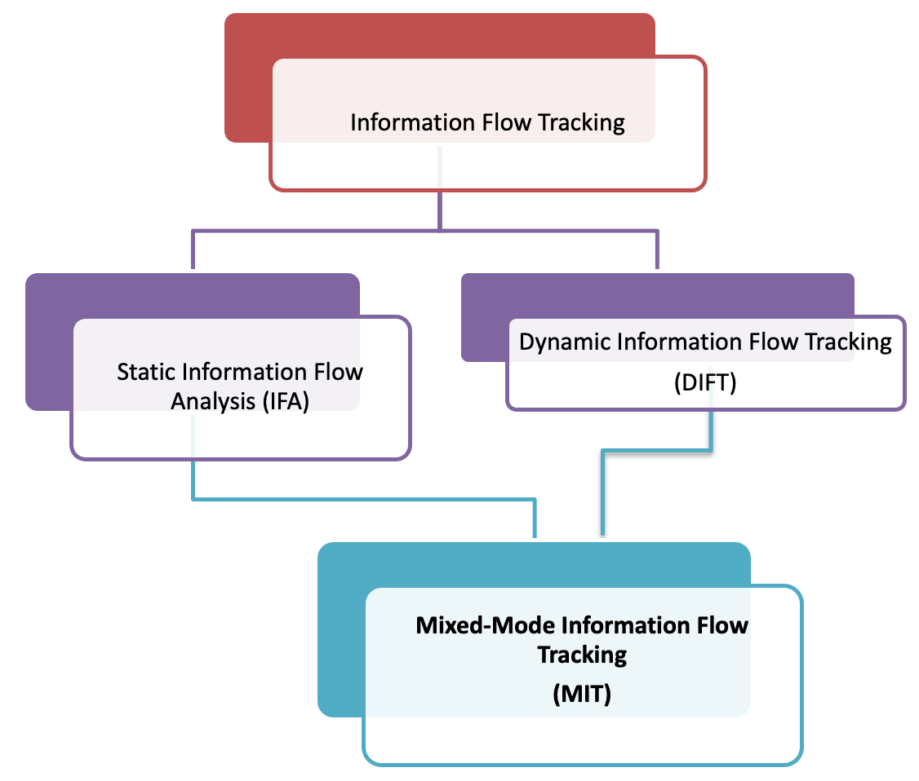
Introduction
Static Taint Analysis
Performed without actually executing the program
No runtime overhead
Limitation: conditional statements, control flow
Dynamic Taint Analysis
Analyzing the program during execution
Limitation : runtime overhead
Tightly-coupled taint propagation policy
Mixed-Mode Information Flow Tracking (MIT)
Streamlined process for IFA and DIFT
The decoupling process consists of compile-time extraction of language-independent taint semantics intermediate representation (TSIR) from the target program and offline replay of the TSIR.
Notes:
Information Flow tracking basically deals with Static information flow analysis (IFA) and Dynamic information flow tracking (DIFT). IFA help us understand the likely flow paths of information in a program so that we can verify their consistency with the security policies. But the problem here is, inherent dynamisms in application workload like conditional statements, control flow, make it difficult to determine the security attributes of the flow paths beforehand.
DIFT overcomes the issue by monitoring the actual flows of information at runtime. but, the monitoring can incur significant performance overhead, and their uses are limited to offline program analysis
Thus we introduce Mixed mode Information Flow Tracking which is a mix of both IFA and DIFT. It has decoupling process that consist of compile time extraction of Taint semantics and offline replay of TSIR.

Slide 4
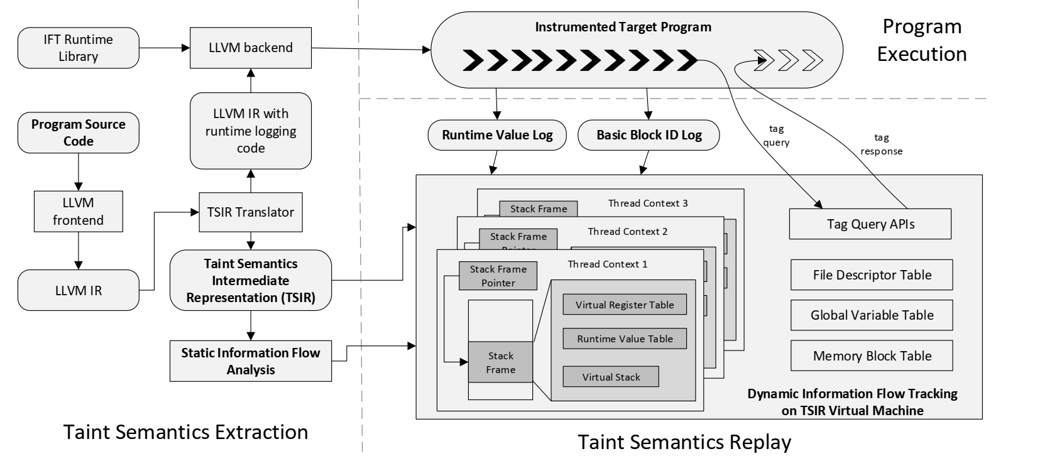
Proposed System
Mixed Information Flow Tracking
Combines the advantages of static analysis and dynamic analysis
Extracts explicit taint semantics during compile-time
Logging execution trace and runtime values
Fig.: Mixed-mode Information Flow Tracking
Notes:
This is the proposed architecture of MIT. It has three major processs. Taint Semantics extraction , program execution and Taint semantics Replay. The features of MIT is it extracts taint semantics during compile time and minimizes the runtime overhead of dynamic information flow tracking by decoupling the tracking logic from program execution.

Slide 5
Proposed System
Taint Semantics Extraction
The TSIR Translator extracts taint semantics from the LLVM IR of the target program at compile-time and translates
Intermediate representation for information flow tracking (i.e. the TSIR)
Fig.: Mixed-mode Information Flow Tracking
Taint Semantics Replay
Dynamic information flow tracking (DIFT) is instantiated by reconstructing the control flows and the data flows of the target program
Replays the TSIR with respect to the basic block ID log and the runtime value log on the TSIR VM
Notes:
Taint semantics extraction Initially converts LLVM IR to an intermediate representation for information flow tracking (i.e. the TSIR) . The instrumented LLVM IR will be compiled and then get linked with the IFT runtime library to produce the instrumented target program ready for dynamic information flow tracking
Program Execution/record Phase :The instrumented target program is deployed in the production environment and gets executed as usual. The instrumented runtime logging code will log the IDs of the executed basic blocks and the accompanying runtime values. DIFT occurs In replay phase. Here, it reconstructs the control flows and the data flows of the target program, which is achieved by replaying the TSIR with respect to the basic block ID log and the runtime value log on the TSIR virtual machine . We may examine each phase in detail

Slide 6
Work Flow
Extraction Phase
Record Phase
Replay Phase
Information Flow Tracking Runtime Library
tag query response
TSIR Translator
Instrumented Target Program
tag query request
LLVM IR Instrumentation
Instrumented
LLVM IR
runtime
log
Taint Semantics Extraction
Taint Semantics Replay
Request Handling
LLVM IR to TSIR
Translation
Taint Semantics Intermediate Representation
Information Flow
Tracking Engine
LLVM IR
of
Target Program
Source Code
of
Target Program
Further Analysis
Whole-system Information Flow Tracking
Data Provenance
Data Leakage Detection
Fig.: Phases of MIT
Notes:
This is the break down of phases. Lets start with Extraction Phase

Slide 7
Extraction Phase
Extraction Phase
Record Phase
Replay Phase
Information Flow Tracking Runtime Library
tag query response
TSIR Translator
Instrumented Target Program
tag query request
LLVM IR Instrumentation
Instrumented
LLVM IR
runtime
log
Taint Semantics Extraction
Taint Semantics Replay
Request Handling
LLVM IR to TSIR
Translation
Taint Semantics Intermediate Representation
Information Flow
Tracking Engine
LLVM IR
of
Target Program
Source Code
of
Target Program
Further Analysis
Whole-system Information Flow Tracking
Data Provenance
Data Leakage Detection
clang
int c;
c = a[2] + b;
Fig.: TSIR Translator extraction phase
Notes:
Consider a c program to be compiled with clang.

Slide 8
Extraction Phase (contd.)
Extraction Phase
Record Phase
Replay Phase
Information Flow Tracking Runtime Library
tag query response
TSIR Translator
Instrumented Target Program
tag query request
LLVM IR Instrumentation
Instrumented
LLVM IR
runtime
log
Taint Semantics Extraction
Taint Semantics Replay
Request Handling
LLVM IR to TSIR
Translation
Taint Semantics Intermediate Representation
Information Flow
Tracking Engine
LLVM IR
of
Target Program
Source Code
of
Target Program
Further Analysis
Whole-system Information Flow Tracking
Data Provenance
Data Leakage Detection
%2 = alloca i32
%3 = getelementptr i32, i32* %0, i64 2
%4 = load i32, i32* %3
%5 = add i32 %4, %1
store i32 %5, i32* %2
Fig.: TSIR Translator extraction phase
Notes:
It is compiled with llvm tool chain and hence the IR(Intermediate Representation) is obtained.

Slide 9
Extraction Phase (contd.)
Extraction Phase
Record Phase
Replay Phase
Information Flow Tracking Runtime Library
tag query response
TSIR Translator
Instrumented Target Program
tag query request
LLVM IR Instrumentation
Instrumented
LLVM IR
runtime
log
Taint Semantics Extraction
Taint Semantics Replay
Request Handling
LLVM IR to TSIR
Translation
Taint Semantics Intermediate Representation
Information Flow
Tracking Engine
LLVM IR
of
Target Program
Source Code
of
Target Program
Further Analysis
Whole-system Information Flow Tracking
Data Provenance
Data Leakage Detection
Fig.: TSIR Translator extraction phase
Notes:
FROM IR, taint semantics is extracted from tsir translator. It has intermediate tsir language design.

Slide 10
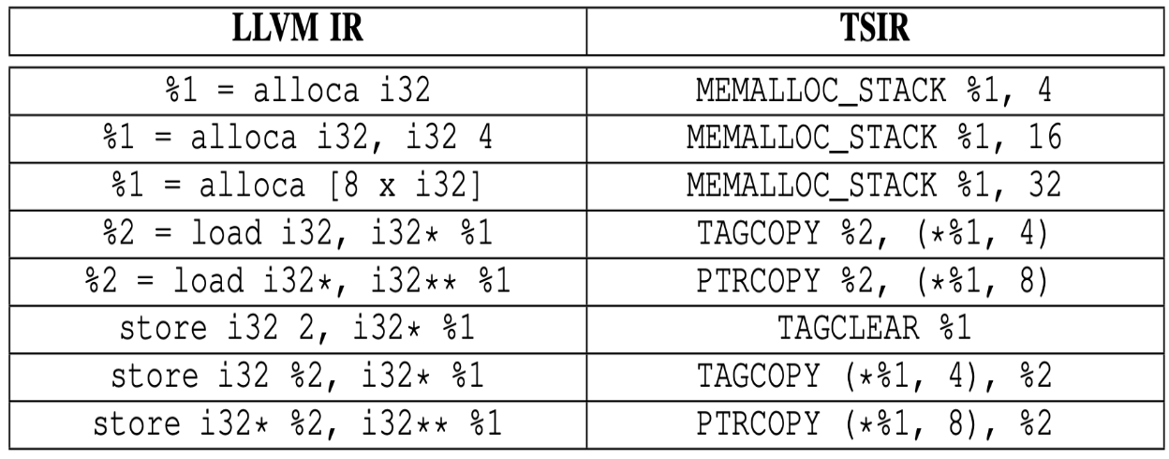

Taint Semantics Extraction
LLVM IR
Binary Operations
Vector and Aggregate Operations
Memory Access and Addressing Operations
Other Operations
Table: TSIR Mappings for Memory Access Operations
Extraction – Binary Operations
add, sub, mul, fadd, fsub, fmul, shl, and, or......
Vector as operands
SIMD: Single Instruction Multiple Data “de-vectorize” into field-to-field operations
Notes:
For each binary operation, vector and aggregate operations, Memory access operation, there is corresponding TSIR language.
The alloca, load, store Instructions etc are formulated in the table. It is to note that when there is vector operation in llvm, it is devectorised . It is explained in subsequent slides.

Slide 11
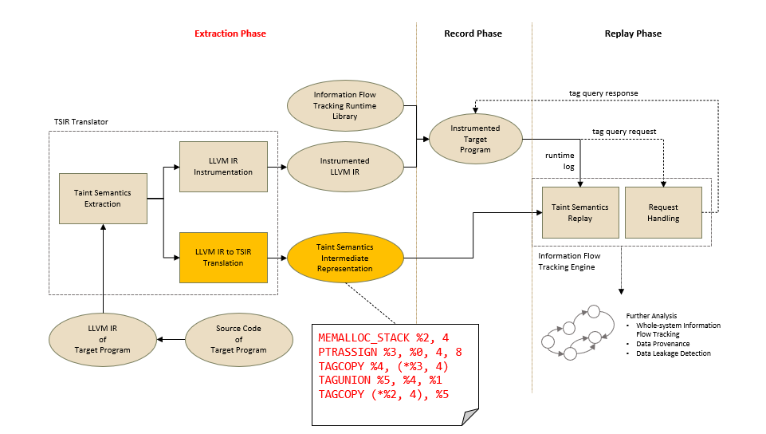
TSIR Language Design
The TAG-prefix for taint tag propagation and manipulation
PTR-prefix for the manipulation of pointers.
COND-suffix: conditional propagation
PHI-suffix: control-flow based propagation
T (%1) to denote %1 as a taglist
P (%2) to denote %2 as a pointer
Table: LLVM IR and TSIR mapping
LLVM IR | TSIR
%3 = add i32 %1, %2 | TAGUNION %3, %1, %2
%2 = add i32 %1, 3 | TAGCOPY %2, %1
%1 = add i32 2, 3 | TAGCLEAR %1
alloca | MEMALLOC_STACK
malloc/calloc/realloc | MEMALLOC_HEAP
Fig.: TSIR Translator extraction phase
Local identifier (%n), Global identifier (@name), Runtime identifier ($n).
register region syntax (%n, i)
(*%p, len, off) to denote the len bytes sized region starting at offset off in the memory block pointed by *%p.
Notes:
Local identifier(%n)s are used to denote virtual registers with local scope while global identifiers(@n) are used to denote virtual registers with global scope. Runtime identifiers ($n) are used in the logging of runtime values.
Then, register region syntax (%n, i) to denote the i-th field of register %n.
Next is the notation for memory region syntax *%p to denote the entire memory block pointed by the pointer-type register %p and the syntax (*%p, len, off) to denote the length bytes sized region starting at offset off in the memory block pointed by *%p .
Also, The TAG-prefix instructions are related to taint tag propagation and manipulation, and the PTR-prefix instructions are for the manipulation of pointers.
Instructions with COND-suffix are used for conditional propagation; instructions with PHI-suffix are used for control-flow based propagation.
We use the notation T (%1) to denote %1 as a taglist and P (%2) to denote %2 as a pointer. The table shows llvm IR & corresponding TSIR.
For the case where both operands are variables as in first row, it is translated as a TAGUNION instruction . Here tag is given to both variables. If any one among them is constant, the tag associated with variable is copied to destination.{TAGCOPY} eg-%2 = add i32 %1, 3 ; 3 is constant, hence copy tag from %1 to %2. Next, if both are constants as in 3rd row, clear TAG by TAGCLEAR. Allocation in stack & heap is MEMALLOC_STACK & MEMALLOC_HEAP.

Slide 12
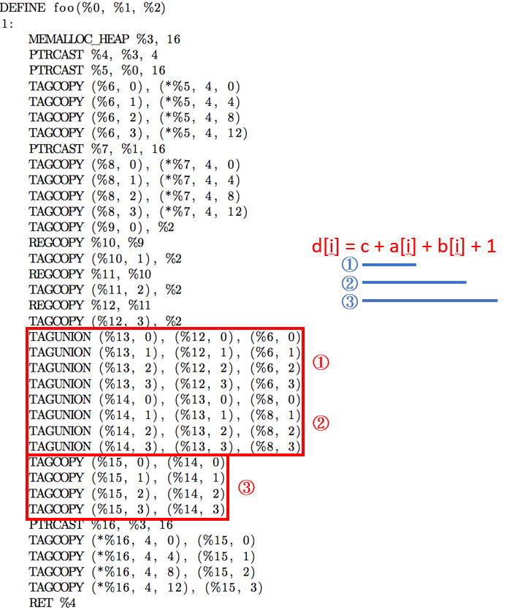
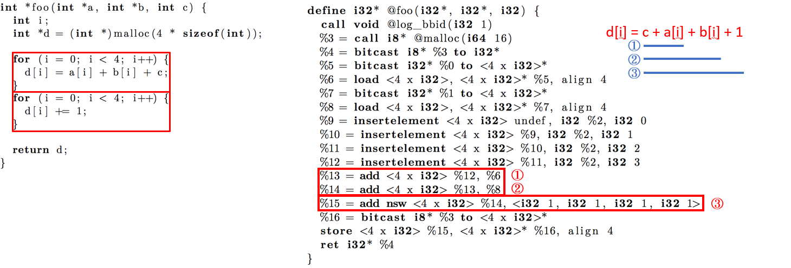
C -> LLVM IR -> TSIR
c-llvm IR
llvm IR-TSIR
Highlighted - Potential Vectorizable Operations
Notes:
Here as you see, there is vectorization since array is used. The for loop gets converted in llvm IR . The highlighted portions show the calculation off d[i] = c+ a[i] +b[i] + c. These operations are de-vectorised in TSIR usingb TAGUNION, TAGCOPY, etc. The single static assignment model is described in next slide

Slide 13
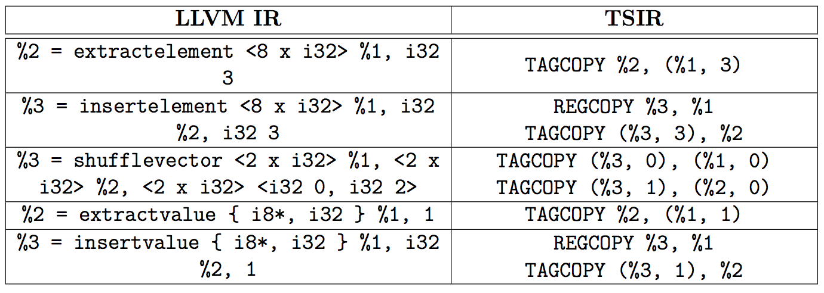
Extraction – Vector and Aggregate Operations
Element: for vector
Value: for struct and array
Static Single Assignment (SSA) form
Table: TSIR Mappings for LLVM IR
Notes:
In LLVM IR, vectors are represented as element- extractelement or insertelement. The values in struct/array is represented as value- extract value & insert value. These are converted to Tagcopy. As in LLVM, In TSIR also, we use static single assignment. Each variable has one assignment.

Slide 14
LLVM Instrumentation
Extraction Phase
Record Phase
Replay Phase
Information Flow Tracking Runtime Library
tag query response
TSIR Translator
Instrumented Target Program
tag query request
LLVM IR Instrumentation
Instrumented
LLVM IR
runtime
log
Taint Semantics Extraction
call void @log_bbid(i32 1)
......
Taint Semantics Replay
Request Handling
LLVM IR to TSIR
Translation
Taint Semantics Intermediate Representation
Information Flow
Tracking Engine
LLVM IR
of
Target Program
Source Code
of
Target Program
Further Analysis
Whole-system Information Flow Tracking
Data Provenance
Data Leakage Detection
Fig.: TSIR LLVM Instrumentation
Notes:
Translator instruments the LLVM IR with runtime logging code . On start of each block, void @log_bbid is instrumented. LLVM pass is used for instrumentation. These Instrumentations will be reflected in TSIR also.

Slide 15
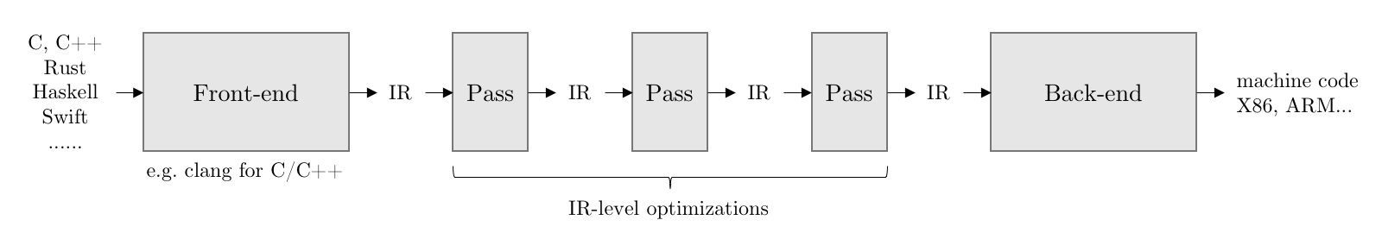
Record-Replay based Information Flow Tracking
Record: LLVM IR Instrumentation
Implemented as LLVM Pass
Execution trace: log_bbid(int id)
Basic Block bbid in TSIR is non-empty
bbid is referenced by any PHI instruction in TSIR
Runtime value: log_rtvalue(int val)
For vector, de-vectorize it
# of log_rtvalue() call = # of RECV instruction in TSIR
Fig.: IR optimizations
Notes:
Lets keep in mind that DIFT has a online record phase and an offline replay phase. The logging of basic block IDs and runtime values is implemented by instrumenting the LLVM IR from the target program. We place a call to the log function at the entry of each basic block using llvm pass. Basic blocks without explicit data flow are skipped during the instrumentation. But phi instruction should be logged to correctly propagate the data flow for TAGCOPY_PHI and PTRCOPY_PHI. For runtime value logging as that of conditional flows, for loops etc, for each reference to a LLVM IR a call to log_rtvalue() is placed right after it and TSIR will have a RECV instruction. If the value to be logged is a vector, the instrumentation will de-vectorizes it and inserts a separate logging call for each vector field. In general, the number of instrumented log_rtvalue() calls should match the number of RECV instructions in the TSIR.

Slide 16
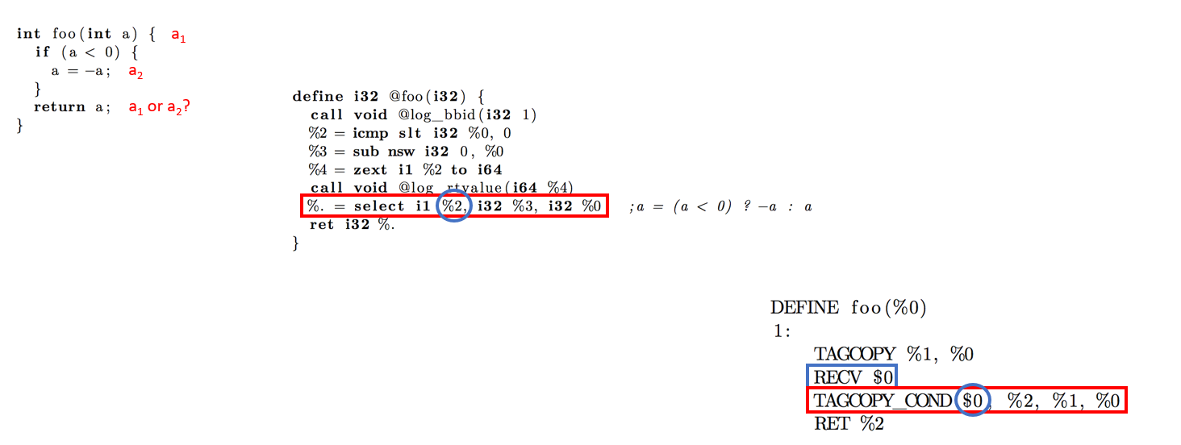
Example : Conditional Instruction (Compiled with -O2 Option)
C-LLVM
LLVM-TSIR
Conversion From c->llvm->TSIR
Notes:
Instrumenting log_bbid on each block entry and while run time, the value needs to be logged hence we use @log_rtvalue . This is represented as RECV $0.

Slide 17
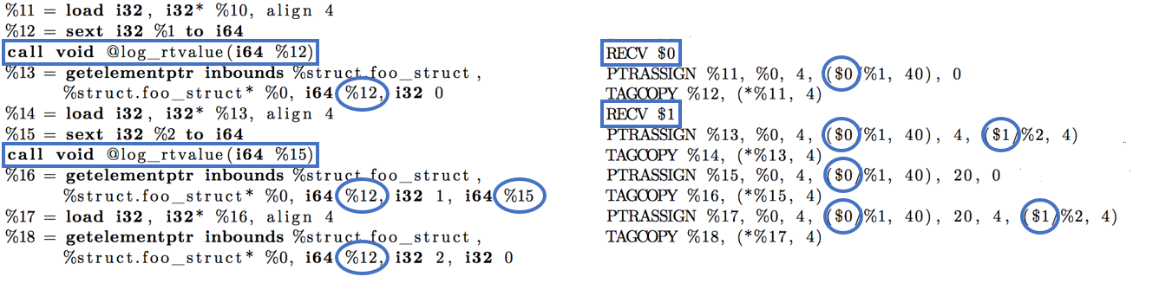
Example: De-vectorisation
Notes:
This is another example Here u may see that, when buffer/array is been used, its RECV in TSIR and log_rtvalue is instrumented. Here we can see devectorisation at two places and the number of instrumented log_rtvalue() calls should match the number of RECV instructions in the TSIR

Slide 18
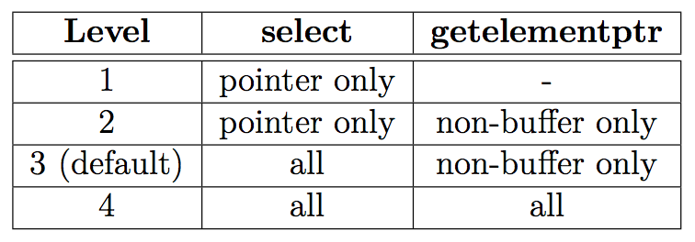
Extraction - Translator and TSIR Optimizations
Buffer: atomic unit
integer array which is larger than threshold size (e.g., 128 bytes)
char buf[512] → [512 x i8] → atomic unit
buf[i] = secret → taint the entire variable
Log Level
runtime value logging: select & getelementptr
Table: Runtime Logging Levels
Notes:
For instance, leaking a few bytes of a 256-bit secret key can be seen as if the whole key is leaked. The TSIR Translator provides an option for setting the threshold size of singleton buffer. The translator will treat any char or int array (in LLVM IR, a char array is represented as an i8 array), whose size is larger than the threshold as an singleton (the default threshold is 128 bytes). Taint propagation to any part of a singleton buffer is treated as if the whole buffer is getting tainted. This optimization implies that the variable offsets involved in getelementptr can be completely ignored in the runtime logging.
We define four log levels for developers to choose the tradeoffs between analysis precision and logging overhead .
It is like this .Level 4 performs the most fine-grained runtime logging. Variable offsets in getelementptr instruction and runtime conditions in select instruction are all logged to achieve byte-level DIFT granularity for all data objects. In level 2 and level 3, variable offsets in getelementptr are logged only for non-singleton buffers. In level 1 and level 2, the runtime conditions in select are logged only when pointer operands are present

Slide 19
Record-Replay
Extraction Phase
Record Phase
Replay Phase
Information Flow Tracking Runtime Library
tag query response
TSIR Translator
Instrumented Target Program
tag query request
LLVM IR Instrumentation
Instrumented
LLVM IR
runtime
log
Taint Semantics Extraction
Taint Semantics Replay
Request Handling
LLVM IR to TSIR
Translation
Taint Semantics Intermediate Representation
Information Flow
Tracking Engine
LLVM IR
of
Target Program
Source Code
of
Target Program
Further Analysis
Whole-system Information Flow Tracking
Data Provenance
Data Leakage Detection
Fig.: MIT Record Phase
Notes:
the Information Flow Tracking Runtime Library provides the functions for logging basic block IDs and runtime values . The run time log value AND block ids on deployment is presented to Replay Phase. Replay reconstructs the information flow

Slide 20
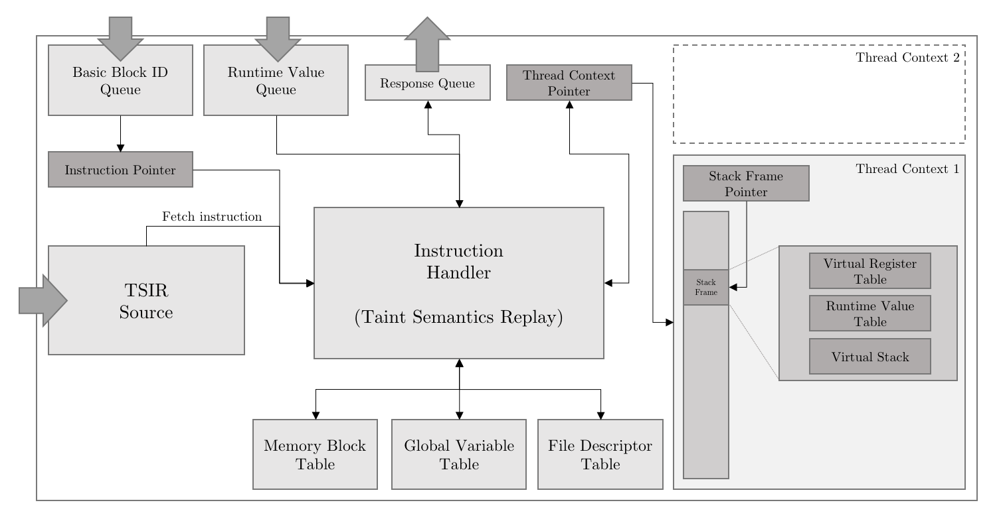
Record-Replay based Information Flow Tracking (cont.)
Replay: TSIR Virtual Machine
Fig.: MIT Record – Replay Breakdown Architecture
Notes:
This figure shows the architecture of TSIR REPLAY.
TSIR IS PROVIDED with block ids and run time values. The TSIR replay phases have following tables
The Memory Block Table tracks all the memory blocks allocated on the heap or on the stack.
The Global Variable Table keeps track of all the global variables and their corresponding memory blocks.
The File Descriptor Table stores the pseudo file descriptors and their corresponding tags.
To support multi-threaded programs, Thread Context for each user thread and keeps it in the Thread Context Table.
When replaying a basic block ID, TSIR VM first detects if a thread context switch is required. If the corresponding thread context does not exist, it will allocate a new one and switch from the current context to it.
Stack Frame is allocated to maintain the function call states. It also includes Runtime Value Table to track the mapping between the identifiers and the values.

Slide 21
Replay Phase
Extraction Phase
Record Phase
Replay Phase
Information Flow Tracking Runtime Library
tag query response
TSIR Translator
Instrumented Target Program
tag query request
LLVM IR Instrumentation
Instrumented
LLVM IR
runtime
log
Taint Semantics Extraction
Taint Semantics Replay
Request Handling
LLVM IR to TSIR
Translation
Taint Semantics Intermediate Representation
Information Flow
Tracking Engine
LLVM IR
of
Target Program
Source Code
of
Target Program
Further Analysis
Whole-system Information Flow Tracking
Data Provenance
Data Leakage Detection
Fig.: MIT Replay Phase
Taint tags are stored in either Virtual Register or Memory Block
Tag storage
32-bit integer: the first 16 bits are reserved for fd
hash map: key value between 0x70000000 to 0x7fffffff are reserved for fd
Notes:
Given a basic block ID, the TSIR VM fetches all the TSIR instructions from the corresponding basic block and replays them. It tracks the usage of memory buffer and propagate the taint tags among the virtual registers and memory blocks . The Virtual Register Table stores the states of virtual registers in the function scope. Virtual Stack tracks all the memory blocks allocated by the MEMALLOC_STACK instruction in the function scope .
The TSIR VM propagates the taint tags associated with the operands of TSIR instructions during the replay. The taint tags can either be encoded as a 32-bit integer or kept in a hash map. In the 32-bit integer encoding, each bit represents a tag so there can be up to 32 tags. The first 16 bits are reserved for virtual file descriptors and the last 16 bits are available for general uses.

Slide 22
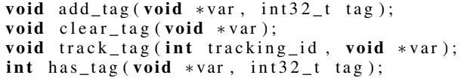
Replay Phase (contd.)
Extraction Phase
Record Phase
Replay Phase
Information Flow Tracking Runtime Library
tag query response
TSIR Translator
Instrumented Target Program
tag query request
LLVM IR Instrumentation
Instrumented
LLVM IR
runtime
log
Taint Semantics Extraction
Taint Semantics Replay
Request Handling
LLVM IR to TSIR
Translation
Taint Semantics Intermediate Representation
Information Flow
Tracking Engine
LLVM IR
of
Target Program
Source Code
of
Target Program
Further Analysis
Whole-system Information Flow Tracking
Data Provenance
Data Leakage Detection
Fig. 6 : MIT Replay phase
Fig.: MIT Replay Phase
List of Tag query API
Notes:
When TSIR VM encounters a TAGQUERY instruction, it will check if the given region contains the tag of interest. The result will be passed back to the IFT runtime, which is blocked at a corresponding call to to has_tag() waiting for the check result.

Slide 23
Experiment Result
Performance
Command-line utilities - wget, tar, gzip , md5sum, sha256sum
Server programs
Effectiveness of Optimizations
Log compression
Effective data flow detection
Log level
Effectiveness of Information Flow Tracking
Notes:
To confirm the applicability of MIT in production environment, we used a variety of target programs including common Unix command-line utilities, server programs, and benchmarks in SPEC CPU2017 [5] to evaluate its runtime overhead . The experiments were conducted on a machine equipped with Intel Core i7-3770 processor and 16GB of RAM, running Ubuntu Linux 16.04.
five common Unix command-line utilities, which are GNU versions of wget, tar, gzip and md5sum, sha256sum from coreutils.

Slide 24
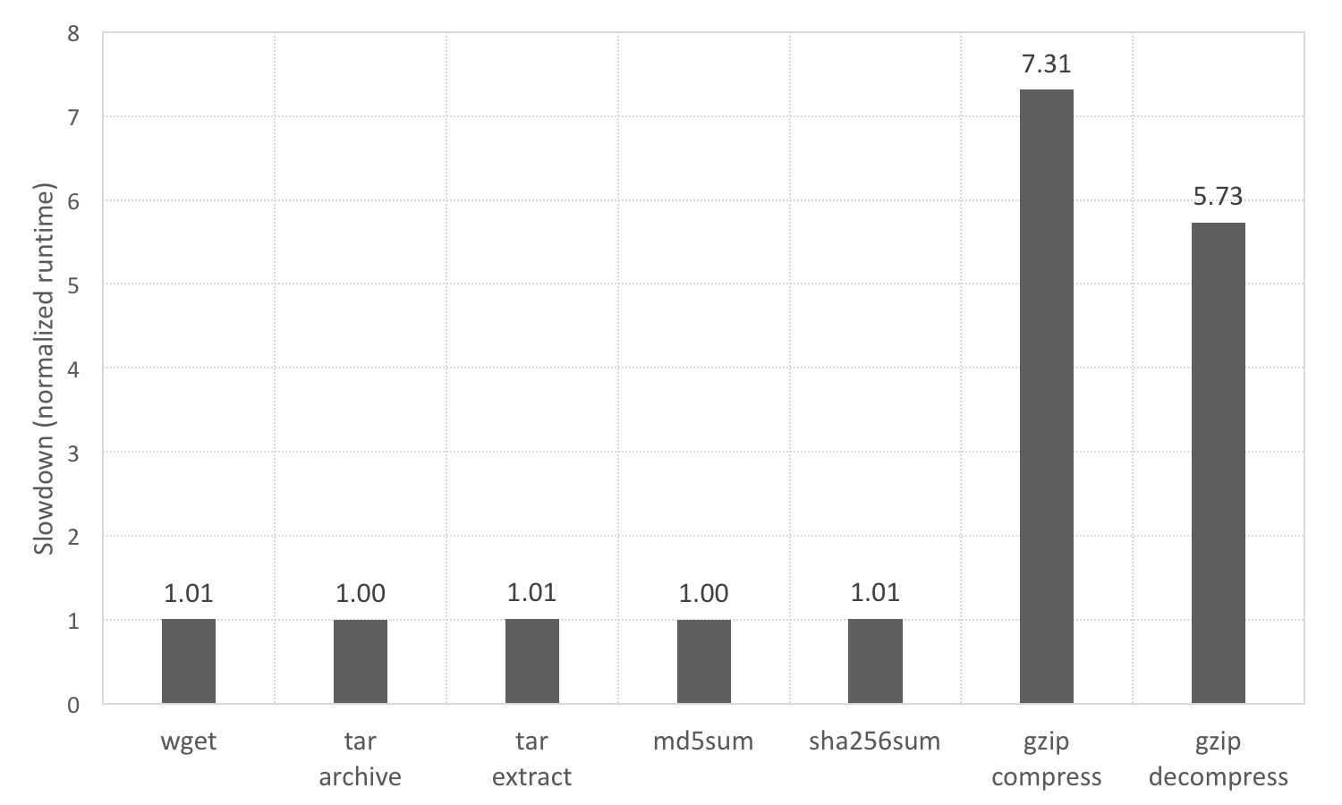
Command-line Utilities – Overhead
Fig.: Slowdowns of Command-line Utilities
Notes:
We can see that MIT instrumentation imposes negligible performance overhead on wget, tar, md5sum and sha256sum. However, for gzip, the slowdowns with respect to both the elapsed time and the CPU time are around 3x to 4x. This slowdown on CPU time indicates that the instrumented code is consuming a significant portion of the CPU time. This is because the execution of gzip involves very frequent control flow switches

Slide 25
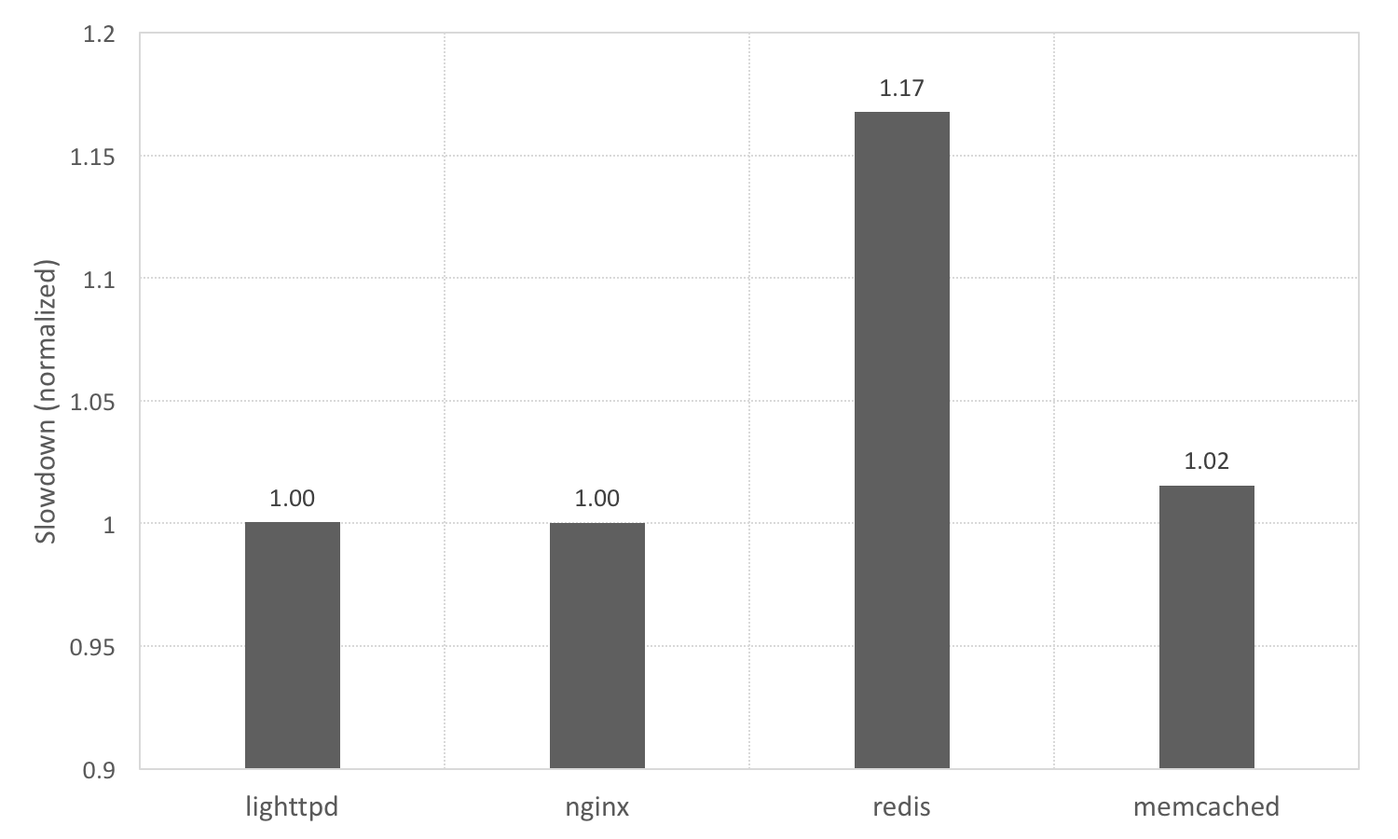
Server Programs – Overhead
Fig.: Slowdowns of Server Programs
Notes:
In this experiment, we tested MIT with four server programs including Lighttpd, Nginx, Redis, and Memcached. Fig. illustrates the performance slowdowns for these server programs. Overall, the performance overheads are negligible. The worst case is with Redis, which has 17% overhead.

Slide 26
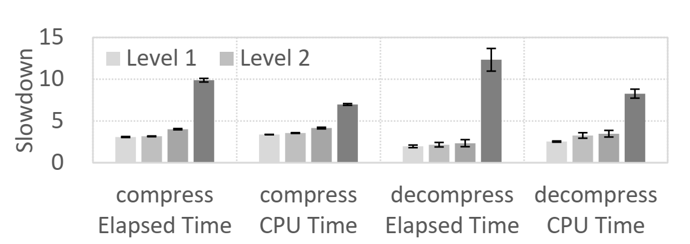
LOG LEVEL
Notes:
Log Level: MIT provides four log level settings for runtime value logging as discussed before. we used gzip to demonstrate how the log level settings affect the performance overhead. Fig. gives the elapsed time slowdown and the CPU time slowdown for each log level. We can see that the default log level 3 is a reasonable choice as it only incurs a little extra slowdown over level 1, and compared with level 4.

Slide 27
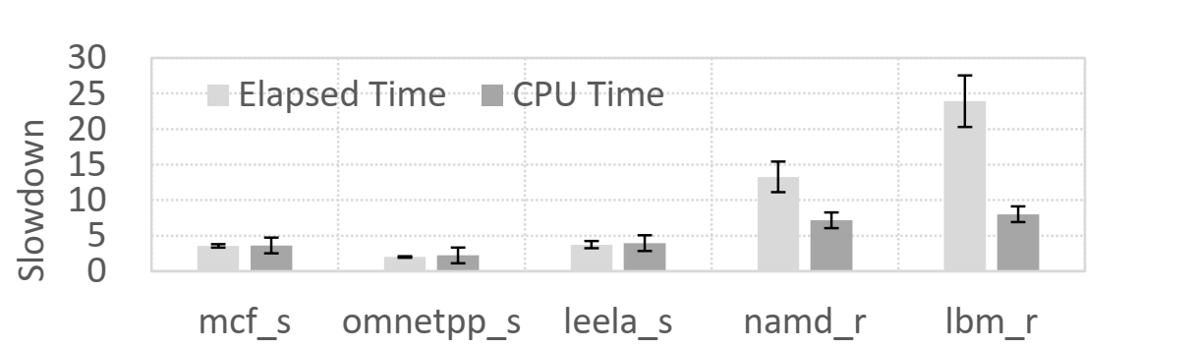
SPEC CPU BENCHMARKS
Fig.: Slowdowns of SPEC CPU Benchmarks
Notes:
We can see that the CPU time slowdowns are around 2x-7x. For mcf_s, omnetpp_s, and leela_s, the elapsed time slowdowns are on par with the CPU time slowdowns. However, for lbm_r and namd_R, the elapsed time slowdowns jump to 13x and 25x respectively. This is because their log throughputs reached beyond the disk I/O throughput.

Slide 28
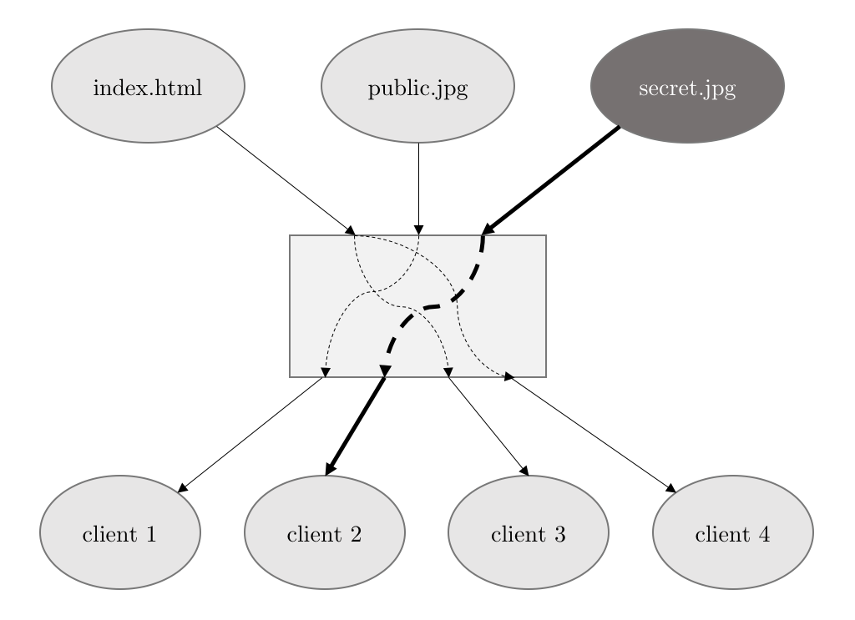
Effectiveness of Information Flow Tracking
Fig : Case study: Lighttpd
Notes:
Information flow of accessing the sensitive HTML document via homepage URL was detected . Anomaly detected with effective info flow tracking with MIT. In this experiment, considered a possible misconfiguration in lighttpd, where a passwordprotected URL is mistakenly set as the homepage of the website. Clients will be able to access a sensitive HTML document at the protected URL freely without authentication by accessing the homepage URL

Slide 29
Conclusion
The MIT prototype is built on top of LLVM
MIT derives the taint semantics TSIR from a target program at compile-time to facilitate IFA
DIFT can be performed asynchronously by replaying the TSIR according to the runtime logs
Decoupling information flow tracking from program execution
Extracting taint semantics
Recording execution trace and runtime values
Replaying taint semantics
Nearly language-independent and architecture-independent
Notes:
We see that MIT is the mixed mode, but at the same time it decouples DIFT from IFA. The compile time IFA is used well during replay phase since Runtime values, execution trace etc are the inputs to replay.
Since we use llvm & tsir, they are language independent & architecture independent. Experimental results have proved that MIT significantly reduces performance overhead and can be deployed in online production environment with byte-level granularity.

Slide 30
Future Scope
Logging Overhead
Single branch target
Loop optimization
Implicit Flow
External Library
Compile-time static analysis → Generate Library Handler
Replay Performance
Interpreter-based → Compiled language
Vulnerability Detection
e.g. stack overflow attack
Notes:
Future scope is that we may still reduce overhead by again loop optimisations and keeping single branch as target at each time. We may also think of developing a library for compile time analysis. Implicit flows are avoided (except phi) In MIT. We may extend to implicit flows too. Relay performance can be increased by using any compiled language. Many exploits can be performed such as stack overflow attack etc for vulnerability detection

Slide 31
References
[1] Vasileios P Kemerlis et al. “libdft: Practical dynamic data flow tracking for commodity systems”. In: Acm Sigplan Notices. Vol. 47. 7. ACM. 2012, pp. 121–132.
[2] David Yu Zhu et al. “TaintEraser: Protecting sensitive data leaks using application-level taint tracking”. In: ACM SIGOPS Operating Systems Review 45.1 (2011), pp. 142–154.
[3] Jonathan Bell and Gail Kaiser. “Phosphor: Illuminating dynamic data flow in commodity jvms”. In: ACM SIGPLAN Notices 49.10 (2014), pp. 83–101.
[4] Lap Chung Lam and Tzi-cker Chiueh. “A general dynamic information flow tracking framework for security applications”. In: Computer Security Applications Conference, 2006. ACSAC’06. 22nd Annual. IEEE. 2006, pp. 463–472.
[5] Kangkook Jee et al. “ShadowReplica: efficient parallelization of dynamic data flow tracking”. In: Proceedings of the 2013 ACM SIGSAC conference on Computer & communications security. ACM. 2013, pp. 235–246.
[6] Gaoyao Xiao et al. “Program-object level data flow analysis with applications to data leakage and contamination forensics”. In: Proceedings of the Sixth ACM Conference on Data and Application Security and Privacy. ACM. 2016, pp. 277–284.
[7] Jiang Ming et al. “StraightTaint: Decoupled offline symbolic taint analysis”. In: Proceedings of the 31st IEEE/ACM International Conference on Automated Software Engineering. ACM. 2016, pp. 308–319.
[8] Jiang Ming et al. “TaintPipe: Pipelined Symbolic Taint Analysis.” In: USENIX Security Symposium. 2015, pp. 65–80.
[9] Ryan Whelan, Tim Leek, and David Kaeli. “Architecture-independent dynamic information flow tracking”. In: International Conference on Compiler Construction. Springer. 2013, pp. 144–163.

