Slide 1
Prediction models on diamond price
Zhenming Yang
932784300

Slide 2
Project description
Final project of CS 540
Finished with R language
Combined with crawler and data analysis
Accelerated by parallel programming
Compare four machine learning models
Rshiny used for predictions

Slide 3
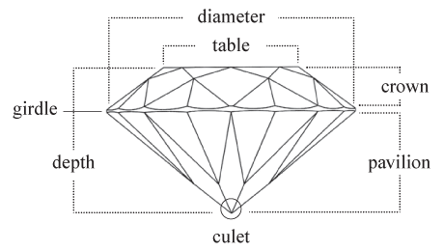
Basic knowledge about diamond dataset
11 properties for one diamond:
Price
Table
Depth
X,Y,Z
Cert
Carat
Clarity
Color
Cut

Slide 4





Basic knowledge about diamond dataset
11 properties for one diamond:
Price
Table
Depth
X,Y,Z
Cert
Carat
Clarity
Color
Cut
Cert

Slide 6
Two Content Layout with Table
First bullet point here
Second bullet point here
Third bullet point here
Class | Group A | Group B
Class 1 | 82 | 95
Class 2 | 76 | 88
Class 3 | 84 | 90

Slide 7
Two Content Layout with SmartArt
Group A
Task 1
Task 2
Group B
Task 1
Task 2
Group C
Task 1
First bullet point here
Second bullet point here
Third bullet point here

Slide 8
Add a Slide Title - 2

Slide 9
Add a Slide Title - 3

Slide 11
Add a Slide Title - 4

Slide 12
Add a Slide Title - 5

Slide 13
Title Layout
Subtitle

