Slide 1
Prediction models on diamond price
Zhenming Yang
932784300

Slide 2
Project description
Final project of CS 540
Finished with R language
Combined with crawler and data analysis
Accelerated by parallel programming
Compare four machine learning models
Rshiny used for predictions

Slide 3
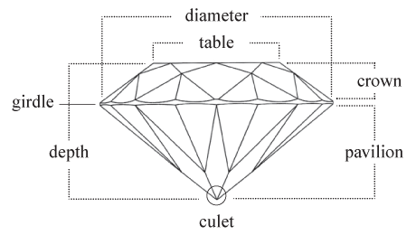
Basic knowledge about diamond dataset
11 properties for one diamond:
Price
Table
Depth
X,Y,Z
Cert
Carat
Clarity
Color
Cut

Slide 4





Basic knowledge about diamond dataset
11 properties for one diamond:
Price
Table
Depth
X,Y,Z
Cert
Carat
Clarity
Color
Cut
Cert

Slide 5
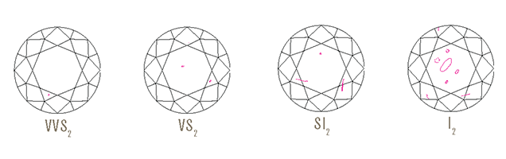
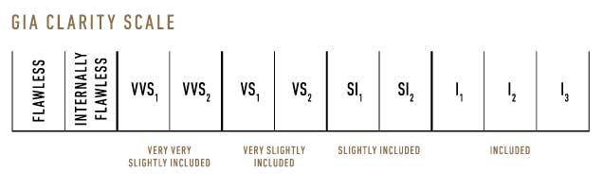
Basic knowledge about diamond dataset
11 properties for one diamond:
Price
Table
Depth
X,Y,Z
Cert
Carat
Clarity
Color
Cut
Clarity
Refers to the absence of these inclusions and blemishes.

Slide 6
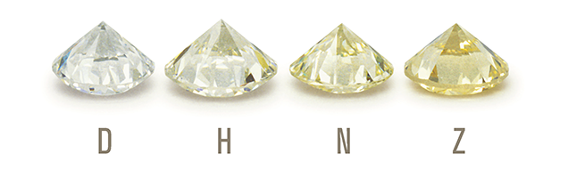
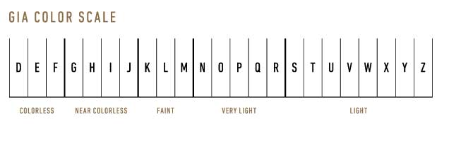
Basic knowledge about diamond dataset
11 properties for one diamond:
Price
Table
Depth
X,Y,Z
Cert
Carat
Clarity
Color
Cut
Color
Is what you cannot see. Diamonds are valued by how closely the approach colorlessness.

Slide 7
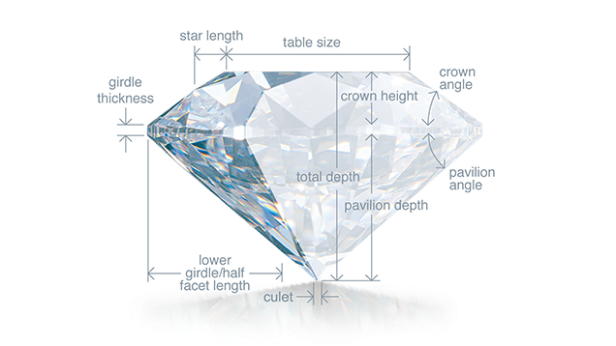
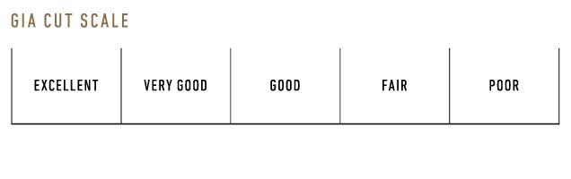
Basic knowledge about diamond dataset
11 properties for one diamond:
Price
Table
Depth
X,Y,Z
Cert
Carat
Clarity
Color
Cut
Cut
Is the factor that fuels a diamonds' fire sparkle and brilliance.

Slide 8
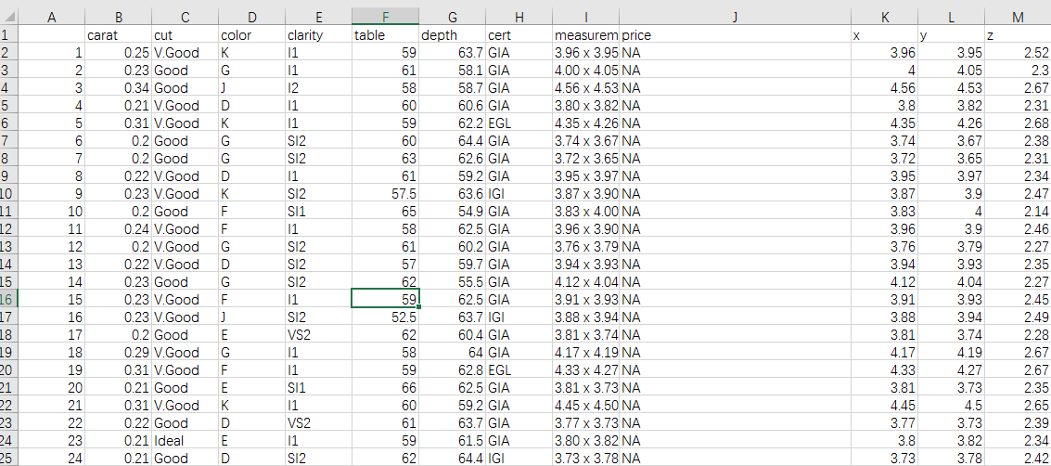
Source of data
All data from diamond search engine
http://www.diamondse.info/diamond-prices.asp
Analysis and collected with R crawler- rverst
More than 500000 round diamonds info collected

Slide 9
Source of data
Separate measurements in to x, y, z.
Omit NA and 0 values.
Shape: Round
Cut: 3 grades ( Good, V.Good, Ideal)
Color: 9 grades (D,E,F,G,H,I,J,K, L)
Clarity 10 (FL,IF,VVS1,VVS2,VS1,VS2,SI1,SI2,I1,I2)
Cert 4 grades( GIA, AGS, EGL, Others)

Slide 10
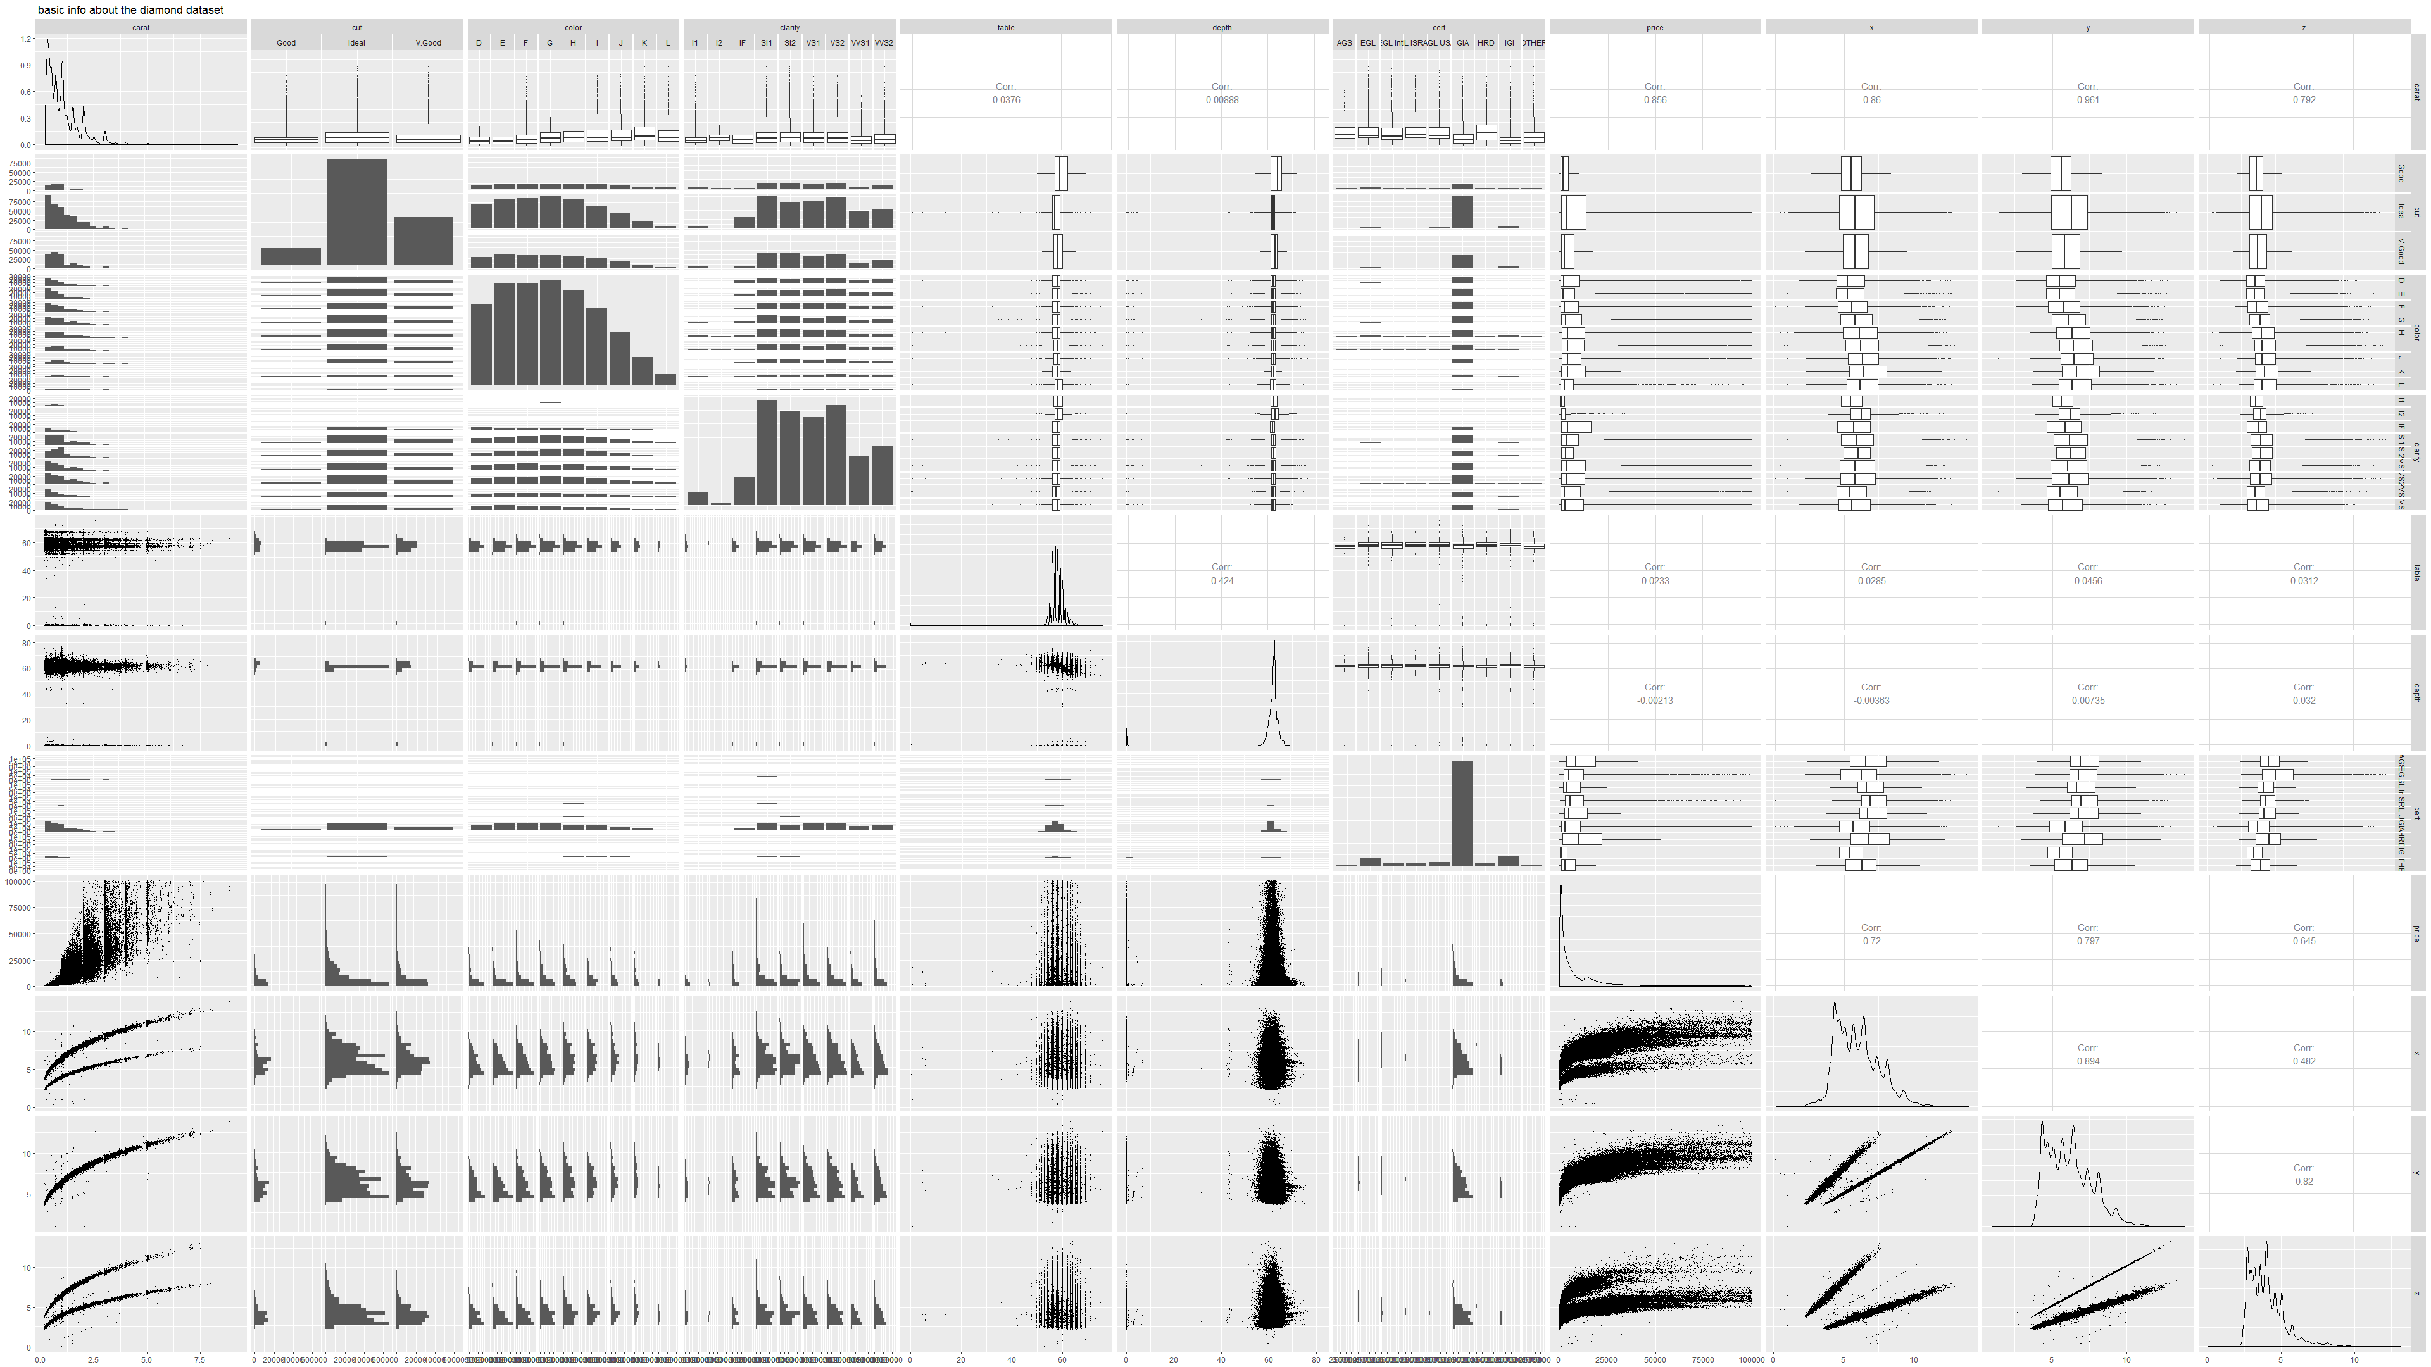
First step: general analysis

Slide 11



Slide 12
Two Content Layout with Table
First bullet point here
Second bullet point here
Third bullet point here
Class | Group A | Group B
Class 1 | 82 | 95
Class 2 | 76 | 88
Class 3 | 84 | 90

Slide 13
Two Content Layout with SmartArt
Group A
Task 1
Task 2
Group B
Task 1
Task 2
Group C
Task 1
First bullet point here
Second bullet point here
Third bullet point here

Slide 14
Add a Slide Title - 2

Slide 15
Add a Slide Title - 3

Slide 17
Add a Slide Title - 4

Slide 18
Add a Slide Title - 5

Slide 19
Title Layout
Subtitle

