Slide 1
Job Tracking.

Slide 2
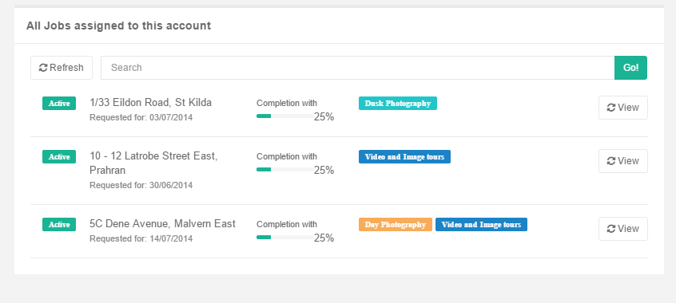
When the user hovers over the Product Group, it should give the user the date and time of the event.

Slide 3
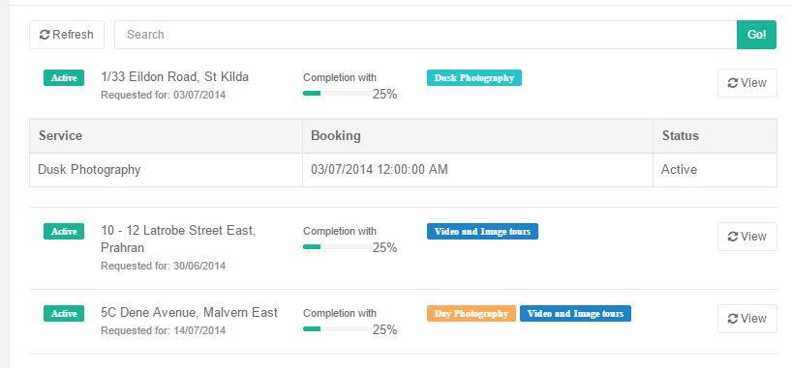
User these coloured tabs here in the grid.

Slide 4
User these coloured tabs here in the grid.

Slide 5
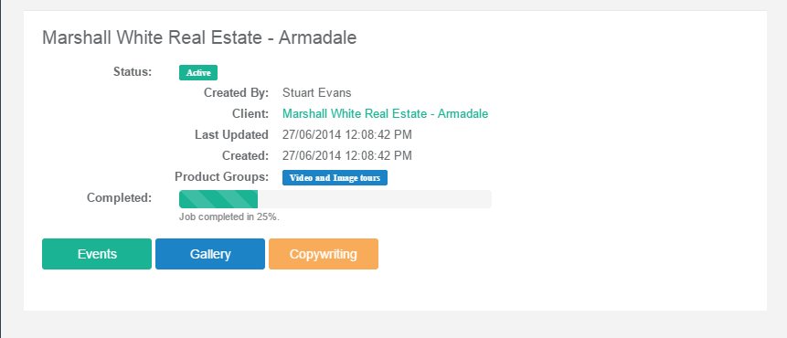
This field should be the Job.Title field.

Slide 6
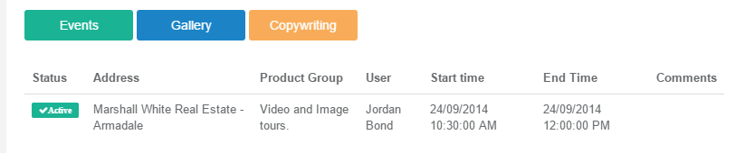
On page load, load the Events tab by default.

Slide 7
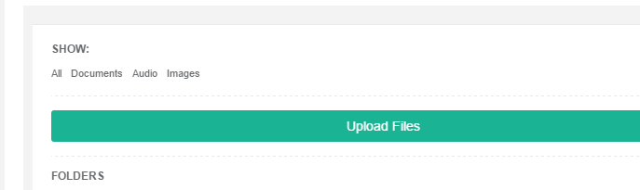
The document extensions are not done?

Slide 8
S3 download Issue.
http://ceph.com/docs/master/radosgw/s3/csharp/
We probably need to get the file programmatically.
See this section
GENERATE OBJECT DOWNLOAD URLS (SIGNED AND UNSIGNED)

Slide 9
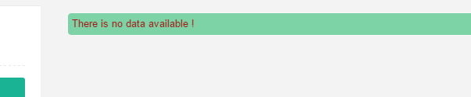
This does not look like good error messaging. Can you look at the 404 page in this boostrap theme. Use it like this, centred text.

