Slide 1
OMS

Slide 2
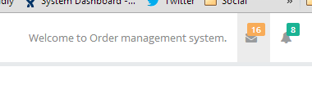
Remove/hide these for now.

Slide 3
Company

Slide 4
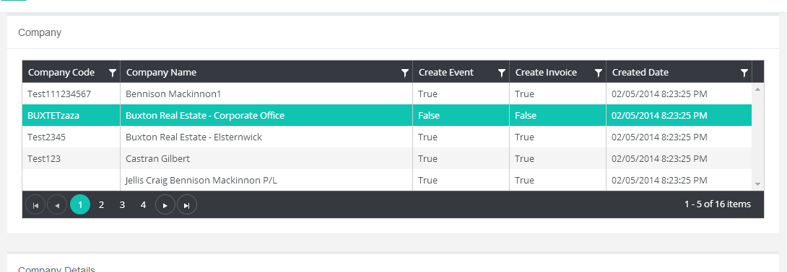
1. Double the number of records in the company list. 2. Should be listed to only Active companies as per previous discussion.

Slide 5
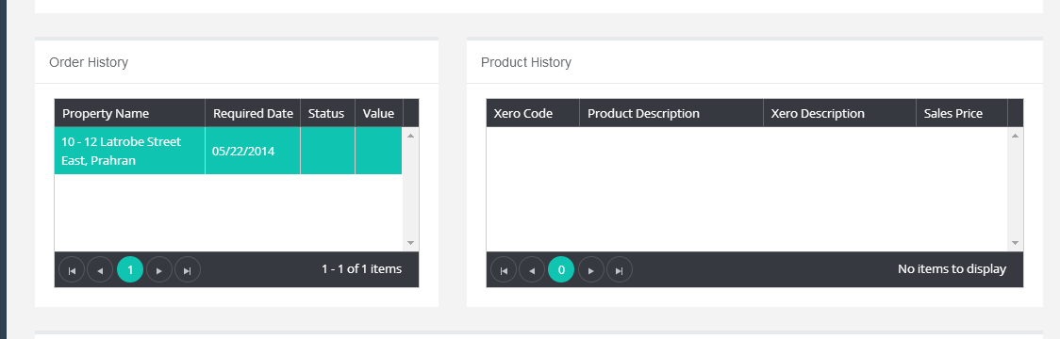
Queries here don’t work if selecting an Order to see the Product History.

Slide 6
Products

Slide 7
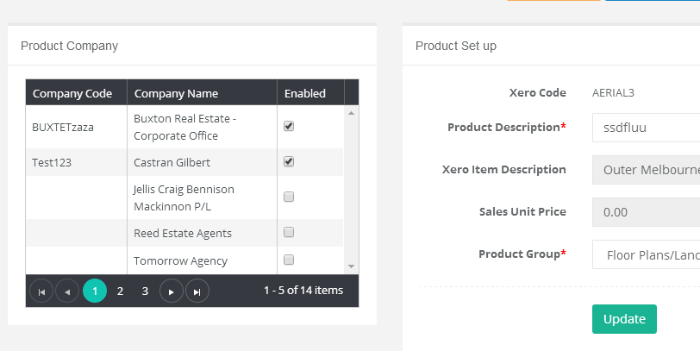
At one point the switch for enabled was implemented now its not.

Slide 8
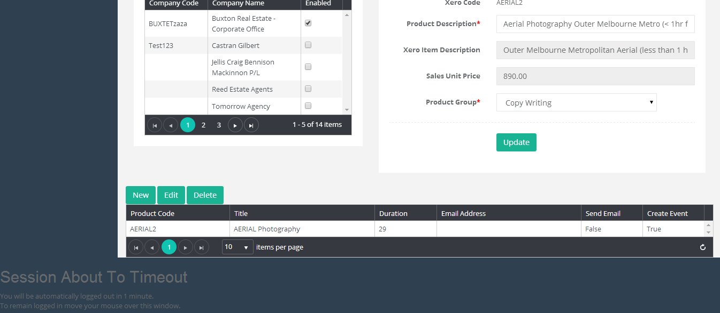
Alignment of this view is not good.

Slide 9
Why is this session info here?

Slide 10
Scheduler

Slide 11
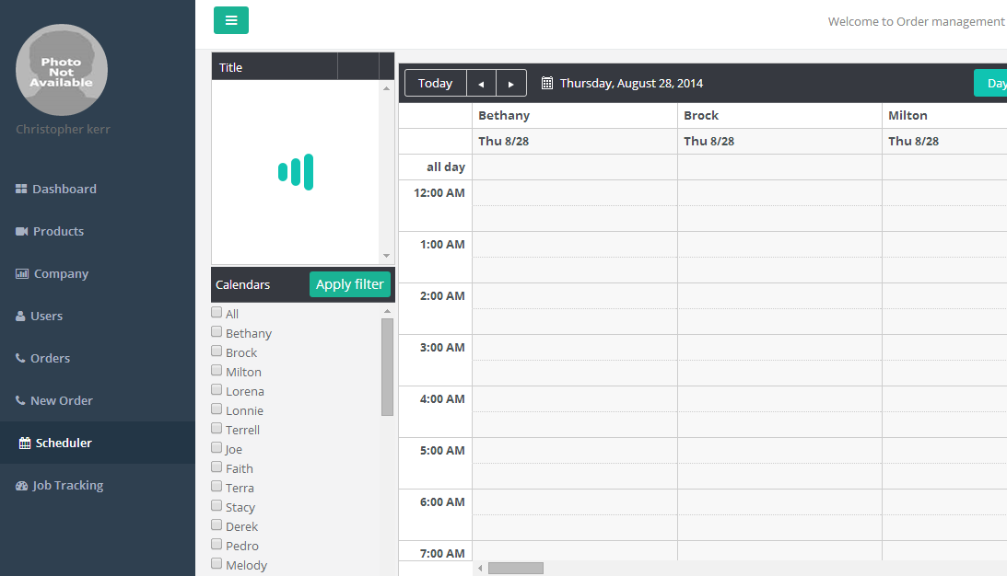
I have said before there is no need to load all calendars on page load in a conversation with someone. Load at max 2. 1. The current user (logged in), if they have one, load that 2. Load the staging calendar (campaigntrack.dpi@gmail.com) listed in the calendars table.

Slide 12
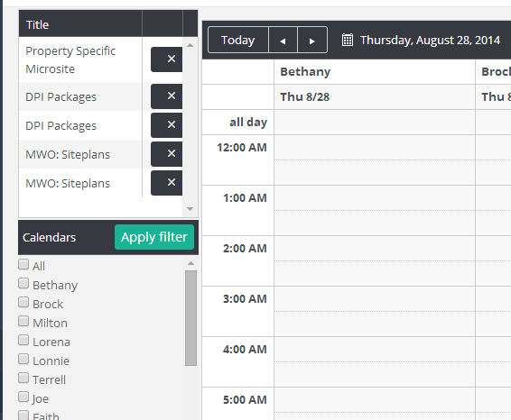
These titles are incorrect, and I suspect you are loading from the wrong db table. They should be coming from the Event table which are assigned to the default staging calendar (campaigntrack.dpi@gmail.com). The process is, the background process is already posting events to google calendar in the default staging calendar (calendar above). Then in this Scheduler calendar they are moved to specific resources (users) from this list – drag drop. Speak to swapnil about the current process.

Slide 13
1. The alignments of this module are sloppy. 2. I discussed with OM that its necessary for the user to be able to double click/hover over these events in the “Unscheduled Jobs” module, so that they can see other details within them. This information is needed to allocate. Ie Required date.

Slide 14
Users

Slide 15
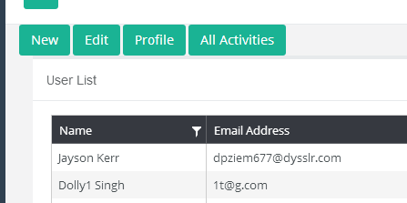
What are these buttons Profile/All activities? This was not how it was proposed. Remove/hide them if it cannot be fixed in time.

Slide 16
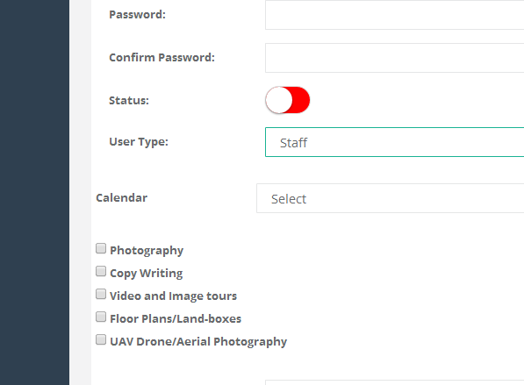
These services lack design.

Slide 17
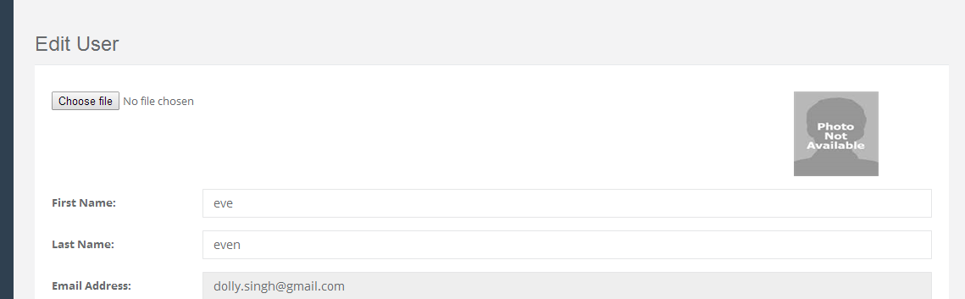
1. Choose file looks sloppy. Is this as per bootstrap design? 2. Use the company logo if one is not defined.

Slide 18
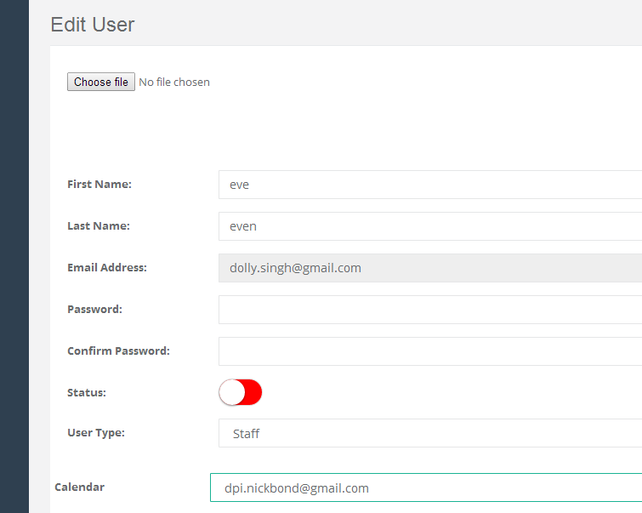
1. Why cant email be edited? 2. Calendar control is misaligned.

Slide 19
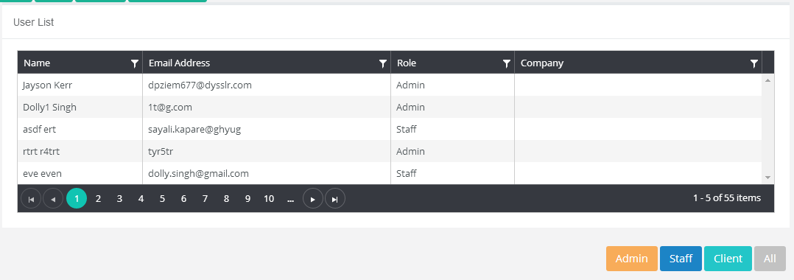
1. Double the number of records in this list by default. 2. Name in edit mode is first/last name as separate fields, should be same in the list.

