Slide 1
Feedback

Slide 2
Multi-tenant db.
1 .In the db there is a table called [dbo].[Organisation]. This table is to contain all the companies using the platform. Eg Organisation 1 will be DPI. Against this record this is where we would get the application name, logo etc.
2. Each table is to have a field on it called OrgId which is a FK to Organisation.Row_Id. This will tag the data created for this organisation.
3. When a user logs in OrgId should be returned and maintained in sessions, so each query performed during the users use is passed in as a query parameter so as not to return any other organisations data apart from that of the user.

Slide 3
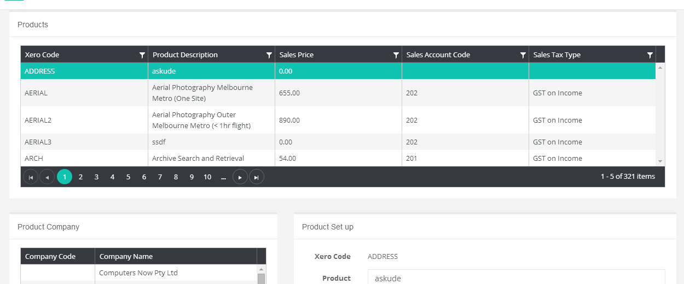
Reduce the width of : Xero Code, Sales Price, Sales Account Code, Sales Tax tupe so Product Description can be wider.

Slide 4
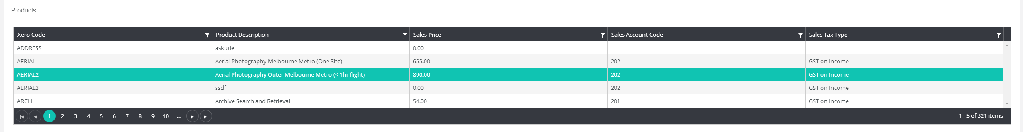
1. Product list needs to show more records in 1 page. Can paging amount be provided as a drop down. 2. We need the ability to filter products by Group. I suggested using buttons to click and constrain the list by Product Group.

Slide 5
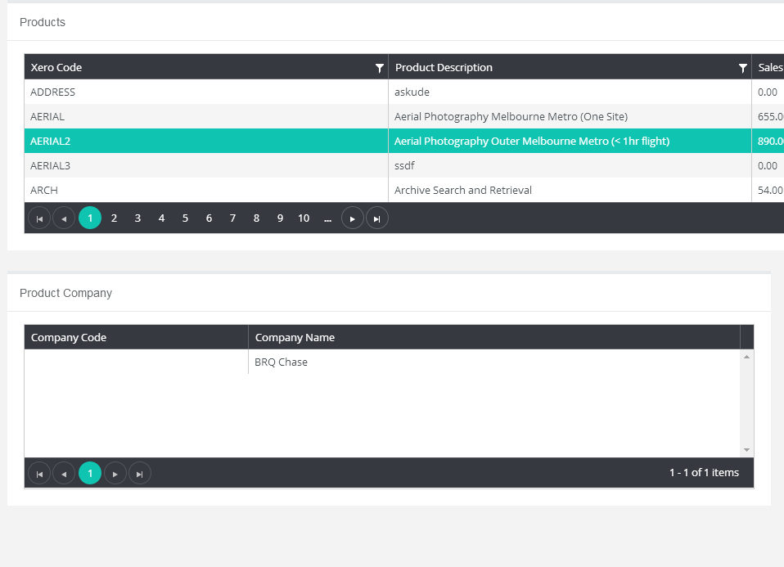
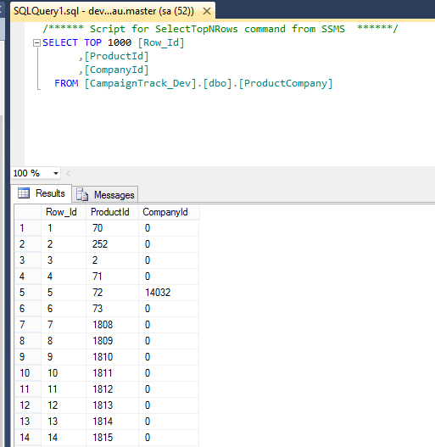
In the [CampaignTrack_Dev] database, Sachin has moved the relationship between Product and company to a 1:M table called ProductCompany.

Slide 6
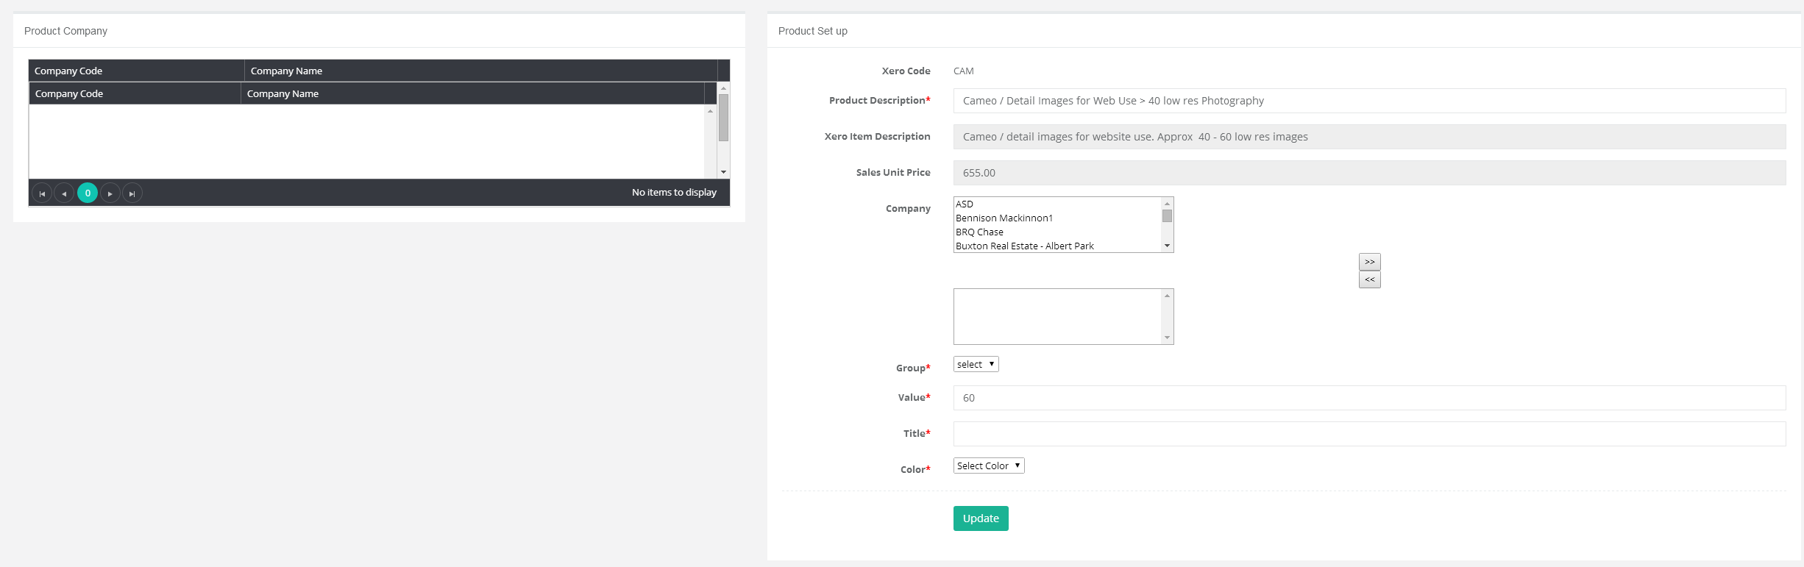
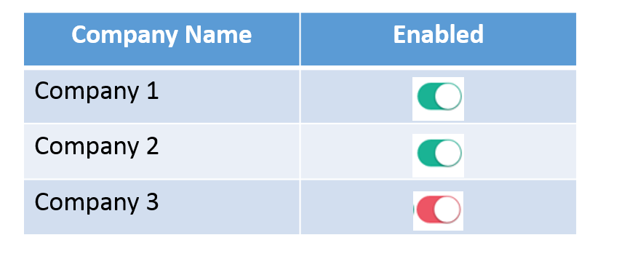
This company box is not required here. The user should be able to activate the product for one or more companies in the Product Company module. The company list should show all companies, whether the product has or has not been activated for it. Eg this is the example I provided in the UX document.

Slide 7
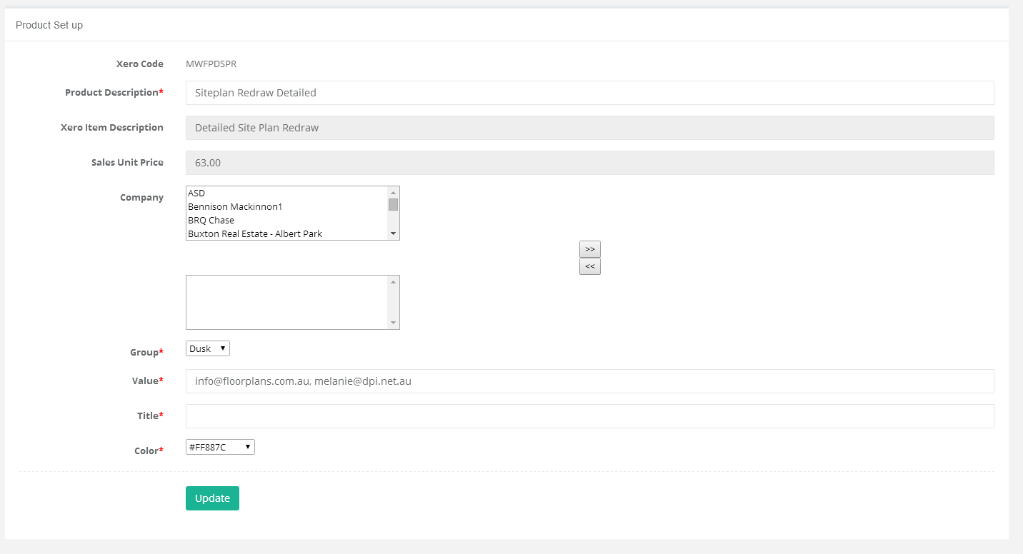
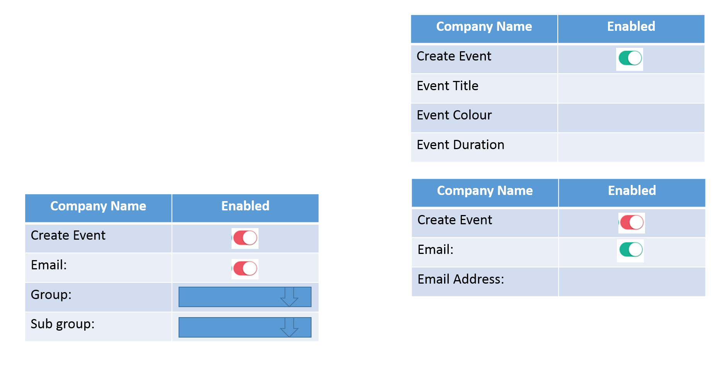
As per my document, we need: 1. Create Event, Send Email flags. 2. Group and Subgroup options

Slide 8
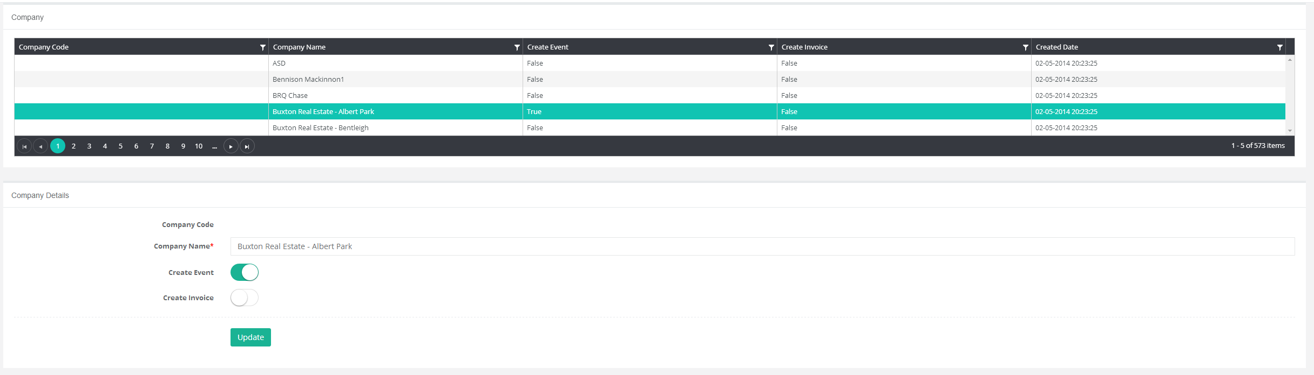
Company Code should be editable.

Slide 9
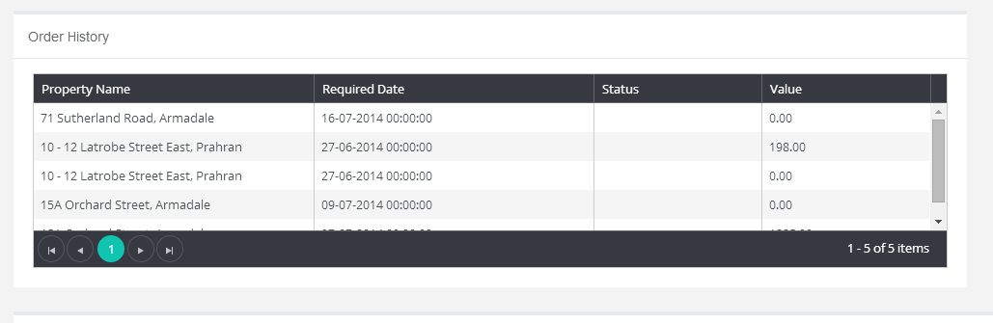
1. Required Date does not require time. 2. Reduce with of Required Date field and make Property Name column wider.

Slide 10
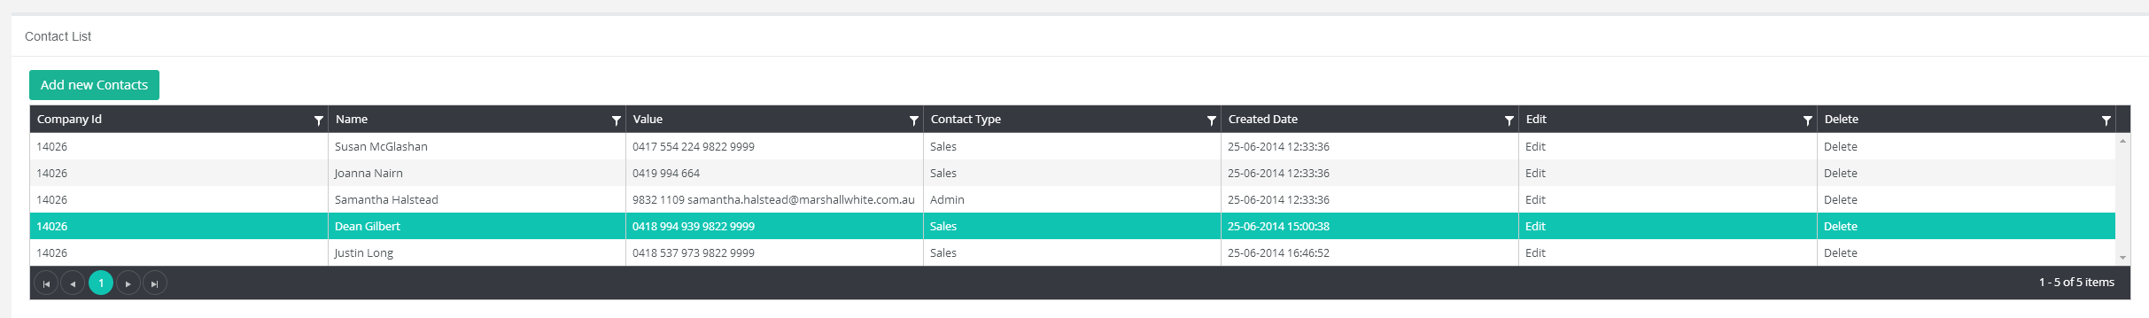
1. Company Id is not required. Please remove from the list. 2. “Add New Contacts” button. Change label to ‘New’ 3. Edit / Delete columns should be moved to buttons like the “Add New Contacts”

Slide 11
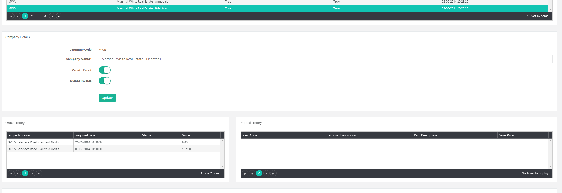
1. If a company is selected, and no Order History record is selected. All Products ever overed by this company should be shows in the Product history grid. 2. If a company is selected and an Order History record is selected, constrain the list of Products listed in Product History to those within that Order.

Slide 12
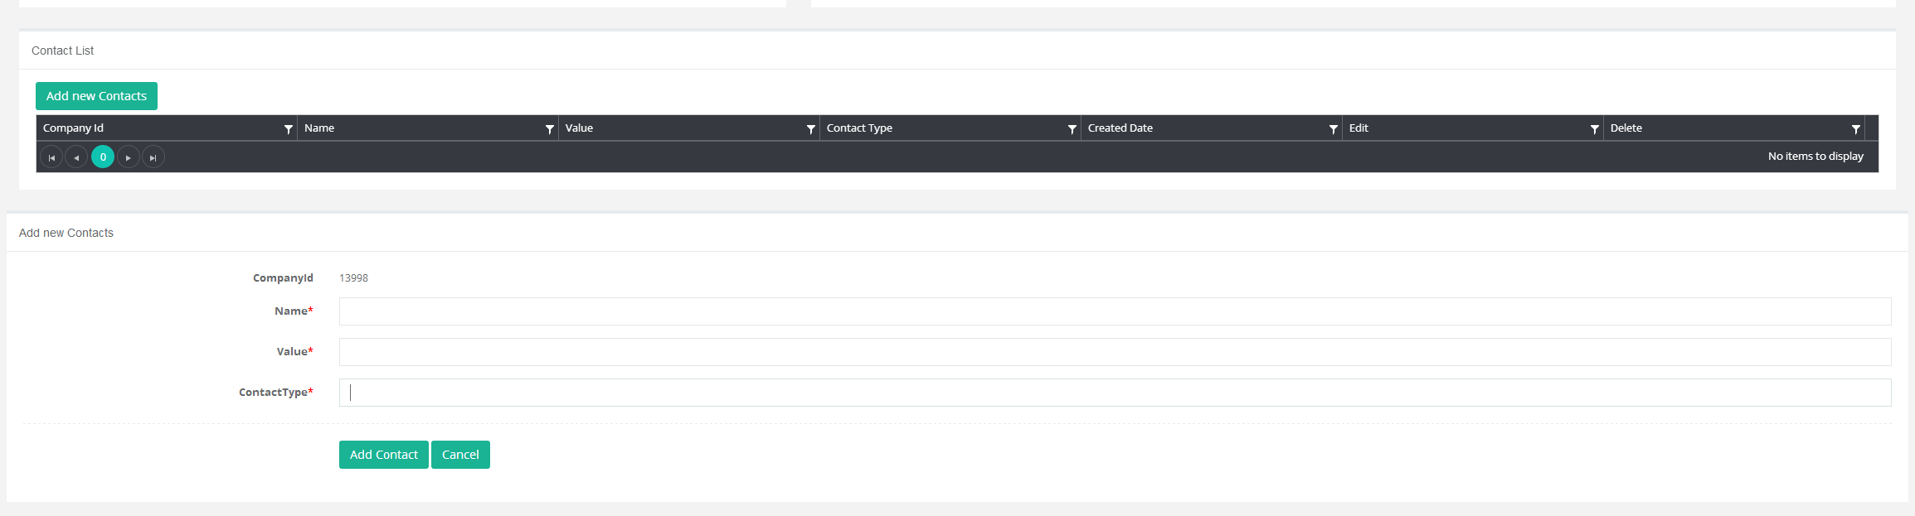
1. Company Id is not needed to be displayed 2. Contact Type should be a drop down. With “Admin, Sales, Tenant, Landlord” in the list.

Slide 13
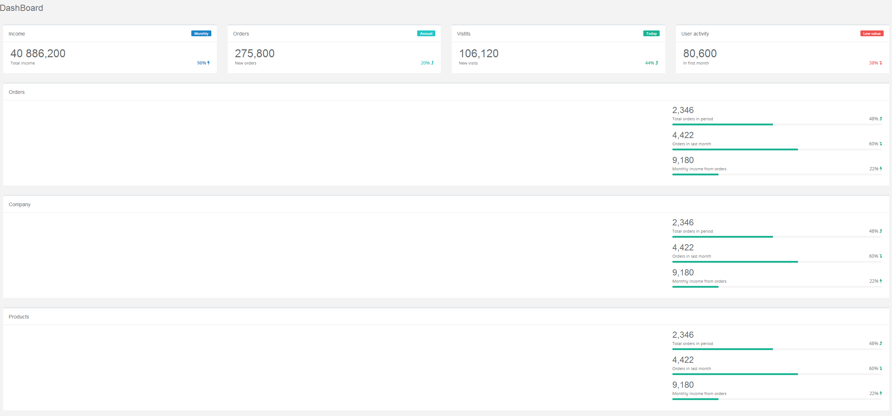
Dashboard. It doesn’t make sense to have the Orders, Company and Products components on one screen. In the design I provided each would be on the individual pages. Eg. For company or product to make sense, a company or product record would need to be set focus.

Slide 14
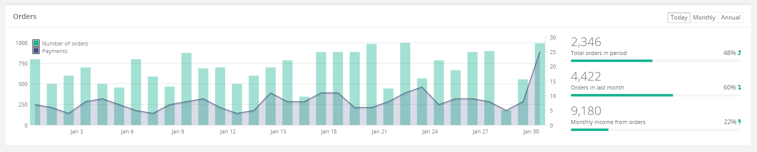
Company Details
@Company Name
Company Form (Allow Edit)
Order History (Read Only)
Products (Read Only)
Contacts (Read, New Edit, Delete)

Slide 15


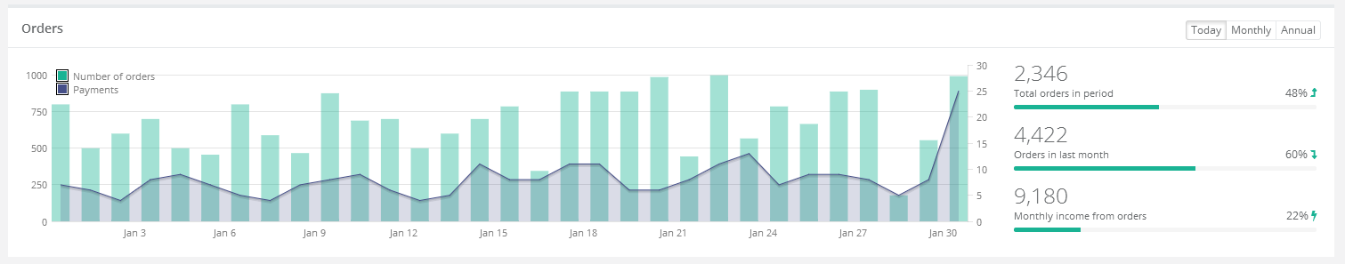
On Page load, all Products from the Product table will be loaded into the Product list. The user will be able to drill
On a Product to go to the Product details page.
Products
Home
Companies
Products
Contacts
Orders
Scheduler
Job Tracking
Product List
Company
Setup

