Slide 1
Job Tracking
The Job tracking form is primarily for External Users (Clients) to see the status of their Orders. External Users will not have any edit functions, just read only of the status’ in the list and constrained to the orders that they have sent.
Internal Users, have the ability to interact with the list, update status’ and also upload the digital assets that have been produced as a result of the job.

Slide 2

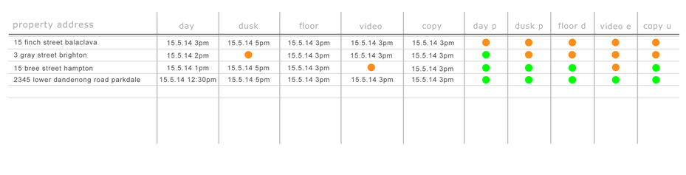
Contacts
Job Tracking
Home
Companies
Products
Contacts
Orders
Scheduler
Job Tracking
All Jobs
My Jobs

Slide 3

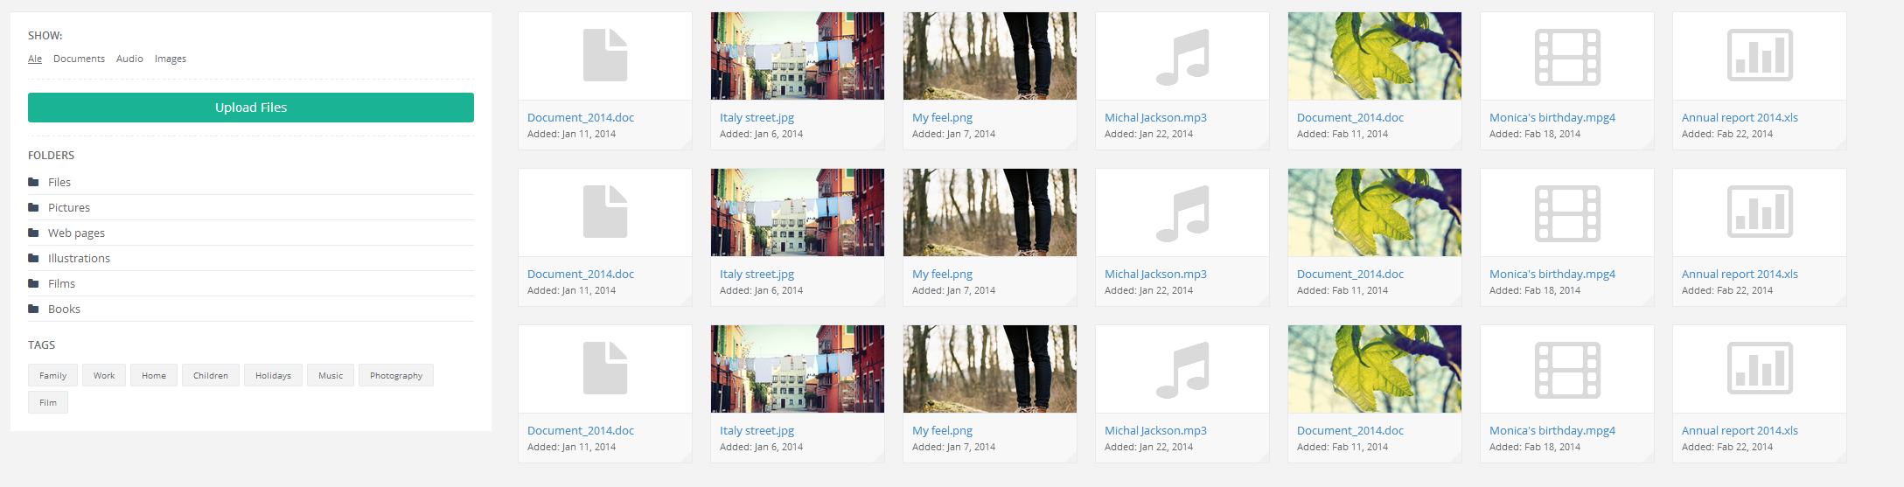
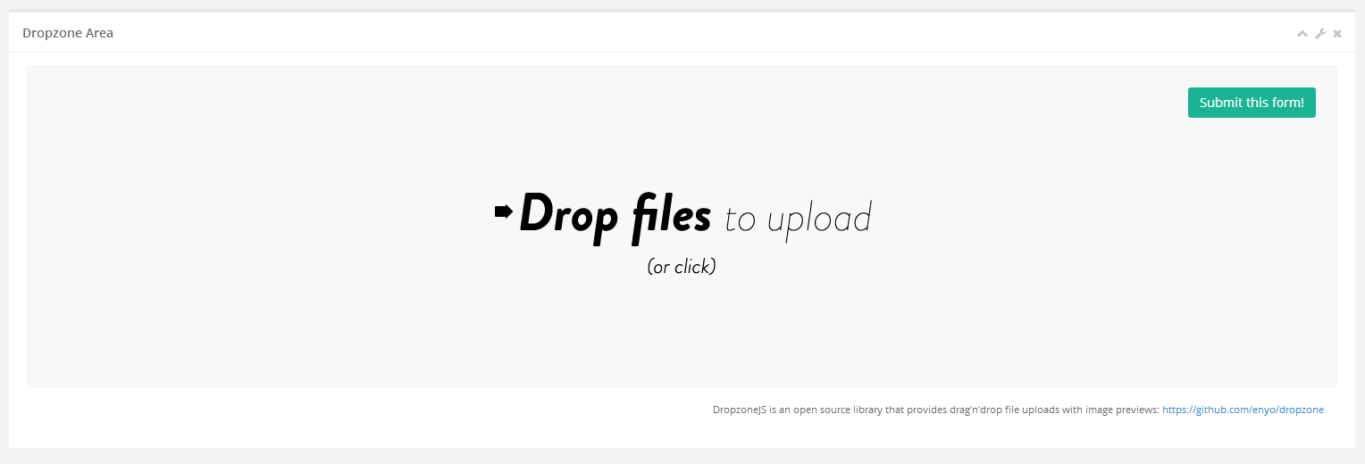
When clicking on the icon for photography (day/dusk)
It should allow the user to upload pictures and mark this activity
Off as complete.
15 Finch Street Balaclava: Photography - Day
Status
Complete

Slide 4
Create a new table to store the attachments. OrderAttachments Row_Id int pk Order_Id int fk to t_order.row_id Org_Id int fk to organisation.row_id FileName varchar(255) FileExtension varchar(5) FileSize int File image Type varchar(100) values Photo Day, Photo Dusk, Video, Copywriting, Floorplan Folder varchar(100) Created datetime CreatedBy int Updated datetime UpdatedBy int

Slide 5
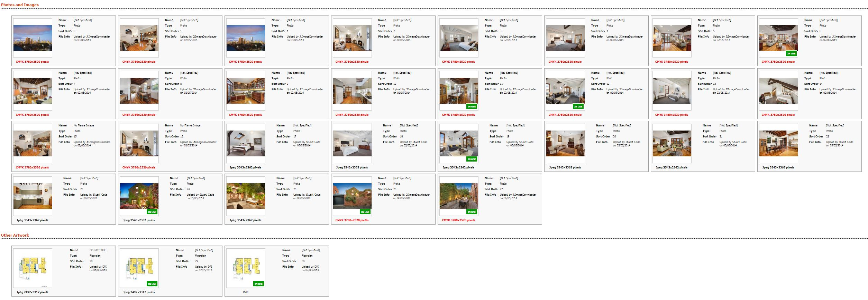
This is a gallery of images that have been uploaded. Divided by Type. This is how campaigntrack does it.

Slide 6
Create a new table. This will store the content if the service was for copywriting. OrderContent Row_Id int pk Order_Id int fk to t_order.row_id Org_Id int fk to organisation.row_id AdCopySub_Title vachar(max) AdCopySub_Body vachar(max) Signboard_Title vachar(max) Signboard_Body vachar(max) Brochure_Title vachar(max) Brochure_Copy vachar(max) AdCopyMetro_Title vachar(max) AdCopyMetro_Body vachar(max) Other_Title vachar(max) Other_Body varchar(max)

Slide 7
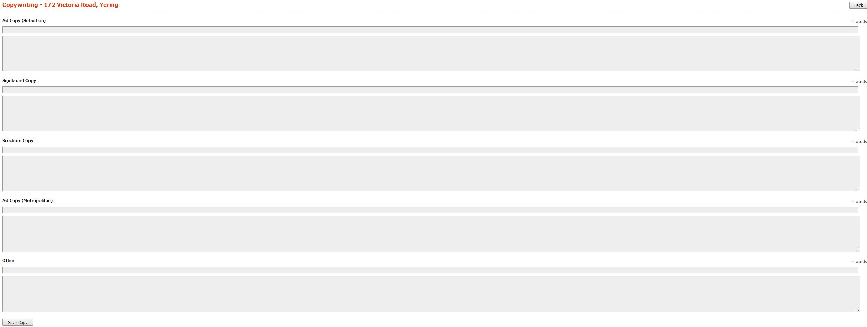
When clicking on the icon for copywriting
It should allow the user to upload content and mark this activity
Off as complete.
15 Finch Street Balaclava: Copywriting
Status
Complete

Slide 8
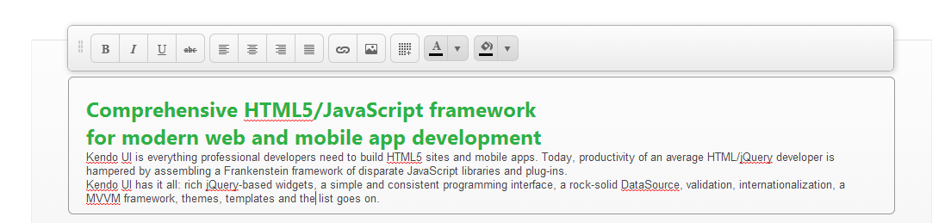
We should use the telrik inline editor for each of the content boxes.
http://demos.telerik.com/kendo-ui/editor/inline-editing

