Slide 1
Job Tracking.

Slide 2
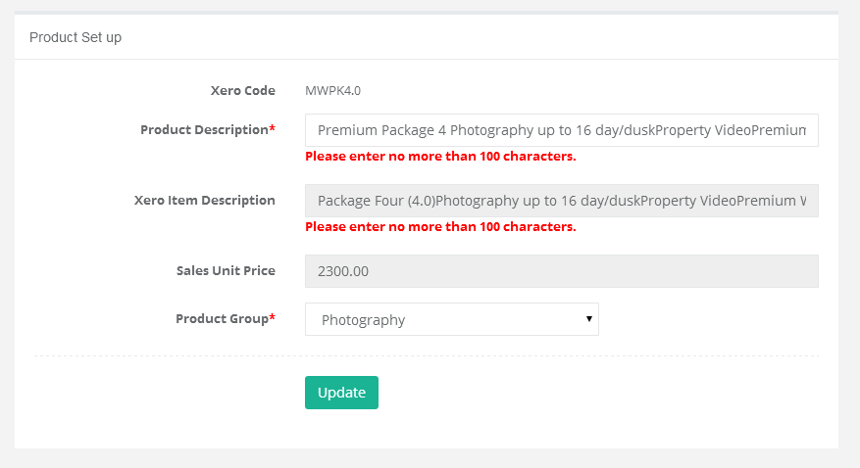
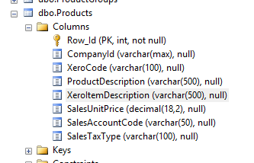
Please align these validation messages with the table field length.

Slide 3
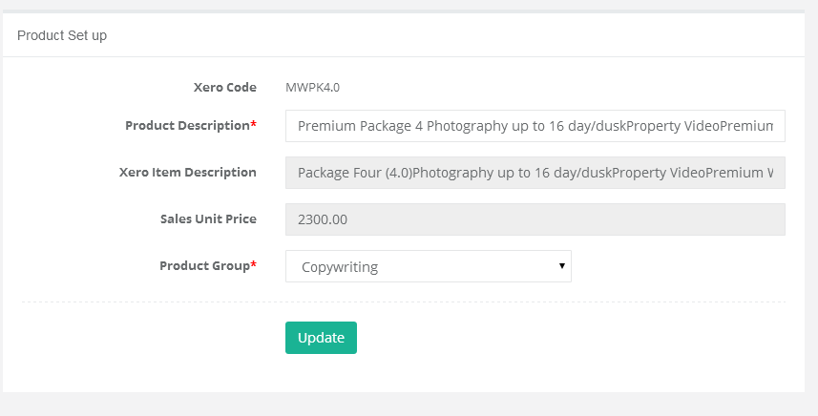
We need a new Product Group called ‘Package’. Products of Type ‘Package’ are bundling one to many products within them.

Slide 4
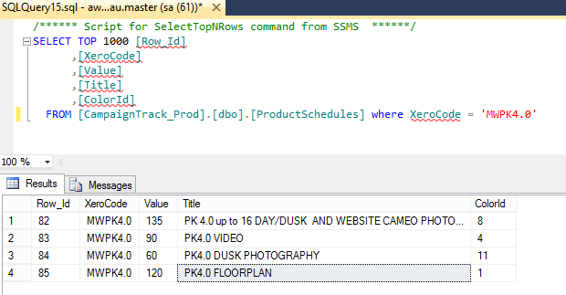
Here is an example of a Package. It contains 4 services within it. We need a new field on ProductSchedule called TRACK_TYPE varchar(100). This is where we would define that this service belongs to Day, Dusk, Video, Floorplan, Copywriting.
Track_Type
Day
Video
Dusk
Floor

Slide 5
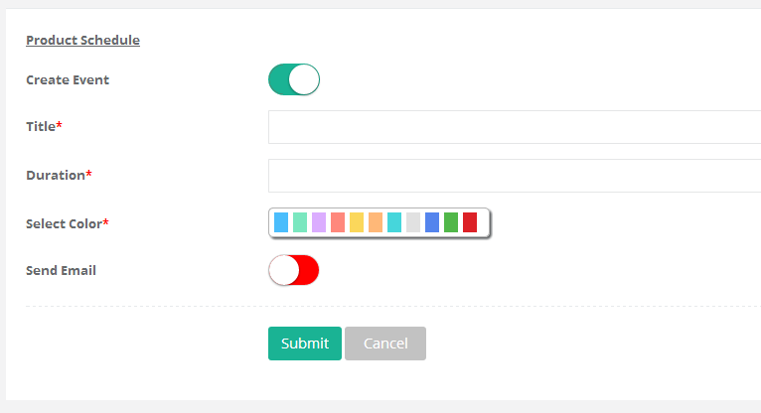
Add this new field (dropdown) to the ProductSchedule view for Insert/Edit.

Slide 6
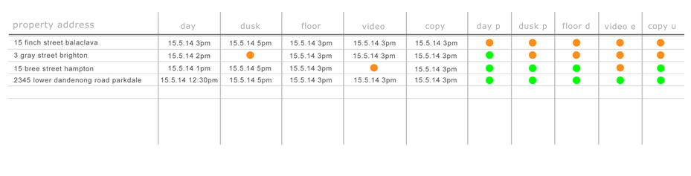
So in order to get the data in this form, I propose a few changes to your orderstatus table.
Group based on TRACK_TYPE

Slide 7
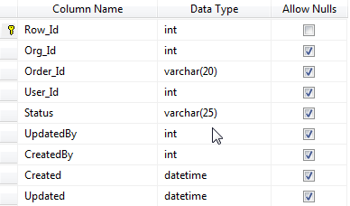
Swapnil, when we create events, either through the background process, or edited via the online calendar, we insert/update into this
Table. This will allow us to Group the Events based on Track_Type and Manage a status against it which can be updated
By the individual user who is associated to the calendar the event is assigned to.
Row_Id | Int
Org_Id | Int
Order_Id | Int
Event_Id | Int | FK to Event.Row_Id
Track_Type | Varchar(100)
StartDateTime | Datetime
Status | Varchar(100)
Updatedby | Int
CreatedBy | Int
Created | Datetime
Updated | Datetime

