Slide 1
Real-estate marketing business.
Photographers, Videographers, copywriters.

Slide 2
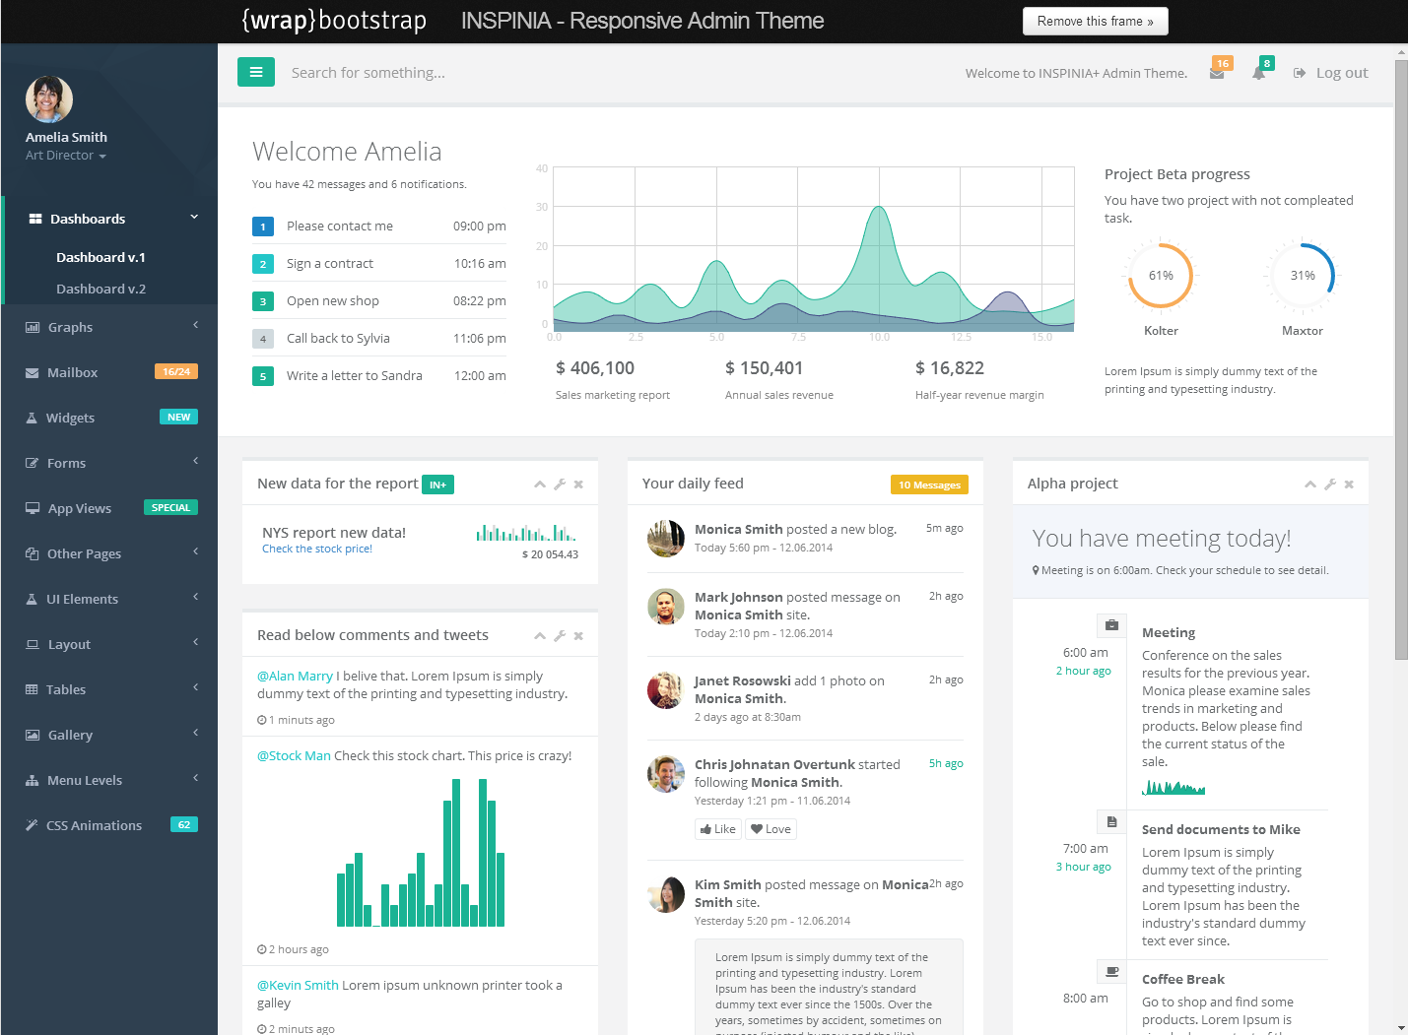
I am happy to use this theme AS Is. It looks good. Fonts, Colours, Styles, layout – like it.

Slide 3
Approach
I have a dba that works for me directly he will design build all db. components, tables, stored procedures, etc. All you will need to do is build the front end and DAL based on ADO. Net.

Slide 4
Site Map – Super Administrator (Internal)
Home
Company List
Product List
Users/Contact List
Job Tracker
Orders
Scheduler
Company Detail
User/Contact Profile
New Order

Slide 5
Site Map – Staff (Internal)
Home
User/Contact Profile
(My Profile)
Job Tracker
New Order

Slide 6
Site Map – External Resource (client)
All data will be constrained only displaying relevant data to their company.
Home
User/Contact Profile
(My Profile)
Job Tracker
New Order

Slide 7
Companies
This table is a list of companies returned from the table Company. These Company records are created in another system called XERO which is an accounting system. The synchronisation from XERO is already happening so company records only need to be Updated, not created or deleted.

Slide 8


On Page load, all companies from the company table will be loaded into the Company list. The user will be able to drill
On a company to go to the company details page.
Home
Companies
Products
Contacts
Orders
Scheduler
Job Tracking
Companies
Company List.

Slide 9
Company List.
The company list should return the following fields Company Code, XeroName (as Company), ScrappedName (as Source Name), Create Events, Create Invoices, Active

Slide 10
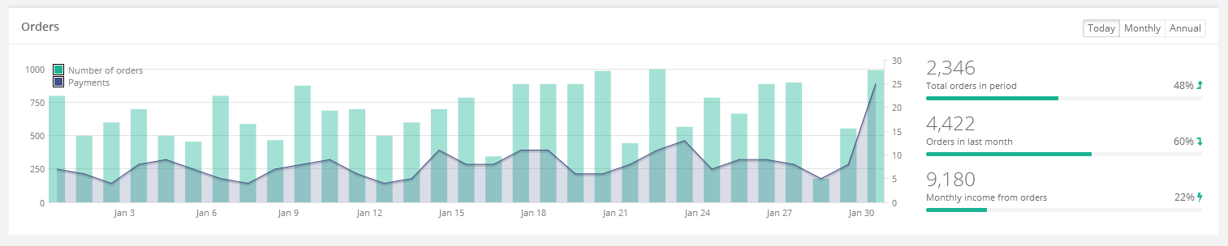
Company Details
@Company Name
Company Form (Allow Edit)
Order History (Read Only)
Products (Read Only)
Contacts (Read, New Edit, Delete)

Slide 11
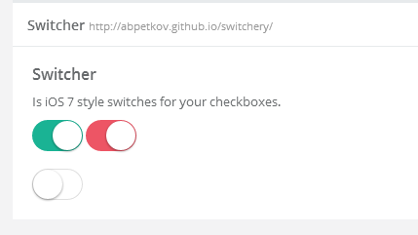
Create Event, Create Invoice flags should be design with this control.
For the Field Active Flag also use a Switcher

Slide 12
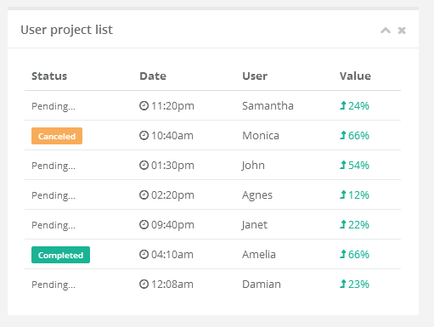
Order History should display like this.
Property Address, Required Date, Status, Value
Products should display like this.
Product Code, Description, Sales Price (Read only)
Order History
Products

Slide 13
Products
This table is a list of Products returned from the Product Table. These Product records are created in another system called XERO which is an accounting system. The synchronisation from XERO is already happening so Product records only need to be Updated, not created or deleted.

Slide 14
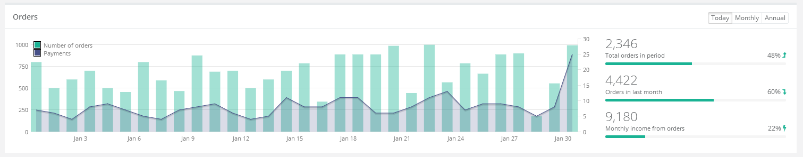
On Page load, all Products from the Product table will be loaded into the Product list. The user will be able to drill
On a Product to go to the Product details page.
Products
Home
Companies
Products
Contacts
Orders
Scheduler
Job Tracking
Product List
Company
Setup

Slide 15
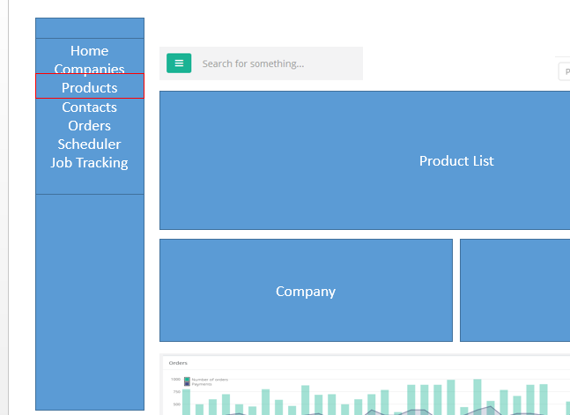
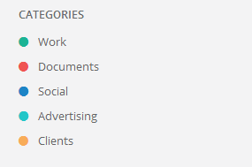
On the LHS panel we will list
The available Product/Service Categories to be applied
The user should be able to add a new one and
Select a colour for the Category.

Slide 16


This module manages the relationship of Products to Company. So for an external User it means which products they are allowed to see and order.
So this company is permitted to order this product.
This will be stored in the company ID field in a comma separated field.
Company
Company Name | Enabled
Company 1
Company 2
Company 3

Slide 17
Setup
Company Name | Enabled
Create Event
Event Title
Event Colour
Event Duration
Company Name | Enabled
Create Event
Email:
Email Address:
Company Name | Enabled
Create Event
Email:
Group:
Sub group:

Slide 18
This will only be visible if a product is selected.
And summarise Orders that contained this product by Month.

Slide 19
Contact/User

Slide 20
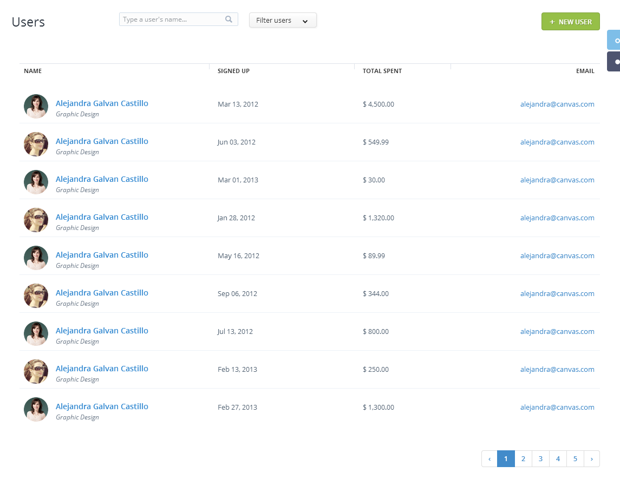
Contact fields to be displayed in the list should be Name, Email Address, User type, Company
Contacts
New
Contacts
Home
Companies
Products
Contacts
Orders
Scheduler
Job Tracking
Admin
Staff
Client
These buttons will constrain the list.

Slide 21
Contact Details Page
Profile
Activities
Home
Companies
Products
Contacts
Orders
Scheduler
Job Tracking

Slide 22
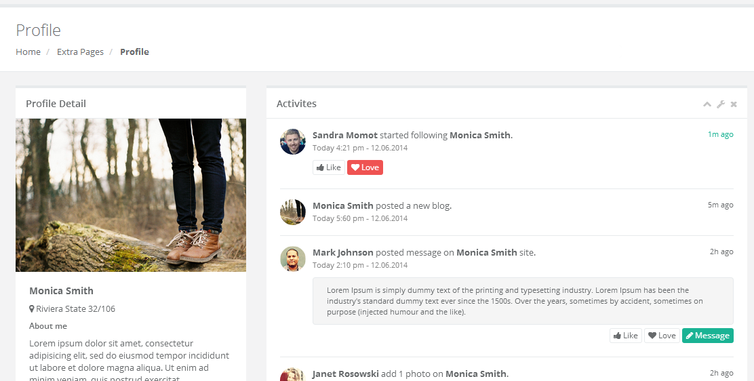
Contact Details Page
Contacts
Home
Companies
Products
Contacts
Orders
Scheduler
Job Tracking

Slide 23
Profile Module:
If user is Staff, then the admin
Will select 1 or more product / service
Group to associate to the user
If a product/service group is selected
The user has the ability to choose from one
Of the available calendars listed in the calendar
Table and store the association in CalendarUser
Table.
3. If a user is Client, then #1, #2, not available
And user must select a company from the company
Table.
4. Only the Administrator resources will have the ability
To edit User Type, Company, Calendar, Product Service
5. All individual resources will have read only and
Only allow change password, image etc.
Image
First Name
Last Name
Email Address
Mobile Number
Password
Role
Active
Company Calendar - Drop down. Associate a user to a google calendar.
User Type
Admin
Staff
Client
Product/Service
Photography
Video
Copywriting

Slide 24
Activities
Activities will list (read only) this activities that pertain to the selected user.
If an internal user (Staff) it will be activities like:
Assigned Jobs
Job statuses like Complete
Files Uploaded
If an external User it will be things like
Order Requested
Job Booked
Order Cancelled
We will provide a Stored procedure that returns all the events, all you need
To do it is display on this control.

Slide 25
Order
User Role: Administrator
Orders module will list the Orders that have been placed by Companies. The module should have a function to create a new Order

Slide 26
Orders
Home
Companies
Products
Contacts
Orders
Scheduler
Job Tracking
Orders
Order Item
Order Contacts
Order Status

Slide 27
Fields to be present in the lists.
Order Fields
1. Company, Property, Date, Required Date, Status, Channel, Total
Order Item fields:
Product Description, Price
Order Contact:
1. Name, Value, Type

Slide 28
The new order page will be designed according to this as a framework. Because the user will be authenticated before creating a new order, the company and agent details will not be required.
http://www.realview.net.au/new-order/

Slide 29
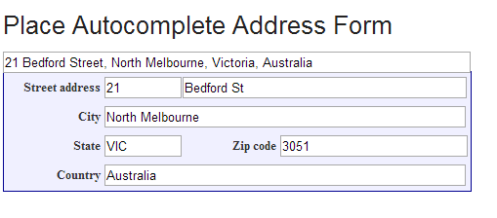
When the client is entering the address of the property, it should use google address auto complete to define a structured address. In addition we want to capture the Lat/Long fields of the address when inserting into the property table.
https://developers.google.com/maps/documentation/javascript/examples/places-autocomplete-addressform

Slide 30
Scheduler
User Role: Administrator
The scheduler page where the Admin users will schedule Jobs. A Job is an Order from a Company which is either received via email or view the new Order form.. A Job is the allocated to one or more internal users for them to perform the job.

Slide 31
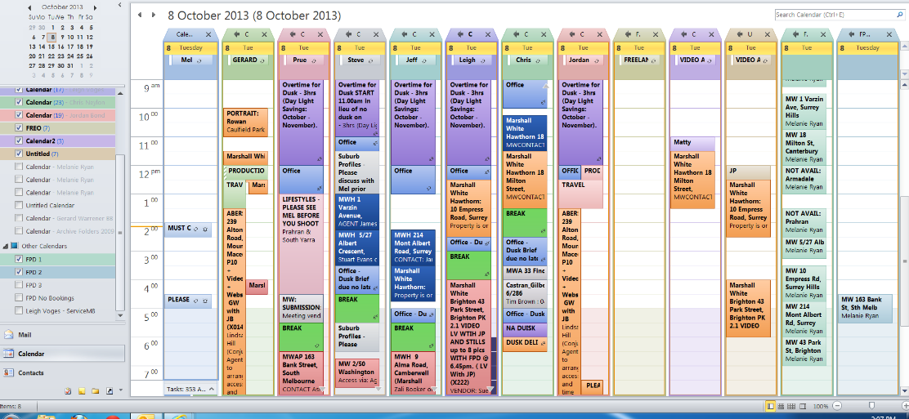
Currently the client is using outlook to manage 50 staff calendars. This is really difficult to schedule jobs on days
Where the job is required to be performed. We are moving to a Telerick calendar which will be more streamlined
In only selecting those resources needed for a specific job based on the products and services a user actually performs.

Slide 32
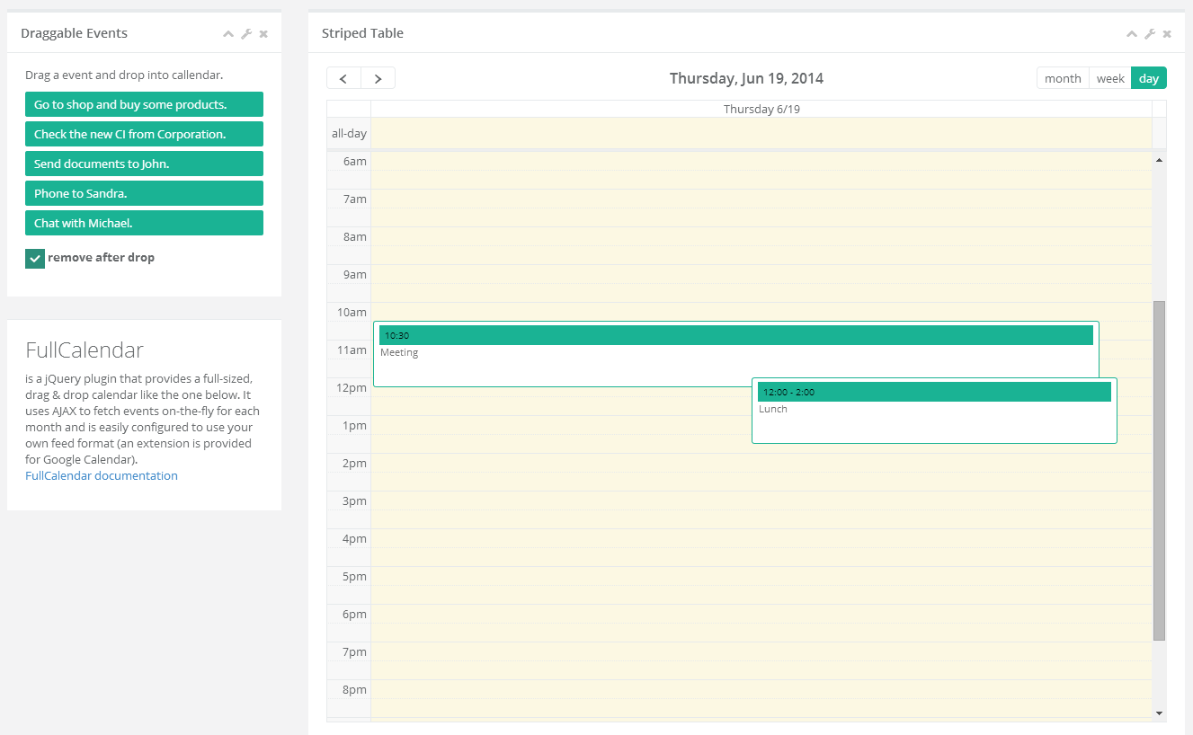
This is the UI structure that I would like on the Schedule Page..
A list of Unscheduled Jobs.
Calendars of Users.

Slide 33
This will be a list of pending Orders that have not been Scheduled. Orders have a Required date.
When selecting an order the calendar will set focus on that date and select the list of calendars (below) to those users that perform that function.
This will be a list of Calendars of Users (Staff) that the user can select one or more and see their availability. Selecting one or more users will have their day view side by side on the required date from the selected order.
Services Offered.

Slide 34
This will be a list of pending Orders that have not been Scheduled. Orders have a Required date.
When selecting an order the calendar will set focus on that date and restrict the list of calendars (below) to those users that perform that function.
Jobs to be Scheduled
Job 1 Title
This will be a list of Calendars of Users that the user can select one or more and see their availability. Selecting one or more users will have their day view side by side on the required date from the selected order.
Job 2 Title
Job 3 Title
Job 4 Title
Jobs in this list will be coloured according to the
Product Group Colour
Services Offered.

Slide 35
This will be a list of pending Order Event that have not been Scheduled. Orders have a Required date.
When selecting an order the calendar will set focus on that date and restrict the list of calendars (below) to those users that perform that function.
Users will be able to drag an Order Event on to a Users calendar.
This will be a list of Calendars of Users that the user can select one or more and see their availability. Selecting one or more users will have their day view side by side on the required date from the selected order.

Slide 36
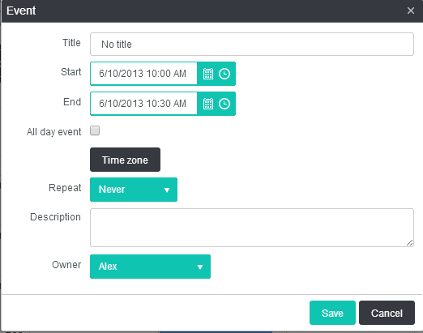
The user should be able to use the native functions of the kendo-ui calendar and create events within the calendar.

Slide 37
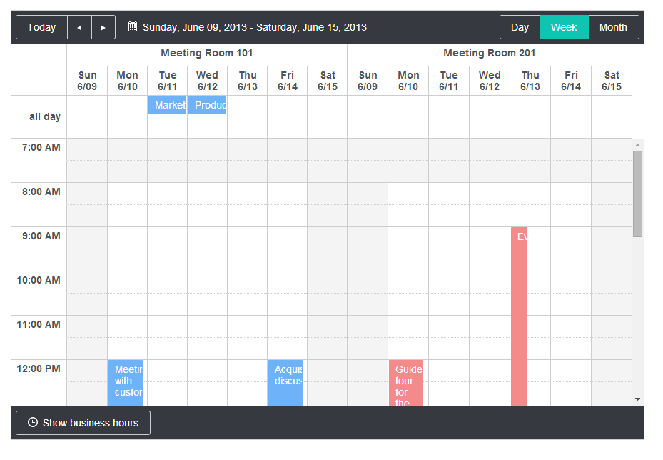
The primary use of the calendar is to have individual resources (staff) members side by side so that the admin resource can schedule jobs to staff members.

Slide 38
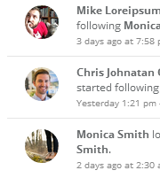
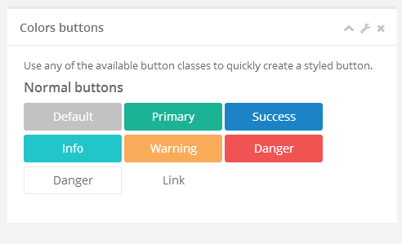
The calendar list
The calendar list should display the Calendars:
1. Profile Picture
2. First Name
3. Last Name
Underneath the calendar list will be a number of buttons
that are defined by the Services offered by the company.
Photography, Video, Copywriting, Floorplans etc.
On selecting one of the buttons will constrain the list of calendars
To the users that are associated with that service.
Product/Service
Photography
Video
Copywriting

Slide 39
Job Tracking
The Job tracking form is primarily for External Users (Clients) to see the status of their Orders. External Users will not have any edit functions, just read only of the status’ in the list and constrained to the orders that they have sent.
Internal Users, have the ability to interact with the list, update status’ and also upload the digital assets that have been produced as a result of the job.

Slide 40
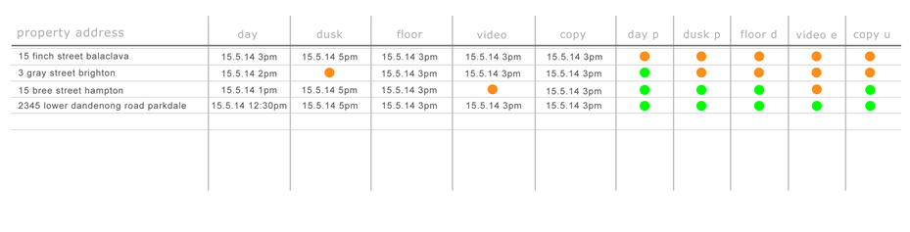
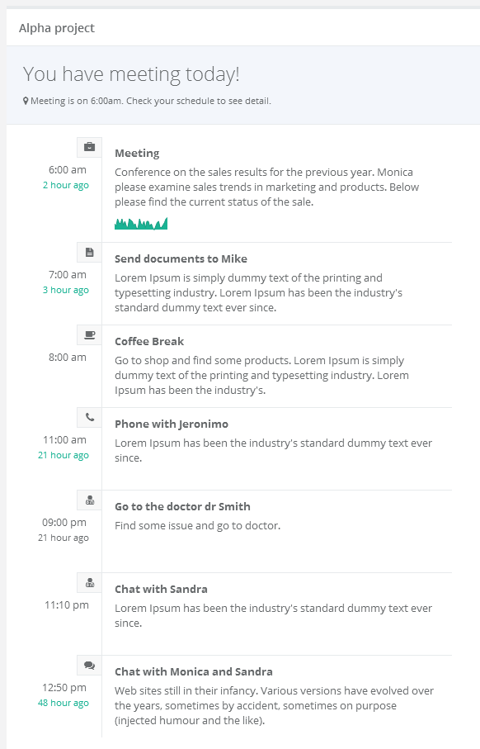
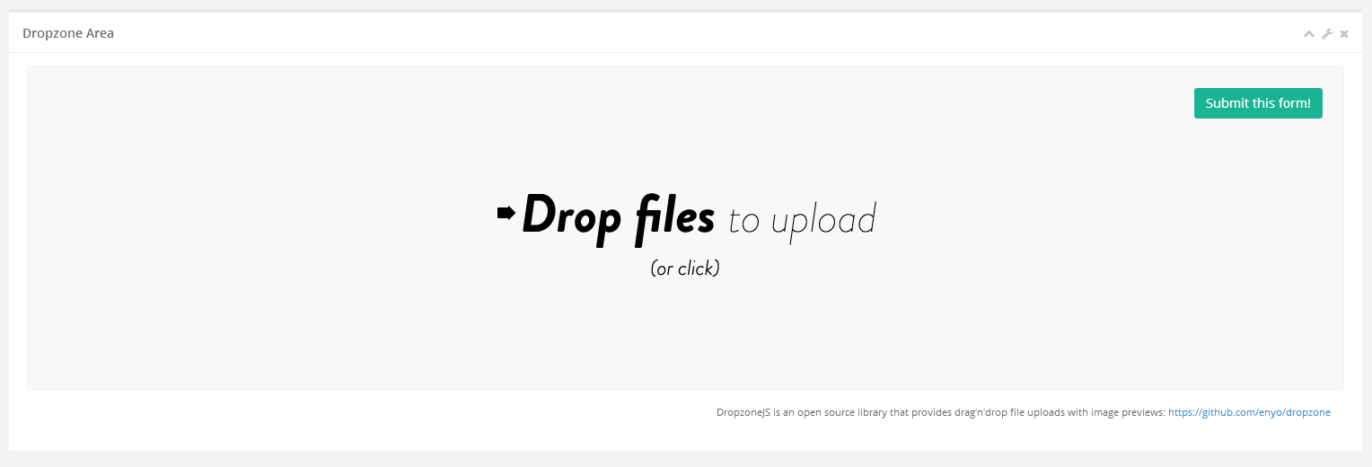
Contacts
Job Tracking
Home
Companies
Products
Contacts
Orders
Scheduler
Job Tracking
All Jobs
My Jobs
Timeline
Upload

Slide 41
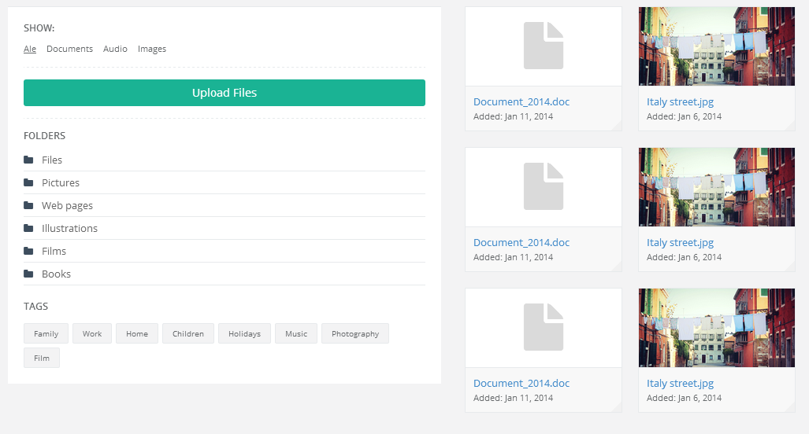

Slide 42
Contacts
Job Tracking
Home
Companies
Products
Contacts
Orders
Scheduler
Job Tracking
These two area’s are not available to external users.
Timeline
Upload

Slide 43
There is an event tracking table that tracks movement of calendar items from a staging calendar, to individual resource
Calendars.
Use this Control to display the individual movement of an individual event.
Events for a particular Job include:
Order Received
Order Cancelled
Job Confirmed
Files Uploaded
Job Complete

Slide 44
Login/forgot password/Misc

Slide 45
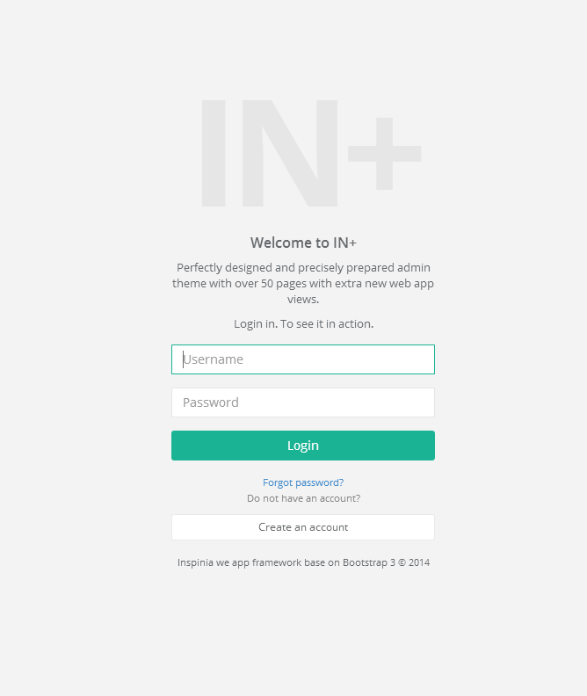
Happy to use this style as is. But no need for the Create Account.

Slide 46
Use the same design for the forgot password function.
Forgot password will send the user a reset password email/link.

Slide 47
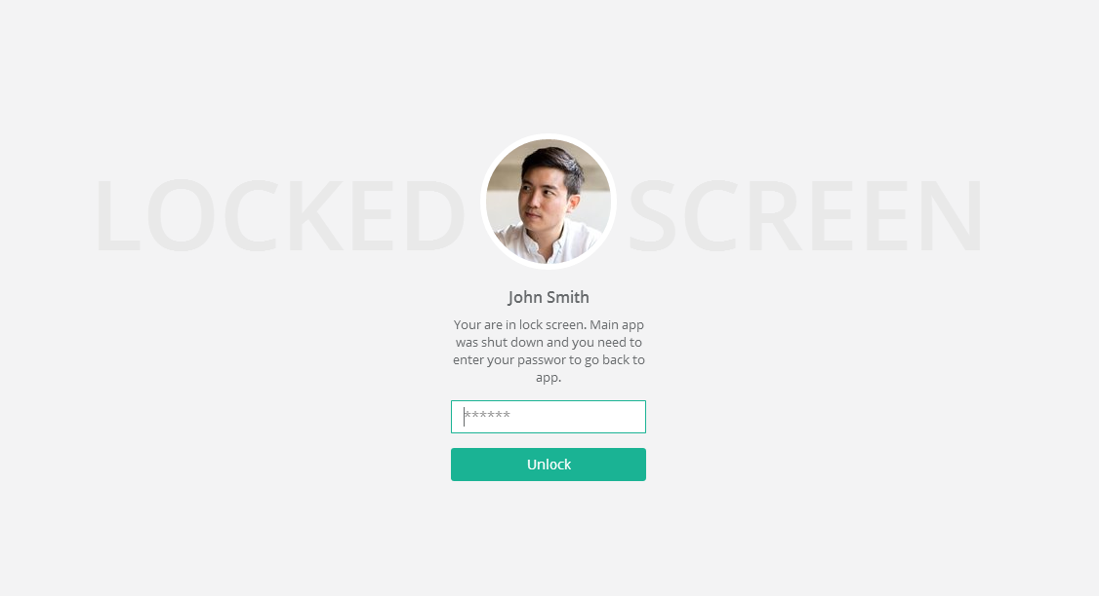
Happy with this as a locked screen – Auto lock if app idle for

