Slide 1
Job Tracking
The Job tracking form is primarily for External Users (Clients) to see the status of their Orders. External Users will not have any edit functions, just read only of the status’ in the list and constrained to the orders that they have sent.
Internal Users, have the ability to interact with the list, update status’ and also upload the digital assets that have been produced as a result of the job.

Slide 2
Step 1. Categorise Newly Created Events.
We. need to categorise new events created by the CTI-DPI application, by Product Group when creating the event in the staging calendar: i.e. by Photography Day/Dusk, Video, Areral, etc
In order to do this, we need to add a new field on Product Schedule table which we will use to store the Product Category in the event body.

Slide 3
In each event created by CT-DPI service it contains the following body extracted by email orders received by Campaign Track.
SalesContact : Stuart Evans on 0402 067 710
Required On :06/11/2014
Product Description :MW Package 3 Photography up to 8 day/dusk images Property Video Medium Floorplan (0-40sq) + Detailed Siteplan
Supplier Instructions :Beds, baths, House/unit etc, sqs approx - PROPERTY READY FROM: Thursday 6th November (all appointments on 6/11)MW BOOKINGS CONTACT: alysha.mccormick@marshallwhite.com.auACCESS CONTACT: Geoff and Susan Wright 9817 3542 (Owners will be home for all appointments) PROPERTY DETAILS: House, 252sqm, 3 bedrooms, brick, facing east
Order Item (Please donot delete or update OrderItemId) :11792039-27

Slide 4
The email body footer contains the Order Id of the email order.
Order Item (Please donot delete or update OrderItemId) :11792039-27
To do:
1. We need to append some additional information to the tracking section to include the Product Group which the order is being created for. Eg. Day, Dusk, Video, Copy, Areral.
2. Fix the typo in the email body footer to include spaces in the two words highlighted in red.

Slide 5
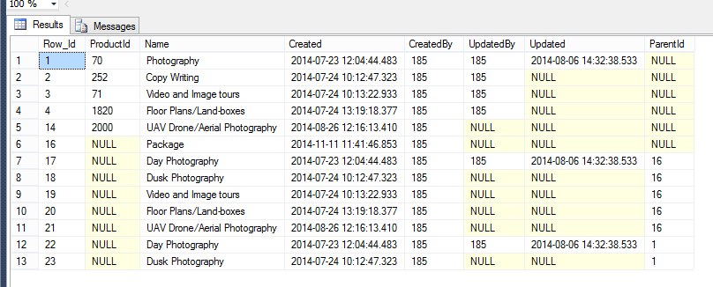
1. Add Org_Id field to ProductGroup table.
2. I have added some new data which includes:
2.1 New ProductGroup record called Package
2.2 SubGroups using Parent Id. These subgroups will be used for Job Tracking.

Slide 6
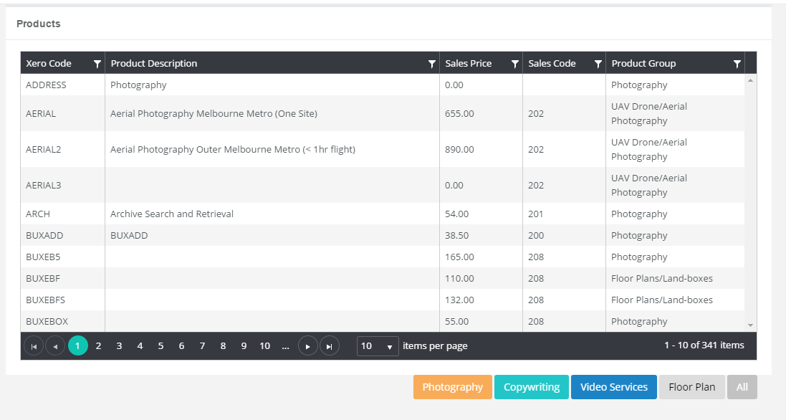
Add a new button here Called “Package”. It will select only those products where Product.ProductGroupId = ‘Package”.

Slide 7
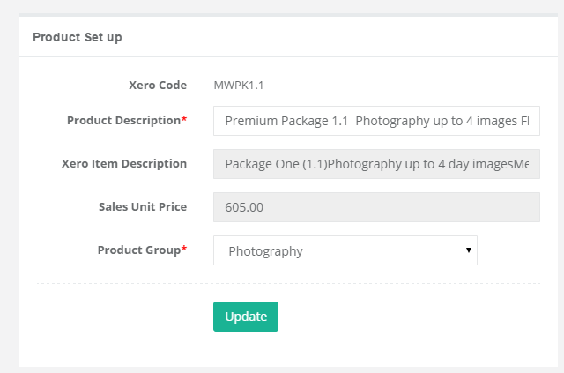
This drop down should be populated using a new SP that I have created. It has 2 parameters OrgId and Parent Id. In this Product setup module, pass Parent Id in as null. exec GetProductCategory 825, null

Slide 8
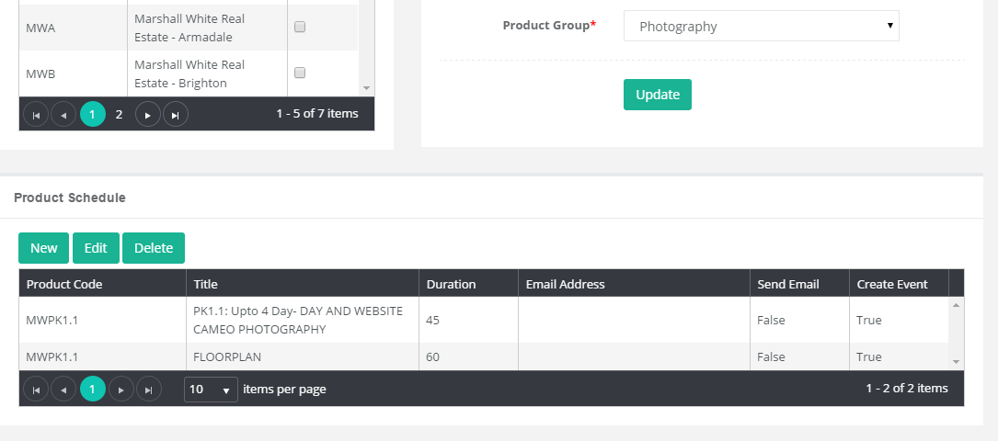
1. Add a new field on the ProductSchedule table called ProductGroupID int.
2.. Add a new field after “Product Code” field, on ProductSchedule list called “Product Group”.
3. Reduce Width of Product Code, Duration, Send Email, Create Event fields.

Slide 9

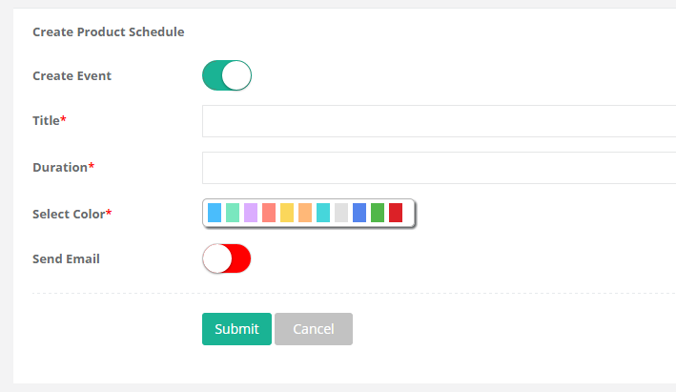
1. Add the “Product Group” Drop down here in New/Edit forms.
2. To populate this Product Group list, exec GetProductCategory passing in OrgId and Product.ProductGroupId. This will generate any child ProductGroups if they exist.
GetProductCategory 825, ProductGroupId

Slide 10
Swapnil: When generating the body of the emails via CT-DPI change the Email body footer to contain the ProductGroupID and Name.
Order Item (Please do not delete or update Order Item Id):11792039-27;ProductGroup.Id-ProductGroup.Name
e.G
Order Item (Please do not delete or update Order Item Id):11792039-27;23-Dusk Photography

Slide 11
Hold until the first section is done.
I will then do the event monitoring and then we can continue with the font end.

Slide 12

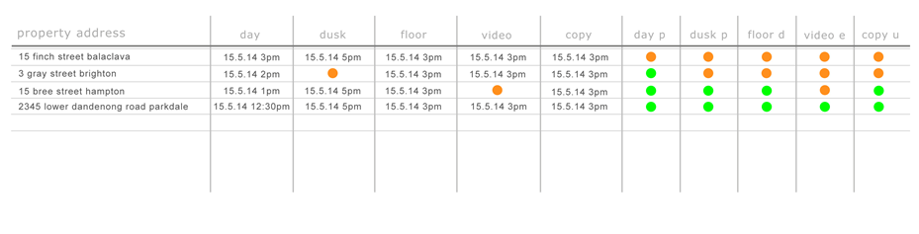
Contacts
Job Tracking
Home
Companies
Products
Contacts
Orders
Scheduler
Job Tracking
All Jobs
My Jobs

Slide 13

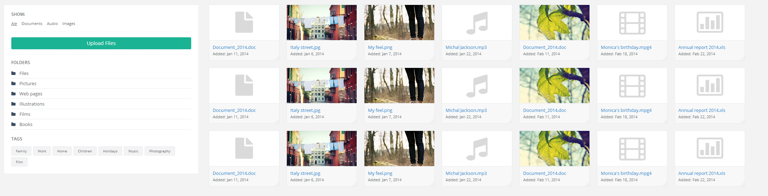
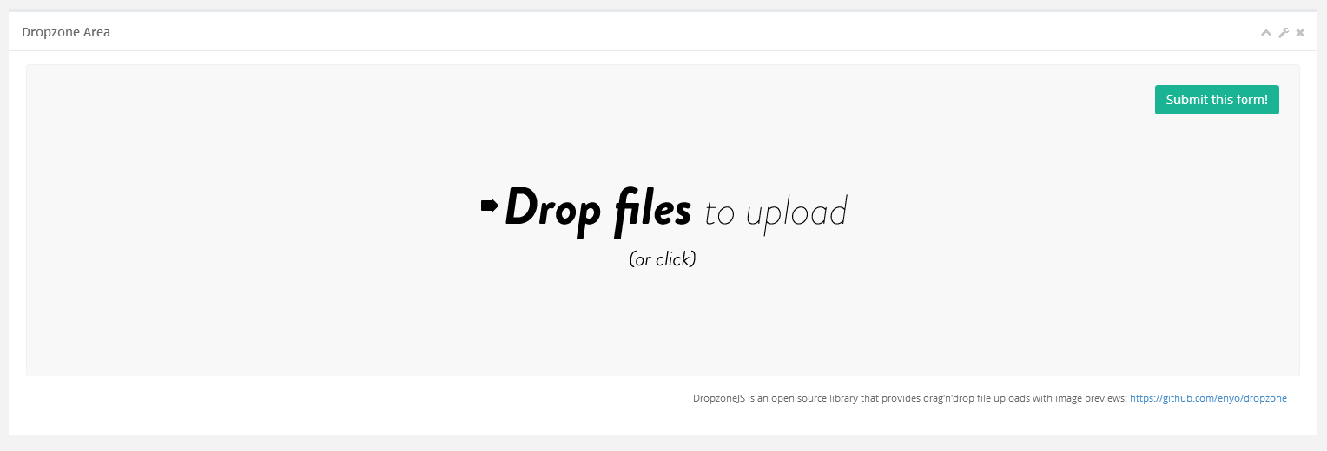
When clicking on the icon for photography (day/dusk)
It should allow the user to upload pictures and mark this activity
Off as complete.
15 Finch Street Balaclava: Photography - Day
Status
Complete

Slide 14
Create a new table to store the attachments.
OrderAttachments
Row_Id int pk
Order_Id int fk to t_order.row_id
Org_Id int fk to organisation.row_id
FileName varchar(255)
FileExtension varchar(5)
FileSize int
File image
Type varchar(100) values Photo Day, Photo Dusk, Video, Copywriting, Floorplan
Folder varchar(100)
Created datetime
CreatedBy int
Updated datetime
UpdatedBy int

Slide 15
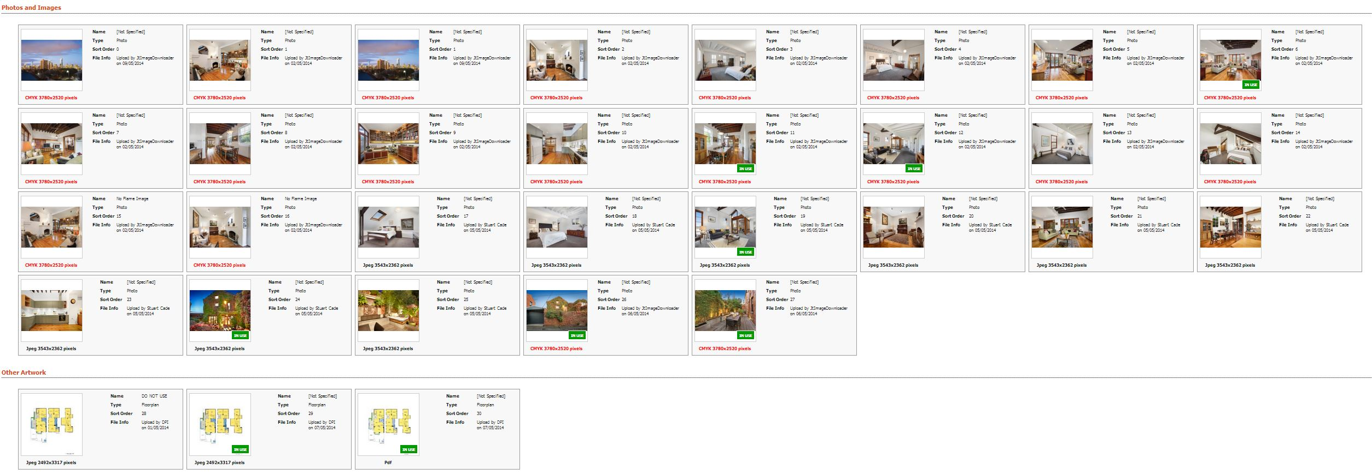
This is a gallery of images that have been uploaded. Divided by Type. This is how campaigntrack does it.

Slide 16
Create a new table. This will store the content if the service was for copywriting.
OrderContent
Row_Id int pk
Order_Id int fk to t_order.row_id
Org_Id int fk to organisation.row_id
AdCopySub_Title vachar(max)
AdCopySub_Body vachar(max)
Signboard_Title vachar(max)
Signboard_Body vachar(max)
Brochure_Title vachar(max)
Brochure_Copy vachar(max)
AdCopyMetro_Title vachar(max)
AdCopyMetro_Body vachar(max)
Other_Title vachar(max)
Other_Body varchar(max)

Slide 17
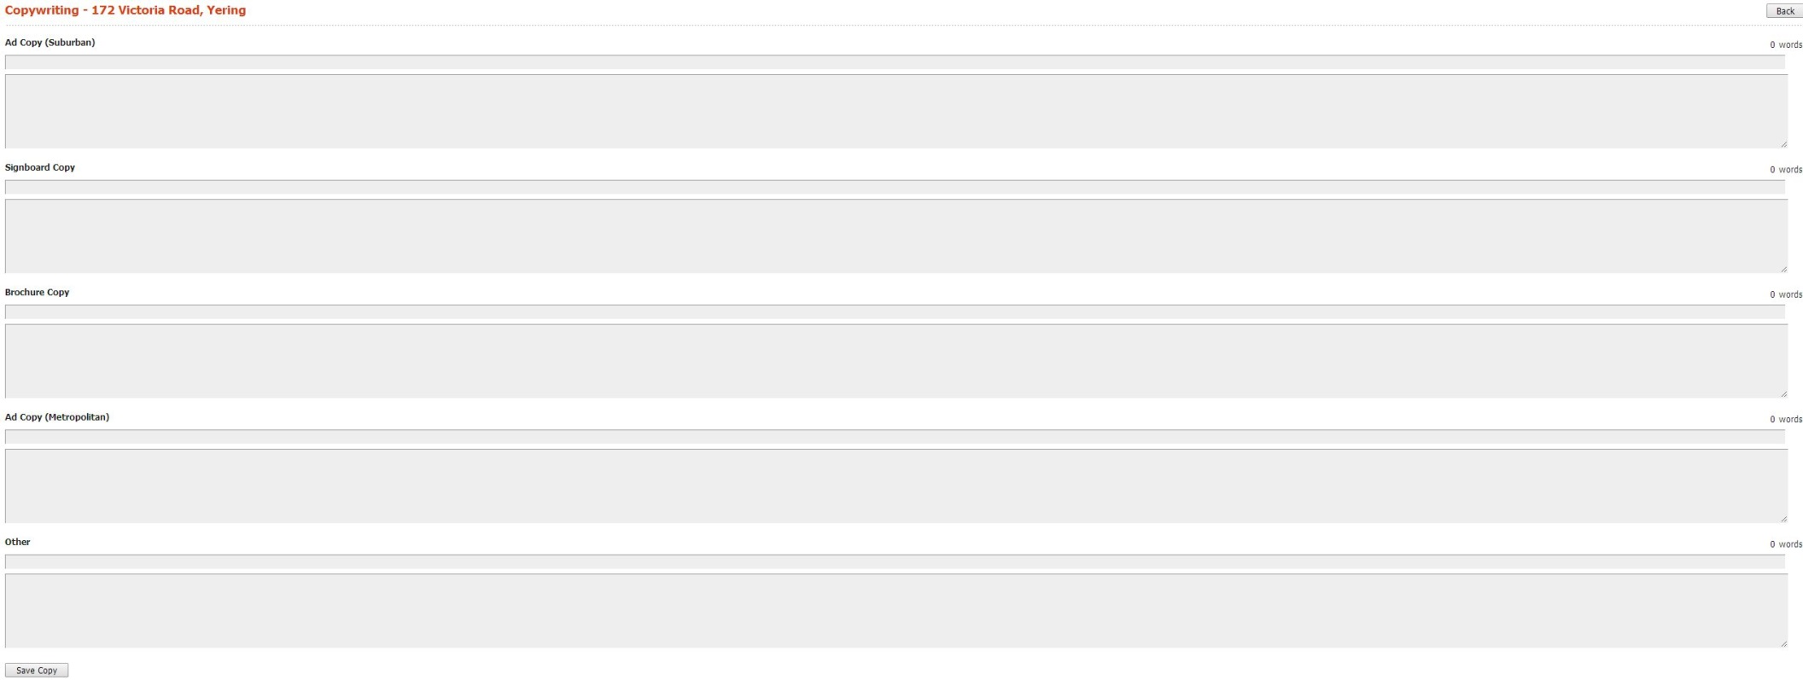
When clicking on the icon for copywriting
It should allow the user to upload content and mark this activity
Off as complete.
15 Finch Street Balaclava: Copywriting
Status
Complete

Slide 18
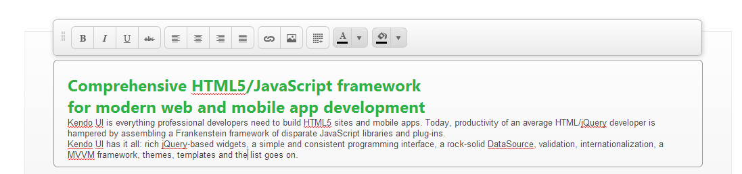
We should use the telrik inline editor for each of the content boxes.
http://demos.telerik.com/kendo-ui/editor/inline-editing

