Slide 1
DSC – Find Donors for you cause
Group 7
Ashwani Nitharwal, Kamalakannan Thayanidhi
Charlotte Gallet
Descriptive and Predictive Analytics
Nick Janssens

Slide 2
Table of Contents
01
02
03
DATA & DONORS
MODEL PERFORMANCE
RESULTS
What information are we using?
Who are our donors?
Lift
Cumulative Gains
Cumulative Response
Who do you contact?
How much would you gain?

Slide 3

Objective
The company
Belgian Communication Company since 1985
Over 20 fundraising for humanitarian causes
Their actions
Sending direct mails to inactive donors so they donate again
Donors are selected randomly
Response rate is 1.8%
The objective
Creating a model to show increase in response rate and in donations after campaign

Slide 4
Timeline
Training
Testing
Scoring
6169
7244
New Campaign
Drop date: Sep. 4, 2018
Drop date: June 18, 2019
Drop date: Feb. 1, 2020

Slide 5
Data Sources
Donors
Campaign
Gifts
Selected Campaigns
General information about previous donors
General information regarding DSC’s campaigns since December 2014
Donations and gifts made by previous donors, in and outside campaigns
List of donors that donated when the selected campaigns were launched.

Slide 6
Feature Engineering
Gifts, Campaigns, Donors were cleaned (dropping unnecessary values, dealing with NA values)
Getting the data from the right timeline (subsetting to have data from 1 month prior to campaign)
For train and test data adding features like, total amount donated, donation frequency
From these new features creating more like average donation, number of donation out of time being a donor
Adding features like Campaign age, age group or minimum age
For train and test data, removing null observations, changing the type of variables and filling the NA values

Slide 7
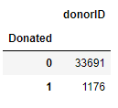
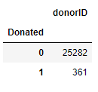
Looking at the Train Set & Test Set of Data
Here for the Train 14 Customers with no Data who were targeted.
So, we Dropped them.
Here all the Customers had Historic Data.

Slide 8
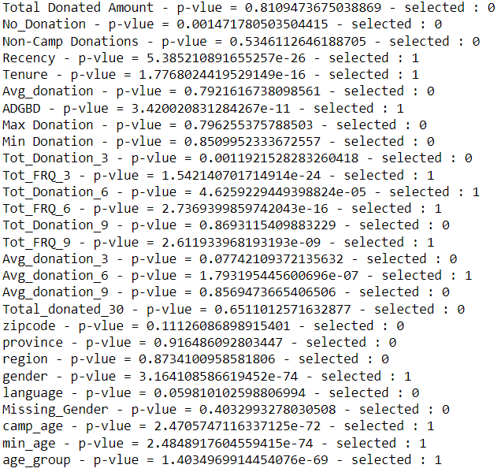
Feature Selection
Recency Tenure ADGBD Total Frequency 3 , 6, 9 Total Donation 6 Gender Campaign Age Minimum Age Avg Donation 6
Calculating the p-value for each feature
Selected Features
P-value = 5.39e-26
P-value = 1.78e-16
P-value = 3.42e-11
P-value = ~1.54e-24
P-value = 4.63e-16
P-value = 3.16e-74
P-value = 2.47e-72
P-value = 2.48e-74
P-value = 1.7e-70

Slide 9
Target Donors’ Profile
GENDER
60%
Female
3574
Donors
40%
Male

Slide 10
Target Donors’ Profile
Total Donated Amount
Least: 5.2 $
Most: 5166 $
Average: 263 $

Slide 11
Target Donors’ Profile
Number of Donations
Least: 2
Most: 225
Average: 9.73

Slide 12
Target Donors’ Profile
Non-Campaign Donations
Least: 0
Most: 216

Slide 13
Target Donors’ Profile
ZIP Code
distribution
Least: 1
Most: 56
Average: 5.91

Slide 14
Target Donors’ Profile
Region
Distribution
Brussels | 79
Flanders | 3304
Wallonia | 191

Slide 15
Target Donors’ Profile
Language
Distribution
NL | 3277
FR | 296
EN | 1

Slide 16
Target Donors’ Profile
Age Group
Distribution
Most of the donors are in age group 40, 50, 60
And
Least in age group 100

Slide 17
Target Donors’ Profile

Slide 18

Model Choice
Final Choice
Selection Criteria
Various Models
Neural Network model because 90% of accuracy and AUC of 61%
Other models seem to be overfitting as well and the AUC is low
Choosing the best model based on accuracy and AUC result
Fitting various models to have a choice

Slide 19
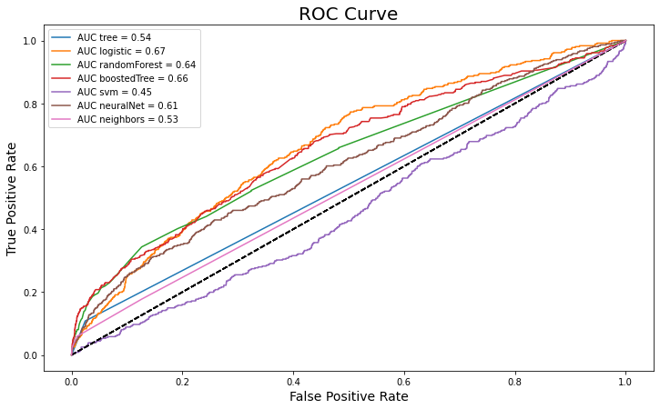
Model Evaluation – ROC Curve
ROC
The base line is in the middle (black dotted line)
We can see that the Neural Network has an AUC of 61% which in turn shows the curve to be in the True Positive Rate.

Slide 20
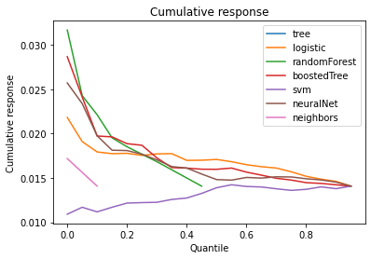
Model Evaluation – Cumulative Response
Cumulative Response
With cumulative response we can say that by contacting the top quantile we will yield a donation rate in the range of 2% – 1.6%.
Note - The Response/Conversion Rate for the Test Campaign (7244) was only 1.4%

Slide 21
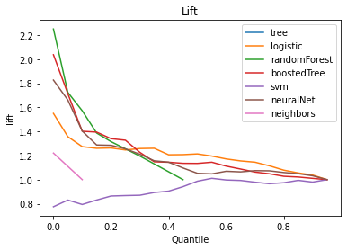
Model Evaluation – Lift
Lift Curve
Here with the neural network model, we increase the chances of contacting a potentital donor by 1.1 – 1.4 times when we contact the top % of our customers.

Slide 22
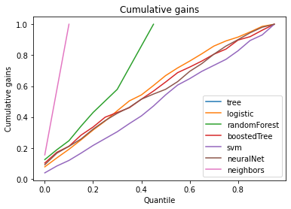
Model Evaluation – Cumulative Gains
Cumulative Gains
With cumulative gains we can understand that the more we contact people the more likely we will contact all the donors
Also, we can see that if we contact Top 40% of our already known donors, we will reach 50% of the potential donors

Slide 23
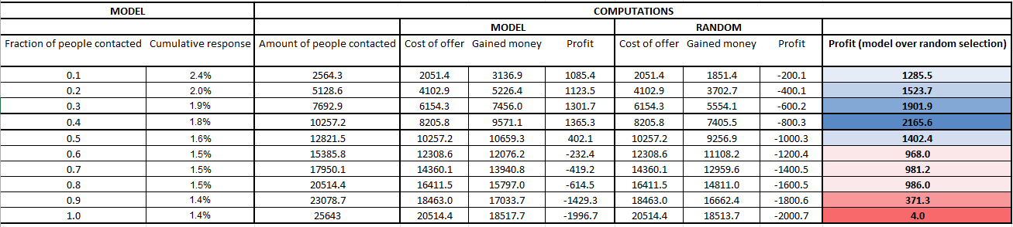
Target & Profit
Optimal Number of people to contact
10,257 people should be contacted for the campaign to be profitable
Profit with the campaign
With a unit cost of €0.80 per letter and having an average donation of €51.56.

Slide 24
Thank you for Listening

