Slide 1
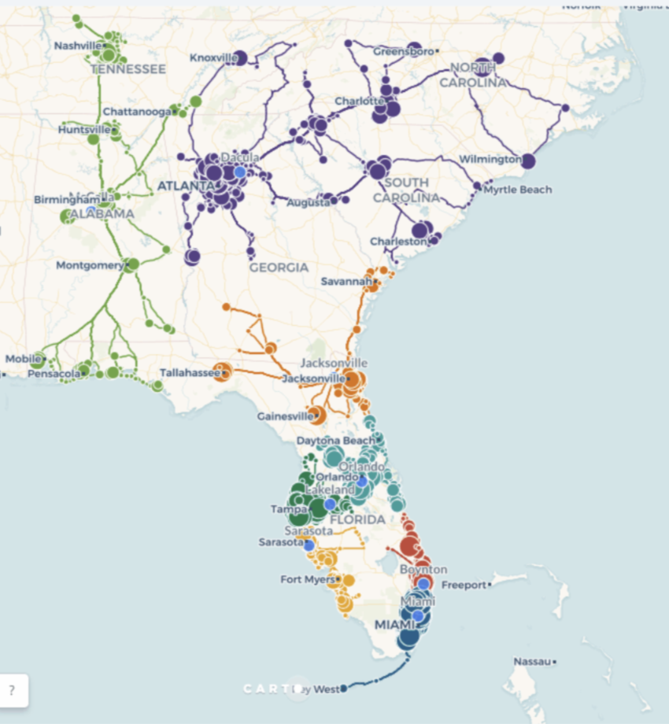
INTRODUCTION
Supply Chain Network Optimization using stimulation software

Slide 2
Overview
Definition and Importance
Supply chain network optimization involves the strategic placement and management of supply chain elements to minimize costs and maximize efficiency.
It is crucial for enhancing operational efficiency, reducing costs, and improving customer satisfaction.
Role of Simulation Software
Simulation software allows for modeling and analysis of supply chain scenarios, helping in decision-making and strategy formulation.
Provides a risk-free environment to test different strategies and predict outcomes.

Slide 3
Key Concepts in Supply Chain Network Optimization
Elements of a Supply Chain Network
Suppliers, manufacturers, distribution centers, and retailers.
Information flow, product flow, and financial flow.
Objectives of Optimization
Reduce operational costs by 15%.
Improve service levels to achieve 98% on-time delivery

Slide 4
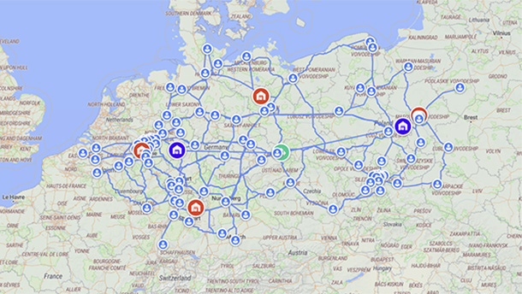
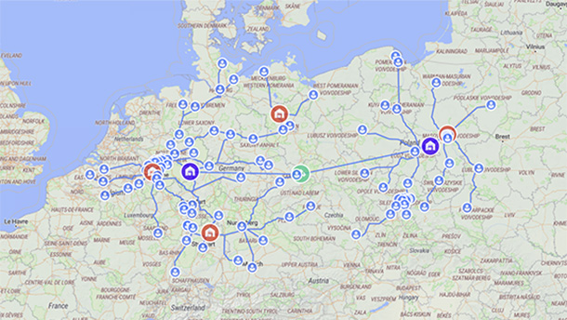
SUPPLY CHAIN SIMULATION
Scenario Analysis
Data Integration
Performance Metrics
Optimization Algorithms
Visualization

Slide 5
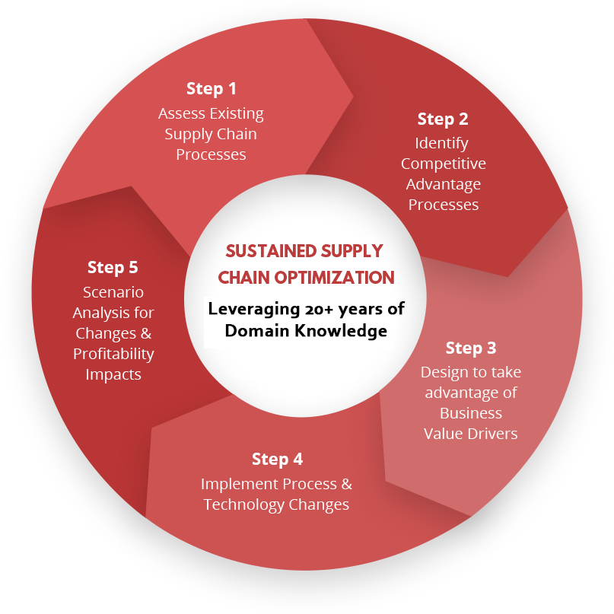
Methodology
Approach
Use of simulation software for scenario analysis.
Application of lean principles and Six Sigma techniques.
Phases
Initial assessment and data collection.
Simulation and modeling.
Implementation and monitoring.

Slide 6
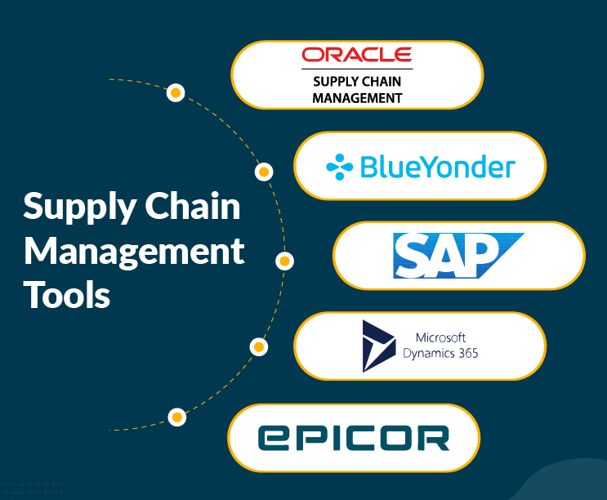
Tools and Technologies Used
Simulation Software
Description and capabilities.
Benefits for supply chain optimization.
Analytical Tools
Data analytics platforms.
Predictive modeling tools.

Slide 7
Optimization Strategies
Inventory Optimization
Strategies for reducing excess inventory.
Techniques for improving inventory turnover.
Network Redesign
Relocation of warehouses and distribution centres.
Route optimization for transportation efficiency.

Slide 8
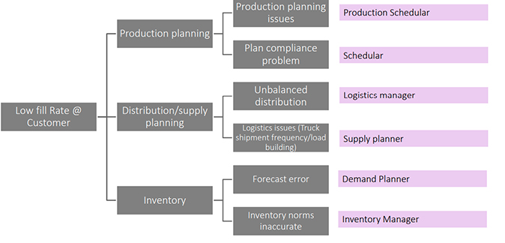

Slide 9
Data Collection and Analysis
Data Sources
Internal records and transaction data.
External market and supplier data.
Analysis Techniques
Descriptive analytics for understanding current state.
Predictive analytics for forecasting and scenario planning.

Slide 10
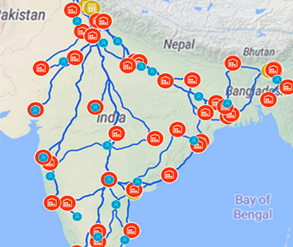
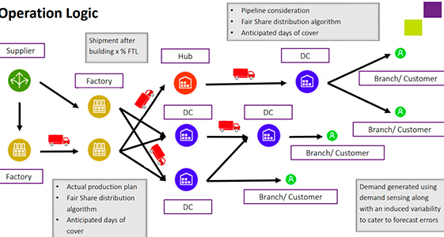
Operation Logic

Slide 11
Challenges in Implementation
Data Integration Issues
Ensuring seamless data flow across systems.
Resistance to Change
Overcoming employee resistance and ensuring adoption.
Cost and Time Overruns
Managing implementation costs and timelines.

Slide 12

Case Studies
Deloitte
Total logistics costs reduced by 9%.
FMCG
Average inventory level dropped 35%
total costs decreased by 20%
Coca-Cola
Reduce the number of second-tier warehouses, e.g., by applying cross-docking instead.
Number of warehouses reduced by 28%.
Transportation costs reduced by 5%.
Total inventory level reduced by 18%.
Inventory turnover increased by 26%.
Reduce last-mile delivery time.
Reduce transportation unit costs.

Slide 13
Future Trends in Supply Chain Management Software
Artificial Intelligence and Machine Learning
Enhancing predictive analytics and decision-making.
Blockchain Technology
Improving transparency and traceability.
Internet of Things (IoT)
Enabling real-time monitoring and control.
Cloud Computing
Facilitating scalability and accessibility.

Slide 14
Conclusion
Summary of Key Points
Recap of SCM software benefits and features.
Importance of choosing the right solution and proper implementation.
Final Thoughts
SCM software is essential for modern supply chain management.
Continuous innovation and adaptation are key to success.

Slide 15
THANK YOU…

