Slide 1



CSE 2213:
Discrete Mathematics
Modified Slides (based on the source mentioned below):
Originals slides by Dr. Baek and Dr. Still, adapted by J. Stelovsky
Based on slides Dr. M. P. Frank and Dr. J.L. Gross
Provided by McGraw-Hill
1-1

Slide 2



Lecture 05
Chapter 1. The Foundations
Nested Quantifiers
Rules of Inference
5-2

Slide 3
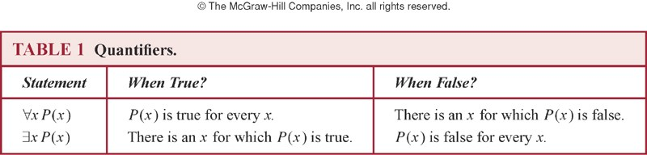
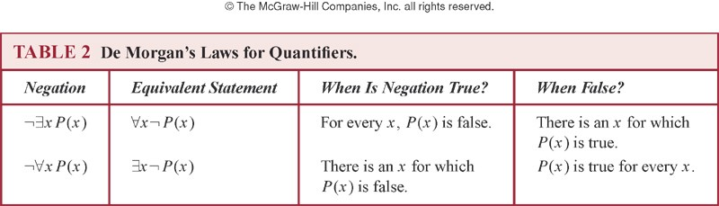
Previously…
5-3

Slide 4






Nesting of Quantifiers
 Example:
Let the domain of x and y be people.
Let L(x,y) = “x likes y” (A statement with 2 free variables – not a proposition)
 Then ∃y L(x,y) = “There is someone whom
x likes.” (A statement with 1 free variable x
– not a proposition)
 Then ∀x (∃y L(x,y)) =
“Everyone has someone whom they like.” (A with free variables.)
5-4

Slide 5

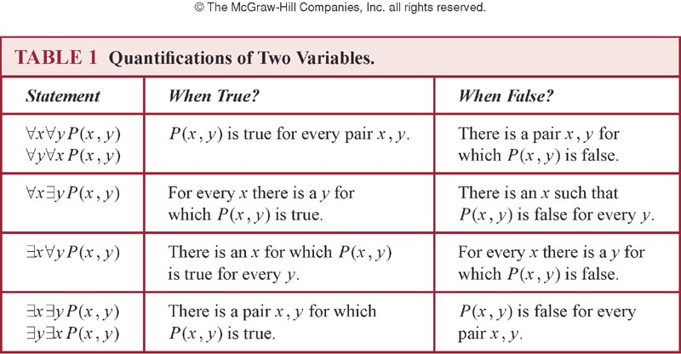
Nested Quantifiers
 Nested quantifiers are quantifiers that occur within the scope of other quantifiers.
 The order of the quantifiers is important, unless all the quantifiers are universal quantifiers or all are existential quantifiers.
5-5

Slide 6
Nested Quantifiers
 Let the domain of x and y is R, and P(x,y): xy = 0.
Find the truth value of the following propositions.
 ∀x ∀y P(x, y)
 ∀x ∃y P(x, y)
 ∃x ∀y P(x, y)
 ∃x ∃y P(x, y)
(F)
(T)
(T)
(T)
R: set of real numbers
 ∀x ∃y P(x,y) ≡ ∃y ∀x P(x,y)
 For every x, there exists y such that x + y = 0.
(T)
 There exists y such that, for every x, x + y = 0. (F)
5-6

Slide 7
Nested Quantifiers: Example
 Let the domain = {1, 2, 3}. Find an expression equivalent to ∀x ∃y P(x,y) where the variables are bound by substitution instead:
 Expand from inside out or outside in.
 Outside in:
∀x ∃y P(x,y)
≡ ∃y P(1,y) ∧ ∃y P(2,y) ∧ ∃y P(3,y)
≡ [P(1,1) ∨ P(1,2) ∨ P(1,3)] ∧
[P(2,1) ∨ P(2,2) ∨ P(2,3)] ∧
[P(3,1) ∨ P(3,2) ∨ P(3,3)]
5-7

Slide 8
Quantifier Exercise
 If R(x,y)=“x relies upon y,” express the following in unambiguous English when the domain is all people
∀x(∃y R(x,y)) = Everyone has someone to rely on.
There’s a poor overburdened soul whom
everyone relies upon (including himself)!
∃y(∀x R(x,y)) =
∃x(∀y R(x,y)) =
There’s some needy person who relies upon everybody (including himself).
∀y(∃x R(x,y)) =
Everyone has someone who relies upon them.
Everyone relies upon everybody, (including themselves)!
∀x(∀y R(x,y)) =
5-8

Slide 9

Negating Nested Quantifiers
 Successively apply the rules for negating
statements involving a single quantifier
 Example: Express the negation of the statement
∀x ∃y (P(x,y) ∧ ∃z R(x,y,z)) so that all negation symbols immediately precede predicates.
 ¬∀x ∃y (P(x,y) ∧ ∃z R(x,y,z))
≡ ∃x ¬∃y (P(x,y) ∧ ∃z R(x,y,z))
≡ ∃x ∀y ¬(P(x,y) ∧ ∃z R(x,y,z))
≡ ∃x ∀y (¬P(x,y) ∨ ¬∃z R(x,y,z))
≡ ∃x ∀y (¬P(x,y) ∨ ∀z ¬R(x,y,z))

Slide 10
Equivalence Laws
 ∀x ∀y P(x,y) ≡ ∀y ∀x P(x,y)
∃x ∃y P(x,y) ≡ ∃y ∃x P(x,y)
 ∀x (P(x) ∧ Q(x)) ≡ (∀x P(x)) ∧ (∀x Q(x))
∃x (P(x) ∨ Q(x)) ≡ (∃x P(x)) ∨ (∃x Q(x))
 Exercise:
See if you can prove these yourself.

Slide 11
Proof ..
∀x (P(x) ∧ Q(x)) ≡ (∀x P(x)) ∧ (∀x Q(x))
∀x(P(x)⋀Q(x)) ≡ ∀xP(x) ⋀∀xQ(x)
Proof: Suppose ∀x(P(x)⋀Q(x)) is true. Then for all a in the domain P(a) ⋀ Q(a) is true. Hence, both P(a) is true and Q(a) is true. Since P(a) is true for all a in the domain, ∀xP(x) is true. Since Q(a) is true for all a in the domain, ∀xQ(x) is true. Hence ∀x(P(x)⋀Q(x)) is true. [What else do we need to show?]

Slide 12
Proof …
Suppose that ∀x(P(x)⋀Q(x)) is true.
It follows that ∀xP(x) is true, and that ∀xQ(x) is true. Hence, for each element a in the domain P(a) is true, and Q(a) is true. Hence P(a)⋀Q(a) is true for each element a in the domain.
Therefore, by definition, ∀x(P(x)⋀Q(x)) is true.

Slide 13
Notational Conventions
 Quantifiers have higher precedence than all logical operators from propositional logic:
(∀x P(x))∧ Q(x)
 Consecutive quantifiers of the same type can be combined:
∀x ∀y ∀z P(x,y,z) ≡ ∀x,y,z P(x,y,z) or even ∀xyz P(x,y,z)

Slide 14
1.5 Rules of Inference
 An argument: a sequence of statements that end with a conclusion
 Some forms of argument (“valid”) never lead from correct statements to an incorrect conclusion. Some other forms of argument (“fallacies”) can lead from true statements to an incorrect conclusion.
 A logical argument consists of a list of (possibly compound) propositions called premises/hypotheses and a single proposition called the conclusion.
 Logical rules of inference: methods that depend on logic alone for deriving a new statement from a set of other statements. (Templates for constructing valid arguments.)

Slide 15

Valid Arguments (I)
 Example: A logical argument
If I work all night, then I get tired. I worked all night.
Therefore I got tired.
 Logical representation of underlying variables:
p: I work all night. q: I get tired.
 Logical analysis of argument:
p → q premise 1
p premise 2
∴ q
conclusion

Slide 16
Valid Arguments (II)
 A form of logical argument is valid if whenever every premise is true, the conclusion is also true. A form of argument that is not valid is called a fallacy.
Example of Fallacy:
p="I am a businessman."
q="A businessman is rich."
Then, a fallacy would be this:
"I am a businessman and I am poor"

Slide 17

Inference Rules: General From
 An Inference Rule is
 A pattern establishing that if we know that a set of premise statements of certain forms are all true, then we can validly deduce that a certain related conclusion statement is true.
premise 1
premise 2
···
∴ conclusion
“∴” means “therefore”

Slide 18

Inference Rules & Implications
 Each valid logical inference rule corresponds to an implication that is a tautology.
Inference rule
premise 1 premise 2 ···
∴ conclusion
 Corresponding tautology:
((premise 1) ∧ (premise 2) ∧ …) → conclusion

