Slide 1
Graphs - 6
CSE 2213 – Discrete Mathematics
Course Instructor: Al-Sakib Khan Pathan, PhD, SMIEEE [Professor, CSE, UIU]
Based on the slides of Minhajul Bashir

Slide 2
Exercise
Show that in a simple graph with at least two vertices, there must be at least two vertices with the same degree.

Slide 3
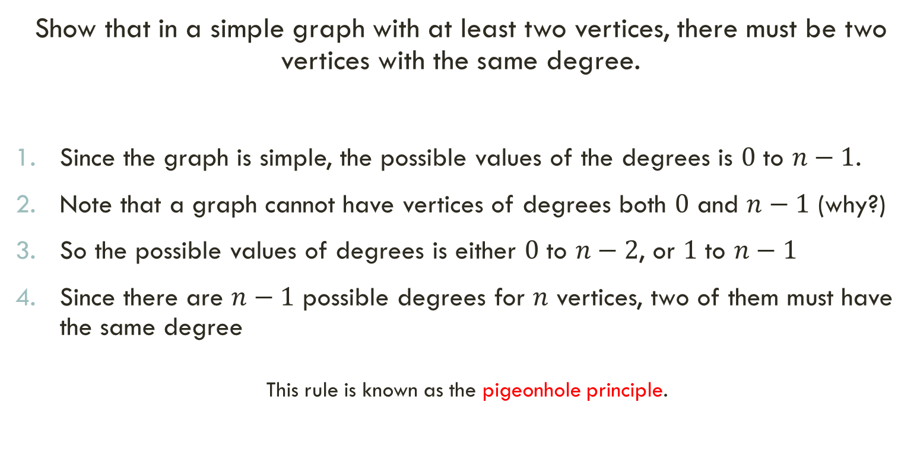
Show that in a simple graph with at least two vertices, there must be two vertices with the same degree.
Since the graph is simple, the possible values of the degrees is $0$ to $n−1$.
Note that a graph cannot have vertices of degrees both $0$ and $n−1$ (why?)
So the possible values of degrees is either $0$ to $n−2$, or $1$ to $n−1$
Since there are $n−1$ possible degrees for $n$ vertices, two of them must have the same degree
This rule is known as the pigeonhole principle.

Slide 4
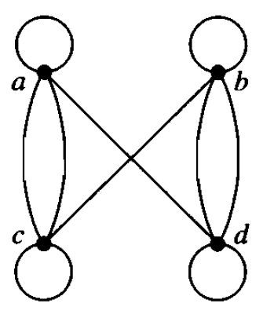
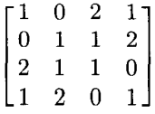
Exercise Rosen, Section 9.3, Exercise 15 or SECTION 10.3, Exercise 15
Show the adjacency matrix representation of the following graph:

Slide 5
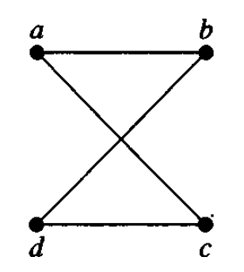
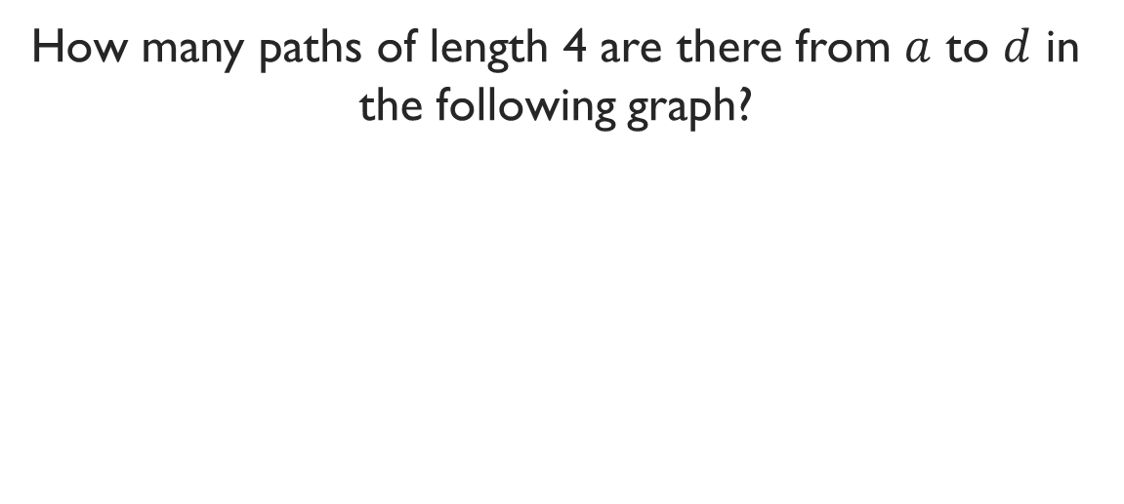
Exercise Rosen, Section 9.4, Example 14 or Section 10.4, Example 15
How many paths of length 4 are there from $a$ to $d$ in the following graph?
a,b,a,b,d
a,b,a,c,d
a,b,d,b,d
a,b,d,c,d
a,c,a,b,d
a,c,a,c,d
a,c,d,b,d
a,c,d,c,d

Slide 6
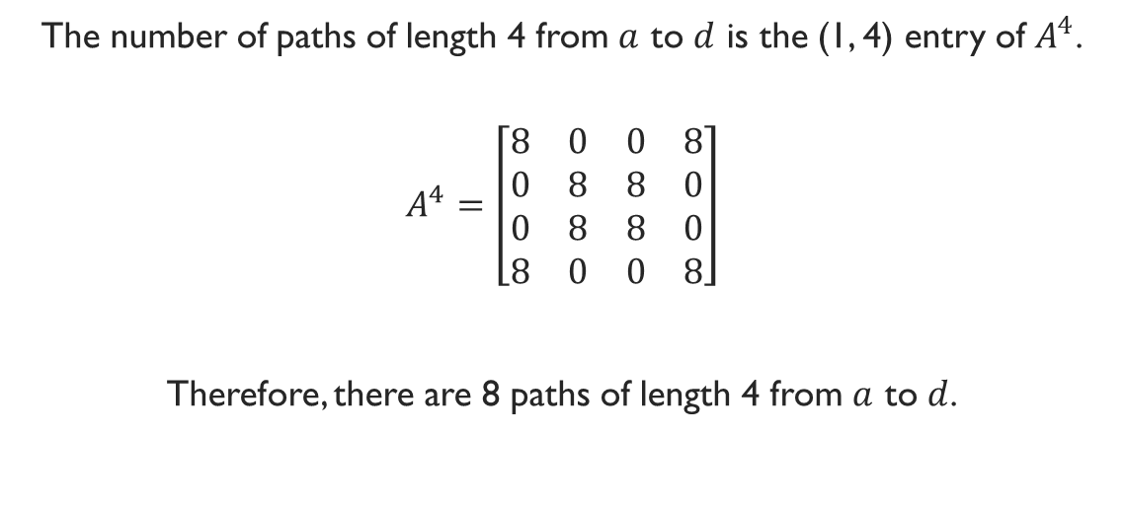
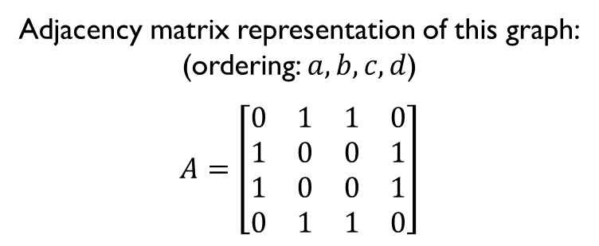
Adjacency matrix representation of this graph:
(ordering: $a,b,c,d$)
$$A=\left[\begin{matrix}0 & 1 & 1 & 0 \\ 1 & 0 & 0 & 1 \\ 1 & 0 & 0 & 1 \\ 0 & 1 & 1 & 0\end{matrix}\right]$$
The number of paths of length 4 from $a$ to $d$ is the (1, 4) entry of $A^{4}$.
$$A^{4}=\left[\begin{matrix}8 & 0 & 0 & 8 \\ 0 & 8 & 8 & 0 \\ 0 & 8 & 8 & 0 \\ 8 & 0 & 0 & 8\end{matrix}\right]$$
Therefore, there are 8 paths of length 4 from $a$ to $d$.

