Slide 1
Graphs - 2
CSE 2213 – Discrete Mathematics
Course Instructor: Al-Sakib Khan Pathan, PhD, SMIEEE [Professor, CSE, UIU]
Based on the slides of Minhajul Bashir

Slide 2
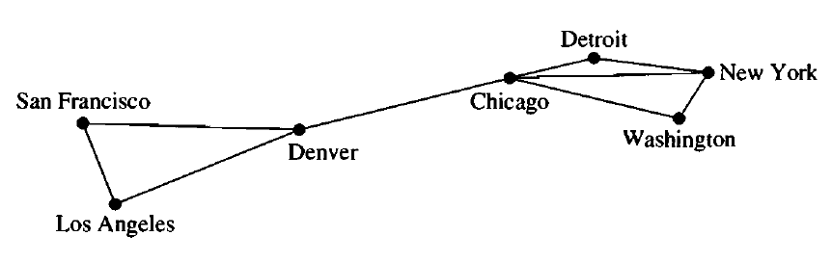
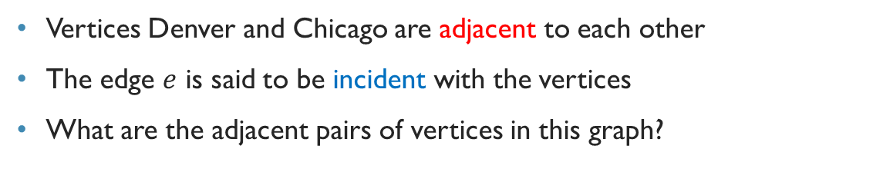

Graph terminology (Undirected graph)
$$e$$
Vertices Denver and Chicago are adjacent to each other
The edge $e$ is said to be incident with the vertices
What are the adjacent pairs of vertices in this graph?

Slide 3
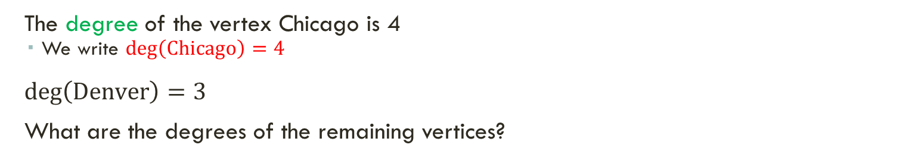
Graph terminology (Undirected graph)
The degree of a vertex in an undirected graph is the number of edges incident with it, except that a loop at a vertex contributes twice to the degree of that vertex.
The degree of the vertex Chicago is 4
We write $\deg\left(\text{Chicago}\right)=4$
$\deg\left(\text{Denver}\right)=3$
What are the degrees of the remaining vertices?

Slide 4
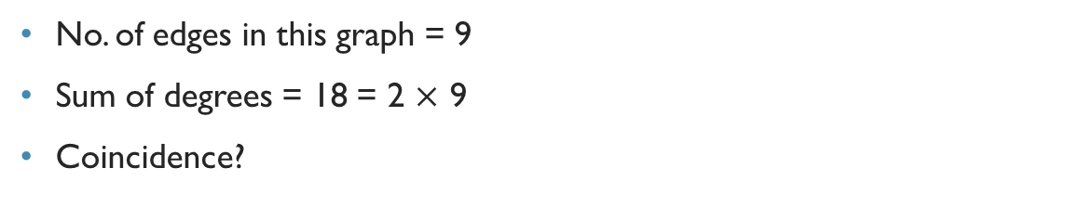
Handshaking theorem
No. of edges in this graph = 9
Sum of degrees = 18 = 2 $×$ 9
Coincidence?

Slide 5
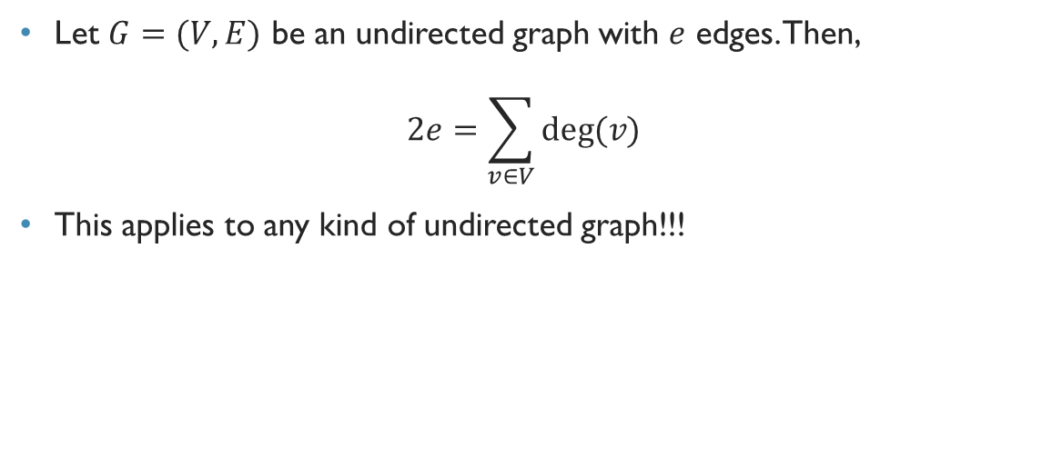
Handshaking theorem
Let $G=(V,E)$ be an undirected graph with $e$ edges. Then,
$$2e=\sum_{v∈V}{deg⁡(v)}$$
This applies to any kind of undirected graph!!!

Slide 6
Quick exercise
How many edges are there in a graph with 10 vertices each of degree six?
As the sum of the degrees of the vertices is 6x10=60, it follows that 2e = 60, where e is the number of edges. Therefore, e = 30.

Slide 7
Another theorem
An undirected graph has an even number of vertices of odd degree.
Really??

Slide 9
Let’s connect these, and verify the theorem!!!
A
E
B
F
C
G
D
H

Slide 10
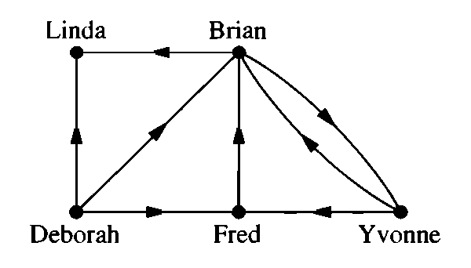
Graph terminology (directed graph)
Vertices Deborah is adjacent to Brian, and Brian is adjacent from Deborah
Deborah is the initial vertex of the edge, and Brian is the terminal vertex of the edge

Slide 11
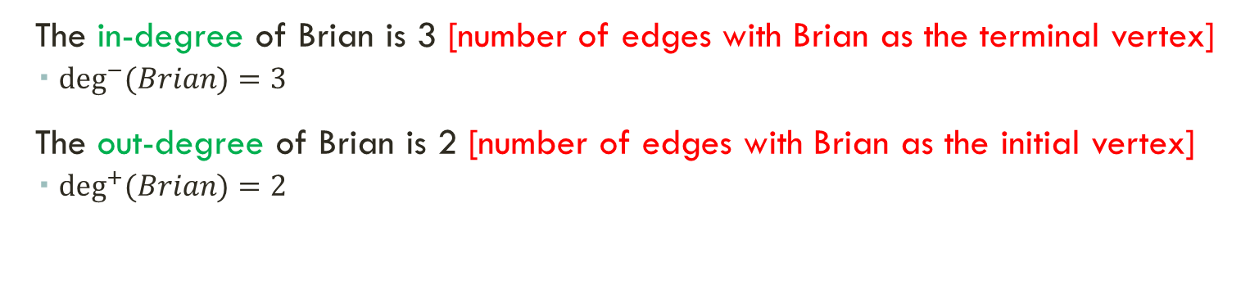
Graph terminology (directed graph)
The in-degree of Brian is 3 [number of edges with Brian as the terminal vertex]
$\deg^{−}{(Brian)}=3$
The out-degree of Brian is 2 [number of edges with Brian as the initial vertex]
$\deg^{+}{(Brian)}=2$

Slide 12
Handshaking theorem (directed graph)
The sum of in-degrees is 8
The sum of out-degrees is 8
No. of edges is 8
Coincidence?

Slide 13
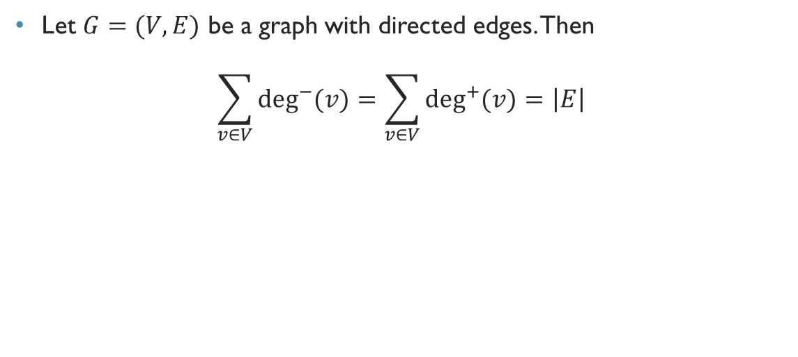
Handshaking theorem (directed graph)
Let $G=(V,E)$ be a graph with directed edges. Then
$$\sum_{v∈V}{\deg^{−}{(v)}}=\sum_{v∈V}{\deg^{+}{(v)}}=\left|E\right|$$

Slide 14
Bipartite graph
A
E
B
F
C
G
D
H
Sometimes a graph has the property that its vertex set can be divided into two disjoint subsets such that each edge connects a vertex in one of these subsets to a vertex in the other subset.

Slide 15
Bipartite graph
Jon
Annie
Ricky
Amy
Adam
Rachel
Nick
Linda
An edge represents that the two persons are married

Slide 16
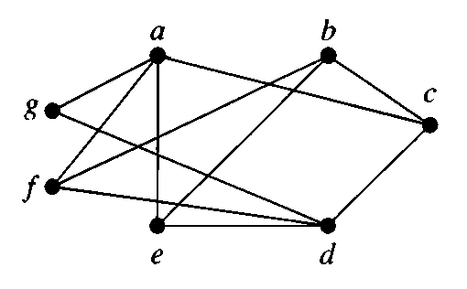
Is this graph bipartite?
What if I say yes??

Slide 17
Graph isomorphism
A
B
A
C
D
C
D
B
We can draw the same graph differently
If we can determine that two graphs are actually two different representations of the same graph, then they are called isomorphic
We will learn more about it later

Slide 18
Is this graph bipartite?
A
C
B
E
D
F
G
A simple graph is bipartite if and only if it is possible to assign one of two different colors to each vertex of the graph so that no two adjacent vertices are assigned the same color.

Slide 19
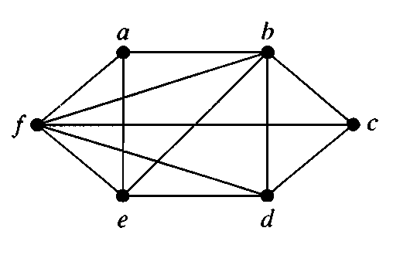
Is this graph bipartite?

