Slide 1
Graphs - 1
CSE 2213 – Discrete Mathematics
Course Instructor: Al-Sakib Khan Pathan, PhD, SMIEEE [Professor, CSE, UIU]
Based on the slides of Minhajul Bashir

Slide 2

Graph
A graph is $G=(V,E)$ consists of $V$, a nonempty set of vertices (or nodes), and $E$, a set of edges
Each edge has one or two vertices associated with it
These vertices are called endpoints of that edge
An edge connects its endpoints

Slide 3
Different types of graph
Simple graph vs Multigraph
With loops vs Without loops
Undirected vs Directed
Unweighted vs Weighted

Slide 4
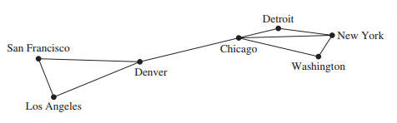
A computer network
The data centers of a company are geographically distributed
This graph shows the connection between data centers
What sort of graph is it?

Slide 5
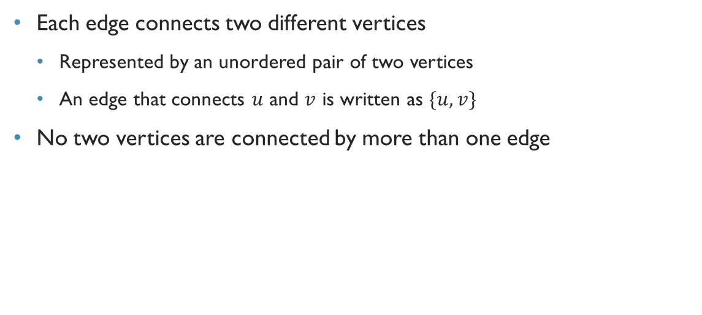
Simple graph
Each edge connects two different vertices
Represented by an unordered pair of two vertices
An edge that connects $u$ and $v$ is written as $\{u,v\}$
No two vertices are connected by more than one edge

Slide 6
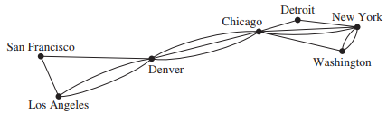
A computer network
This graph shows links between data centers
Note that there exists multiple links between some pair
What sort of graph is it?

Slide 7
Multigraph
Each edge connects two different vertices
There exists at least two edges that connect the same pair of vertices

Slide 8
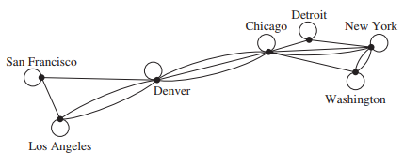
A computer network
Now there are links that connect a data center to itself!!!
Used for diagnosis purpose
What sort of graph is it?

Slide 9
Pseudograph
Each edge connects one or two vertices
There may exist edges that connect the same pair of vertices
There exists at least one edge that connects a vertex to itself
Known as loop

Slide 10
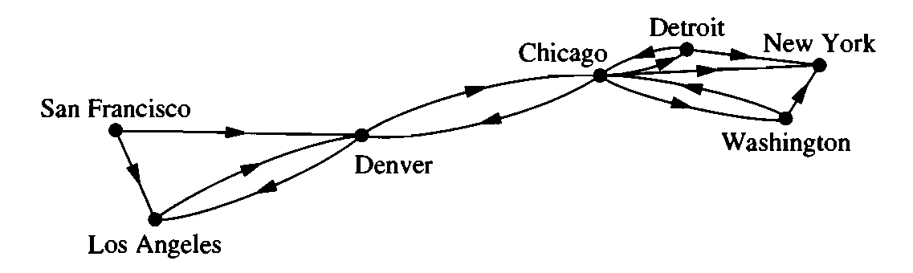
A computer network
This time the links are simplex, and data can be passed in one direction through a link
What sort of graph is it?

Slide 11

Directed graph
Also known as digraph
Each edge has a direction associated with it
Directed edge
Represented by an ordered pair of two vertices
If a directed edge starts at $u$ and ends at $v$, then it is represented as $(u,v)$

Slide 12
Variants of directed graph
Simple directed graph
Multiple edges not allowed in the same direction
Loop not allowed
Directed multigraph
Multiple edges allowed
Loop allowed

Slide 13
Mixed graph
Edges may be directed, or undirected
Multiple edges allowed
Loops allowed

Slide 14
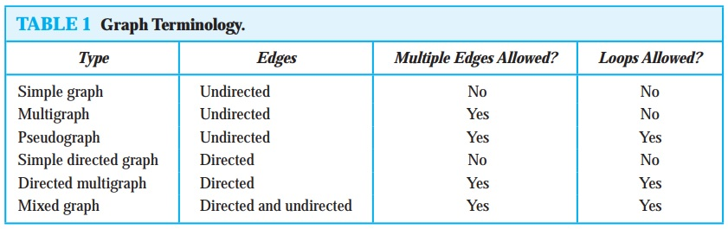
Different types of graphs

Slide 15
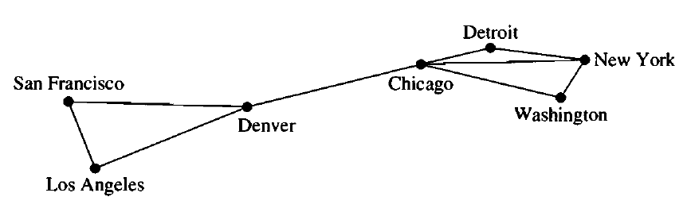
Weighted graph
9
1
7
3
5
2
8
2
4
Each edge has a weight
Here, weight means data transmission rate between the vertices (for instance)

Slide 16
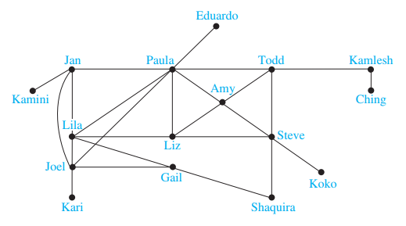
Exercise
Acquaintanceship graph
A graph that represents whether two people know each other or not
What sort of graph is it?
Simple

Slide 17
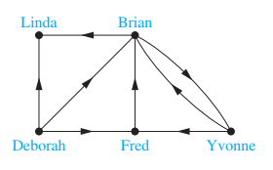
Exercise
Influence graph
- In studies of group behavior, it is observed that certain people can influence the thinking of others.
- A directed graph called an influence graph can be used to model this behavior.
- Each person of the group is represented by a vertex.
- Direction for influence ‘from’ one ‘to’ another.
What sort of graph is it?

Slide 18
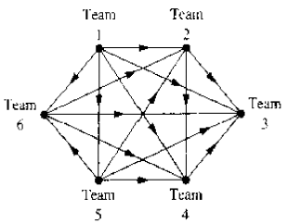
Exercise
Round robin tournament
Each team plays with the other teams exactly once
We create a graph to represent the match results
What sort of graph is it?
Directed graph. Team 1 is undefeated while Team 3 is winless for instance.

Slide 19
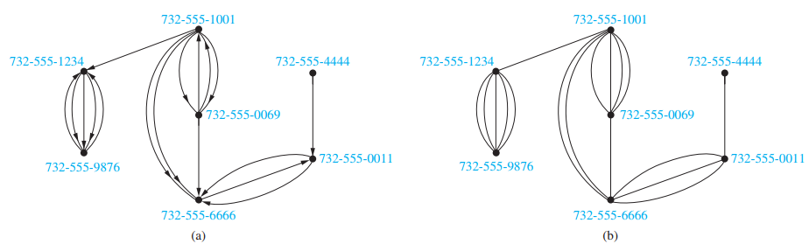
Exercise
Call graph
Graph that shows the phone calls made from one number to another
What sort of graph is it?
A directed multigraph
An undirected multigraph

