Slide 1
Graphs - 3
CSE 2213 – Discrete Mathematics
Course Instructor: Al-Sakib Khan Pathan, PhD, SMIEEE [Professor, CSE, UIU]
Based on the slides of Minhajul Bashir

Slide 2
Some special simple graphs

Slide 3
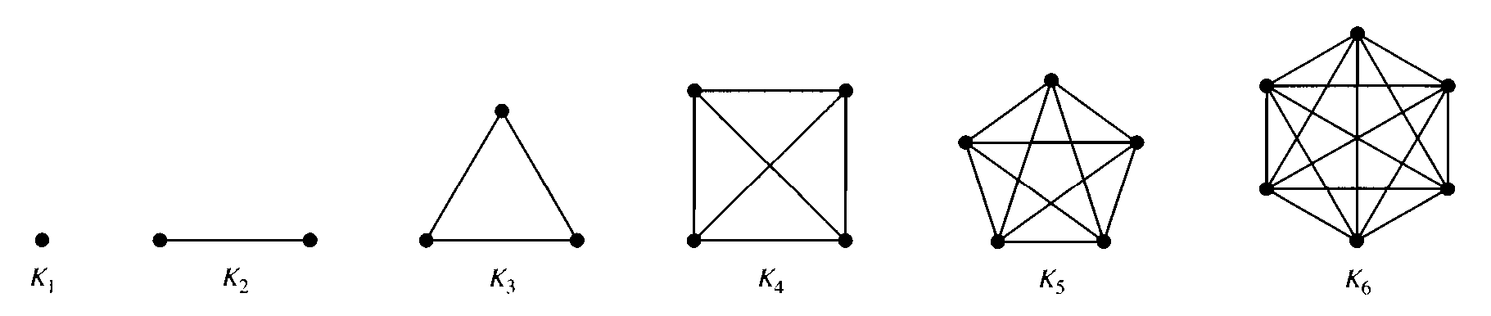
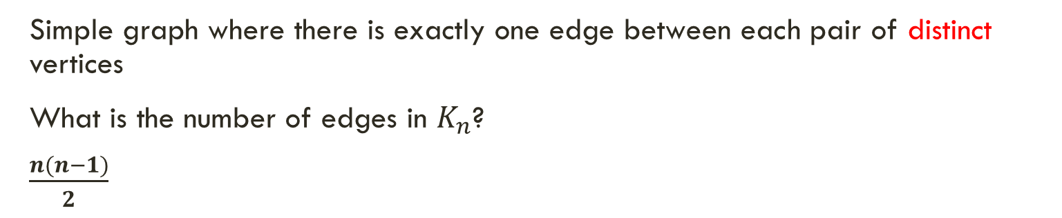
Complete graph
Simple graph where there is exactly one edge between each pair of distinct vertices
What is the number of edges in $K_{n}$?
$\frac{n(n−1)}{2}$

Slide 4
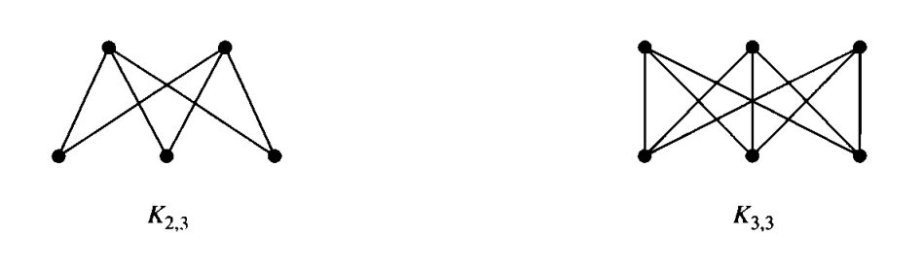
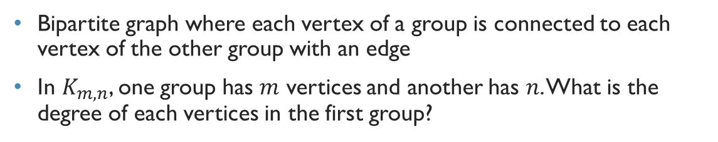
Complete bipartite graph
Bipartite graph where each vertex of a group is connected to each vertex of the other group with an edge
In $K_{m,n}$, one group has $m$ vertices and another has $n$. What is the degree of each vertices in the first group?

Slide 5
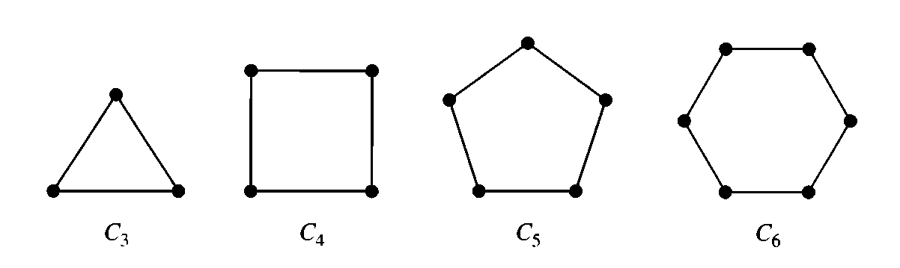
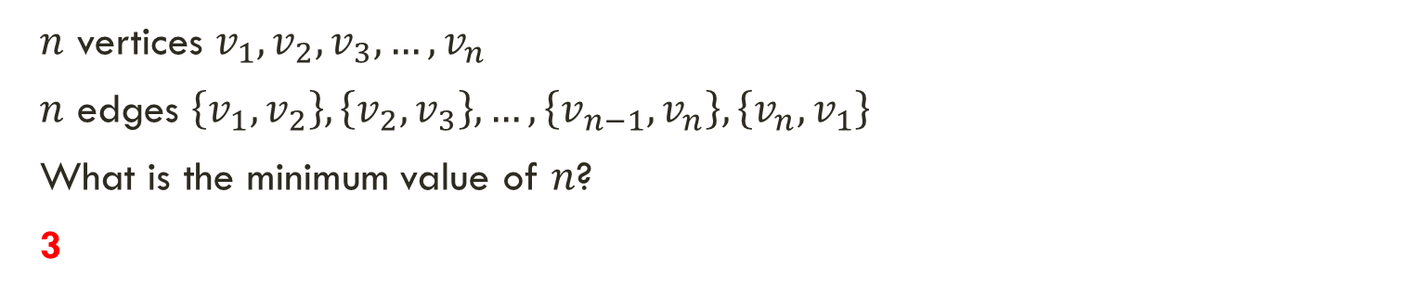
Cycles
$n$ vertices $v_{1},v_{2},v_{3},…,v_{n}$
$n$ edges $\left\{v_{1},v_{2}\right\},\left\{v_{2},v_{3}\right\},…,\left\{v_{n−1},v_{n}\right\},\left\{v_{n},v_{1}\right\}$
What is the minimum value of $n$?
3

Slide 6
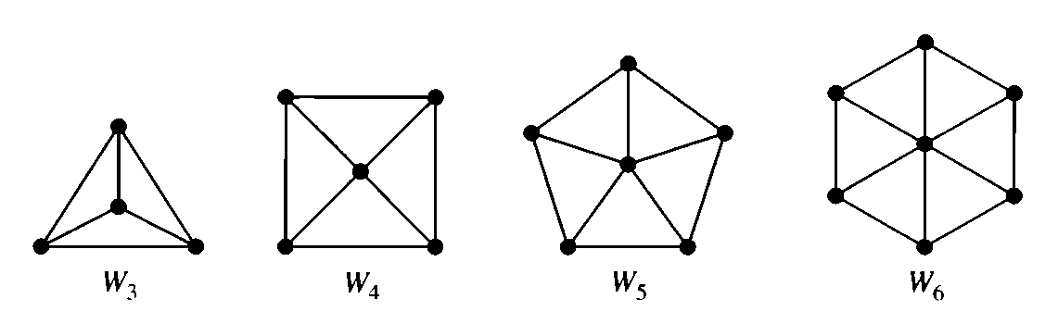
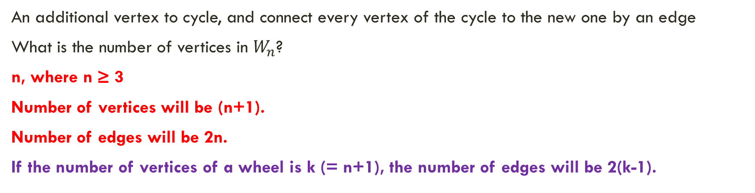
Wheels
An additional vertex to cycle, and connect every vertex of the cycle to the new one by an edge
What is the number of vertices in $W_{n}$?
n, where n ≥ 3
Number of vertices will be (n+1).
Number of edges will be 2n.
If the number of vertices of a wheel is k (= n+1), the number of edges will be 2(k-1).

Slide 7
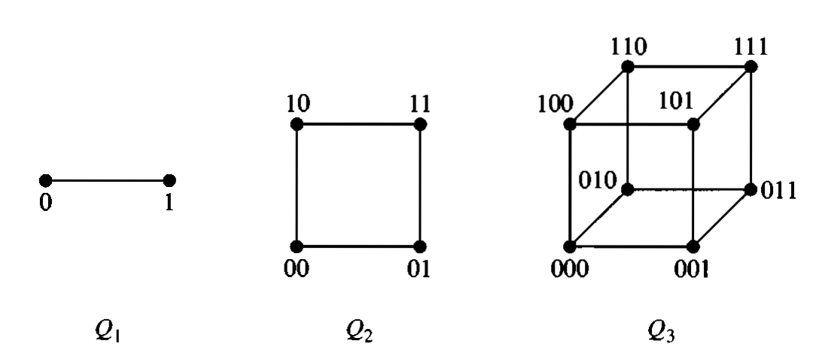
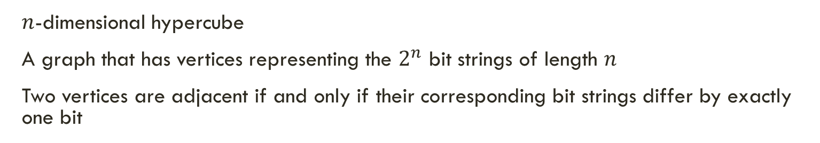

$n$-cubes
$n$-dimensional hypercube
A graph that has vertices representing the $2^{n}$ bit strings of length $n$
Two vertices are adjacent if and only if their corresponding bit strings differ by exactly one bit

Slide 8
Graph representation

Slide 9
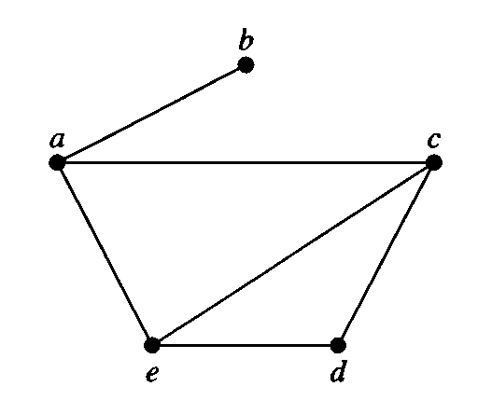

Adjacency list
Vertex Adjacent vertices
$a$ $b,c,e$
$b$ $a$
$c$ $a,d,e$
$d$ $c,e$
$e$ $a,c,d$

Slide 10
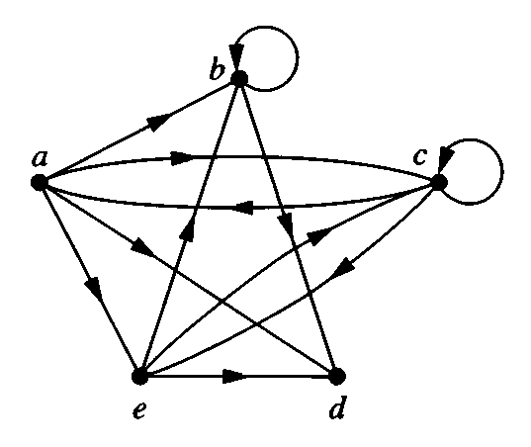

Adjacency list
Initial Terminal vertices
$a$ $b,c,d,e$
$b$ $b,d$
$c$ $a,c,e$
$d$
$e$ $b,c,d$

Slide 11
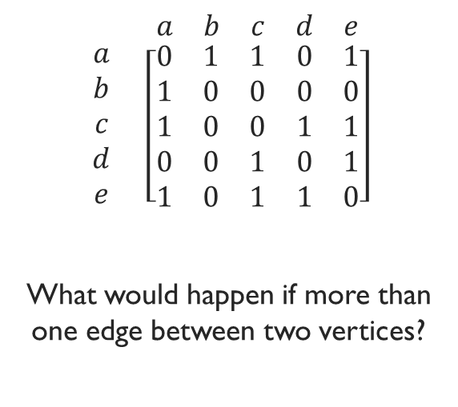
Adjacency matrix
$$\begin{matrix} & \begin{matrix}a & b & c & d & e\end{matrix} \\ \begin{matrix}a \\ b \\ c \\ d \\ e\end{matrix} & \left[\begin{matrix}0 & 1 & 1 & 0 & 1 \\ 1 & 0 & 0 & 0 & 0 \\ 1 & 0 & 0 & 1 & 1 \\ 0 & 0 & 1 & 0 & 1 \\ 1 & 0 & 1 & 1 & 0\end{matrix}\right]\end{matrix}$$
What would happen if more than one edge between two vertices?

Slide 12
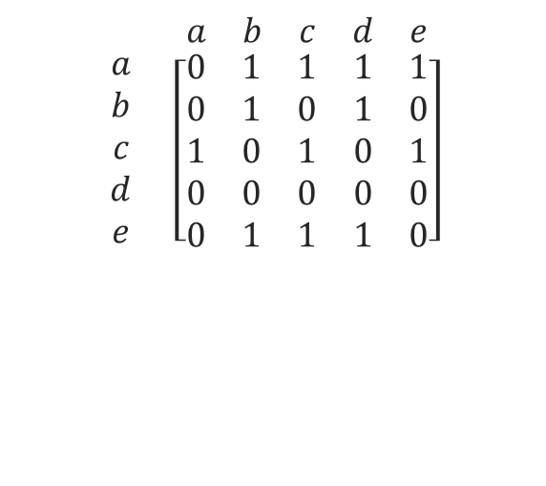
Adjacency matrix
$$\begin{matrix} & \begin{matrix}a & b & c & d & e\end{matrix} \\ \begin{matrix}a \\ b \\ c \\ d \\ e\end{matrix} & \left[\begin{matrix}0 & 1 & 1 & 1 & 1 \\ 0 & 1 & 0 & 1 & 0 \\ 1 & 0 & 1 & 0 & 1 \\ 0 & 0 & 0 & 0 & 0 \\ 0 & 1 & 1 & 1 & 0\end{matrix}\right]\end{matrix}$$

Slide 13
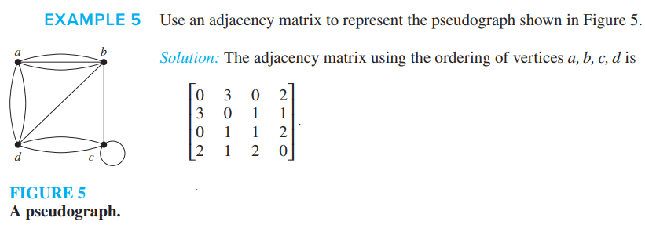
Adjacency matrix

Slide 14
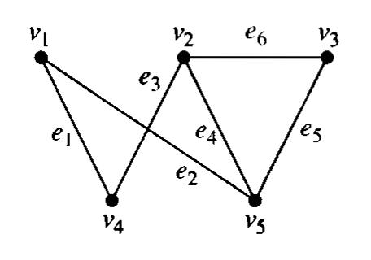
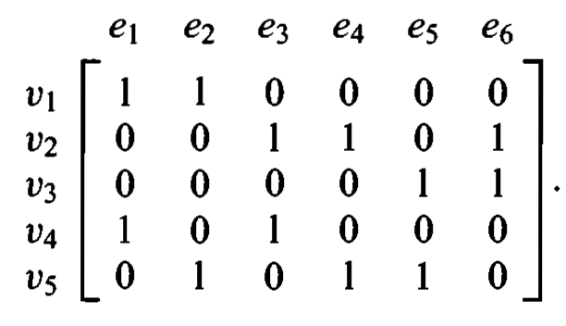
Incidence matrix

