Slide 1



CSE 2213:
Discrete Mathematics
Modified Slides (based on the source mentioned below):
Originals slides by Dr. Baek and Dr. Still, adapted by J. Stelovsky
Based on slides Dr. M. P. Frank and Dr. J.L. Gross
Provided by McGraw-Hill
1-1

Slide 2



Lecture 10
Chapter 5 (or, 6). Counting
The Basics of Counting
The Pigeonhole Principle

Slide 3


Sum and Product Rules
 Let m be the number of ways to do task 1 and n the number of ways to do task 2,
 with each number independent of how the other task is done,
 and also assume that no way to do task 1 simultaneously also accomplishes task 2.
 Then, we have the following rules:
 The sum rule: The task “do either task 1 or task 2, but not both” can be done in m + n ways.
 The product rule: The task “do both task 1 and task 2” can be done in mn ways.

Slide 4

The Sum Rule
 If a task can be done in one of n₁ ways, or in one of n₂ ways, …, or in one of n_{m} ways, where none of the set of n_{i} ways of doing the task is the same as any of the set of n_{j} ways, for all pairs i and j with 1 ≤ i < j ≤ m.
 Then, the number of ways to do the task is:
n₁ + n₂ + …+ n_{m}.
$$\sum_{i=1}^{m}{n_{i}}$$

Slide 5
The Sum Rule: Example 1
 A student can choose a computer project from one of three lists A, B, and C:
 List A: 23 possible projects
 List B: 15 possible projects
 List C: 19 possible projects
 No project is on more than one list
 How many possible projects are there to choose from?
23 + 15 + 19 = 57

Slide 6
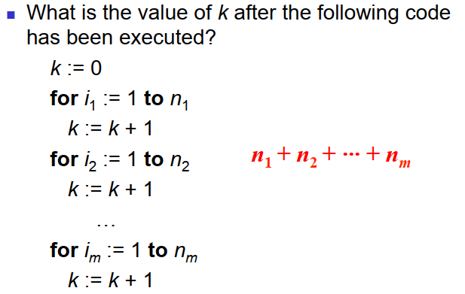
The Sum Rule: Example 2

Slide 7

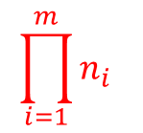
The Product Rule
 Suppose that a procedure can be broken down into a sequence of m successive tasks.
If the task T₁ can be done in n₁ ways;
the task T₂ can then be done in n₂ ways; ...; and the task T_{m} can be done in n_{m} ways, then there are n₁·n₂···n_{m} ways to do the procedure.
$$\prod_{i=1}^{m}{n_{i}}$$

Slide 8

The Product Rule: Example
 Show that a set {x₁,…, x_{n}} containing n elements has 2^{n} subsets.
 A subset can be constructed in
n successive steps:
 Pick or do not pick x₁, pick or do not pick
x₂, …, pick or do not pick x_{n} .
 Each step can be done in two ways.
 Thus the number of possible subsets is 2·2···2 = 2^{n}.
n factors

Slide 9

The Product Rule: Example
 What is the value of k after the following code has been executed?
k := 0
for i₁ := 1 to n₁
for i₂ := 1 to n₂
…
for i_{m} := 1 to n_{m} k := k + 1
n₁·n₂···n_{m}

Slide 10

The Product Rule: Example
 How many functions are there from a set with m
elements to one with n elements?
_{n}m
 How many one-to-one functions are there from a set with m elements to one with n elements?
n·(n – 1)(n – 2) ··· (n – m + 1)
 More examples in the textbook

Slide 11

Rules
 Sum Rule: If a task can be done in one of n₁ ways, or in one of n₂ ways, …, or in one of n_{m} ways, where none of the set of n_{i} ways of doing the task is the same as any of the set of n_{j} ways, for all pairs i and j with 1 ≤ i < j ≤ m. Then the number of ways to do the task is n₁ + n₂ + …+ n_{m}.
 Product Rule: Suppose that a procedure can be broken down into a sequence of m successive tasks. If the task T₁ can be done in n₁ ways; the task T₂ can then be done in n₂ ways; ...; and the task T_{m} can be done in n_{m} ways, then there are n₁·n₂···n_{m} ways to do the procedure.

Slide 12

The Pigeonhole Principle
 a.k.a. the “Dirichlet drawer principle” or the “Shoe Box Principle”.
 If k + 1 or more objects are assigned to k places, then at least 1 place must be assigned 2 or more objects.
 In terms of the assignment function:
 If f: A → B and |A| ≥ |B| + 1, then some element of B has more than two preimages under f.
 i.e., f is not one-to-one.

Slide 13

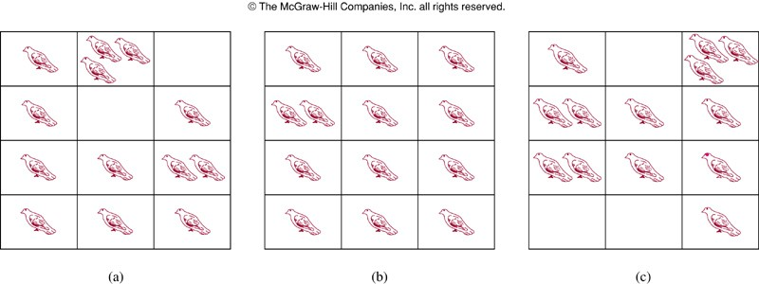
The Pigeonhole Principle
 Proof by contradiction:
 If the conclusion is false, each pigeonhole contains at most one pigeon and in this time, we can account for at most k pigeons.
 Since there are k + 1 pigeons, we have a contradiction.

Slide 14
Pigeonhole Principle: Example
 There are 101 possible numeric grades
(0% ~ 100%) rounded to the nearest integer.
 Also, there are >101 students in a class.
 Therefore, there must be at least one (rounded) grade that will be shared by at least 2 students at the end of the semester.
 i.e., the function from students to rounded grades is not a one-to-one function.

Slide 15
Another Example of P.P.
 10 persons have first names as Alice, Bernare, and Charles, and last names as Lee, McDuff, and Ng. Show that at least two persons have the same first and last names.
 Solution:
 9 possible names for the 10 persons → 10 pigeons and 9 pigeonholes.
 Assignment of names to people = assignment of pigeonholes to the pigeons
 By the Pigeonhole Principle, some name (pigeonhole) is assigned to at least two persons (pigeons).

Slide 16
Generalized Pigeonhole
Principle
 If N objects are assigned to k places, then at least one place must be assigned at least
[N/k] objects.
 E.g., there are N = 280 students in a class.
There are k = 52 weeks in the year.
 Therefore, there must be at least 1 week during which at least [280/52] = [5.38] = 6 students in the class have a birthday.

Slide 17

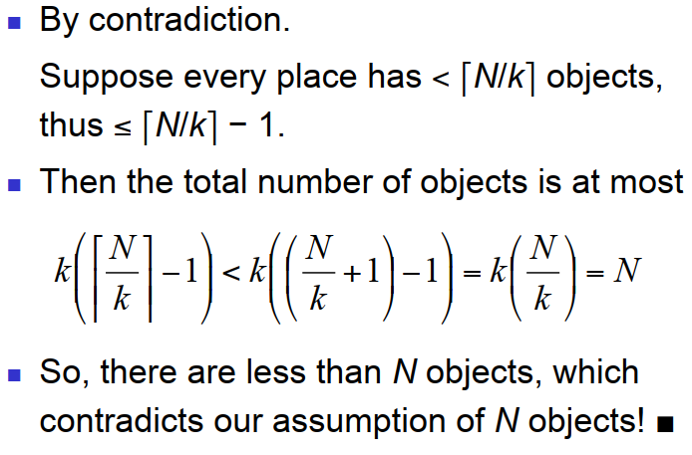
Proof of G.P.P.

Slide 18

G.P.P. Example I
 Given: There are 280 students in a class.
 Without knowing anybody’s birthday, what is the largest value of n for which we can prove using the G.P.P. that at least n students must have been born in the same month?
 Answer:
[280/12] = 23.33 = 24

Slide 19

G.P.P. Example II
 What is the least number of area codes needed to guarantee that the 25 million phones in a state can be assigned distinct 10-digit telephone numbers?
 Phone #: NXX-NXX-XXXX
 N: 2 ~ 9 and X: any digit
 Solution
 NXX-XXXX: (8·10·10) ·(10·10·10·10) = 8 million [see Example 8 of Section 6.1)]
 By G.P.P. at least [25,000,000/8,000,000] = 4 phones have the identical numbers
 Hence, at least 4 area codes are required

