Slide 1
Trees - 1
CSE 2213 – Discrete Mathematics
Course Instructor: Al-Sakib Khan Pathan, PhD, SMIEEE [Professor, CSE, UIU]
Based on the slides of Minhajul Bashir

Slide 2
What is a tree?
A tree is a connected undirected graph with no simple circuits
Since there is no simple circuits, there cannot be multiple edges and loops
Thus, the graph must be a simple graph
What is the difference between a circuit and a cycle?
A circuit is path that begins and ends at the same vertex.
A circuit that does not repeat vertices is called a cycle.

Slide 3
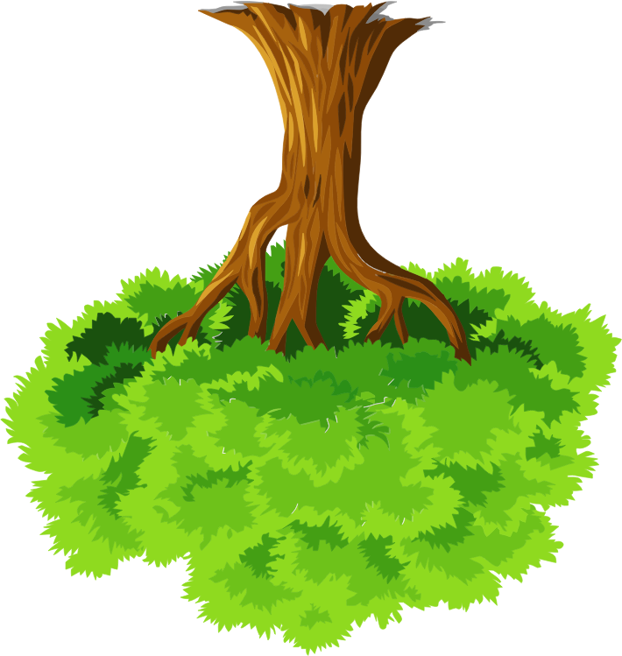
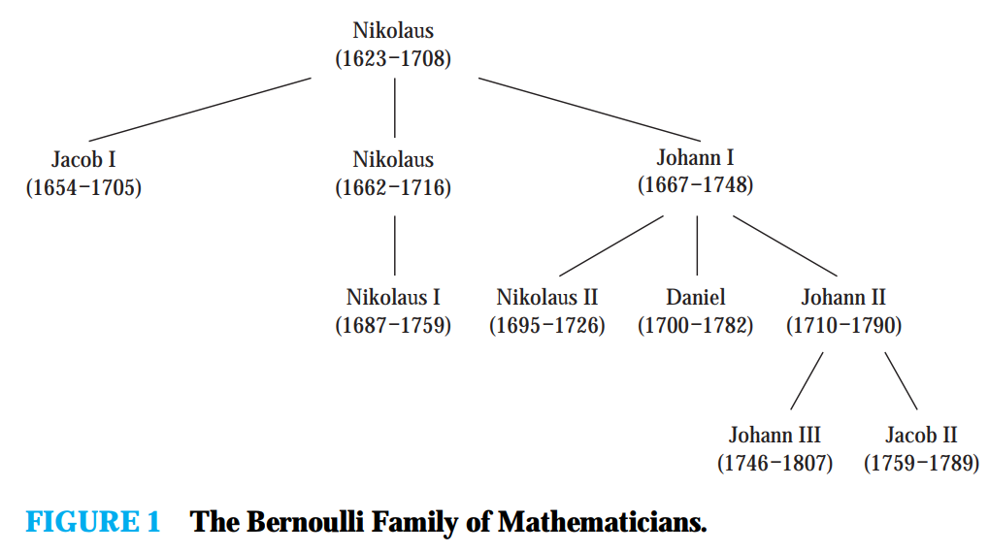
What is a tree?

Slide 4
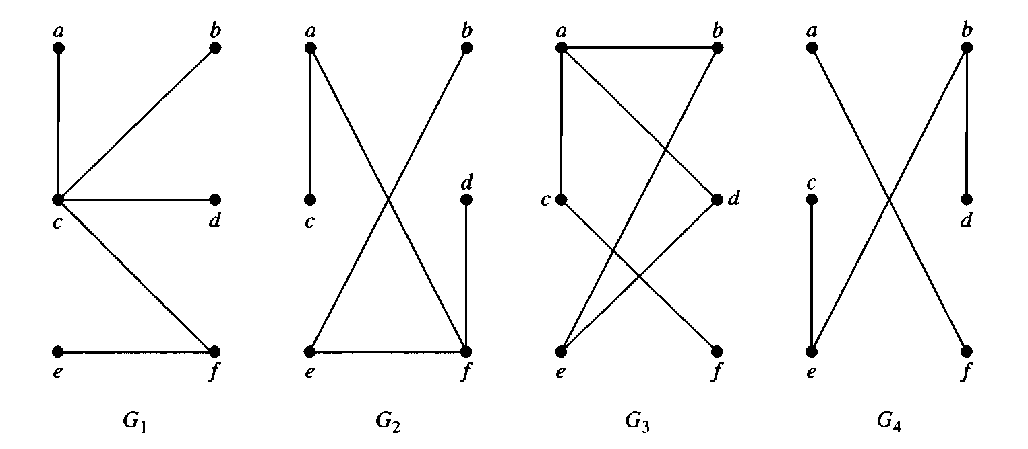

Which of the following are trees?

Slide 5






Rooted trees
$$c$$
$$a$$
$$b$$
$$f$$
$$d$$
$$e$$

Slide 6






Rooted trees
$$c$$
Root
$$a$$
$$b$$
$$f$$
$$d$$
$$e$$
Leaves

Slide 7
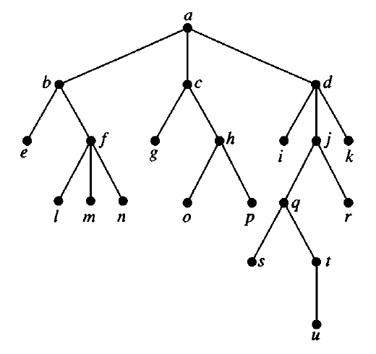
Some terminologies
Root of the tree

Slide 8
Some terminologies
Internal vertices

Slide 9
Some terminologies
Leaves

Slide 10

Some terminologies
Children of $j$

Slide 11

Some terminologies
Parent of $h$

Slide 12
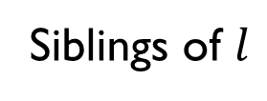
Some terminologies
Siblings of $l$

Slide 13

Some terminologies
Ancestors of $m$

Slide 14
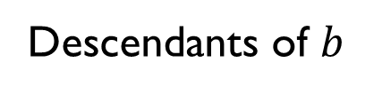
Some terminologies
Descendants of $b$

Slide 15
Properties of trees

Slide 16
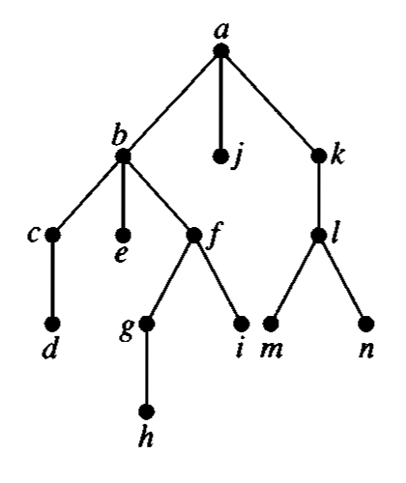
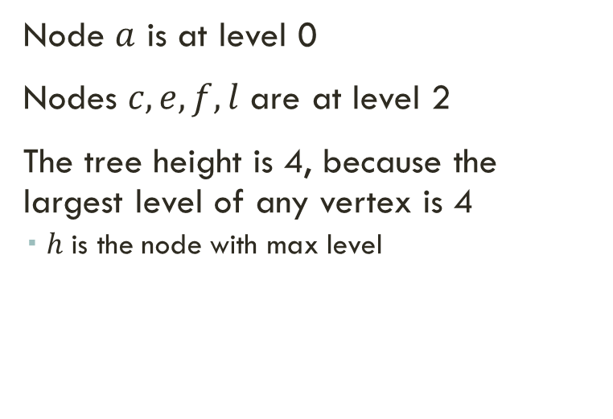
Height of tree and level of nodes
Node $a$ is at level 0
Nodes $c,e,f,l$ are at level 2
The tree height is 4, because the largest level of any vertex is 4
$h$ is the node with max level

Slide 17
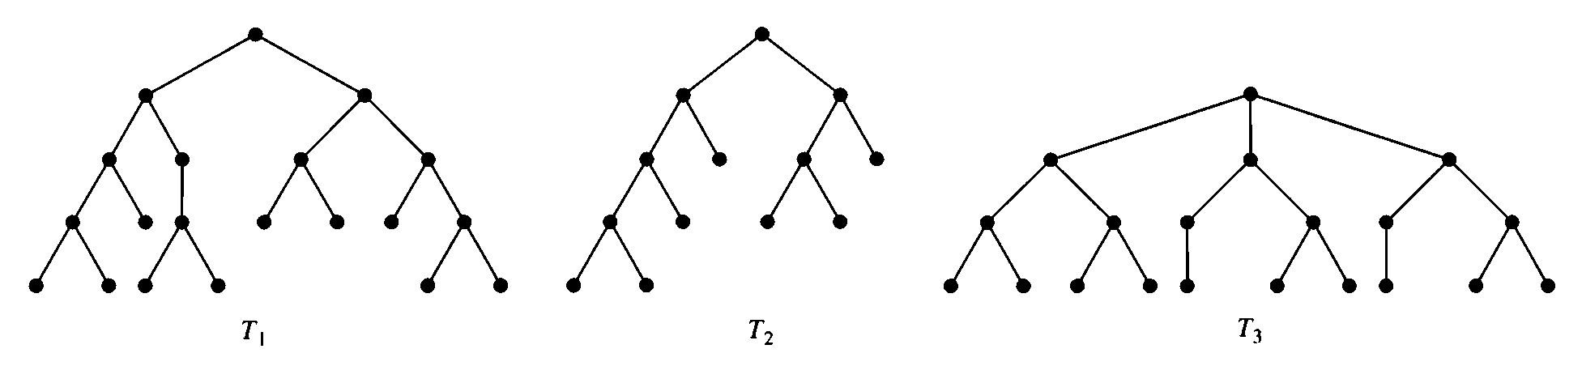
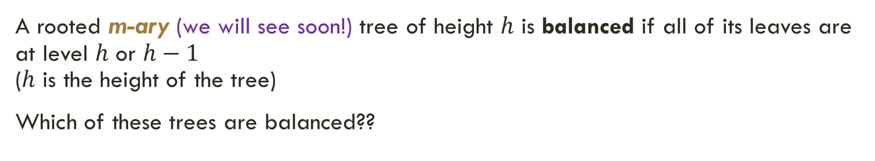
Balanced tree
A rooted m-ary (we will see soon!) tree of height $h$ is balanced if all of its leaves are at level $h$ or $h−1$ ($h$ is the height of the tree)
Which of these trees are balanced??

Slide 18
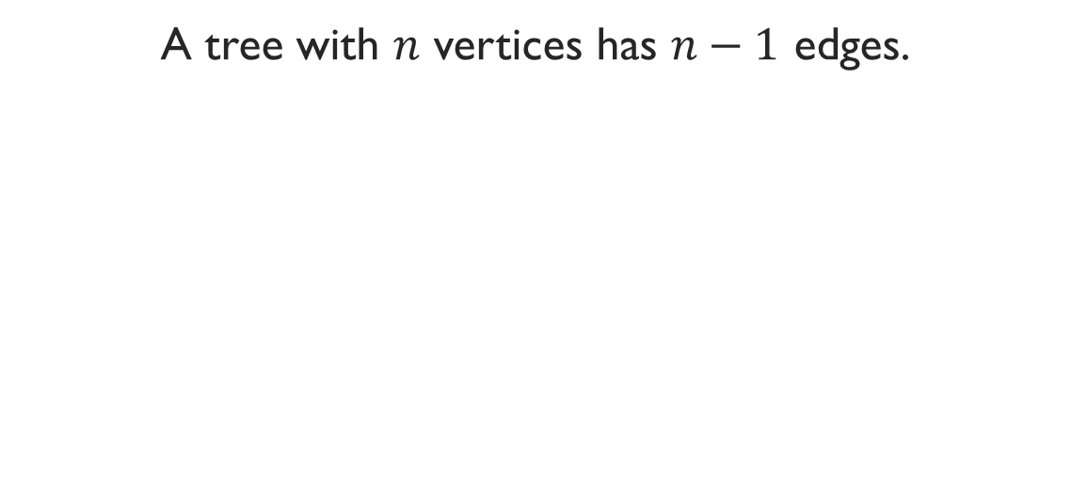
Theorem 2 Note -- theorem 1: An undirected graph is a tree if and only if there is a unique simple path between any two of its vertices.
A tree with $n$ vertices has $n−1$ edges.

Slide 19
Definition 3:
A rooted tree is called an m-ary tree if every internal vertex has no more than m children.
The tree is called a full m-ary tree if every internal vertex has exactly m children. An m-ary tree with m = 2 is called a binary tree.

Slide 20
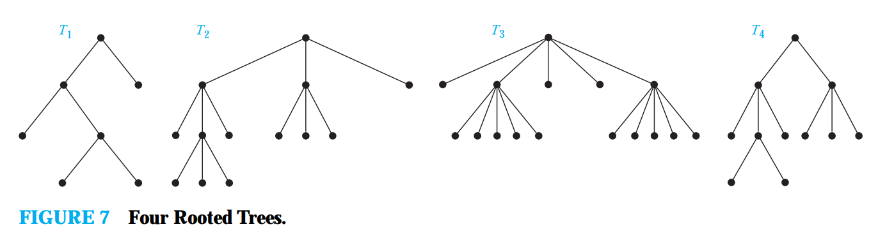
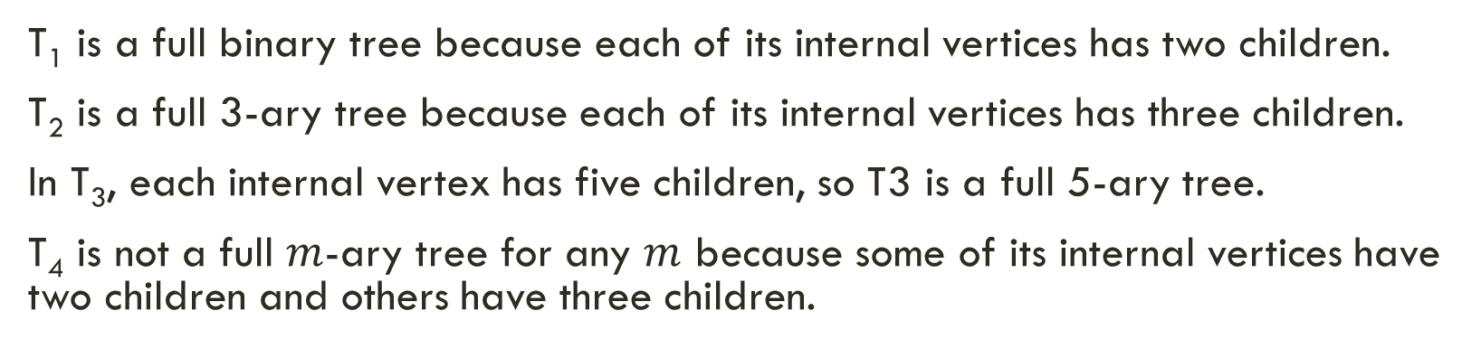
Example
T₁ is a full binary tree because each of its internal vertices has two children.
T₂ is a full 3-ary tree because each of its internal vertices has three children.
In T₃, each internal vertex has five children, so T3 is a full 5-ary tree.
T₄ is not a full $m$-ary tree for any $m$ because some of its internal vertices have two children and others have three children.

Slide 21
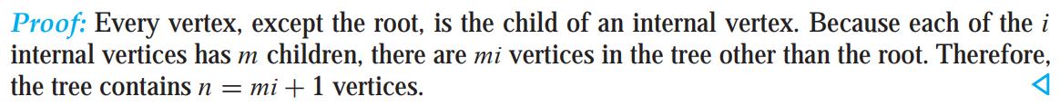
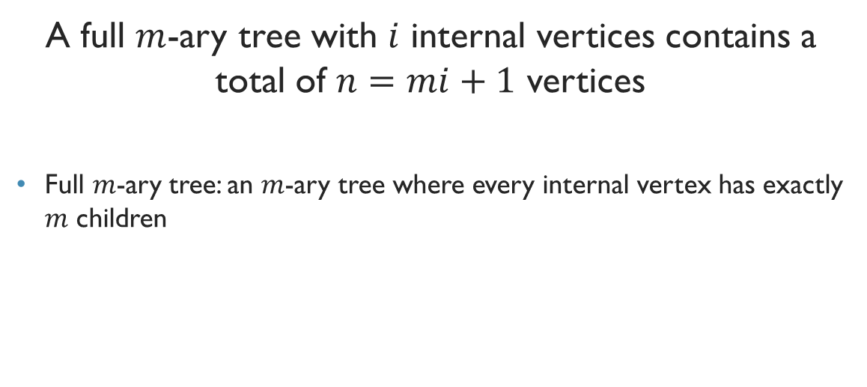
Theorem 3
A full $m$-ary tree with $i$ internal vertices contains a total of $n=mi+1$ vertices
Full $m$-ary tree: an $m$-ary tree where every internal vertex has exactly $m$ children

Slide 22
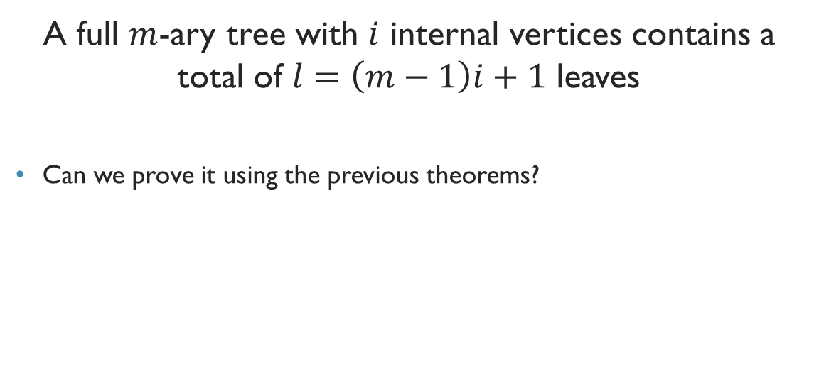
Theorem 4
A full $m$-ary tree with $i$ internal vertices contains a total of $l=\left(m−1\right)i+1$ leaves
Can we prove it using the previous theorems?

Slide 23

But theorem 4 has three parts in the textbook!!!
Theorem 4 gives us formula to find out every possible parameters of a full $m$-ary tree
We can deduce the other relations using theorem 3 and 4.
As a matter of fact, only theorem 3 suffices!!!

Slide 24
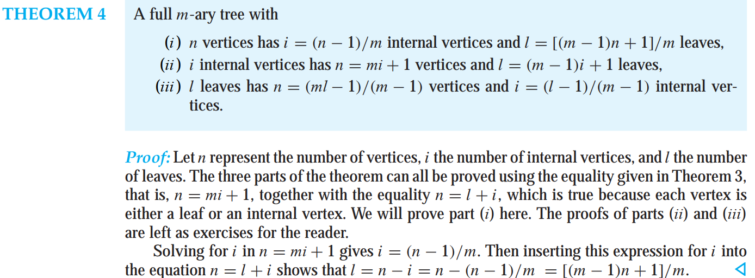
theorem 4 As in the textbook!!!

Slide 25
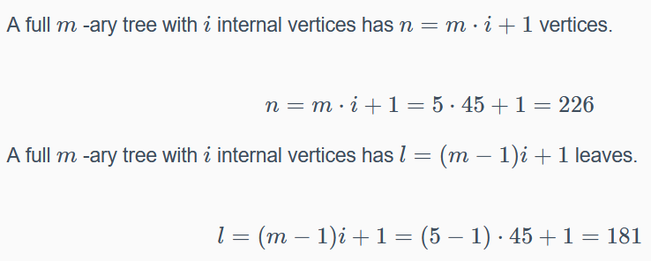
Example
Calculate the number of vertices in a full 5-ary tree with 45 internal vertices.
Also, find out the number of leaves.

Slide 26
Example
Calculate the number of internal vertices in a full 5-ary tree with 45 leaves.
Also, find out the total number of vertices.

Slide 27
Exercise
Calculate the number of vertices in a full 5-ary tree with 35 internal vertices.
Also, find out the number of leaves.
*******
Calculate the number of internal vertices in a full 5-ary tree with 35 leaves.
Also, find out the total number of vertices.

Slide 28
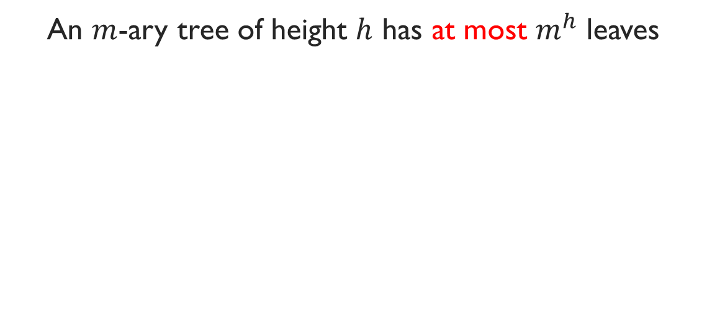
Theorem 5
An $m$-ary tree of height $h$ has at most $m^{h}$ leaves

