Slide 1
Trees - 3
CSE 2213 – Discrete Mathematics
Course Instructor: Al-Sakib Khan Pathan, PhD, SMIEEE [Professor, CSE, UIU]
Based on the slides of Minhajul Bashir

Slide 2
How Do calculators compute expressions??

Slide 3












Ordered rooted tree of expressions
$$\left(\left(x+y\right)↑2\right)+\left(\left(x−4\right)/3\right)$$
$$+$$
$$↑$$
$$/$$
$$+$$
$$2$$
$$−$$
$$3$$
$$x$$
$$y$$
$$x$$
$$4$$

Slide 4















Quick exercise: Construct expression tree for the following expression
$$\left(\left(x+y\right)↑2\right)+\left(\left(x−4\right)/3\right)+(y−7)$$
$$+$$
$$+$$
$$−$$
$$↑$$
$$/$$
$$y$$
$$7$$
$$+$$
$$2$$
$$−$$
$$3$$
$$x$$
$$y$$
$$x$$
$$4$$

Slide 5












Traversal of the tree: infix, prefix and postfix notations
$$+$$
$$↑$$
$$/$$
$$+$$
$$2$$
$$−$$
$$3$$
$$x$$
$$y$$
$$x$$
$$4$$
In-order: $x+y↑2+x−4 / 3$ $→$ Infix notation
Pre-order: $+ ↑+ x y 2 / −x 4 3$ $→$ Prefix notation
Post-order: $x y+2↑x 4−3 / +$ $→$ Postfix notation

Slide 6

Example
Calculate the result of the following prefix expression:
$$+ − ∗2 3 5 / ↑2 3 4$$

Slide 7
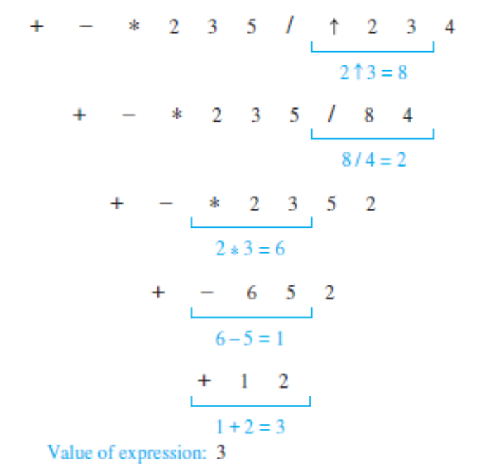
Solution
- The steps used to evaluate this expression by working right to left, and performing operations using the operands on the right, are shown in the figure here.
- The value of this expression is 3.

Slide 8
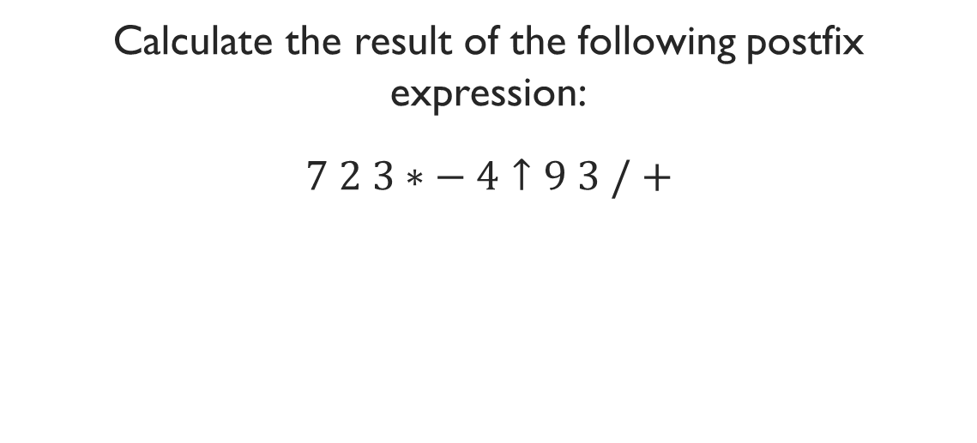
Example
Calculate the result of the following postfix expression:
$$7 2 3∗− 4↑9 3 / +$$

Slide 9
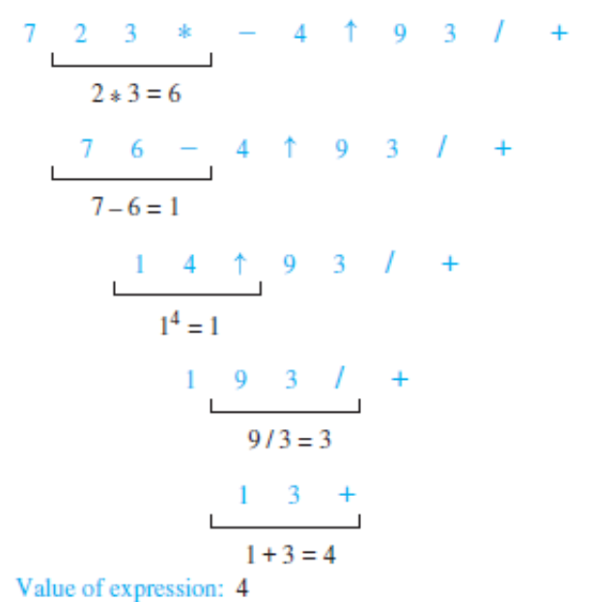
Solution
- The steps used to evaluate this expression by starting at the left and carrying out operations when two operands are followed by an operator are shown in the figure here.
- The value of this expression is 4.

