Slide 1
Graphs - 5
CSE 2213 – Discrete Mathematics
Course Instructor: Al-Sakib Khan Pathan, PhD, SMIEEE [Professor, CSE, UIU]
Based on the slides of Minhajul Bashir

Slide 2
Graph isomorphism
A
B
A
C
D
C
D
B
We can draw the same graph differently
If we can determine that two graphs are actually two different representations of the same graph, then they are called isomorphic

Slide 3
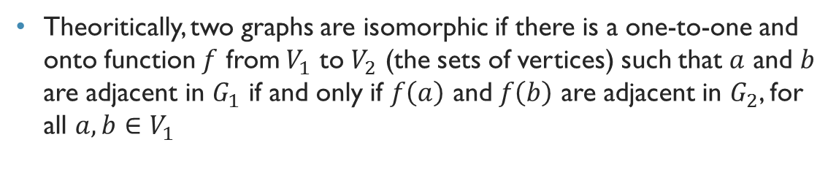
Graph isomorphism
A
B
a
c
D
C
d
b
Theoritically, two graphs are isomorphic if there is a one-to-one and onto function $f$ from $V_{1}$ to $V_{2}$ (the sets of vertices) such that $a$ and $b$ are adjacent in $G_{1}$ if and only if $f\left(a\right)$ and $f\left(b\right)$ are adjacent in $G_{2}$, for all $a,b∈V_{1}$

Slide 4
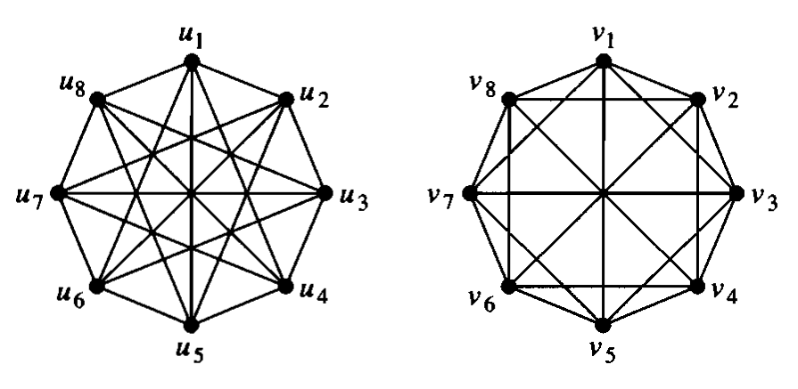
Are these graphs isomorphic?

Slide 5
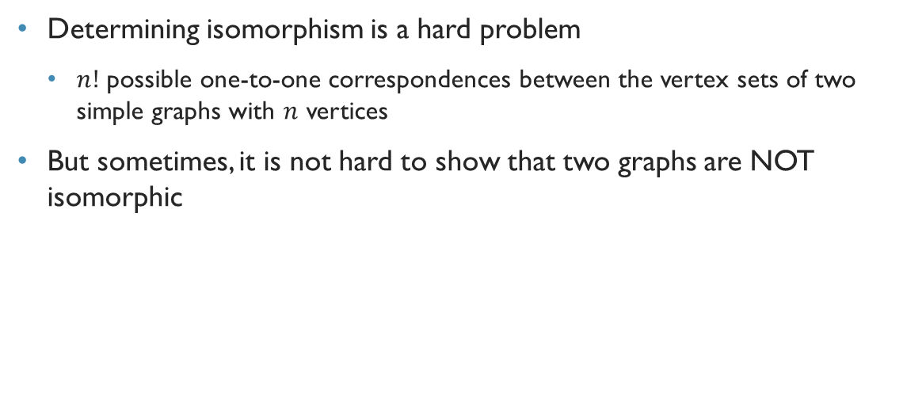
Determining isomorphism
Determining isomorphism is a hard problem
$n!$ possible one-to-one correspondences between the vertex sets of two simple graphs with $n$ vertices
But sometimes, it is not hard to show that two graphs are NOT isomorphic

Slide 6
Are these graphs isomorphic?

Slide 7
Disproving isomorphism: Graph invariants
We can show that two graphs are not isomorphic if we can find a property that only one of the two graphs has, but the property is preserved by isomorphism
Such a property is called a graph invariant
For example, two isomorphic graphs must have the same number of vertices, and the same number of edges as well

Slide 8
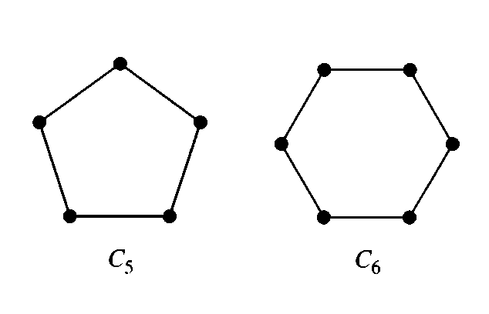
Are these graphs isomorphic?
Number of vertices different

Slide 9
Are these graphs isomorphic?
Number of edges different

Slide 10
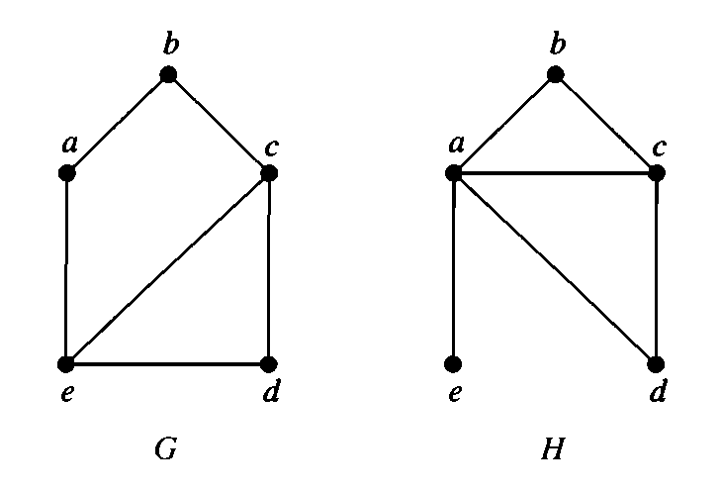

Are these graphs isomorphic?
Graph $G$: Degree sequence is 3, 3, 2, 2, 2 (Maximum degree 3)
Graph $H$: Degree sequence is 4, 3, 2, 2, 1 ($a$ has degree 4)

Slide 11
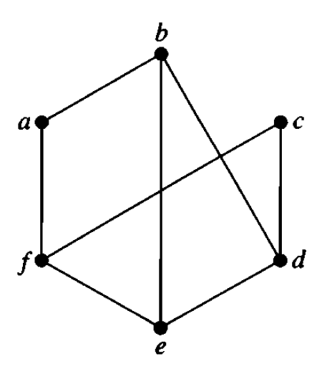
Degree sequence
The degree sequence of a graph is the sequence of the degrees of its vertices in non-increasing order
The degree sequence of the given graph is 3, 3, 3, 3, 2, 2

Slide 12
Graph invariants
Number of vertices
Number of edges
Degree sequence

Slide 13
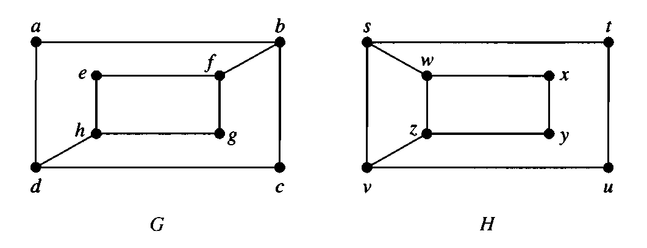
Are these graphs isomorphic?

Slide 14
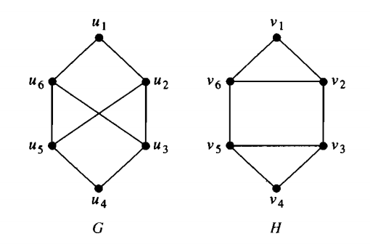

Cycle length as graph invariant
Graph $G$ does not have any simple cycle of length 3.
Graph $H$ has two simple cycles of length 3.

Slide 15
Graph invariants
Many more invariants are out there
Many invariants are yet to discover
So even if you see that all the three invariants are same in the two graphs, it does not guarantee isomorphism

Slide 16
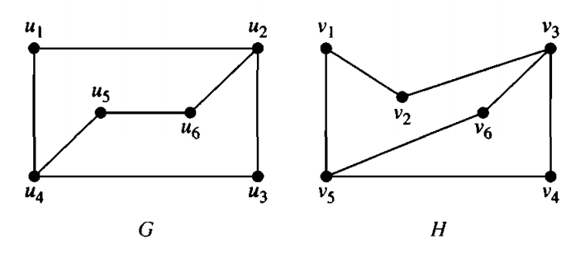
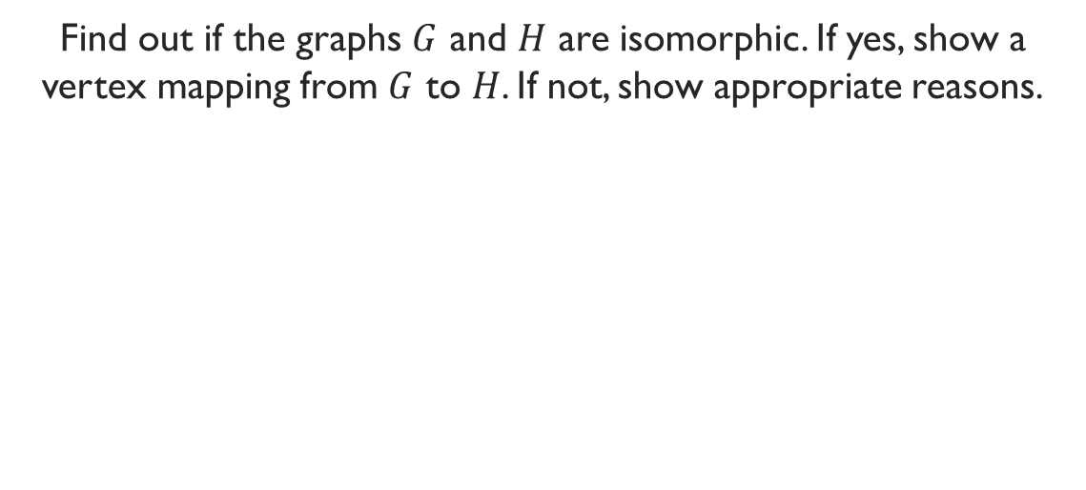
Problem
Find out if the graphs $G$ and $H$ are isomorphic. If yes, show a vertex mapping from $G$ to $H$. If not, show appropriate reasons.

Slide 17
Miscellaneous examples

Slide 18
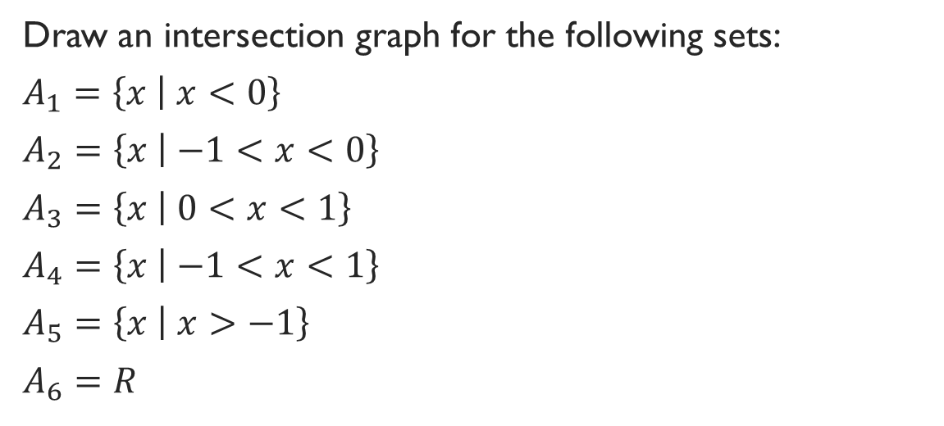
Exercise
Draw an intersection graph for the following sets:
$A_{1}=\left\{x | x<0\right\}$
$A_{2}=\left\{x | −1<x<0\right\}$
$A_{3}=\left\{x | 0<x<1\right\}$
$A_{4}=\left\{x | −1<x<1\right\}$
$A_{5}=\left\{x | x>−1\right\}$
$A_{6}=R$

Slide 19



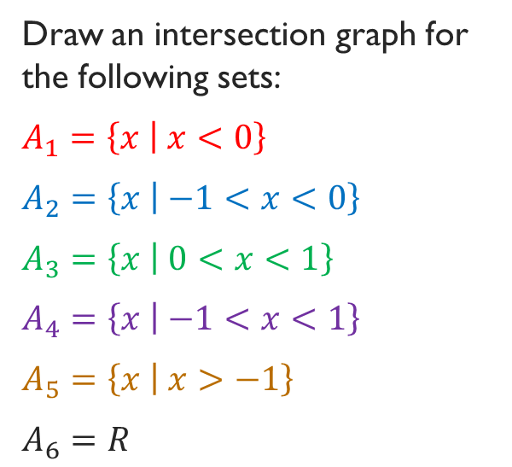



Draw an intersection graph for the following sets:
$A_{1}=\left\{x | x<0\right\}$
$A_{2}=\left\{x | −1<x<0\right\}$
$A_{3}=\left\{x | 0<x<1\right\}$
$A_{4}=\left\{x | −1<x<1\right\}$
$A_{5}=\left\{x | x>−1\right\}$
$A_{6}=R$
$$A_{1}$$
$$A_{2}$$
$$A_{3}$$
$$A_{4}$$
$$A_{5}$$
$$A_{6}$$
-1
0
1

Slide 20
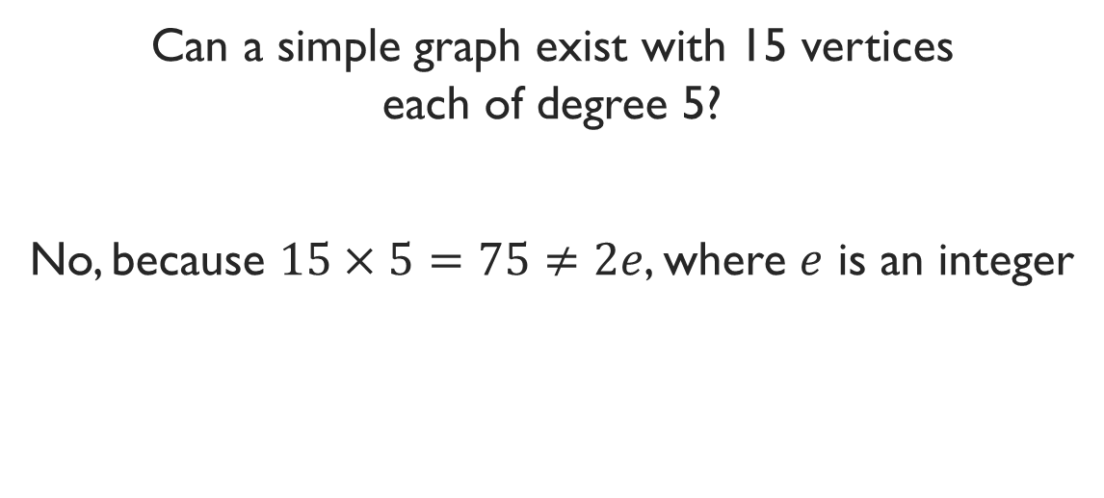
Exercise
Can a simple graph exist with 15 vertices each of degree 5?
No, because $15×5=75≠2e$, where $e$ is an integer

