Slide 1
Katana: a hot-patching framework for
ELF executables
Ashwin Ramaswamy
Sergey Bratus
Sean W. Smith
Michael E. Locasto

Slide 2
Motivation
Patches: for reliabilility, availability, and trustworthiness of software
Users and organizations hesitate to apply patches
“Some reports, such as the case of the Conficker outbreak
within Sheffield Hospital's operating ward, suggest that even
security-conscious environments may elect to forgo automated
software patching, choosing to trade off vulnerability exposure
for some perceived notion of platform stability...''
-- http://mtc.sri.com/Conficker/

Slide 3
The Challenge
Automatic patching is “common wisdom” in contemporary IT
When common wisdom is widely shunned, it may point to a fundamental technical problem, not yet fully recognized as such
Removing habitual annoyances & stumbling blocks often requires new software engineering abstractions

Slide 4
Annoyances
Patch-and-restart downtime
  Redundancy, failover with rolling updates are specialized & expensive
Loss of process/application state
  Engineering software to save-and-restore state from scratch is hard
Lack of trust in “opaque” patches
  System owners cannot reason about effects of patch on functionality

Slide 5
Opaque patches: a thorny choice
Owners of a dedicated, mission-critical software system face a hard choice:
  Auto-patch working systems and risk breaking essential functionality
  Do not patch, risk exposure of a latent vulnerability, try to mitigate via configuration & “perimeter” controls
Action appears as risky as inaction
Balance must shift towards patching

Slide 6
Patch Reasoning and Trust
Current binary patches do not support any form of reasoning about the contents or effects of the patch
  Reverse engineering of patch and target binary is hard (may even be illegal)
  Will the patch affect any particular subsystems or features?
System owners must be able to examine a patch at least on the level of affected modules and symbols

Slide 7
Patching & development cycle
Patching will be required
Must be treated as an essential development life cycle phase, like compilation & linking
Must be treated as an essential part of runtime, like loading & dynamic linking

Slide 8
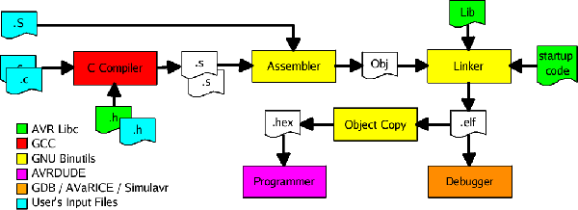
A part of the tool chain ...
Patching must become a first-class ELF object handling operation (~ ld, objcopy)
Driven by symbol information in sections of an ELF file (~ relocation, .dynamic)

Slide 9
ELF is central to the toochain
Defines & cross-links positions and relocation info of objects in files and process spaces
.plt
.text
.init
.fini
.rodata
.ctors
.dtors
G
O
T
.data
.bss
.dynamic
.dynsym
.symtab
.rel.text
.rel.dyn
.rel.data
.rel.plt

Slide 10
Software life cycle
Development
Compiler
Assembler
Linker
Runtime
Core
Dyn. linker
Loader

Slide 11
Software life cycle
Development
Compiler
Assembler
Linker
Runtime
Core
Dyn. linker
Loader
Patch
Patch

Slide 12
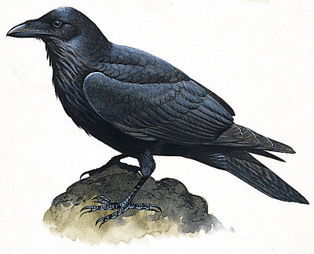
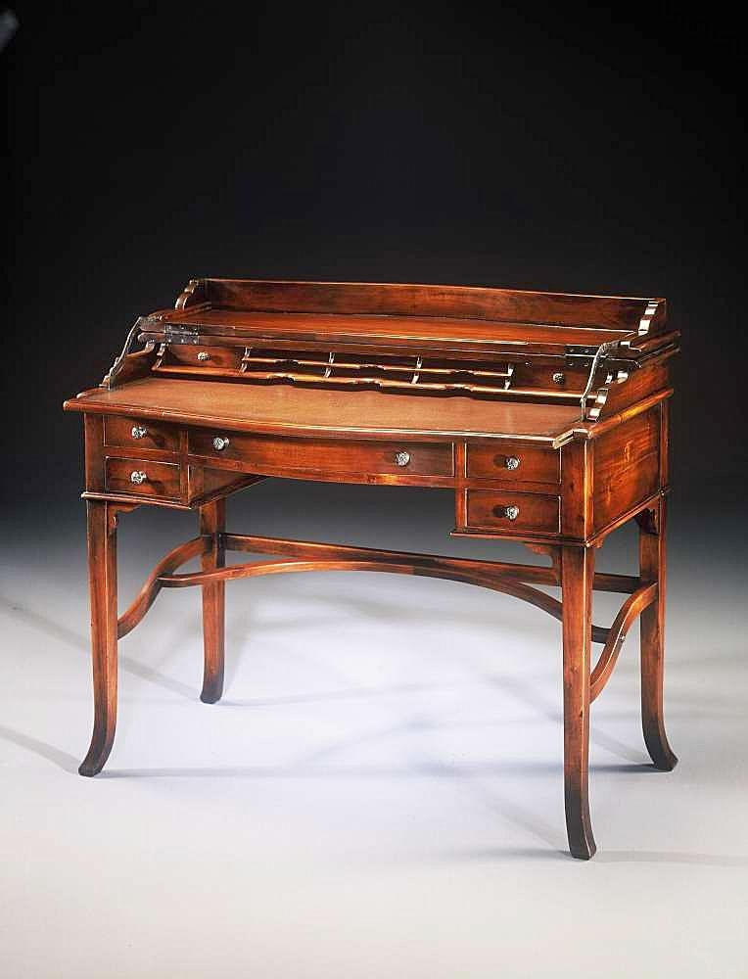
Why Patching is like Linking
Combines and/or replaces pieces of program based on symbolic descriptions
Resolves conflicts between multiple versions of a symbol (new vs. old)
Must deal with relocations: generate, modify, and/or apply relocation info

Slide 13
Katana's Patch Objects (.po)
Define Patch Objects as first-class for the toolchain (like .o, .so, .a, core, ...)
Add “patch” sections to ELF spec, modeled on relocation sections (.rel*)
View the process' virtual memory layout as derived from ELF (cf. ERESI project)
Apply .po to process based on its loaded ELF header/section info

Slide 14
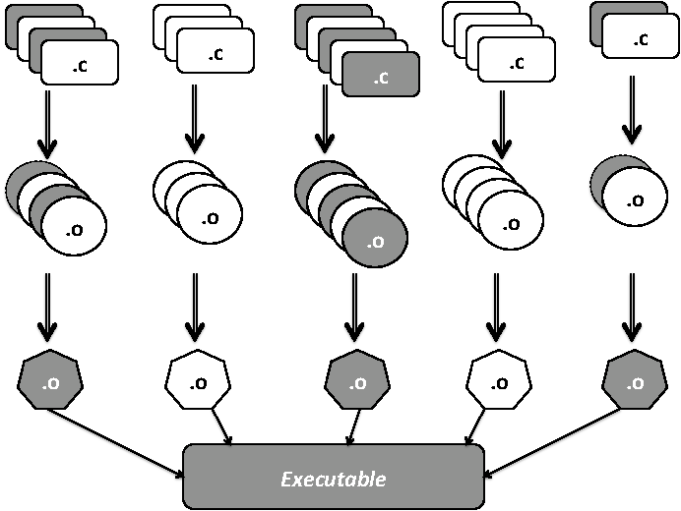
Tracking dependencies
From source to .po by compilation unit:

Slide 15
Tracking dependencies
From source to .po by compilation unit:
Develop source code patch :-) , apply to source tree, save old binaries
Instrument build tree with inotify to track which compilation unit (.o) files change
Run top-level make (with debug info)
Generate patch objects for changed compilation units (code and global data)

Slide 16
Code patching
For each changed .o, get all global and static functions via symbol table (.symtab), copy to patch object
Get relocations within functions (.rel*.text), look up resolutions of corresponding symbols in old, saved executable's .symtab
  Statically resolved vs. PLT stubs
At runtime, map .po to process memory and insert classic jmp trampolines to link

Slide 17
Relocations for patching
unit1.o
External
symbol reference
.text
.rel.text
.symtab
Process virtual space

Slide 18
Data patching challenges
Data and code that acts on it must be kept “in sync”
  Ex.: adding a new field to a global C struct must also change its accessor methods
Code—data unit ownership relations are important to preserve consistent state
  Developer must track & specify them
ELF symbols are opaque (addr + extent)
  But DWARF keeps full type definitions!

Slide 19
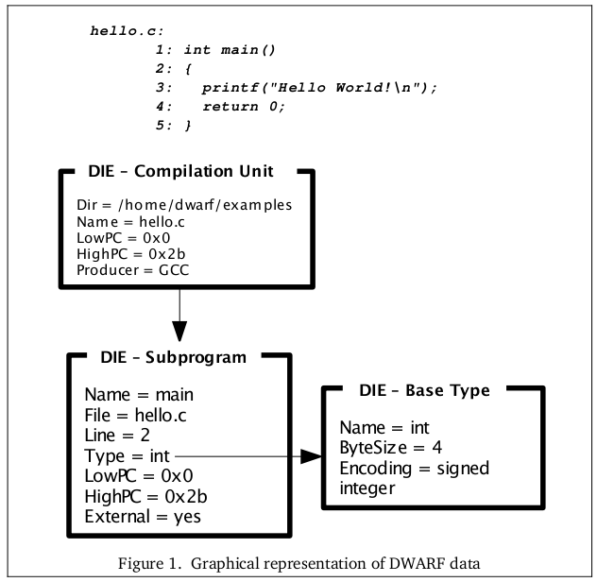
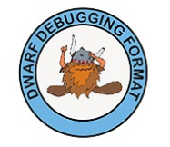
DWARF to the rescue
Full, recursive descriptions:
base types
composite data types
compilation units
Debugging
Information Entry

Slide 20
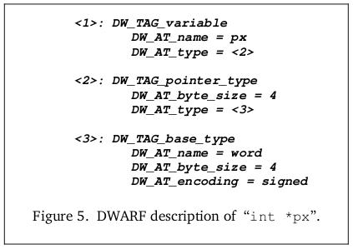
DWARF to the rescue
Full, recursive descriptions:
base types
composite data types
compilation units
From: “Introduction to the DWARF debugging format”,
Michael Eager

Slide 21
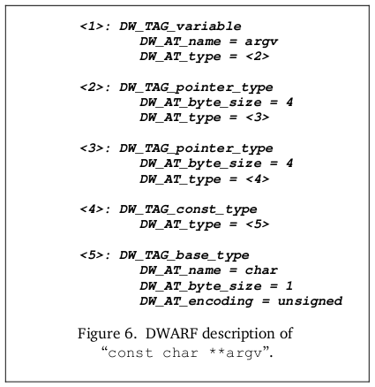
DWARF to the rescue
Full, recursive descriptions:
base types
composite data types
compilation units

Slide 22
Finding a “safe state”
It's dangerous to patch code “in flight”
  Wait till the patch's target unit is inactive
Data and code must be patched “in sync”
  Code must be ready for patched data
  Data must be ready for patched code, e.g., local data in target function's stack frame
No general solution, but the tool must support patch developer's knowledge of program flow & semantics

Slide 23
Stack “walk for safety”
Walk the activation frames on the stack to ensure there are none from patched functions
Determine frame identity based on EIP/saved RET and extents of (relocated) compilation units
Breakpoint the first “safe” frame, break into patcher when reached

Slide 24
Like stack unwinding?
DWARF complex unwinding for exception handling
  Call Frame Information (CFI) + DIE address ranges
This info can be used to walk the stack while evaluating DWARF expressions
Let developers specify “safe” pre-conditions for applying the patch (stack state, etc.)

Slide 25
Summary
Patching must become an ABI-supported part of the standard tool chain & runtime
To shift the balance of trust towards patching, opaque patches must go
ELF and DWARF contain “almost all” info
for patching runtime process images
Patching should be like runtime (re-)linking

Slide 26

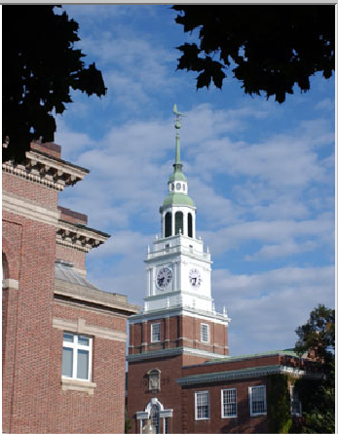
Thank you!

