Slide 1
Gyro Logic
A New Reasoning Architecture Beyond Static Logic

Slide 2
Problem
LLMs rely on static logic
Cannot handle contradictions well
Multi-agent reasoning breaks
Real-world truth is multi-perspective

Slide 3
Root Cause
Truth treated as fixed value
Logic assumed context-free
Reasoning modeled as linear
Reality is none of the above

Slide 4
Insight
Truth depends on Observer, Goal, History
Context defines meaning
Truth is not a value, but a state

Slide 5
Solution: Gyro Logic
Truth = Point in space
Conflict = Curvature
Inference = Path
Logic becomes geometry

Slide 6
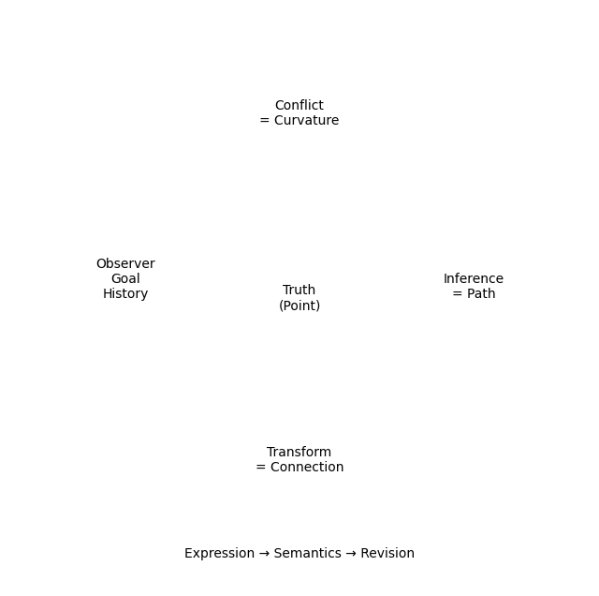
Core Model

Slide 7
New Capabilities
Multi-perspective reasoning
Conflict-aware inference
Context-preserving logic
Dynamic belief revision

Slide 8
Applications
Multi-agent AI
Autonomous systems
Advanced reasoning engines
LLM reasoning layer upgrade

Slide 9
Why It Matters
Static → Dynamic logic
Single truth → Multi-truth
Error handling → Conflict modeling
Next AI breakthrough layer

Slide 10
Vision: GyroOS
Logic-native OS
Context-aware computation
Semantic state system
Future AI infrastructure

Slide 11
Ask
Research collaboration
Strategic partnership
Early integration opportunities
Building next-gen reasoning layer

